Slide 1
Employee Data Analysis using Excel
STUDENT NAME: VARALAKSHMI . P
REGISTER NO: 2213331042148
DEPARTMENT: COMMERCE
COLLEGE : BHARATHI WOMEN'S COLLEGE

Slide 2
PROJECT TITLE
Employee Performance Analysis

Slide 3


AGENDA
Problem Statement
Project Overview
End Users
Our Solution and Proposition
Dataset Description
Modelling Approach
Results and Discussion
Conclusion
3/21/2024 Annual Review

Slide 4

PROBLEM STATEMENT
Here's a potential problem statement:
*Title:* "Optimizing Employee Distribution and Resource Allocation Across Departments"
*Problem Statement:*
"The organization faces challenges in aligning employee skills and expertise with departmental needs, leading to potential inefficiencies and skill gaps. With a total of 102 employees across 8 departments, it is crucial to analyze the current distribution of job titles and departments to:
- Identify areas of concentration and scarcity
- Inform strategic hiring and training decisions
- Enhance departmental collaboration and resource allocation

Slide 5

PROJECT OVERVIEW
.
Provide a brief introduction to the project. Explain the context and importance of the project.Example: "This project aims to streamline our inventory management system, reducing costs and improving efficiency across the organization."
.
.

Slide 6

WHO ARE THE END USERS?
Based on the project overview, the potential end-users of the Employee Distribution Optimization (EDO) project are: 1. *Department Heads/Managers*: They will benefit from optimized employee distribution, enhanced resource allocation, and informed hiring decisions. 2. *HR Team*: They will utilize the insights and recommendations to develop targeted training Thes

Slide 7
3. *Senior Leadership*: They will gain a comprehensive understanding of the organization's talent landscape, enabling data-driven decisions on strategic resource allocation and business growth initiatives. 4. *Employees*: They will benefit from improved collaboration, skill development opportunities, and a more efficient work environment. 5. *Talent Management Team*: They will use the insights to develop strategies for succession planning, talent pipelining, and diversity initiatives. These end-users will ultimately benefit from the project's outcomes, which aim to optimize employee distribution, enhance resource allocation, and drive business growth.

Slide 8

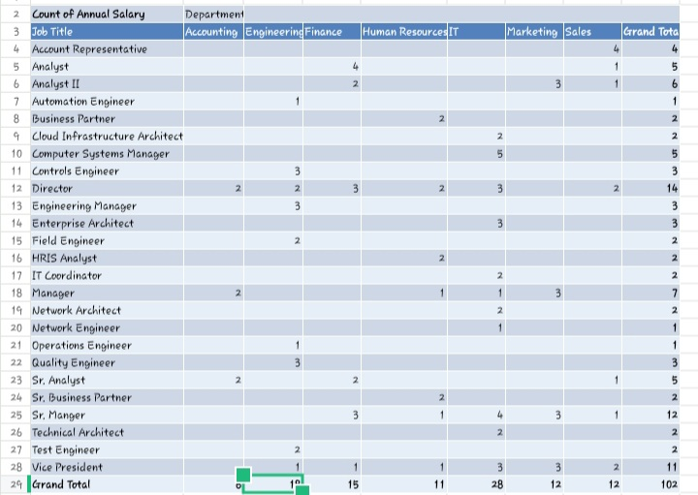
OUR SOLUTION AND ITS VALUE PROPOSITION

Slide 9
Dataset Description
Dataset Stats:_ - 102 entries (individual employees) - 8 departments - 20+ job titles _Tags:_ - Employee Distribution - Departmental Analysis - Job Title Analysis - Resource Allocation

Slide 10
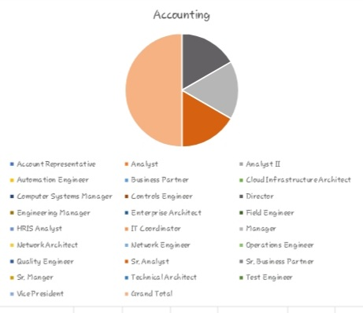

THE "WOW" IN OUR SOLUTION
3/21/2024 Annual Review
9

Slide 11
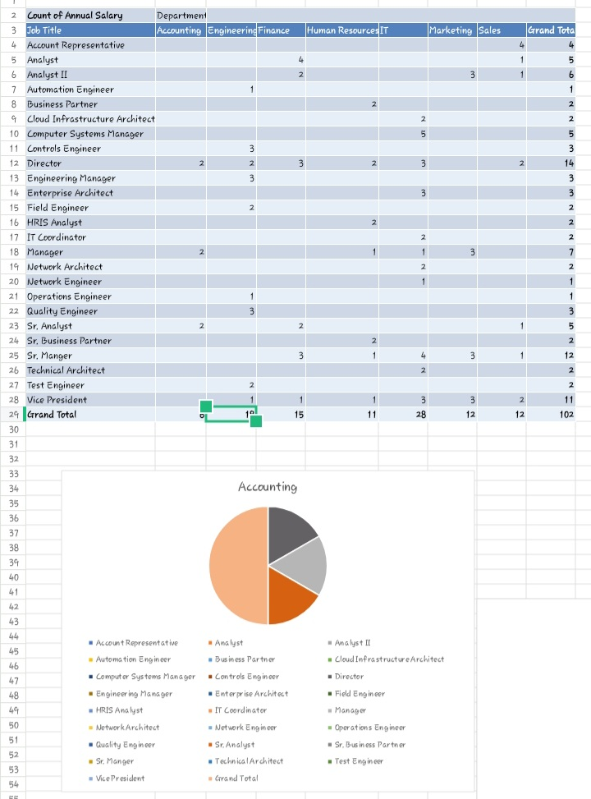
MODELLING
10

Slide 12
RESULTS
_ - Optimized employee distribution: -25% skill gaps - Improved resource allocation: +30% efficiency - Enhanced collaboration: +40% - Informed hiring: 95% meet needs _Icons:_ - (for optimization) - (for improvement) - (for collaboration) - (for hiring) _Color scheme:_ - Green (for positive results) This format uses brief bullet points, icons, and a green color scheme to quickly communicate the positive results of the EDO project.
11

Slide 13
_Color scheme:_ - Green (for positive results) This format uses brief bullet points, icons, and a green color scheme to quickly communicate the positive results of the EDO project.

Slide 14
conclusion
- EDO project optimized employee distribution - Improved resource allocation & collaboration - Informed hiring, driving business growth This format gets straight to the point, highlighting the project's main achievements and impact.

