Slide 1
CAMPUS OPERATIONS · HACKATHON BUILD
Campus
Rescue
Scheduling that can explain its answer.
UNDERSTAND · PROVE · COMMIT

Slide 2
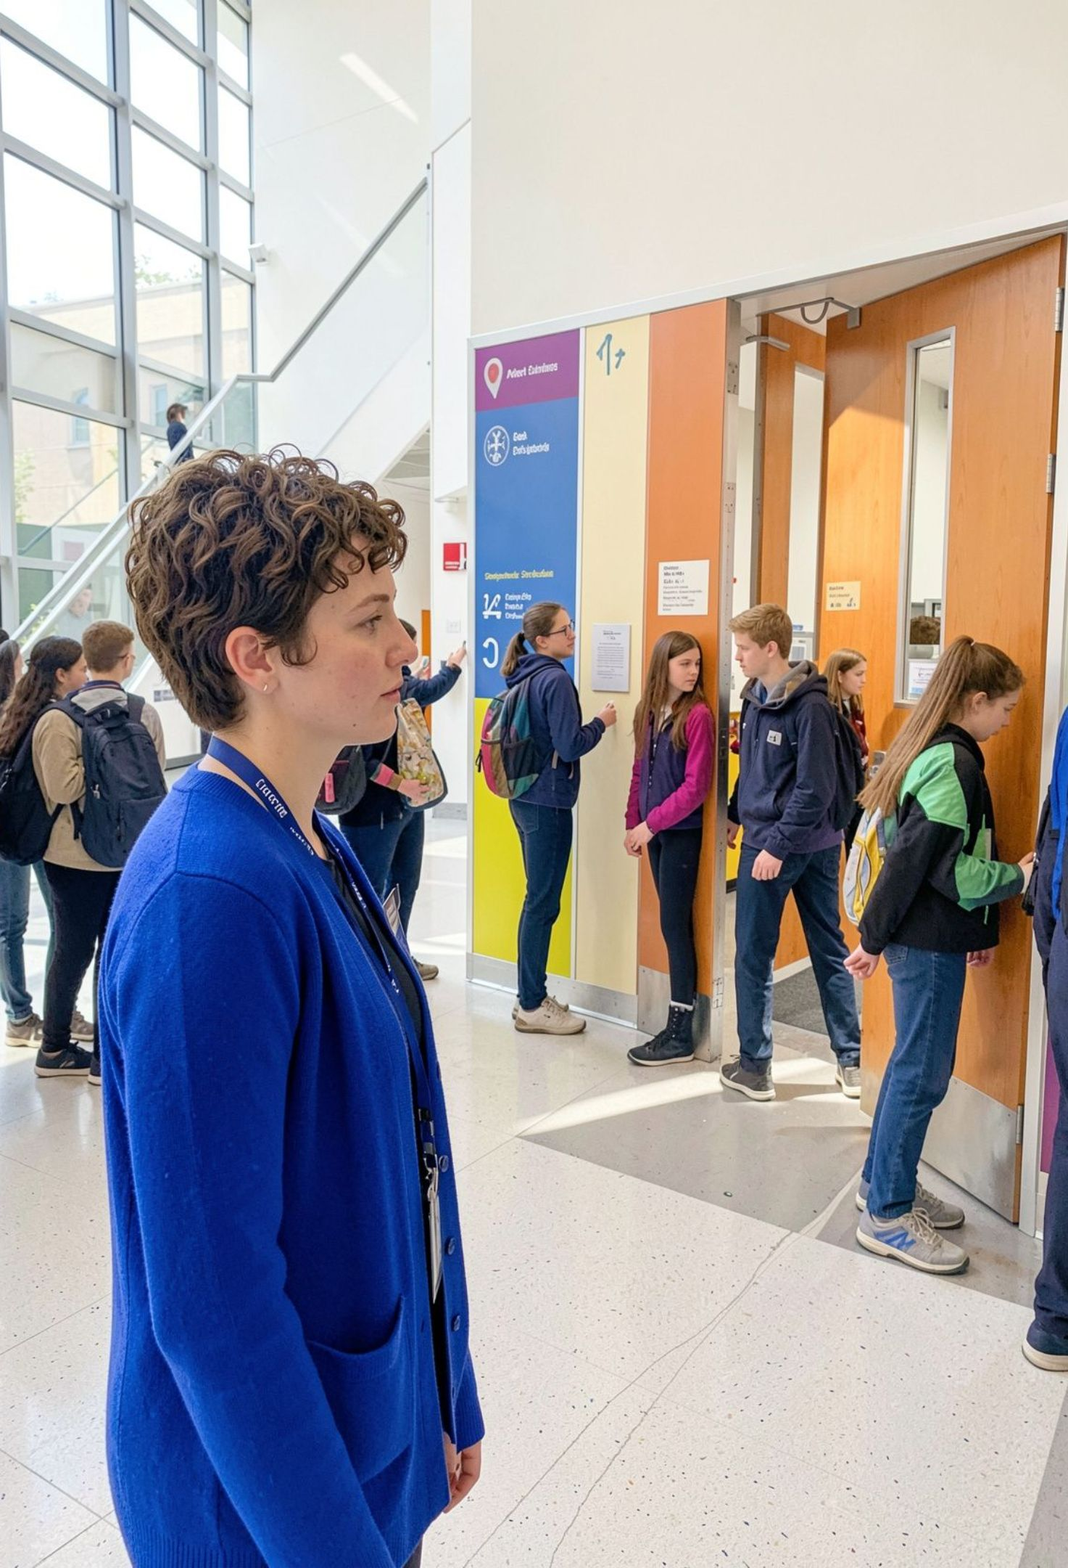
THE PRESSURE POINT
Campus scheduling breaks under pressure
Manual approvals, room clashes, and unreliable chatbot guesses turn small disruptions into campus-wide friction.
CLASH
QUEUE
GUESS

Slide 3
THE CORE ARCHITECTURE
One system separates understanding from proof
Natural-language access with deterministic scheduling truth.
UNDERSTAND
PROVE
Gemma 4
Z3 SMT
Turns free-form requests into a typed scheduling AST.
Proves capacity, equipment, timing, and overlap constraints before anything is committed.
Request → typed intent
Constraints → verified truth

Slide 4
THE VERIFIED PATH
From messy request to verified calendar
01
02
Intake
Parse
Intake the request in plain English or a structured form.
Parse attendance, equipment, duration, and preferences with Gemma 4.
Every handoff stays visible.
03
04
Search
Commit
Search feasible slots with Z3, then audit every result independently.
Send to an admin queue or commit automatically when the SLA expires.

Slide 5


THE SOLVER'S CONTRACT
The solver protects what matters
RESULT
Same input.
Same answer.
Hard constraints
Repair objective
Room capacity, equipment fit, valid 30-minute slots, room and supervisor non-overlap, setup buffers, and protected events.
Move as few existing events as possible, then minimize time drift, then preserve room preference.
Identical inputs produce a reproducible schedule.
AUDITABLE BY DESIGN

Slide 6
THE APPROVAL LOOP
The 2-hour SLA removes the approval bottleneck
01
02
03
Proposal
Review
Auto-commit
Verified slot appears with a visible countdown.
Coordinators approve, reject, or modify during the 120-minute window.
If no one acts, the verified slot commits and notifies stakeholders.
120 min
NO BOTTLENEK
Enough time to review. Short enough to keep campus moving.

Slide 7
EXPLAINABLE FAILURE
When the answer is no, the system shows why
IMPOSSIBLE REQUEST
WRONG CHATBOT RESPONSE
CAMPUS RESCUE RESPONSE
45 students
Invent a room
Prove UNSAT
Need electronics kits after 2 PM.
Or ignore a constraint.
Isolate the conflicting constraints and suggest options: split the group or relax a requirement.
One equipped room seats 35. The larger room is closed.

Slide 8
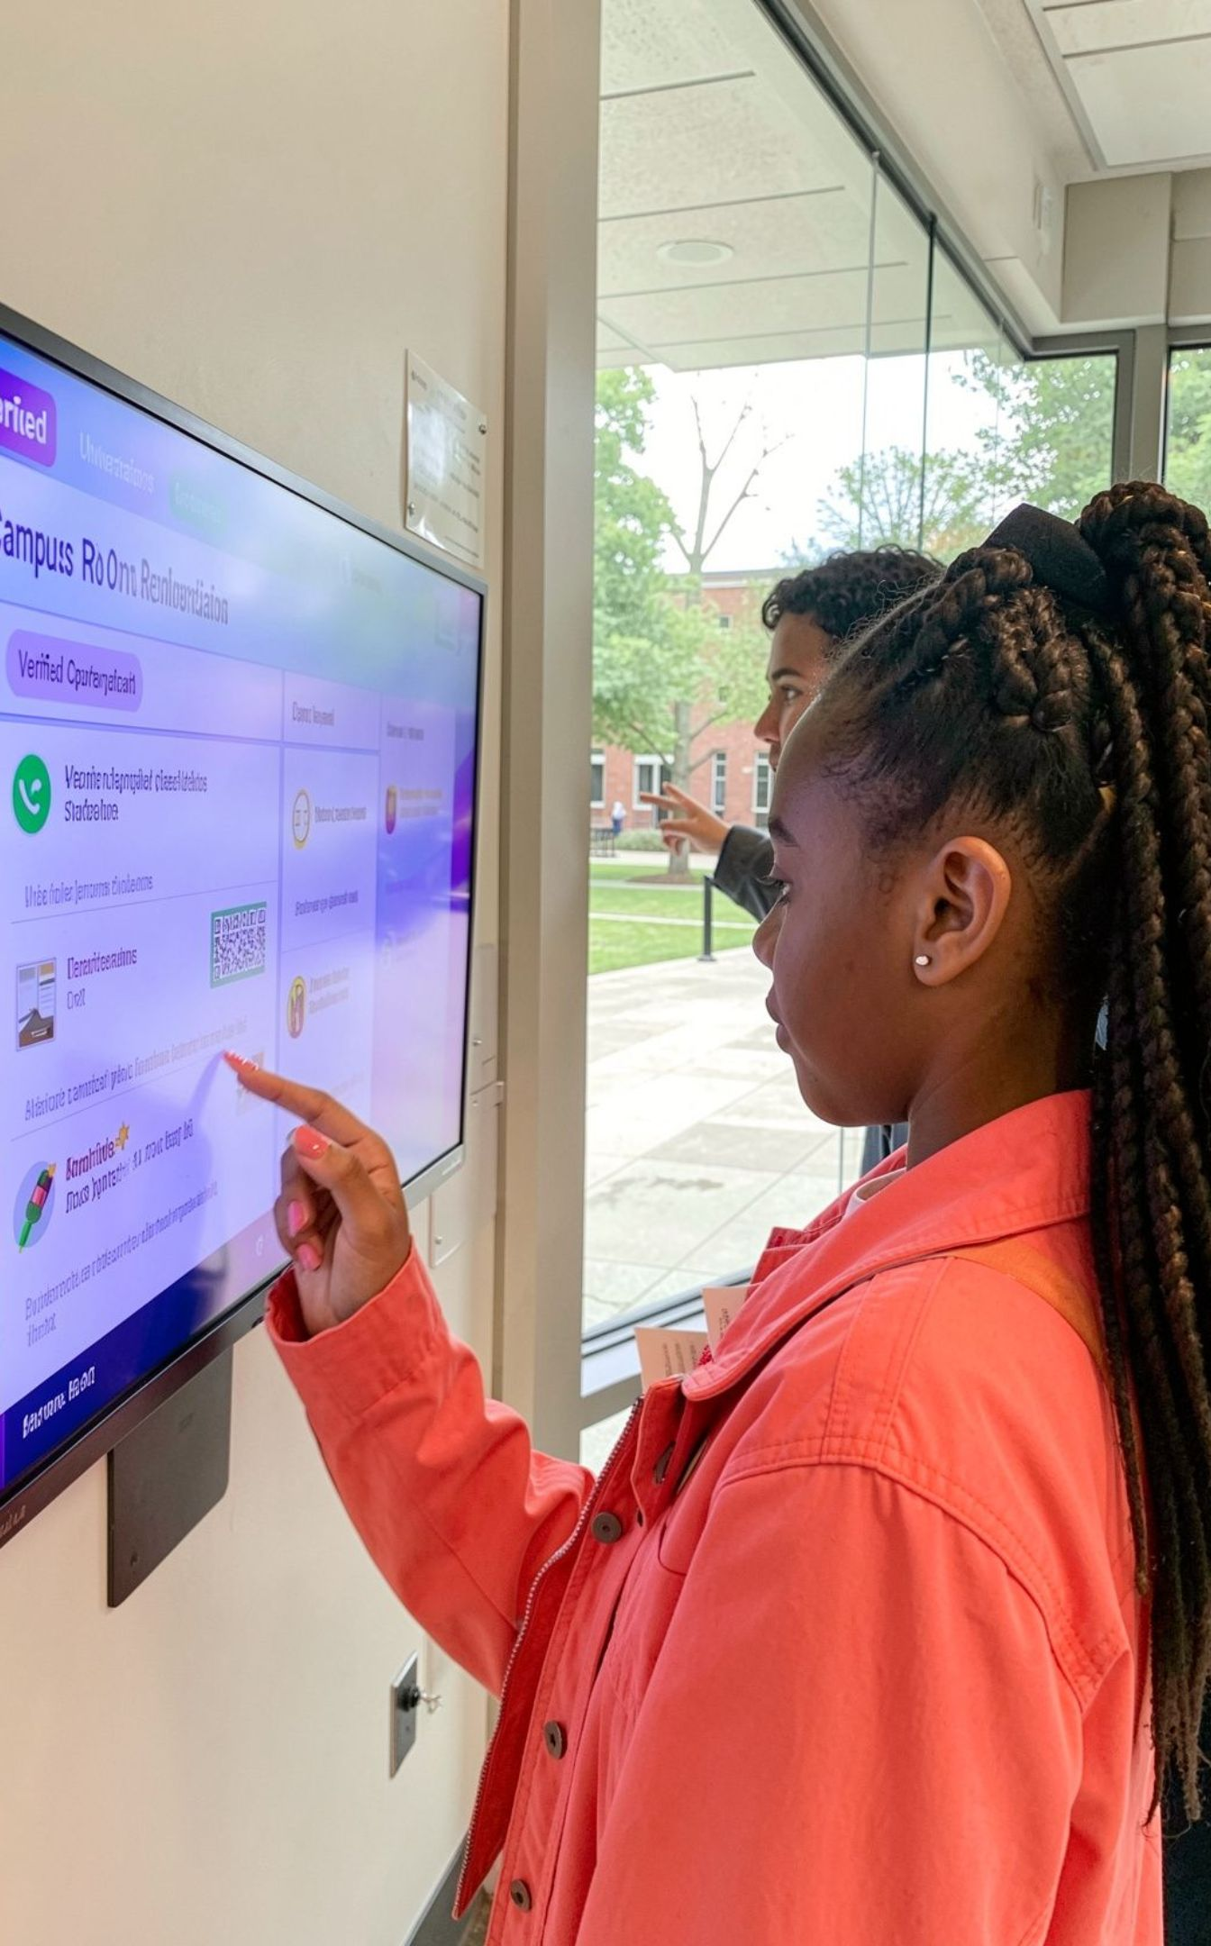



THREE WAYS IN
Three views make the product usable
Students and club leads
Request a room, see a verified recommendation, understand why it fits, and export the calendar event.
Coordinators
Manage the queue, simulate SLA expiry, and review the audit trail.
Disruption teams
Trigger repairs, compare before/after schedules, and apply only an 8/8-audited result.

Slide 9




THE BUILD
Near-term expansion
Built for resilient campus operations
Multi-campus coordination
Energy-aware room routing
Foundation
Google Gemma 4, Z3 SMT Solver,
FastAPI,
React + vide
Two-way calendar sync
QR-based room release
CLOSING IDEA
Replace fragile timetable edits with explainable, mathematically verified campus operations.
UNDERSTAND · PROVE · COMMIT

