Slide 1

K
KAPORA PROTOCOL
BUYER DEPOSIT
SELLER STAKE
Kapora
D = 2,000
S = 2,000
locked on reserve
locked first
Trustless deposits for marketplaces
PROGRAM-OWNED VAULT
P = 4,000
One trust component for every marketplace and sector.
No one in the middle can touch it
“You can disappear — but not with my money.”
No court, no escrow agent — just the rule
● LIVE ON SOLANA DEVNET
HackYeah 2026 · Superteam PL · Finance Without Intermediaries
Notes:
Hi, I'm [Name]. This is Kapora: trustless deposits for marketplaces, built as one trust component that any marketplace, in any sector, can plug in. Our one-liner: you can disappear, but not with my money.

Slide 2

02 · THE PROBLEM
A deposit to a stranger is a leap of faith
Car, real-estate and second-hand marketplaces share one weak spot: the up-front deposit.
1
2
3
A listing that looks too good
Paid by bank transfer
Then the seller disappears
Car, flat or rental at a great price. The “seller” asks for a deposit to hold it.
Straight to a stranger’s IBAN. No vault, no conditions, no undo.
Listing deleted, phone offline. No history to check, nobody to chase.
POLISH CIVIL CODE
Buyer backs out → seller keeps the deposit.
Seller backs out → buyer gets double back.
Art. 394
The law already says who pays.
But nobody sues a stranger over a few thousand złoty.
“zadatek” (earnest money)
Kapora Protocol · HackYeah 2026
02 / 10
Notes:
On car, real-estate and second-hand marketplaces the scam is always the same: a listing that looks too good, a deposit by bank transfer, and the seller vanishes. Polish law already has the answer, art. 394 zadatek, but nobody sues a stranger over a few thousand zloty.

Slide 3
03 · TARGET USER & DESIGN RATIONALE
Who it’s for — and what we redesigned
PRIMARY USER
1
Which relationship?
People in Poland paying a zadatek to strangers from listing sites — and their sellers.
An up-front deposit paid to a stranger before the deal is completed.
Not crypto users. The app says “account”, shows amounts in PLN and hides the chain.
2
Who was the intermediary?
Usually nobody — an IBAN transfer straight to the stranger. Or costly ones: a court to enforce art. 394, a notary escrow, a platform’s paid payment protection.
SECONDARY USER
Marketplaces that embed the widget — our distribution channel.
3
What changes without it?
The rule runs instantly, with no court: whoever backs out loses; a seller who walks pays 2×. Money waits in the program, not with either side. No fee, and nobody can block the payout.
Kapora Protocol · HackYeah 2026
03 / 10
Notes:
Who is this for? Primarily people in Poland who find a car or a flat on a listing site and pay a zadatek to a stranger, and their sellers. They are not crypto users, so the interface talks about accounts and PLN. Secondary users are marketplaces that embed our widget. The relationship we redesigned is the up-front deposit. Today the intermediary is either nobody, just an IBAN transfer, or an expensive one: a court, a notary escrow or paid platform protection. Without it, the legal rule runs instantly.

Slide 4
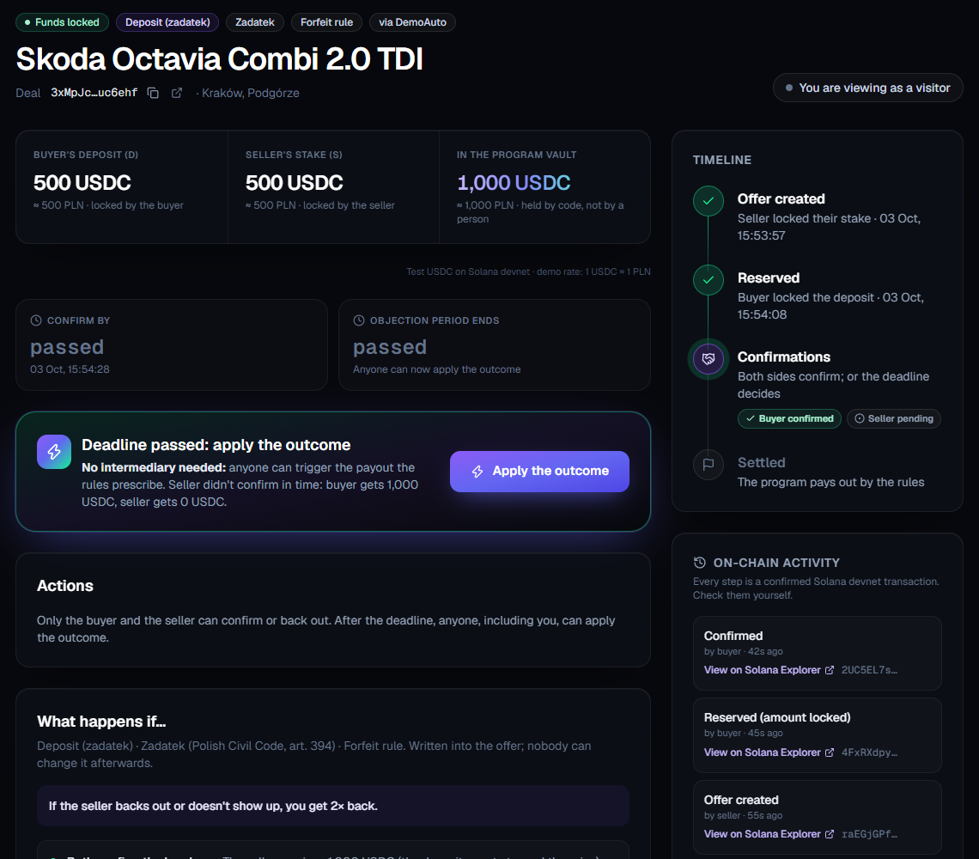
04 · THE SOLUTION
The law, as code
The deposit rule becomes a Solana program. Nobody in the middle holds the money.
1
Seller locks a stake S first
Equal to D — a fake seller must risk their own money.
2
Buyer locks the deposit D
Into a program-owned vault — never the seller’s account.
3
Both confirm the handover
Two confirmations release P = D + S to the seller.
4
Someone backs out or vanishes?
The rule pays out: if the seller walks, the buyer gets 2×.
/d/<deal> after the deadline: even a visitor can press “Apply the outcome”
Kapora Protocol · HackYeah 2026
04 / 10
Notes:
Kapora is the law as code. The seller locks a stake first, so a fake seller has to risk their own money. The buyer locks the deposit into a vault owned by the program. Two confirmations at the handover release the money. If someone backs out or vanishes, the legal rule pays out automatically.

Slide 5
05 · RELEVANCE
Where the intermediary disappears
Every rule that moves money lives in the on-chain program. The app and widget cannot move funds.
confirm_complete()
withdraw()
claim_after_deadline()
THE MOMENT THE INTERMEDIARY IS NO LONGER NEEDED
payer + payee
payer or payee
ANYONE, after deadline
Seller vanished? After the deadline, anyone can press “Apply the outcome” (claim_after_deadline). The program counts the missing party as a no-show and pays out by the rule. No court, no support ticket, no admin.
programs/kapora/src/settle.rs
payout(penalty, on_complete, outcome, D, S, bps)
→ (to_payer, to_payee)
settle() checks to_payer + to_payee == P, pays out from the vault by PDA signature, updates Profile + PlatformStats
WHO CAN CALL WHAT
create_offer
payee
reserve
payer
confirm_complete · withdraw · open_dispute
payer or payee
Vault PDA ["vault", deal]
resolve
arbiter, only if agreed
claim_after_deadline · expire_dispute
anyone
authority = the Deal PDA · no private key · funds leave only through settle()
cancel_offer
payee; anyone after window
No admin instruction. Upgrade authority will be revoked after final deploy.
Kapora Protocol · HackYeah 2026
05 / 10
Notes:
Where exactly does the intermediary disappear? In settle.rs: payout computes the split from the rule, and settle moves the money out of the vault PDA. It is called by confirm_complete, withdraw and claim_after_deadline. The vault has no private key; funds leave only through settle. And here is the moment the intermediary is no longer needed: if the seller vanishes, after the deadline anyone can call claim_after_deadline and the program pays out by the rule. There is no admin instruction, and the upgrade authority will be revoked after the final deploy.

Slide 6
06 · THE RULE ENGINE
Same program, four templates, one payout table
Deposit · zadatek
Rental
Freelance
Purchase
payer / payee = buyer / seller
payer / payee = renter / owner
payer / payee = client / freelancer
payer / payee = buyer / seller
Forfeit · ToPayee · S=D
Forfeit · ToPayer · S=0
Forfeit · ToPayee · S=0
Forfeit · ToPayee · S=0
OUTCOME
WHEN
Forfeit
Refund
to payer / to payee
to payer / to payee
Completed
Both confirmed (ToPayee · ToPayer)
0 / P · D / S
0 / P · D / S
PayerWithdrew / NoShow
Payer backed out, or only payee confirmed
0 / P
D / S
PayeeWithdrew / NoShow
Payee backed out, or only payer confirmed
P / 0 2× for zadatek
D / S
Expired
Deadline passed, nobody confirmed
D / S
D / S
Resolved
Optional arbiter splits by payer_bps
bps split
bps split
DisputeTimeout
Arbiter missed the deadline
D / S
D / S
Cancelled
No payer reserved the offer
— / S
— / S
D = payer amount · S = payee stake · P = D + S · payouts always sum to P · label Zadatek enforces Forfeit + ToPayee + S = D; Zaliczka enforces Refund
Kapora Protocol · HackYeah 2026
06 / 10
Notes:
One payout table drives everything. Two parameters: penalty, Forfeit or Refund, and on_complete, whether the payer's amount goes to the payee or back to the payer. The four templates are just presets of the same program. Deposit is our main story: Forfeit, to the payee, stake equals deposit, labelled zadatek. If the payee backs out under Forfeit, the payer receives P, which for a zadatek is twice the deposit.

Slide 7
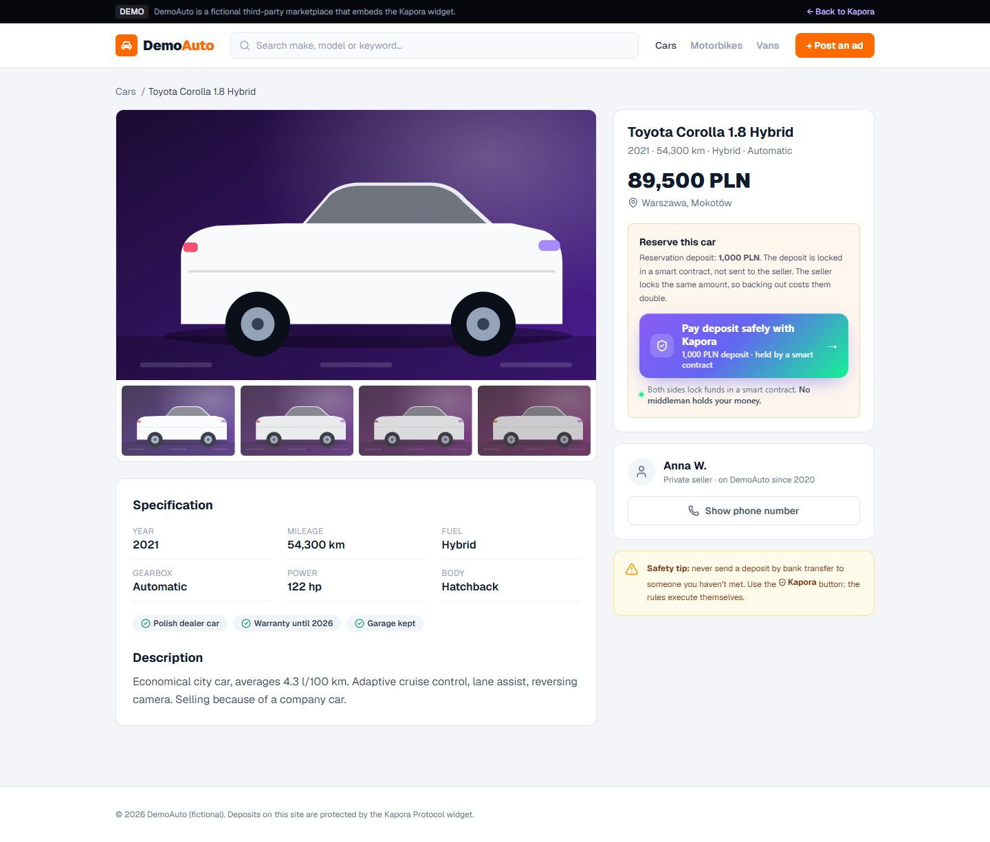
07 · IMPLEMENTATION POTENTIAL
One component. Every marketplace, every sector.
1 Drop-in widget
<script src="https://<app>/widget.js"
data-platform="<PLATFORM_PUBKEY>"
data-listing-id="abc123"
data-amount="2000"
data-template="deposit"></script>
data-template = deposit | rental | freelance | purchase
2 TypeScript SDK
createOffer()
reserve()
confirm()
withdraw()
claimAfterDeadline()
getProfile()
3 Shareable deal link
DemoAuto · cars · deposit
DemoRent · cameras · rental
/d/<deal> — send it on WhatsApp; both sides see the same live page.
Fictional demo marketplaces — same widget, same program
Kapora Protocol · HackYeah 2026
07 / 10
Notes:
Integration is one script tag. A marketplace adds the widget to a listing page with a template, and the button opens the Kapora deal flow. Developers can use the TypeScript SDK instead, and every deal has a shareable link. Our two demo marketplaces, DemoAuto for cars and DemoRent for equipment rental, are fictional, and they run the same widget on the same program.

Slide 8
08 · PRIVACY BY DESIGN
Money on-chain. People off-chain.
GDPR-friendly by construction: reputation without identity.
ON-CHAIN
Solana · public · permanent
OFF-CHAIN
app server · private · deletable
Amounts, deadlines, rule parameters, status
Names, emails, phone numbers
Pseudonymous wallet addresses
Listing details, photos, evidence files
Salted SHA-256 hashes of listing & evidence
Hash salts — delete one, the hash points to nothing
Behaviour counters per wallet (Profile)
Wallet ↔ person link
Anonymous platform aggregates (PlatformStats)
Off-chain data can’t move money or outcomes
Never on-chain: names · emails · phones · addresses · plates · listing text · free text
Kapora Protocol · HackYeah 2026
08 / 10
Notes:
Privacy by design. On-chain we keep only money and behaviour: amounts, wallets, deadlines, the rule, status, salted hashes and behaviour counters, so you can see how a wallet behaved without knowing who it is. Everything personal lives off-chain and can be deleted; delete the salt and the hash points to nothing. And nothing off-chain can move money or change an outcome.

Slide 9
09 · VISION
Deposits are step one
A trust layer any website can plug in — the same Deal account; a new kind only for new mechanics.
1
2
3
4
5
6
LIVE ON DEVNET
NEXT
LATER
LATER
LATER
LATER
One program + widget
Auto-confirmed shipping
Milestone payments
Digital asset swaps
Event-based payouts
Payment API for any site
4 templates: deposit, rental, freelance, purchase. Nothing extra.
Adds a shipping-data attester and an inspection window.
Adds a sequence of stages (kind: Milestones).
Adds nothing: asset and payment swap in one transaction.
e.g. parametric flight-delay insurance. Adds an oracle.
Adds dashboard, webhooks and a fee model.
Deliberately out of scope: betting / prediction markets. Vision only, not in the MVP: encrypted identity escrow for large deals (an off-chain trust feature).
Kapora Protocol · HackYeah 2026
09 / 10
Notes:
Where this goes: one trust component that any site in any sector can plug in, like a payment provider but without the intermediary. Today: one program and one widget with four templates. Next: auto-confirmed shipped purchases, milestone payments, asset swaps, event-based payouts via oracles, and a payment API. Betting and prediction markets are deliberately out of scope.

Slide 10
K
One component —
every marketplace, every sector,
every country.
Solana
Anchor 0.32
SPL Token
Next.js
TypeScript SDK
LIMITATIONS (HONEST)
The handover is off-chain: confirmations come from the parties.
REPO
[ github.com/<user>/kapora ]
VIDEO
[ public video link, ≤ 3 min ]
An arbiter is optional — and trusted once both agree to one.
LIVE DEMO
[ https://<demo-url> ] · devnet, Phantom
Devnet and test USDC only; not audited, not production-ready.
PROGRAM
AkQXPVXUYDqyNUVNAsYGYXy9sHQR636xcuJbAJkiJe5F
TEAM
[Team name] · [Name Surname] · ahmetenes2004@hotmail.com
Legal effect of an on-chain zadatek needs legal review.
Notes:
One component: every marketplace, every sector, every country. Built on Solana with Anchor, SPL Token, Next.js and a TypeScript SDK. And honestly: confirmations of the real-world handover come from the parties, an arbiter is trusted once both agree to one, and this is devnet with test USDC. Repo, video and live demo are linked here. Thank you.

