Slide 1
KD-Tree
It’s Cool

Slide 2
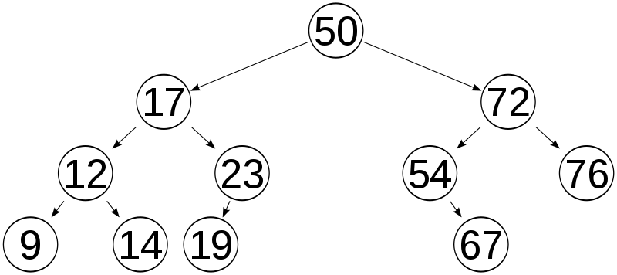
Binary Search Tree
Items Have Exact Location

Slide 3
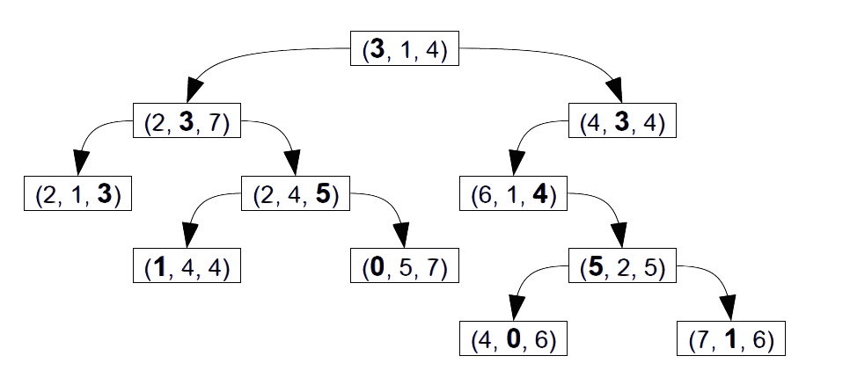
KD-Tree
Disc 0
Disc 1
Disc 2
Disc 0
Disc 1

Slide 4
KD-Tree
( 3 , 1 , 4 )
( 2 , 3 , 7 )
( 4 , 3 , 4 )
( 2 , 1 , 3 )
( 2 , 4 , 5 )
( 6 , 1 , 4 )
( 1 , 4 , 4 )
( 0 , 5, 7 )
( 5 , 2 , 5 )
( 4 , 0 , 6 )
( 7 , 1 , 6 )

Slide 5
KD-Tree
( 2 , 3 , 7 )
Root is Null
( 4 , 3 , 4 )
( 3 , 1 , 4 )
( 2 , 1 , 3 )
( 2 , 4 , 5 )
( 6 , 1 , 4 )
( 1 , 4 , 4 )
( 0 , 5, 7 )
( 5 , 2 , 5 )
( 4 , 0 , 6 )
( 7 , 1 , 6 )

Slide 6
KD-Tree
( 2 , 3 , 7 )
Compare discriminator 0
( 4 , 3 , 4 )
( 3 , 1 , 4 )
( 2 , 1 , 3 )
( 2 , 4 , 5 )
( 6 , 1 , 4 )
( 1 , 4 , 4 )
( 0 , 5, 7 )
( 5 , 2 , 5 )
( 4 , 0 , 6 )
( 7 , 1 , 6 )

Slide 7
KD-Tree
Compare discriminator 0
( 4 , 3 , 4 )
( 3 , 1 , 4 )
( 2 , 1 , 3 )
( 2 , 3 , 7 )
( 2 , 4 , 5 )
( 6 , 1 , 4 )
( 1 , 4 , 4 )
( 0 , 5, 7 )
( 5 , 2 , 5 )
( 4 , 0 , 6 )
( 7 , 1 , 6 )

Slide 8
KD-Tree
Compare discriminator 0
( 4 , 3 , 4 )
( 3 , 1 , 4 )
( 2 , 1 , 3 )
( 2 , 3 , 7 )
( 2 , 4 , 5 )
( 6 , 1 , 4 )
( 1 , 4 , 4 )
( 0 , 5, 7 )
( 5 , 2 , 5 )
( 4 , 0 , 6 )
( 7 , 1 , 6 )

Slide 9
KD-Tree
Compare discriminator 0
( 3 , 1 , 4 )
( 2 , 1 , 3 )
( 2 , 3 , 7 )
( 4 , 3 , 4 )
( 2 , 4 , 5 )
( 6 , 1 , 4 )
( 1 , 4 , 4 )
( 0 , 5, 7 )
( 5 , 2 , 5 )
( 4 , 0 , 6 )
( 7 , 1 , 6 )

Slide 10
KD-Tree
Compare discriminator 0
( 3 , 1 , 4 )
( 2 , 1 , 3 )
( 2 , 3 , 7 )
( 4 , 3 , 4 )
( 2 , 4 , 5 )
( 6 , 1 , 4 )
( 1 , 4 , 4 )
( 0 , 5, 7 )
( 5 , 2 , 5 )
( 4 , 0 , 6 )
( 7 , 1 , 6 )

Slide 11
KD-Tree
Compare discriminator 0
( 3 , 1 , 4 )
( 2 , 1 , 3 )
( 2 , 3 , 7 )
( 4 , 3 , 4 )
( 2 , 4 , 5 )
( 6 , 1 , 4 )
( 1 , 4 , 4 )
( 0 , 5, 7 )
( 5 , 2 , 5 )
( 4 , 0 , 6 )
( 7 , 1 , 6 )

Slide 12
KD-Tree
Compare discriminator 1
( 3 , 1 , 4 )
( 2 , 1 , 3 )
( 2 , 3 , 7 )
( 4 , 3 , 4 )
( 2 , 4 , 5 )
( 6 , 1 , 4 )
( 1 , 4 , 4 )
( 0 , 5, 7 )
( 5 , 2 , 5 )
( 4 , 0 , 6 )
( 7 , 1 , 6 )

Slide 13
KD-Tree
( 3 , 1 , 4 )
( 2 , 3 , 7 )
( 4 , 3 , 4 )
( 2 , 4 , 5 )
( 6 , 1 , 4 )
( 2 , 1 , 3 )
( 1 , 4 , 4 )
( 0 , 5, 7 )
( 5 , 2 , 5 )
( 4 , 0 , 6 )
( 7 , 1 , 6 )

Slide 14
KD-Tree
Compare discriminator 0
( 3 , 1 , 4 )
( 2 , 3 , 7 )
( 4 , 3 , 4 )
( 2 , 4 , 5 )
( 6 , 1 , 4 )
( 2 , 1 , 3 )
( 1 , 4 , 4 )
( 0 , 5, 7 )
( 5 , 2 , 5 )
( 4 , 0 , 6 )
( 7 , 1 , 6 )

Slide 15
KD-Tree
Compare discriminator 1
( 3 , 1 , 4 )
( 2 , 3 , 7 )
( 4 , 3 , 4 )
( 2 , 4 , 5 )
( 6 , 1 , 4 )
( 2 , 1 , 3 )
( 1 , 4 , 4 )
( 0 , 5, 7 )
( 5 , 2 , 5 )
( 4 , 0 , 6 )
( 7 , 1 , 6 )

Slide 16
KD-Tree
( 3 , 1 , 4 )
( 2 , 3 , 7 )
( 4 , 3 , 4 )
( 6 , 1 , 4 )
( 2 , 1 , 3 )
( 2 , 4 , 5 )
( 1 , 4 , 4 )
( 0 , 5, 7 )
( 5 , 2 , 5 )
( 4 , 0 , 6 )
( 7 , 1 , 6 )

Slide 17
KD-Tree
Compare discriminator 0
( 3 , 1 , 4 )
( 2 , 3 , 7 )
( 4 , 3 , 4 )
( 6 , 1 , 4 )
( 2 , 1 , 3 )
( 2 , 4 , 5 )
( 1 , 4 , 4 )
( 0 , 5, 7 )
( 5 , 2 , 5 )
( 4 , 0 , 6 )
( 7 , 1 , 6 )

Slide 18
KD-Tree
Compare discriminator 1
( 3 , 1 , 4 )
( 2 , 3 , 7 )
( 4 , 3 , 4 )
( 6 , 1 , 4 )
( 2 , 1 , 3 )
( 2 , 4 , 5 )
( 1 , 4 , 4 )
( 0 , 5, 7 )
( 5 , 2 , 5 )
( 4 , 0 , 6 )
( 7 , 1 , 6 )

Slide 19
KD-Tree
( 3 , 1 , 4 )
( 2 , 3 , 7 )
( 4 , 3 , 4 )
( 2 , 1 , 3 )
( 2 , 4 , 5 )
( 6 , 1 , 4 )
( 1 , 4 , 4 )
( 0 , 5, 7 )
( 5 , 2 , 5 )
( 4 , 0 , 6 )
( 7 , 1 , 6 )

Slide 20
KD-Tree
Compare discriminator 0
( 3 , 1 , 4 )
( 2 , 3 , 7 )
( 4 , 3 , 4 )
( 2 , 1 , 3 )
( 2 , 4 , 5 )
( 6 , 1 , 4 )
( 1 , 4 , 4 )
( 0 , 5, 7 )
( 5 , 2 , 5 )
( 4 , 0 , 6 )
( 7 , 1 , 6 )

Slide 21
KD-Tree
Compare discriminator 1
( 3 , 1 , 4 )
( 2 , 3 , 7 )
( 4 , 3 , 4 )
( 2 , 1 , 3 )
( 2 , 4 , 5 )
( 6 , 1 , 4 )
( 1 , 4 , 4 )
( 0 , 5, 7 )
( 5 , 2 , 5 )
( 4 , 0 , 6 )
( 7 , 1 , 6 )

Slide 22
KD-Tree
Compare discriminator 2
( 3 , 1 , 4 )
( 2 , 3 , 7 )
( 4 , 3 , 4 )
( 2 , 1 , 3 )
( 2 , 4 , 5 )
( 6 , 1 , 4 )
( 1 , 4 , 4 )
( 0 , 5, 7 )
( 5 , 2 , 5 )
( 4 , 0 , 6 )
( 7 , 1 , 6 )

Slide 23
KD-Tree
Compare discriminator 2
( 3 , 1 , 4 )
( 2 , 3 , 7 )
( 4 , 3 , 4 )
( 2 , 1 , 3 )
( 2 , 4 , 5 )
( 6 , 1 , 4 )
( 1 , 4 , 4 )
( 0 , 5, 7 )
( 5 , 2 , 5 )
( 4 , 0 , 6 )
( 7 , 1 , 6 )

Slide 24
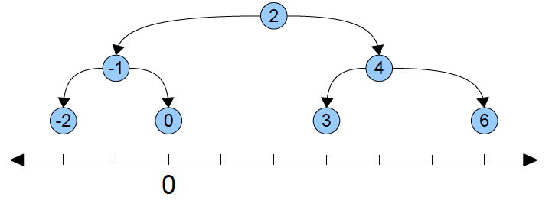
Binary-Tree
The Geometric Intuition Behind kd-Trees

Slide 25
Binary-Tree
The Geometric Intuition Behind kd-Trees

Slide 26
Binary-Tree
The Geometric Intuition Behind kd-Trees
Values < 2
Values > 2

Slide 27
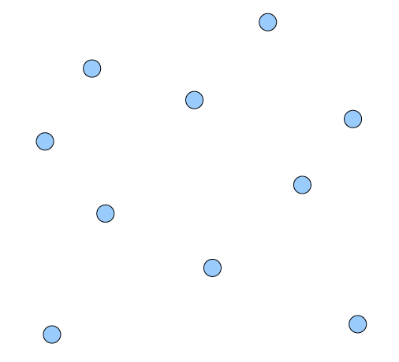
Binary Space Partitioning
The Geometric Intuition Behind kd-Trees

Slide 28
Binary Space Partitioning
The Geometric Intuition Behind kd-Trees

Slide 29
Binary Space Partitioning
The Geometric Intuition Behind kd-Trees
Splitting Hyperplane

Slide 30
Binary Space Partitioning
The Geometric Intuition Behind kd-Trees
Splitting Hyperplane
(point)

Slide 31
Building Kd-Tree
4
6
0
7
2
1
3
5
8
9

Slide 32
Building Kd-Tree
4
6
0
7
2
1
3
5
8
9
X < X₀
X >= X₀

Slide 33
Building Kd-Tree
4
6
Y >= Y₁
0
7
2
1
3
5
Y < Y₁
8
9

Slide 34
Building Kd-Tree
Y >= Y₂
4
6
0
7
2
1
3
Y < Y₂
5
8
9

Slide 35
Building Kd-Tree
4
6
0
7
2
1
3
5
8
9
X < X₃
X >= X₃

Slide 36
Building Kd-Tree
X < X₄
X >= X₄
4
6
0
7
2
1
3
5
8
9

Slide 37
Building Kd-Tree
4
6
0
7
2
1
3
5
8
9
X < X₅
X >= X₅

Slide 38
Building Kd-Tree
X < X₆
X >= X₆
4
6
0
7
2
1
3
5
8
9

Slide 39
Building Kd-Tree
4
Y >= Y₇
6
0
7
2
Y < Y₇
1
3
5
8
9

Slide 40
Building Kd-Tree
4
6
0
7
2
1
3
Y >= Y₈
5
8
Y < Y₈
9

Slide 41
Building Kd-Tree
4
6
0
7
2
1
3
Y >= Y₉
5
8
Y < Y₉
9

Slide 42
Searching Kd-Tree
4
6
0
7
2
1
3
5
8
9

Slide 43
Searching Kd-Tree
4
6
0
7
2
1
3
5
8
9
Search for Node 8

Slide 44
Searching Kd-Tree
Compare Node 8’s X to Node 0’s X
4
6
0
7
2
1
3
5
8
9
Search for Node 8

Slide 45
Searching Kd-Tree
Compare Node 8’s Y to Node 1’s Y
4
6
0
7
2
1
3
5
8
9
Search for Node 8

Slide 46
Searching Kd-Tree
Compare Node 8’s X to Node 5’s X
4
6
0
7
2
1
3
5
8
9
Search for Node 8

Slide 47
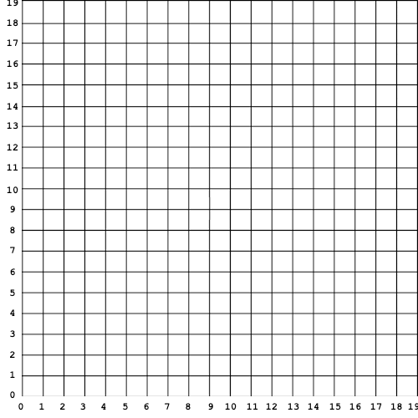
Nearest Neighbor Search
4
6
0
7
2
1
3
5
9
8

Slide 48
Region Search
4
6
0
7
2
1
3
5
9
8

Slide 49
NNearest Neighbor Search
4
6
0
7
2
1
3
5
9
8

