Slide 1
Chapter 12: Advanced File Operations

Slide 2
12.1
File Operations

Slide 3
File Operations
File: a set of data stored on a computer, often on a disk drive
Programs can read from, write to files
Used in many applications:
Word processing
Databases
Spreadsheets
Compilers

Slide 4
Using Files
Requires fstream header file
use ifstream data type for input files
use ofstream data type for output files
use fstream data type for both input, output files
Can use >>, << to read from, write to a file
Can use eof member function to test for end of input file

Slide 5
fstream Object
fstream object can be used for either input or output
Must specify mode on the open statement
Sample modes:
ios::in – input
ios::out – output
Can be combined on open call:
dFile.open("class.txt", ios::in | ios::out);

Slide 6
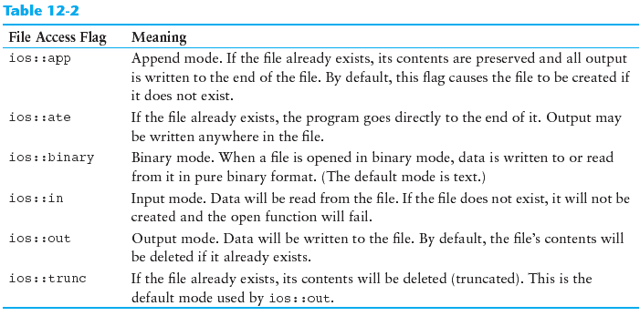
File Access Flags

Slide 7
Using Files - Example
// copy 10 numbers between files
// open the files
fstream infile("input.txt", ios::in);
fstream outfile("output.txt", ios::out);
int num;
for (int i = 1; i <= 10; i++)
{
infile >> num; // use the files
outfile << num;
}
infile.close(); // close the files
outfile.close();

Slide 8
Default File Open Modes
ifstream:
open for input only
file cannot be written to
open fails if file does not exist
ofstream:
open for output only
file cannot be read from
file created if no file exists
file contents erased if file exists

Slide 9
More File Open Details
Can use filename, flags in definition:
ifstream gradeList("grades.txt");
File stream object set to 0 (false) if open failed:
if (!gradeList) ...
Can also check fail member function to detect file open error:
if (gradeList.fail()) ...

Slide 10
12.2
File Output Formatting

Slide 11
File Output Formatting
Use the same techniques with file stream objects as with cout: showpoint, setw(x), showprecision(x), etc.
Requires iomanip to use manipulators

Slide 12
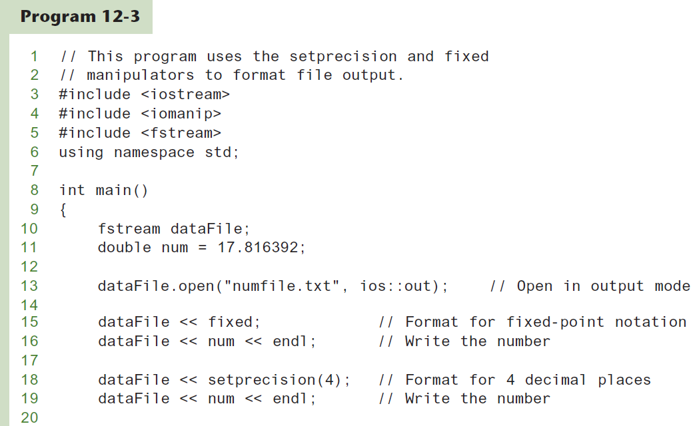

Slide 13
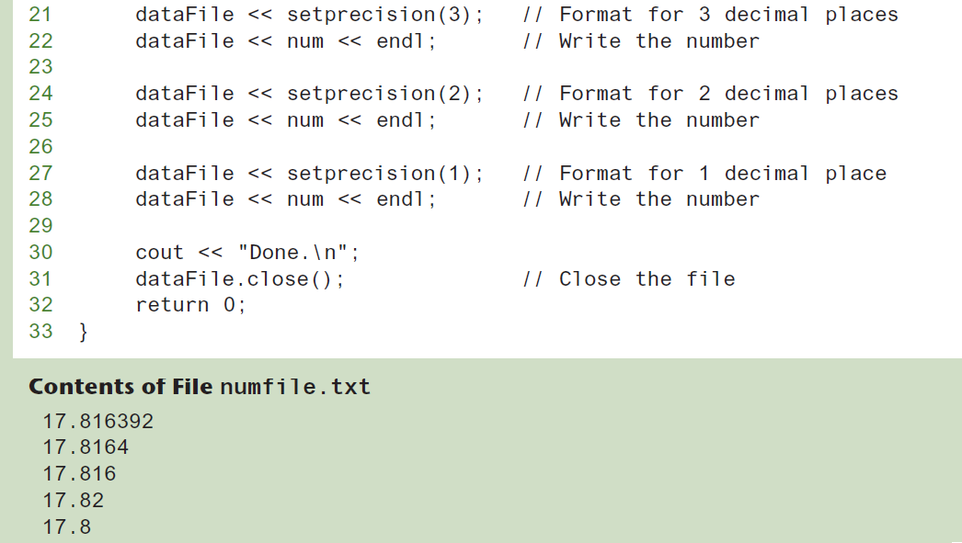

Slide 14
12.3
Passing File Stream Objects to Functions

Slide 15
Passing File Stream Objects to Functions
It is very useful to pass file stream objects to functions
Be sure to always pass file stream objects by reference

Slide 16
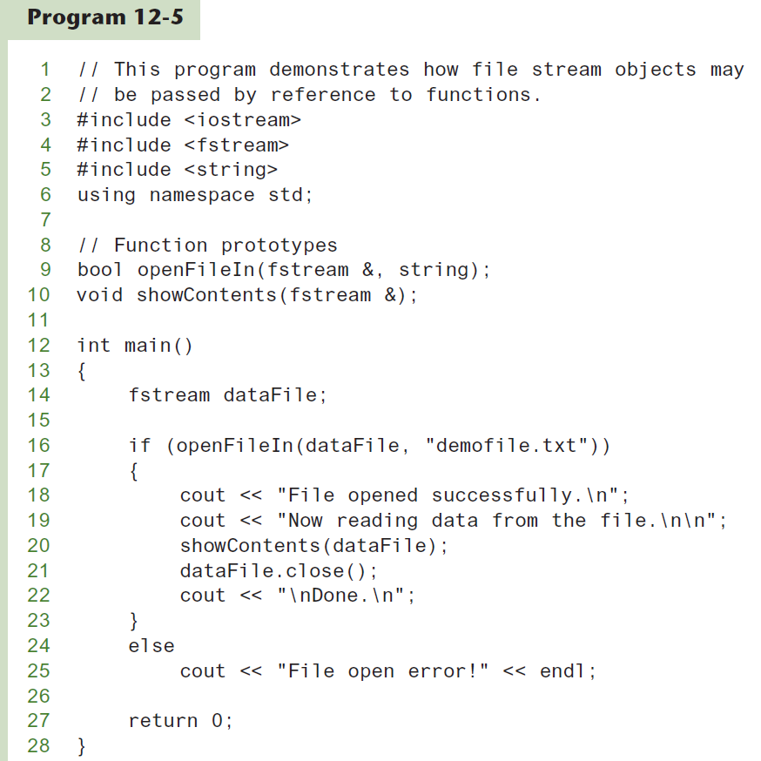

Slide 17
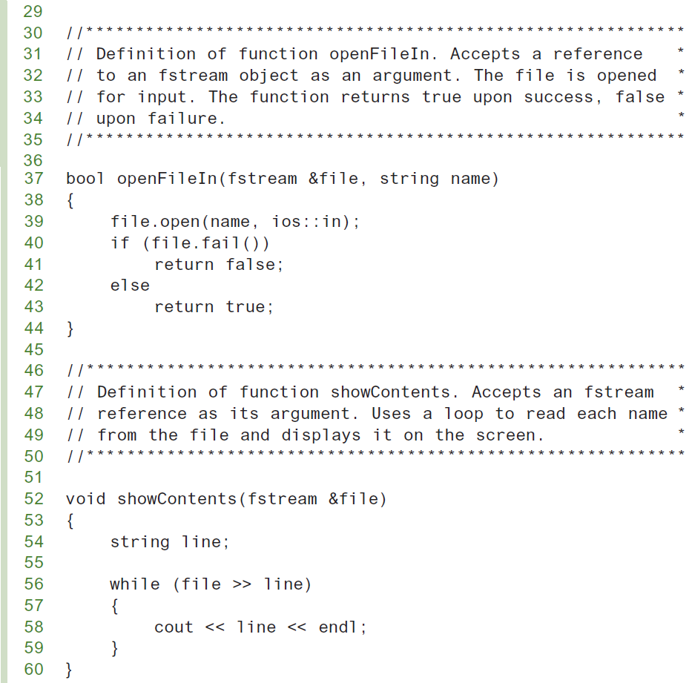

Slide 18
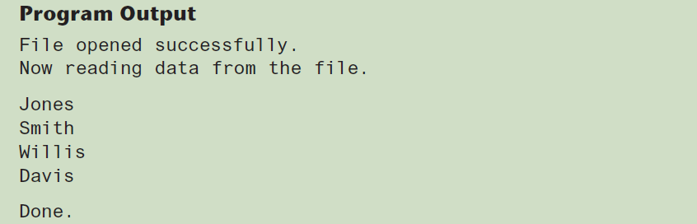

Slide 19
12.4
More Detailed Error Testing

Slide 20
More Detailed Error Testing
Can examine error state bits to determine stream status
Bits tested/cleared by stream member functions
ios::eofbit | set when end of file detected
ios::failbit | set when operation failed
ios::hardfail | set when error occurred and no recovery
ios::badbit | set when invalid operation attempted
ios::goodbit | set when no other bits are set

Slide 21
Member Functions / Flags
eof() | true if eofbit set, false otherwise
fail() | true if failbit or hardfail set, false otherwise
bad() | true if badbit set, false otherwise
good() | true if goodbit set, false otherwise
clear() | clear all flags (no arguments), or clear a specific flag

Slide 22
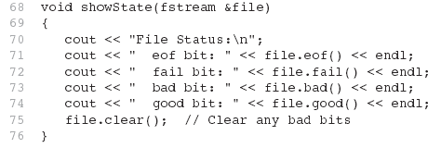
From Program 12-6

Slide 23
12.5
Member Functions for Reading and Writing Files

Slide 24
Member Functions for Reading and Writing Files
Functions that may be used for input with whitespace, to perform single character I/O, or to return to the beginning of an input file
Member functions:
getline: reads input including whitespace
get: reads a single character
put: writes a single character

Slide 25
The getline Function
Three arguments:
Name of a file stream object
Name of a string object
Delimiter character of your choice
Examples, using the file stream object myFile, and the string objects name and address:
getline(myFile, name);
getline(myFile, address, '\t');
If left out, '\n' is default for third argument

Slide 26
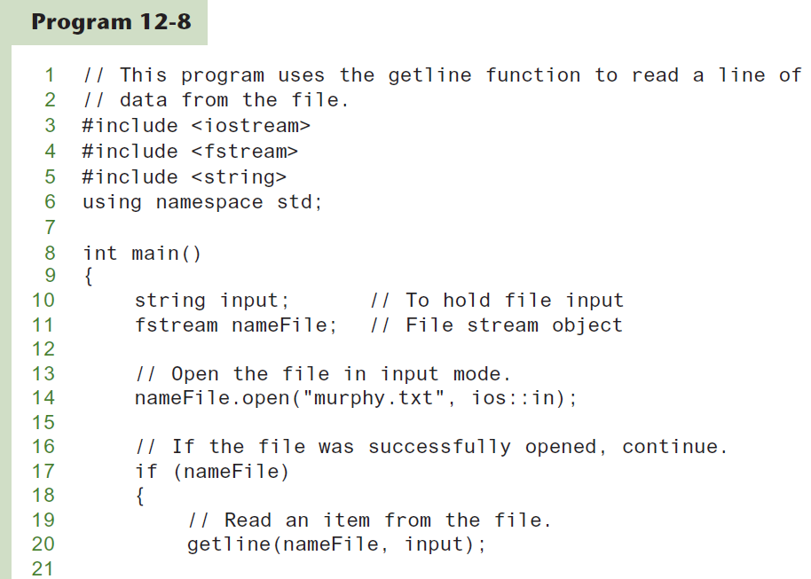

Slide 27
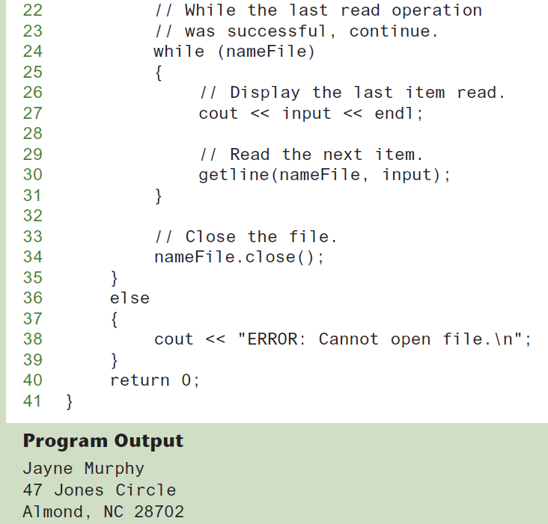

Slide 28
Single Character I/O
get: read a single character from a file
char letterGrade;
gradeFile.get(letterGrade);
Will read any character, including whitespace
put: write a single character to a file
reportFile.put(letterGrade);

Slide 29
12.6
Working with Multiple Files

Slide 30
Working with Multiple Files
Can have more than file open at a time in a program
Files may be open for input or output
Need to define file stream object for each file

Slide 31
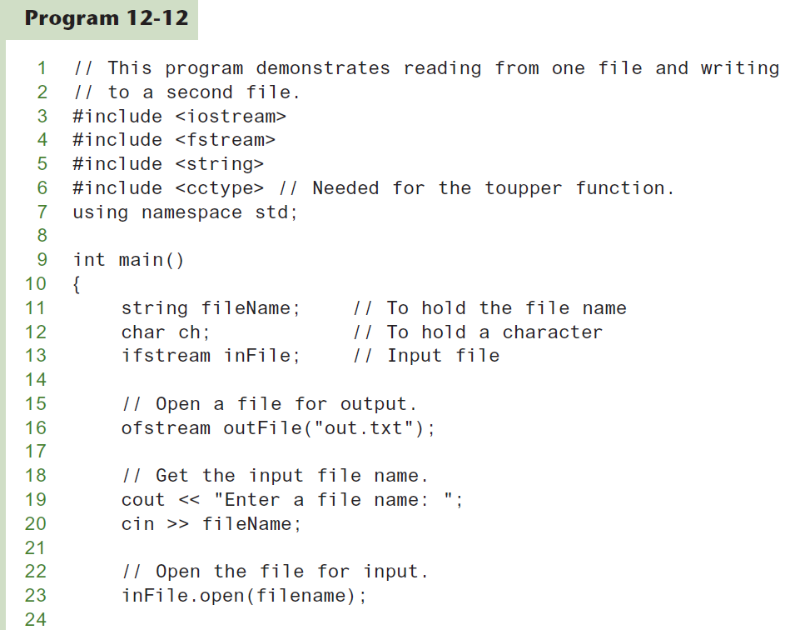

Slide 32
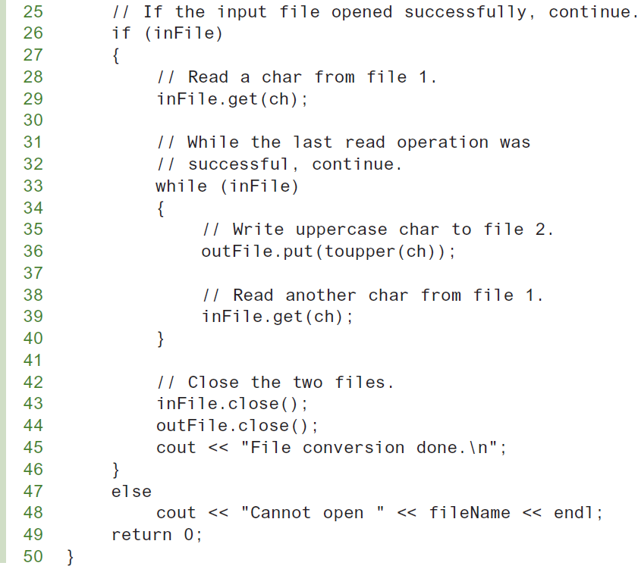

Slide 33
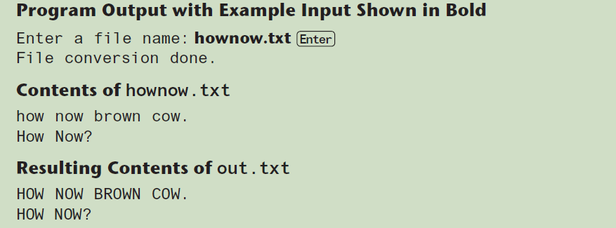

Slide 34
12.7
Binary Files

Slide 35
Binary Files (1 of 3)
Binary file contains unformatted, non-ASCII data
Indicate by using binary flag on open:
inFile.open("nums.dat", ios::in | ios::binary);

Slide 36
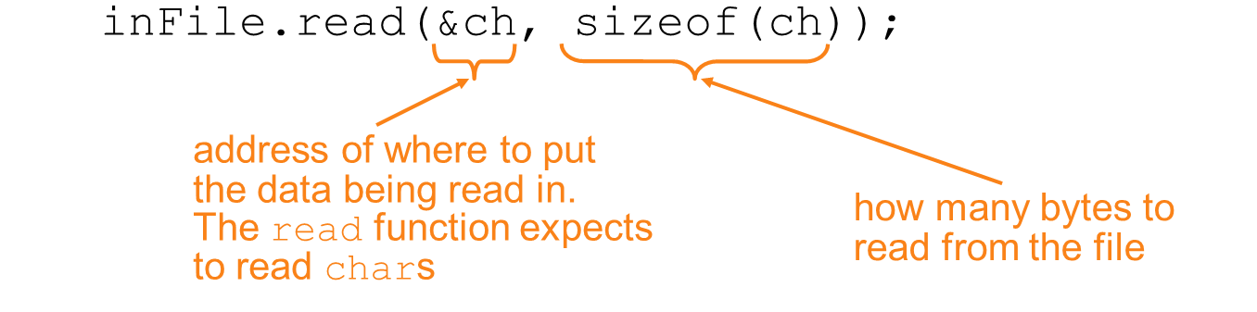
Binary Files (2 of 3)
Use read and write instead of <<, >>
char ch;
// read in a letter from file
// send a character to a file
outFile.write(&ch, sizeof(ch));

Slide 37
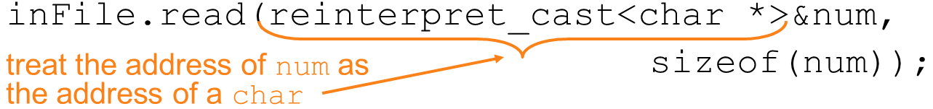
Binary Files (3 of 3)
To read, write non-character data, must use a typecast operator to treat the address of the data as a character address
int num;
// read in a binary number from a file
// send a binary value to a file
outf.write(reinterpret_cast<char *>&num,
sizeof(num));

Slide 38
12.8
Creating Records with Structures

Slide 39
Creating Records with Structures (1 of 2)
Can write structures to, read structures from files
To work with structures and files,
use ios::binary file flag upon open
use read, write member functions

Slide 40
Creating Records with Structures (2 of 2)
struct TestScore
{
int studentId;
double score;
char grade;
};
TestScore oneTest;
...
// write out oneTest to a file
gradeFile.write(reinterpret_cast<char *> (&oneTest), sizeof(oneTest));

Slide 41
12.9
Random-Access Files

Slide 42
Random-Access Files
Sequential access: start at beginning of file and go through data in file, in order, to end
to access 100th entry in file, go through 99 preceding entries first
Random access: access data in a file in any order
can access 100th entry directly

Slide 43
Random Access Member Functions (1 of 2)
seekg (seek get): used with files open for input
seekp (seek put): used with files open for output
Used to go to a specific position in a file

Slide 44
Random Access Member Functions (2 of 2)
seekg,seekp arguments:
offset: number of bytes, as a long
mode flag: starting point to compute offset
Examples:
inData.seekg(25L, ios::beg);
// set read position at 26th byte
// from beginning of file
outData.seekp(-10L, ios::cur);
// set write position 10 bytes
// before current position

Slide 45
Important Note on Random Access
If eof is true, it must be cleared before seekg or seekp:
gradeFile.clear();
gradeFile.seekg(0L, ios::beg);
// go to the beginning of the file

Slide 46
Random Access Information
tellg member function: return current byte position in input file
long int whereAmI;
whereAmI = inData.tellg();
tellp member function: return current byte position in output file
whereAmI = outData.tellp();

Slide 47
12.10
Opening a File for Both Input and Output

Slide 48
Opening a File for Both Input and Output
File can be open for input and output simultaneously
Supports updating a file:
read data from file into memory
update data
write data back to file
Use fstream for file object definition:
fstream gradeList("grades.dat",
ios::in | ios::out);
Can also use ios::binary flag for binary data

Slide 49
12.11
Working With the File System

Slide 50
Working With the File System (1 of 2)
In C++ 17 and later, the standard library provides numerous functions and types that you can use to work with the file system.
Use the following #include directive:
#include <filesystem>

Slide 51
Working With the File System (2 of 2)
All of the file system functions and types are in the filesystem namespace, which is in the std namespace
In your code, the name of a file system function or type will be prefixed with filesystem::

Slide 52
Directories and Paths (1 of 3)
In your file system, files are stored in folders
A directory is the same thing as a folder
The two terms mean the same thing
In C++ documentation, directory is typically used instead of folder

Slide 53
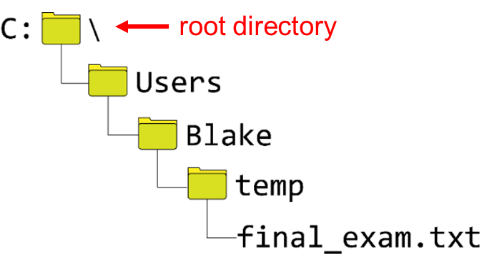
Directories and Paths (2 of 3)
A path, or pathname, is a string that specifies the location of a file or a directory on a computer system
Here is an example of a Windows pathname:
C:\Users\Blake\temp\final_exam.txt

Slide 54
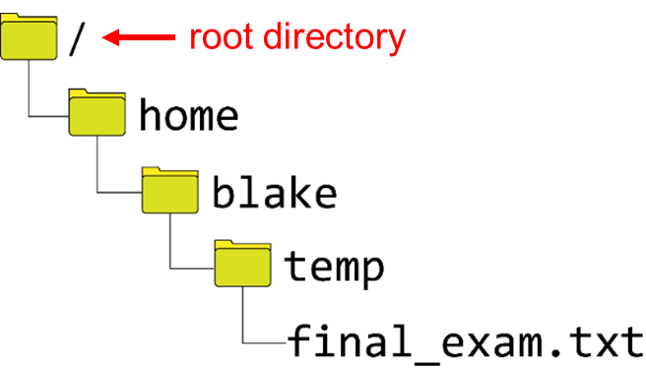
Directories and Paths (3 of 3)
Here is an example of a Unix or Linux style pathname:
/home/blake/temp/final_exam.txt
NOTE: macOS uses Unix style pathnames.

Slide 55
Absolute Paths (1 of 2)
An absolute path is a path that fully specifies a file or directory's location, starting at the root directory.
Windows example:
C:\Users\Stacey\Desktop\sheepdog.jpg
Starting at the root directory of drive C:
We go to the Users directory,
Then we go to the Stacey directory,
Then we go to the Desktop directory,
There we will find the file sheepdog.jpg.

Slide 56
Absolute Paths (2 of 2)
Unix and Linux example:
/home/stacey/images/sheepdog.jpg
Starting at the root directory,
We go to the home directory,
Then we go to the stacey directory,
Then we go to the images directory,
There we will find the file sheepdog.jpg.

Slide 57
The Current Working Directory and Relative Paths (1 of 3)
When a program is running it has a current working directory.
When the program creates a file, the file will be created in the current working directory unless a path to some other location is given.
If we know the current working directory, we can use relative paths to specify locations on the disk.
A relative path specifies a file or directory's location relative to the current working directory.

Slide 58
The Current Working Directory and Relative Paths (2 of 3)
Example of a relative path on Windows:
Stacey\Desktop\sheepdog.jpg
Starting at the current working directory,
We go to the Stacey directory,
Then we go to the Desktop directory,
There we will find the file sheepdog.jpg.

Slide 59
The Current Working Directory and Relative Paths (3 of 3)
Example of a relative path on a Unix or Linux system:
stacey/images/sheepdog.jpg
Starting at the current working directory,
We go to the stacey directory,
Then we go to the iamges directory,
There we will find the file sheepdog.jpg.

Slide 60
Working with path Objects (1 of 4)
You can use the path data type to create objects that represent the path of a file or directory
The following statement creates a path object named myPath:
filesystem::path myPath;
Then, the following statement assigns a string containing a pathname to the object:
myPath = "stacey/images/sheepdog.jpg";

Slide 61
Working with path Objects (2 of 4)
Windows example:
filesystem::path myPath;
myPath = "C:\\Users\\Blake\\temp\\final_exam.txt";
Or, using a raw string:
filesystem::path myPath;
myPath = R"(C:\Users\Blake\temp\final_exam.txt)";

Slide 62
Working with path Objects (3 of 4)
Declaring and initializing a path object in Windows:
filesystem::path myPath {"C:\\Images\\Sunset.jpg"};
filesystem::path myPath {R"(C:\Notes\meeting.txt)"};
In Unix and Linux:
filesystem::path myPath {"/home/jim/captains_log.txt"};

Slide 63
Working with path Objects (4 of 4)
To display a pathname, use the path object's string() method:
filesystem::path myPath {"C:\\Images\\Sunset.jpg"};
cout << myPath.string() << endl;
This code displays:
C:\Images\Sunset.jpg

Slide 64
Determining Whether a File or Directory Exists
You can use the exists function to determine whether the file or directory specified by a path object exists. Here is the general format:
filesystem::exists(path)
Example:
filesystem::path targetPath { "C:\\data\\stats.csv " };
if (filesystem::exists(targetPath))
cout << "That item exists." << endl;
else
cout << "That item does not exist." << endl;

Slide 65
Copying a File (1 of 2)
You can use the copy_file function to copy an existing file.
General format:
filesystem::copy_file(pathFrom, pathTo);
The file specified by pathFrom must exist
The file specified by pathTo must not exist
Otherwise, an exception (a critical error) will occur

Slide 66
Copying a File (2 of 2)
filesystem::path original { "C:\\data\\stats.csv " };
filesystem::path duplicate { "C:\\backup\\stats.csv " };
// Make sure the original file exists.
if (filesystem::exists(original))
{
// Make sure the destination file does NOT exist.
if (!filesystem::exists(duplicate))
{
// Copy the file.
filesystem::copy_file(original, duplicate);
}
else
{
cout << "The destination file " << duplicate.string()
<< " already exists." << endl;
}
}
else
{
cout << "The file " << original.string()
<< " does not exist." << endl;
}

Slide 67
Deleting a File or Empty Directory (1 of 2)
You can use the remove function to delete an existing file, or an empty directory.
General format:
filesystem::remove(path);
If the file or directory is successfully deleted, the function returns true. Otherwise the function returns false.
If the specified path refers to a nonempty directory, an exception (a critical error that aborts the program) will occur.

Slide 68
Deleting a File or Empty Directory (2 of 2)
filesystem::path target { "C:\\data\\stats.csv " };
// Delete the file.
if (filesystem::remove(targetPath))
{
cout << target.string()
<< " deleted." << endl;
}
else
{
cout << "Error deleting "
<< target.string() << endl;
}

Slide 69
Renaming a File or Directory (1 of 4)
You can use the rename function to rename an existing file or directory
General format:
filesystem::rename(sourcePath, destinationPath);
The file or directory specified by sourcePath must exist
Otherwise, an exception (a critical error) will occur

Slide 70
Renaming a File or Directory (2 of 4)
filesystem::path sourcePath{ "C:\\temp\\old_file.txt" };
filesystem::path destinationPath{"C:\\temp\\new_file.txt" };
// Make sure the file exists.
if (filesystem::exists(sourcePath))
{
// Make sure the destination file does NOT exist.
if (!filesystem::exists(destinationPath))
{
// Rename the file.
filesystem::rename(sourcePath, destinationPath);
cout << sourcePath.string() << " renamed to "
<< destinationPath.string() << endl;
}
else
{
cout << "The destination file "
<< destinationPath.string()
<< " already exists." << endl;
}
}
else
{
cout << "The file " << sourcePath.string()
<< " does not exist." << endl;
}

Slide 71
Renaming a File or Directory (3 of 4)
When using the rename function to rename a file:
If sourcePath is an existing file and destinationPath is a nonexistent file, then sourcePath will be renamed to destinationPath
If sourcePath is an existing file and destinationPath is also an existing file, then destinationPath will be deleted and then sourcePath will be given the new name specified by destinationPath
The rename function can be used to move a file or directory. If sourcePath is an existing file or directory and destinationPath specifies a nonexistent file or directory that is in a different location than sourcePath, then sourcePath will be moved to the location specified by destinationPath

Slide 72
Renaming a File or Directory (4 of 4)
When using the rename function to rename a directory:
If sourcePath is an existing directory and destinationPath does not exist, then sourcePath will be renamed to destinationPath
If sourcePath is an existing directory and destinationPath is also an existing directory, the result is system dependent. On some systems, an exception (critical error) will occur, but on other systems the destinationPath will be deleted and then sourcePath will be given the new name specified by destinationPath
The rename function can be used to move a directory. If sourcePath is an existing directory and destinationPath specifies a nonexistent directory that is in a different location than sourcePath, then sourcePath will be moved to the location specified by destinationPath

Slide 73
Getting and Setting the Path of the Current Working Directory (1 of 2)
The current_path function returns a path object that contains the path of the current working directory
// Get the path of the current working directory.
filesystem::path cwd = filesystem::current_path();
// Display the current working directory.
cout << "The current working directory is:\n"
<< cwd.string() << endl;

Slide 74
Getting and Setting the Path of the Current Working Directory (2 of 2)
You can also use the current_path function to set the current working directory
General format:
filesystem::current_path(path);
Example:
filesystem::path homePath = "/home/jess";
filesystem::current_path(homePath);

Slide 75
Creating a Directory (1 of 2)
You can use the create_directory function to create a directory
General format:
filesystem::create_directory(path);
The function returns true if the directory is successfully created, or false otherwise

Slide 76
Creating a Directory (2 of 2)
filesystem::path newDir { "C:\\temp\\stuff" };
if (filesystem::create_directory(newDir))
cout << "Directory created." << endl;
else
cout << "Directory not created." << endl;

Slide 77
Deleting a Nonempty Directory (1 of 2)
The remove function cannot be used to delete a directory that contains files or other directories
To delete a directory that has contents, you must use the remove_all function
General format:
filesystem::remove_all(path);
The function returns the number of files and directories that were deleted, as an integer

Slide 78
Deleting a Nonempty Directory (2 of 2)
filesystem::path targetPath{ "C:\\temp\\junk" };
int numDeleted = filesystem::remove_all(targetPath);
cout << numDeleted << " items were deleted." << endl;

Slide 79
Getting the Contents of a Directory (1 of 2)
To iterate over the items in a directory, use a range-based for loop along with the directory_iterator function
General format:
for (const auto &entry : filesystem::directory_iterator(path))
{
// Insert code here to work with directory entries.
}
entry is a directory_entry object and path is a path object

Slide 80
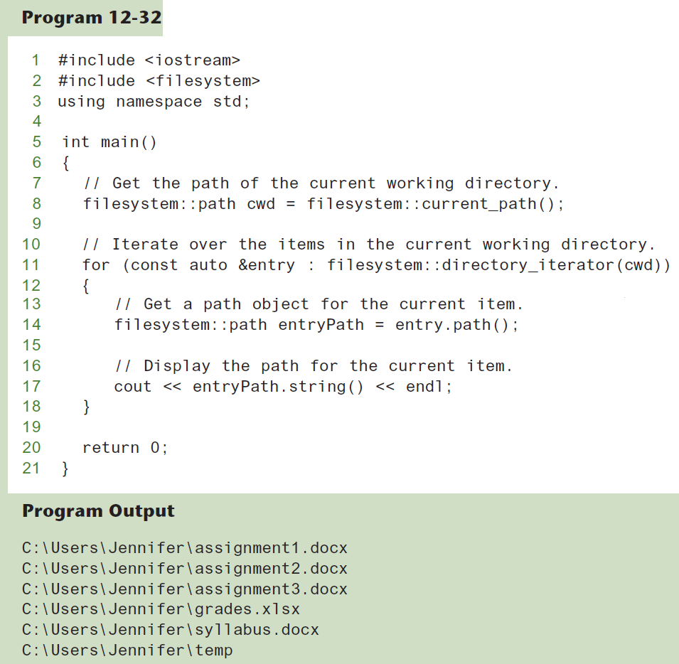

Slide 81
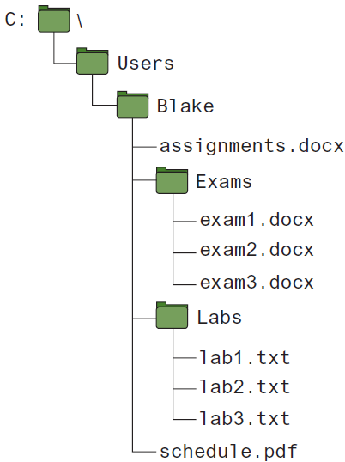
Getting the Contents of a Directory (2 of 2)
The directory_iterator function allows you to iterate over the items in a single directory
If you want to get the contents of a directory and the contents of all its subdirectories, use the recursive_directory_iterator function

Slide 82
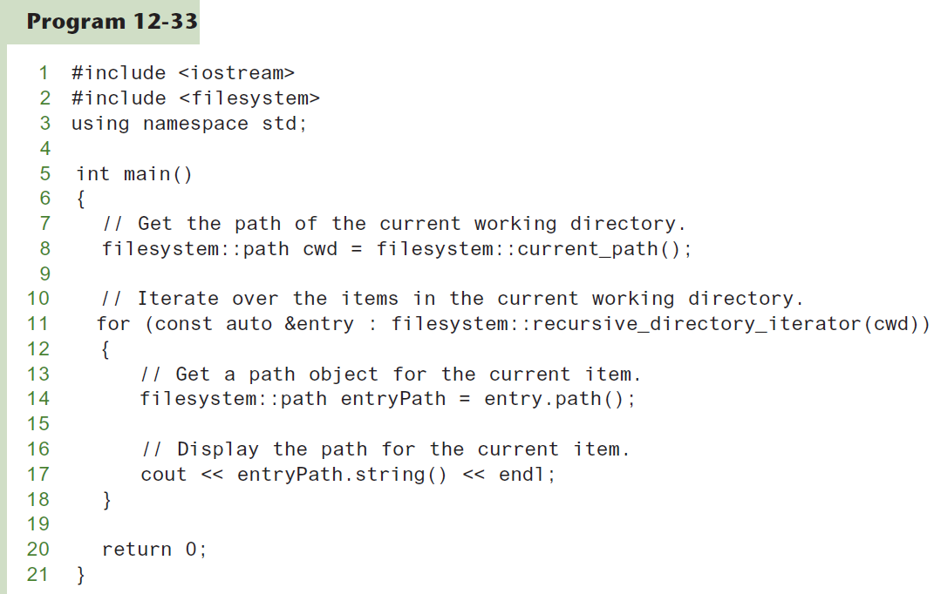

Slide 83
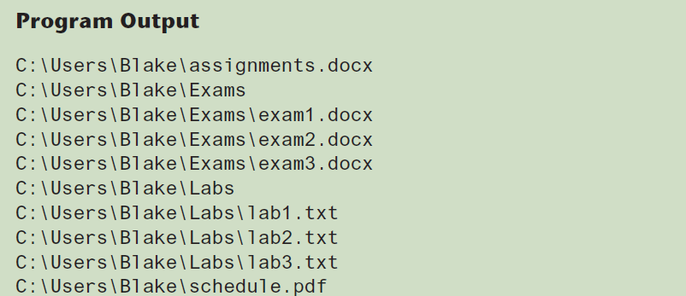

Slide 84
More About directory_entry Objects
Member Function | Description
path() | Returns a path object for the item.
exists() | Returns true if the item exists, or false otherwise.
is_regular_file() | Returns true if the item exists and is a regular file, or false otherwise.
is_directory() | Returns true if the item exists and is a directory, or false otherwise.
is_symlink() | Returns true if the item exists and is a symbolic link, or false otherwise.
is_other() | Returns true if the item exists and is not a regular file, not a directory, and not a symbolic link. Returns false otherwise.
file_size() | If the item is a file, returns the size of the file as an integer, measured in bytes. If the item is a directory, returns 0.

Slide 85
More About path Objects
Member Function | Description
root_name() | If the path object contains a Windows-style path, returns a path object containing the drive name (such as C:) If the path object contains a Unix or Linux-style path, returns an empty path object.
root_directory() | If the path is an absolute path, this member function returns a path object containing "\\" for a Windows-style path, or "/" for a Unix or Linux-style path. If the path is a relative path that does not include the root directory, this member function returns an empty path object.
root_path() | If the path is an absolute Windows-style path, this member function returns a path object containing the drive name followed by the root symbol, such as "C:\\". If the path is an absolute Unix or Linux-style path, this member function returns a path object containing the root symbol, "/". If the path is a relative path that does not include the root directory, this member function returns an empty a path object.
relative_path() | This member function returns a path object containing the part of the path that is relative to the root directory.
parent_path() | This member function returns a path object containing the path without the filename.
filename() | This member function returns a path object containing only the filename without the parent path.
stem() | This member function returns a path object containing only the filename without any extension that the filename might have.
extension() | This member function returns a path object containing only the extension.

Slide 86
Function Call Chaining (1 of 2)
Look at the following code:
1 filesystem::path cwd = filesystem::current_path(); 2 filesystem::path filenamePath = cwd.filename(); 3 cout << filenamePath.string() << endl;
Line 1 gets a path object for the current working directory and assigns that object to the cwd variable
Line 2 calls the cwd.filename() member function which returns another path object containing only the filename portion of the cwd object's path. This second path object is assigned to the filenamePath variable
Line 3 calls the filenamePath.string() member function to get the filenamePath object's path in its native format as a string. That string is sent to cout to be displayed on the screen

Slide 87
Function Call Chaining (2 of 2)
The previously shown code can be simplified to one statement with function call chaining.
Example:
cout << filesystem::current_path().filename().string() << endl;
The expression first calls the filesystem::current_path()function, which returns a path object
Then the expression calls that path object's filename() member function, which returns another path object
Then, the expression calls that path object's string() member function, which returns a string
The string is then sent to cout

