Slide 1
Chapter 20 Lists, Stacks, Queues, and Priority Queues

Slide 2
Objectives
To explore the relationship between interfaces and classes in the Java Collections Framework hierarchy (§20.2).
To use the common methods defined in the Collection interface for operating collections (§20.2).
To use the Iterator interface to traverse the elements in a collection (§20.3).
To use a foreach loop to traverse the elements in a collection (§20.3).
To use a forEach method to perform an action on each element in a collection (§20.4).
To explore how and when to use ArrayList or LinkedList to store a list of elements (§20.5).
To compare elements using the Comparable interface and the Comparator interface (§20.6).
To use the static utility methods in the Collections class for sorting, searching, shuffling lists, and finding the largest and smallest element in collections (§20.7).
To develop a multiple bouncing balls application using ArrayList (§20.8).
To distinguish between Vector and ArrayList and to use the Stack class for creating stacks (§20.9).
To explore the relationships among Collection, Queue, LinkedList, and PriorityQueue and to create priority queues using the PriorityQueue class (§20.10).
To use stacks to write a program to evaluate expressions (§20.11).

Slide 3
What is Data Structure?
A data structure is a collection of data organized in some fashion. The structure not only stores data, but also supports operations for accessing and manipulating the data.

Slide 4
Java Collection Framework hierarchy
A collection is a container object that holds a group of objects, often referred to as elements. The Java Collections Framework supports two types of collections:
One, for storing a collection , is simply called collection.
The other, for storing key/value pairs, is called a map.

Slide 5
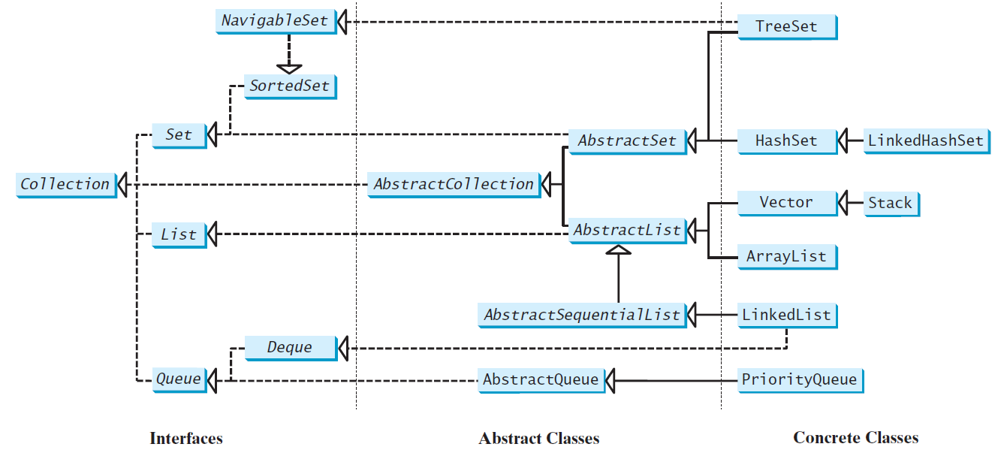
Java Collection Framework hierarchy, cont.
Set and List are subinterfaces of Collection.

Slide 6
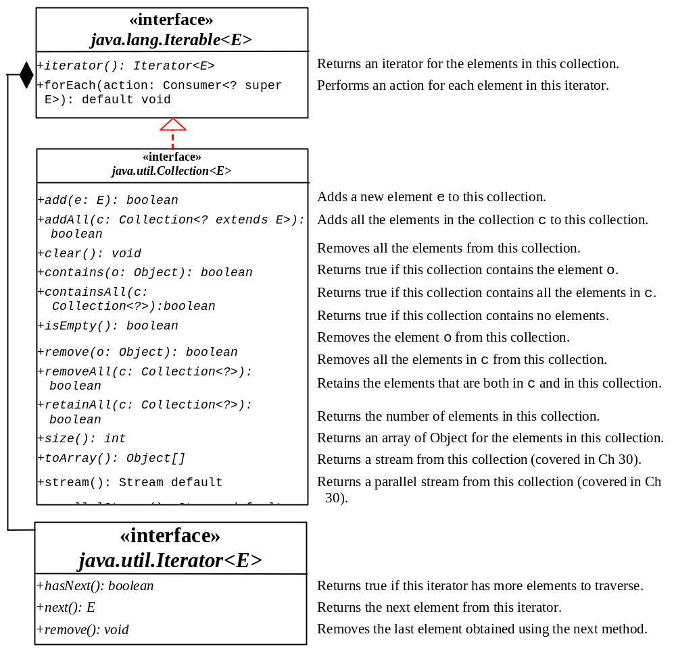
The Collection Interface
The Collection interface is for manipulating a collection of objects.
UML Diagram
TestCollection

Slide 7
Iterators
Iterator is a classic design pattern for walking through a data structure without having to expose the details of how data is stored in the data structure.
TestIterator

Slide 8
Using the forEach Method
Java 8 added a new forEach method in the Iterable interface. It functions like a foreach loop.
TestForEach

Slide 9
The List Interface
A list stores elements in a sequential order, and allows the user to specify where the element is stored. The user can access the elements by index.

Slide 10
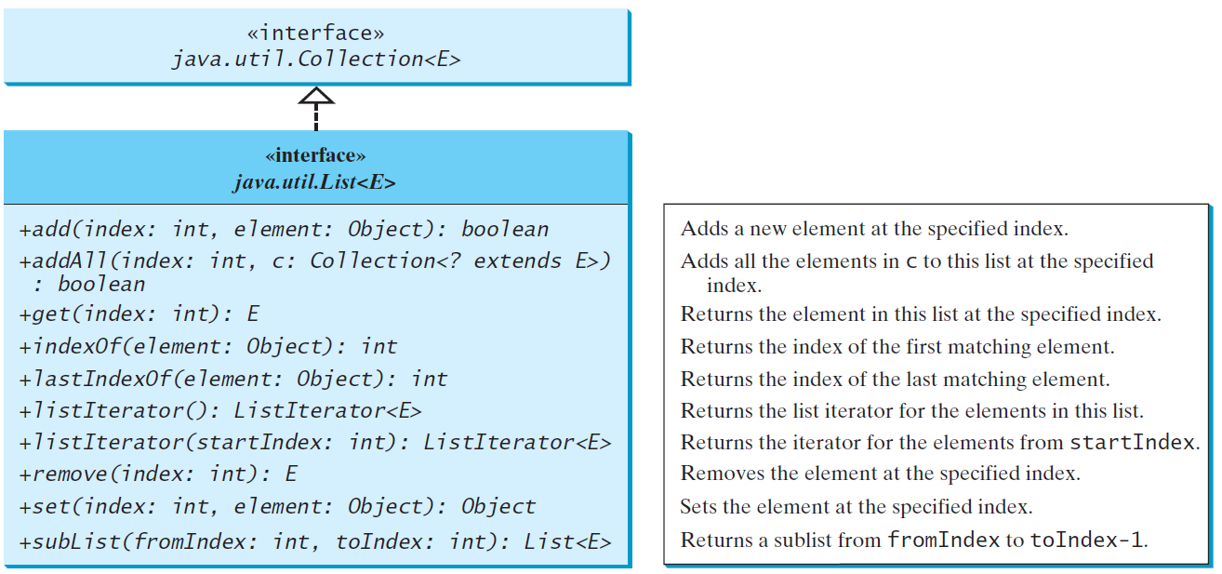
The List Interface, cont.

Slide 11
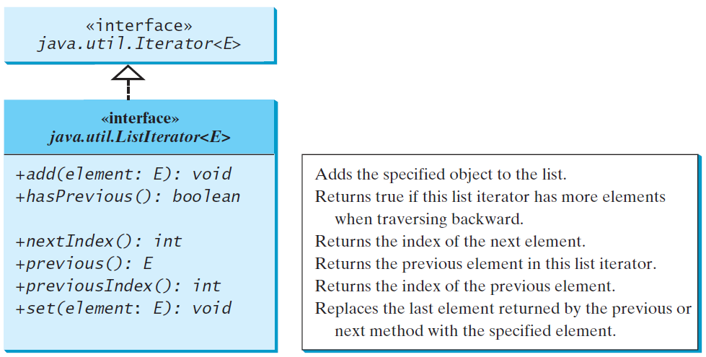
The List Iterator

Slide 12
ArrayList and LinkedList
The ArrayList class and the LinkedList class are concrete implementations of the List interface. Which of the two classes you use depends on your specific needs. If you need to support random access through an index without inserting or removing elements from any place other than the end, ArrayList offers the most efficient collection. If, however, your application requires the insertion or deletion of elements from the beginning of the list, you should choose LinkedList. A list can grow or shrink dynamically. An array is fixed once it is created. If your application does not require insertion or deletion of elements, the most efficient data structure is the array.

Slide 13
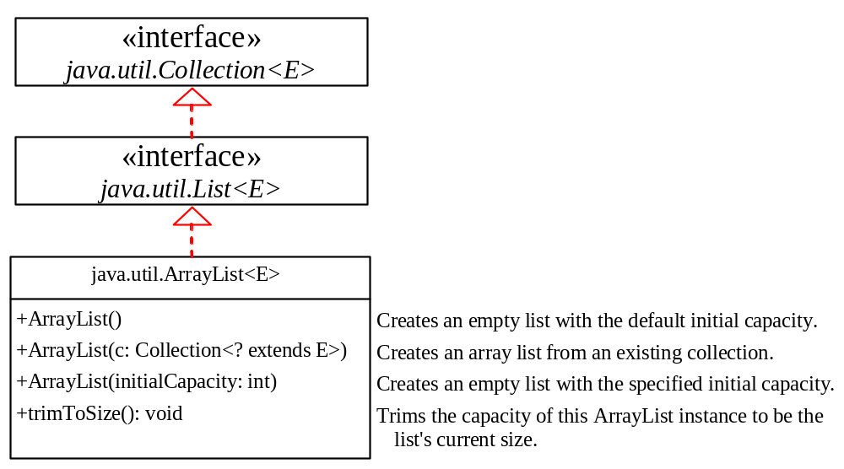
java.util.ArrayList

Slide 14
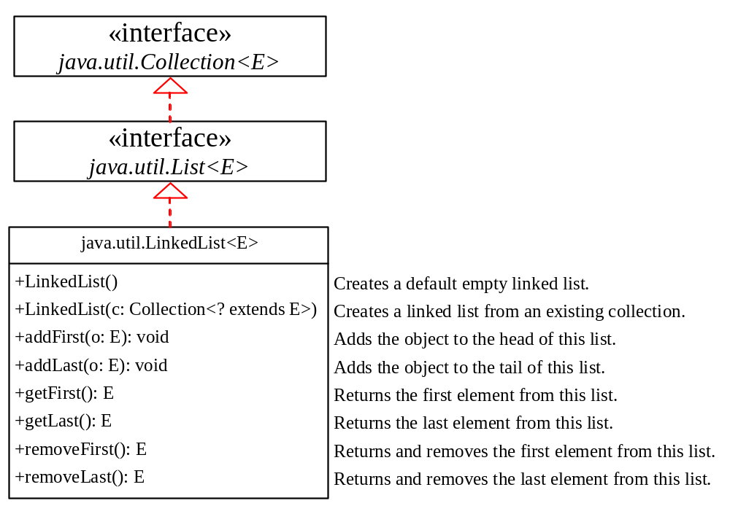
java.util.LinkedList

Slide 15
Example: Using ArrayList and LinkedList
This example creates an array list filled with numbers, and inserts new elements into the specified location in the list. The example also creates a linked list from the array list, inserts and removes the elements from the list. Finally, the example traverses the list forward and backward.
TestArrayAndLinkedList

Slide 16
The Comparator Interface
You have learned to compare objects using the Comparable interface. What happens if the objects are not instances of Comparable. You can define a comparator to compare these elements.
The Comparator interface has the compare method for comparing two objects.

Slide 17
The Comparator<T> Interface
public int compare(T element1, T element2)
Returns a negative value if element1 is less than element2, a positive value if element1 is greater than element2, and zero if they are equal.
GeometricObjectComparator
TestComparator

Slide 18
Using Lambda Expression in Comparator
Comparator is a functional interface. It has just a single method, compare. We can use lambda expression to simplify coding.

Slide 19
Other Comparator Examples
SortStringByLength
SortStringIgnoreCase

Slide 20
Method Reference
String::compareToIgnoreCase
is known as method reference, which is equivalent to the lambda expression:
(s1, s2) -> s1.compareToIgnoreCase(s2)
The compiler automatically translates a method reference to an equivalent lambda expression.

Slide 21
The comparing Method
You can use the static comparing method in the Comparator interface to create a comparator.
For example, the following code sorts a list of loans based on their loan amount property.
Loan[] list = {new Loan(5.5, 10, 2323), new Loan(5, 10, 1000)};
Arrays.sort(list, Comparator.comparing(Loan::getLoanAmount));

Slide 22
Add Additional Sort Criteria
You can sort using a primary criteria, second, third, and so on using the Comparator’s default thenComparing method.
Loan[] list = {new Loan(5.5, 10, 100), new Loan(5, 10, 1000)};
Arrays.sort(list, Comparator.comparing(Loan::getLoanAmount)
.thenComparing(Loan::getAnnualInterestRate));

Slide 23
The Collections Class
The Collections class contains various static methods for performing common operations in a collection and a list.

Slide 24
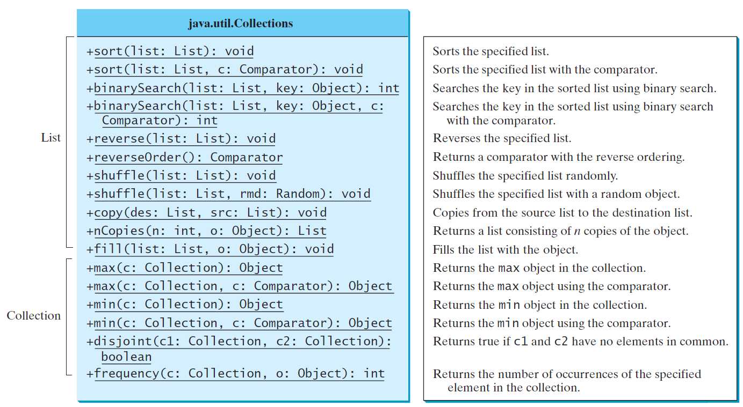
The Collections Class UML Diagram

Slide 25
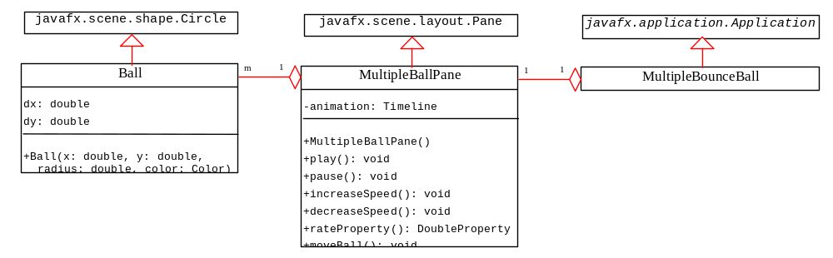
Case Study: Multiple Bouncing Balls
MultipleBounceBall

Slide 26
The Vector and Stack Classes
The Java Collections Framework was introduced with Java 2. Several data structures were supported prior to Java 2. Among them are the Vector class and the Stack class. These classes were redesigned to fit into the Java Collections Framework, but their old-style methods are retained for compatibility. This section introduces the Vector class and the Stack class.

Slide 27
The Vector Class
The Vector class is replaced by the ArrayList.
Vector contains the synchronized methods for accessing and modifying the vector. It is not efficient for most of the applications.
You may encounter Vector in the legacy Java code.

Slide 28
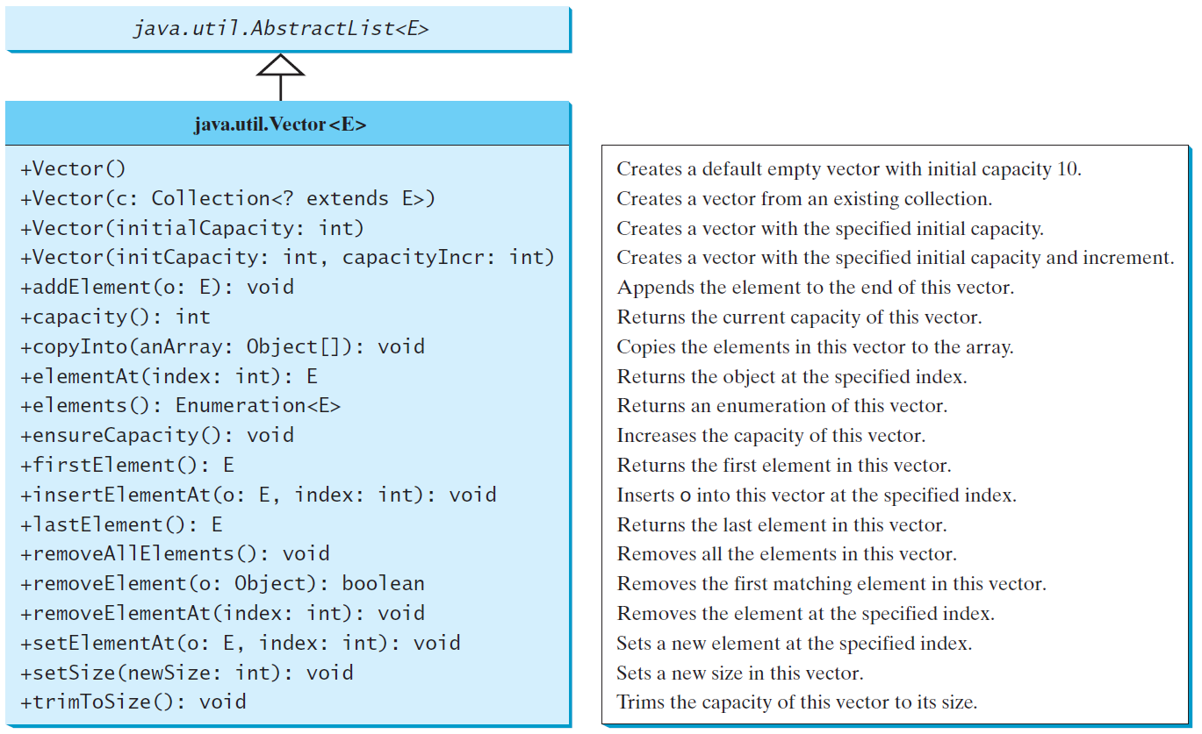
The Vector Class, cont.

Slide 29
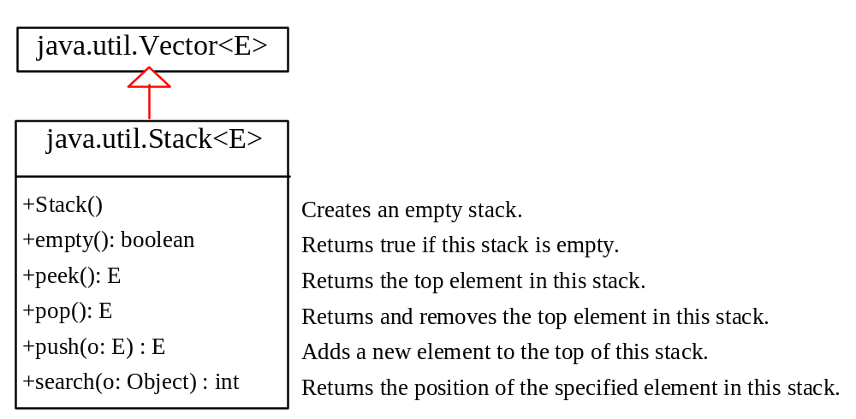
The Stack Class
The Stack class represents a last-in-first-out stack of objects. The elements are accessed only from the top of the stack. You can retrieve, insert, or remove an element from the top of the stack.

Slide 30
Queues and Priority Queues
A queue is a first-in/first-out data structure. Elements are appended to the end of the queue and are removed from the beginning of the queue. In a priority queue, elements are assigned priorities. When accessing elements, the element with the highest priority is removed first.

Slide 31
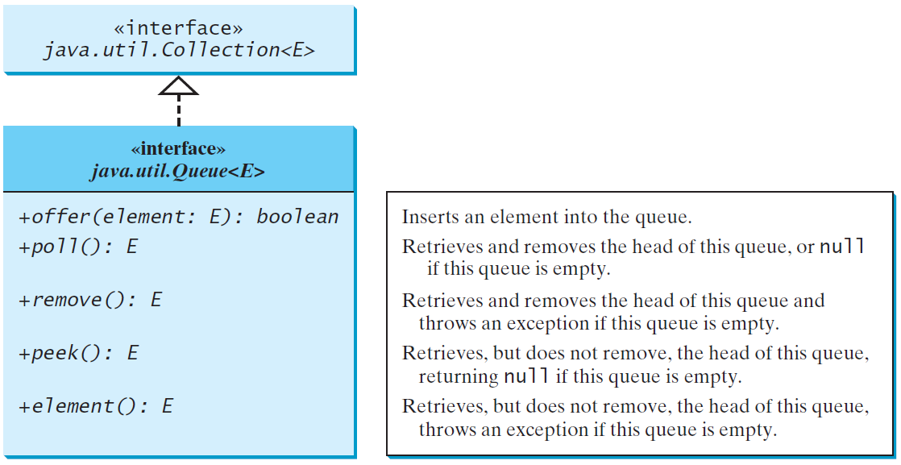
The Queue Interface

Slide 32
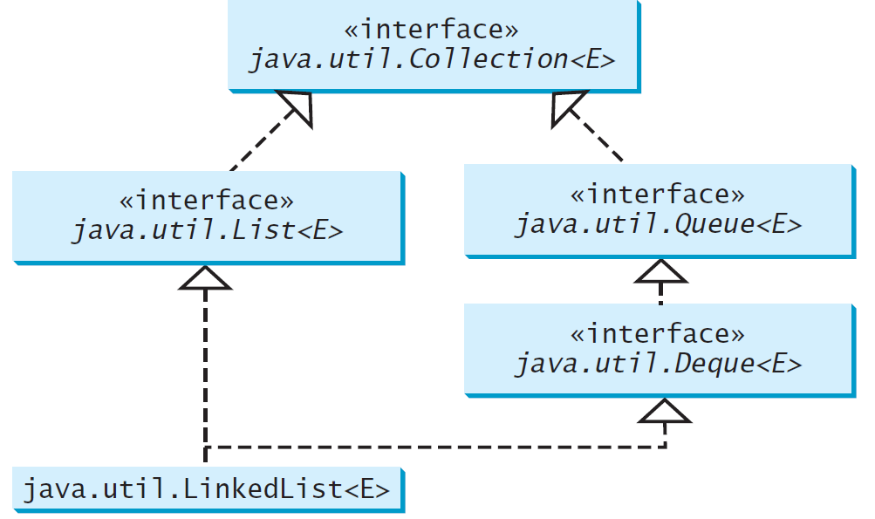
Using LinkedList for Queue

Slide 33
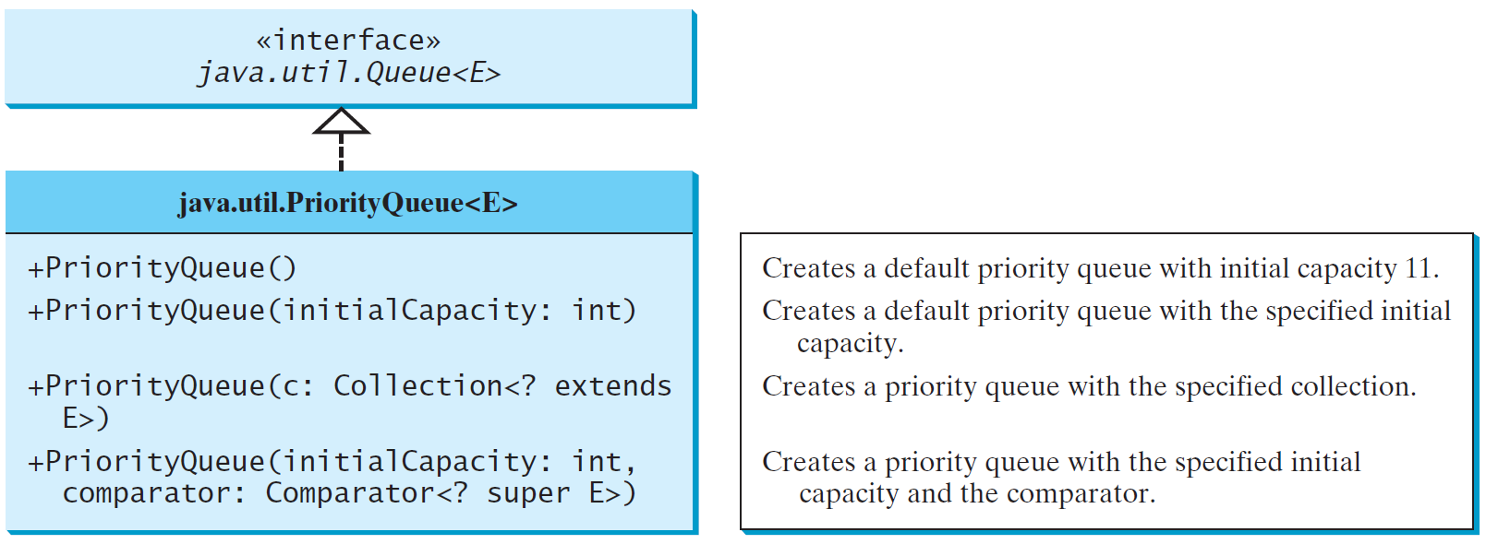
The PriorityQueue Class
PriorityQueueDemo

Slide 34
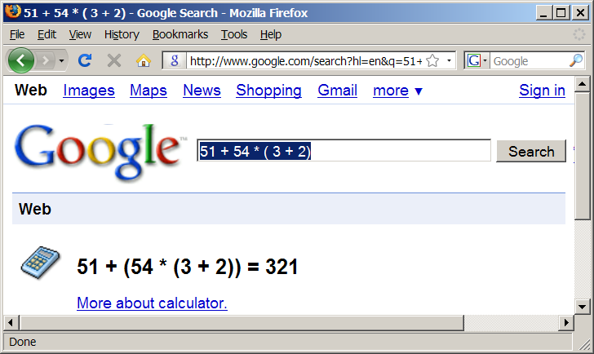
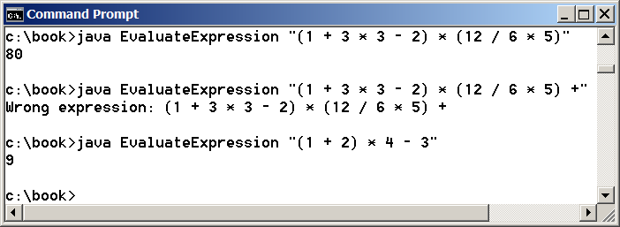
Case Study: Evaluating Expressions
Stacks can be used to evaluate expressions.
Evaluate Expression

Slide 35
Algorithm
Phase 1: Scanning the expression
The program scans the expression from left to right to extract operands, operators, and the parentheses.
1.1. If the extracted item is an operand, push it to operandStack.
1.2. If the extracted item is a + or - operator, process all the operators at the top of operatorStack and push the extracted operator to operatorStack.
1.3. If the extracted item is a * or / operator, process the * or / operators at the top of operatorStack and push the extracted operator to operatorStack.
1.4. If the extracted item is a ( symbol, push it to operatorStack.
1.5. If the extracted item is a ) symbol, repeatedly process the operators from the top of operatorStack until seeing the ( symbol on the stack.
Phase 2: Clearing the stack
Repeatedly process the operators from the top of operatorStack until operatorStack is empty.

Slide 36
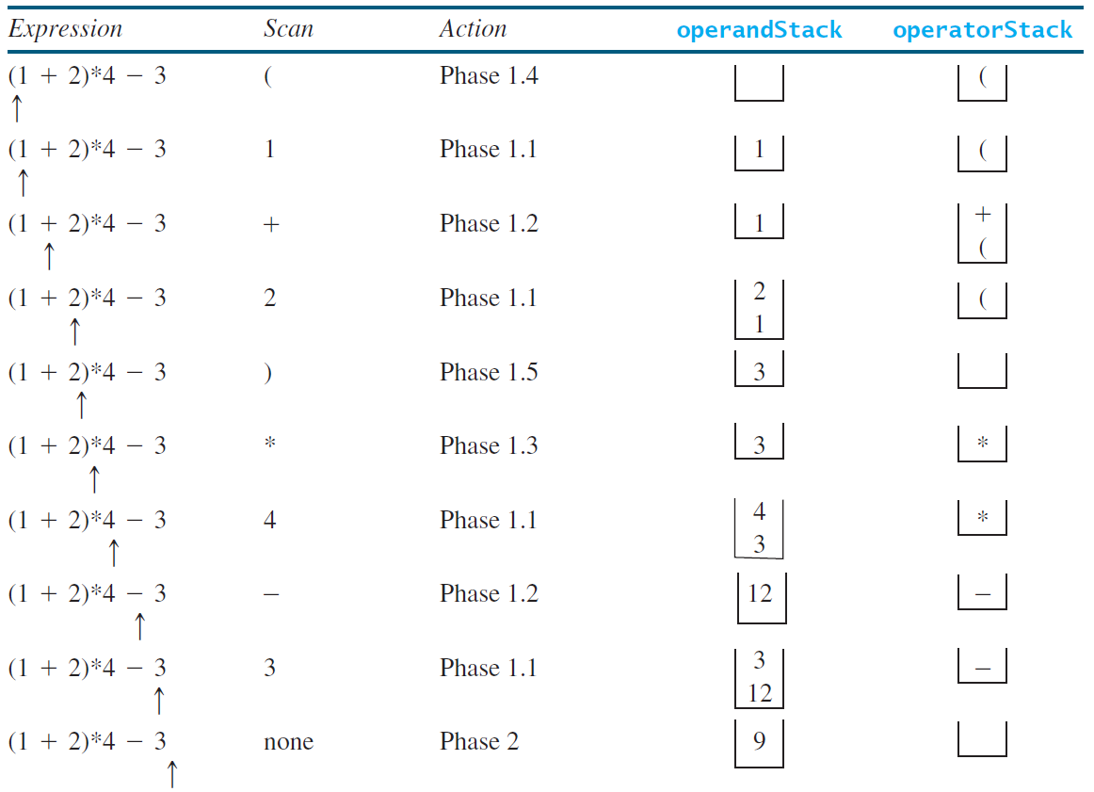
Example

