Slide 1


Java Programming I
Cist2371 – lesson5 (Loops – (Repeating structures))

Slide 2
Objectives
To write programs for executing statements repeatedly using a while loop (§5.2).
To follow the loop design strategy to develop loops (§§5.2.1–5.2.3).
To control a loop with a sentinel value (§5.2.4).
To obtain large input from a file using input redirection rather than typing from the keyboard (§5.2.5).
To write loops using do-while statements (§5.3).
To write loops using for statements (§5.4).
To discover the similarities and differences of three types of loop statements (§5.5).
To write nested loops (§5.6).
To learn the techniques for minimizing numerical errors (§5.7).
To learn loops from a variety of examples (GCD, FutureTuition, Dec2Hex) (§5.8).
To implement program control with break and continue (§5.9).
To write a program that displays prime numbers (§5.11).

Slide 3
Motivations
Suppose that you need to print a string (e.g., "Welcome to Java!") a hundred times. It would be tedious to have to write the following statement a hundred times:
System.out.println("Welcome to Java!");
So, how do you solve this problem?
3

Slide 4
Opening Problem
Problem:
System.out.println("Welcome to Java!");
System.out.println("Welcome to Java!");
System.out.println("Welcome to Java!");
System.out.println("Welcome to Java!");
System.out.println("Welcome to Java!");
System.out.println("Welcome to Java!");
…
…
…
System.out.println("Welcome to Java!");
System.out.println("Welcome to Java!");
System.out.println("Welcome to Java!");
100 times
4
4

Slide 5
Opening Problem
Answer:
Loops are constructs that control repeated executions of a block of statements. The concept of looping is fundamental to programming. Java provides three types of loop statements: while loops, do-while loops, and for loops.
5
5

Slide 6
Looping Design Strategies
Identify statements that need to be repeated
Wrap those statements in the loop
Add the logic that controls the loop
Evaluated conditions
User Input controlled loops
Sentinel Value controlled loops
6
6

Slide 7
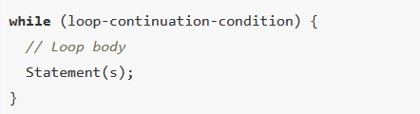
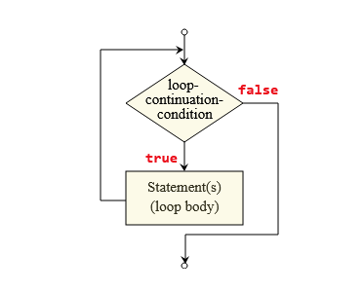
Introducing while Loops
Syntax:
Each execution of the loop body is called an iteration.
Notes:
Speak to the syntax –
The while keyword, the Boolean evaluation to true, open parens, loop body, and closed parens
Next discuss the flowchar

Slide 8
Introducing while Loops
Loop continuation condition
int count = 0;
while (count < 100) {
System.out.println("Welcome to Java");
count++;
}
Loop body
Notes:
Speak to the syntax –
The while keyword, the Boolean evaluation to true, open parens, loop body, and closed parens
Next speak to the code and show the example in the code.

Slide 9
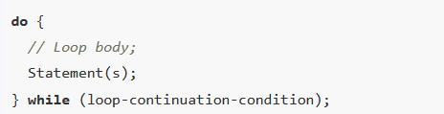
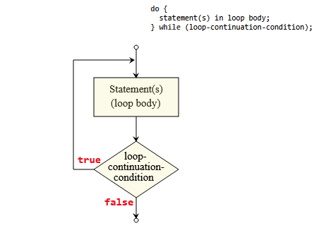
Introducing do-while Loops
Syntax:
Notes:
Speak to the syntax –
TestDoWhile.java

Slide 10
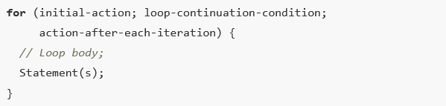
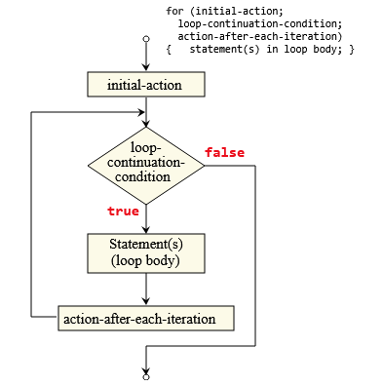
Introducing for Loops
Syntax:
Notes:
Speak to the syntax –
TestDoWhile.java

Slide 11
Introducing for Loops
int i;
for (i = 0; i < 100; i++) {
System.out.println("Welcome to Java!");
}
OR
for (int i = 0; i < 100; i++) {
System.out.println("Welcome to Java!");
}
Notes:
Speak to the syntax –
TestDoWhile.java

Slide 12
Which Loop to Use?
The three forms of loop statements, while, do-while, and for, are expressively equivalent; that is, you can write a loop in any of these three forms. For example, a while loop in (a) in the following figure can always be converted into the following for loop in (b):
A for loop in (a) in the following figure can generally be converted into the following while loop in (b) except in certain special cases (see Review Question 3.19 for one of them):

Slide 13
Recommendations
Use the one that is most intuitive and comfortable for you. In general, a for loop may be used if the number of repetitions is known, as, for example, when you need to print a message 100 times. A while loop may be used if the number of repetitions is not known, as in the case of reading the numbers until the input is 0. A do-while loop can be used to replace a while loop if the loop body has to be executed before testing the continuation condition.

Slide 14
Nested Loops
Nested loops consist of an outer loop and one or more inner loops. Each time the outer loop is repeated, the inner loops are reentered, and started anew.
False
True
False
True
Notes:
Speak to the syntax –
TestDoWhile.java

Slide 15
Minimizing Numerical Errors
Numeric errors involving floating-point numbers are inevitable. This section discusses how to minimize such errors through an example.
Here is an example that sums a series that starts with 0.01 and ends with 1.0. The numbers in the series will increment by 0.01, as follows: 0.01 + 0.02 + 0.03 and so on.
TestSum

Slide 16
Keywords break and continue additional controls in a loop.
use break in a loop to immediately terminate the loop.
continue ends the current iteration and program control goes to the end of the loop body.

Slide 17
Guessing Number Problem Revisited
Here is a program for guessing a number. You can rewrite it using a break statement.

Slide 18
Problem: Checking Palindrome
A string is a palindrome if it reads the same forward and backward. The words “mom,” “dad,” and “noon,” for instance, are all palindromes.
The problem is to write a program that prompts the user to enter a string and reports whether the string is a palindrome. One solution is to check whether the first character in the string is the same as the last character. If so, check whether the second character is the same as the second-to-last character. This process continues until a mismatch is found or all the characters in the string are checked, except for the middle character if the string has an odd number of characters.
Palindrome

Slide 19
Problem: Displaying Prime Numbers
Problem: Write a program that displays the first 50 prime numbers in five lines, each of which contains 10 numbers. An integer greater than 1 is prime if its only positive divisor is 1 or itself. For example, 2, 3, 5, and 7 are prime numbers, but 4, 6, 8, and 9 are not.
Solution: The problem can be broken into the following tasks:
For number = 2, 3, 4, 5, 6, ..., test whether the number is prime.
Determine whether a given number is prime.
Count the prime numbers.
Print each prime number, and print 10 numbers per line.
PrimeNumber

Slide 20
5.10 (Find numbers divisible by 5 and 6) Write a program that displays all the numbers from 100 to 1,000 (10 per line) that are divisible by 5 and 6. Numbers are separated by exactly one space.
Deliverables:
DivisorProgram.java
DivisorProgram.mp4
JavaNotes.docx (Keypoints from this chapter)

