Slide 1


Java Programming I
Cist2371 – lesson9 (Objects & classes)

Slide 2
Objectives
To describe objects and classes, and use classes to model objects (§9.2).
To use UML graphical notation to describe classes and objects (§9.2).
To demonstrate how to define classes and create objects (§9.3).
To create objects using constructors (§9.4).
To access objects via object reference variables (§9.5).
To define a reference variable using a reference type (§9.5.1).
To access an object’s data and methods using the object member access operator (.) (§9.5.2).
To define data fields of reference types and assign default values for an object’s data fields (§9.5.3).
To distinguish between object reference variables and primitive data type variables (§9.5.4).

Slide 3
Objectives - Cont
To use the Java library classes Date, Random, and Point2D (§9.6).
To distinguish between instance and static variables and methods (§9.7).
To define private data fields with appropriate get and set methods (§9.8).
To encapsulate data fields to make classes easy to maintain (§9.9).
To develop methods with object arguments and differentiate between primitive-type arguments and object-type arguments (§9.10).
To store and process objects in arrays (§9.11).
To create immutable objects from immutable classes to protect the contents of objects (§9.12).
To determine the scope of variables in the context of a class (§9.13).
To use the keyword this to refer to the calling object itself (§9.14).

Slide 4
9.1 Introduction to OOP
Object-oriented programming(OOP) enables you to develop large-scale software and GUIs effectively.
Notes:
Show the example of adding a range

Slide 5
9.2 Defining Classes for Objects
OOP involves programming using objects
Objects has properties and behaviors
Objects are derived from Classes
A class is a template, blueprint, or contract that defines what an object’s data fields and methods will be.
An object is an instance of a class.
Many instances of a class can be created.
Creating an instance is referred to as instantiation.
Notes:
Show the example of adding a range

Slide 6
9.2 Defining Classes for Objects
Circle (attributes)
Radius
Diameter
Area
Perimeter
Circle (behaviors)
getArea
getPerimeter
Notes:
Show the example of adding a range

Slide 7
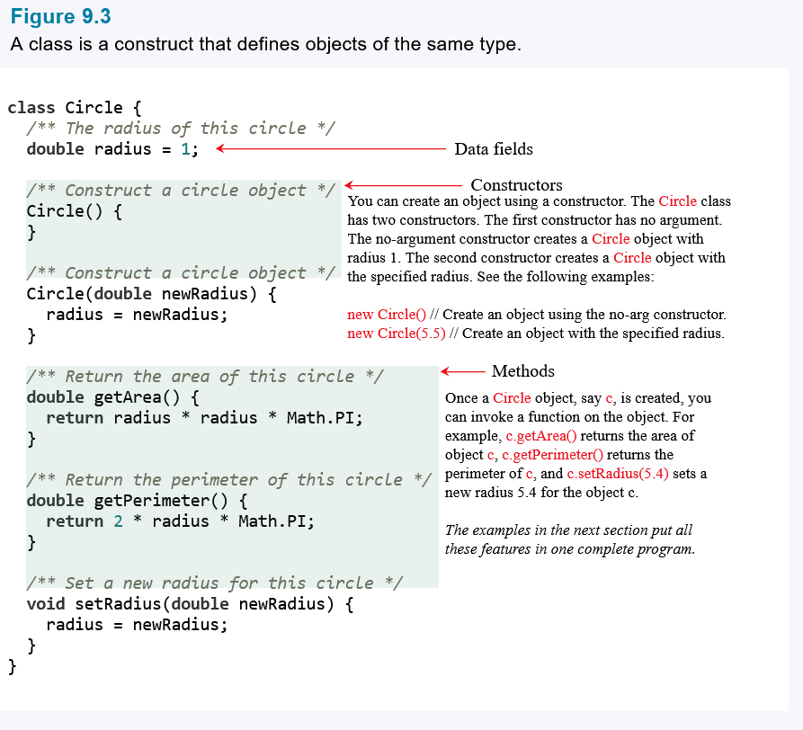
9.2 Defining Classes for Objects
Notes:
Show the example of adding a range

Slide 8
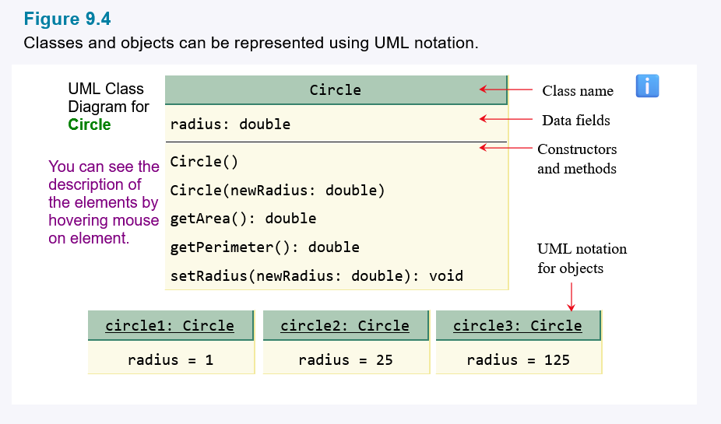
9.2 Defining Classes for Objects
Unified Modeling Language (UML) notation. This notationis called a UML class diagram, or simply a class diagram.
Notes:
Show the example of adding a range

Slide 9
9.3 Defining Classes and Creating Objects
Classes are definitions for objects and objects are created from classes.
Circle.java TestCircle.java TestTV.java
Notes:
Show the example of adding a range

Slide 10
9.4 Constructing Objects Using Constructors
A constructor is invoked to create an object using the new operator
A constructor with no parameters is referred to as a no-arg constructor.
· Constructors must have the same name as the class itself.
· Constructors do not have a return type—not even void.
· Constructors are invoked using the new operator when an object is created. Constructors play the role of initializing objects
Notes:
Show the example of adding a range

Slide 11
9.4 Constructing Objects Using Constructors
A constructor is invoked to create an object using the new operator
public Circle() { } public Circle(double radius) { this.radius = radius; }
public void Circle() { }
This is NOT a contructor;
It is a method
Notes:
Show the example of adding a range

Slide 12
9.5 Accessing Objects via Reference Variables
An objects data and methods can be accessed through the dot(.) operator via the object's reference variable
Scanner input = new Scanner();
input.nextInt();
Double[] scores = new double[10];
scores.length;
Circle circle = new Circle()
circle.getArea();
Notes:
Show the example of adding a range

Slide 13
9.5 Accessing Objects via Reference Variables
An objects data and methods can be accessed through the dot(.) operator via the object's reference variable
Scanner input = new Scanner();
input.nextInt();
instance method
Double[] scores = new double[10];
scores.length;
instance variable
Circle circle = new Circle()
circle.getArea();
instance method
circle.radius
instance variable
Notes:
Show the example of adding a range

Slide 14
9.5 Accessing Objects via Reference Variables
If a data field of a reference type does not reference any object, the data field holds a special Java reserved value, null.
Student.java
Notes:
Show the example of adding a range

Slide 15
9.5 Primitive Data Types vs. Reference Type
int i = 7;
int j = 9
i = j;
Circle c1 = new Circle();
Circle c2 = new Circle();
c1 = c2;
c1
c1
c2
c2
Notes:
Show the example of adding a range

Slide 16
9.6 Using Classes from the Java Library
LocalDate vs. Date
LocalDate is the modernized version of the Date utility
Math.random() vs java.util.Random
Math.random() | Java.util.Random
Double only | Int, double, long, float, boolean
Manual Scaling | Built-Ins (nextInt)
 | Instance based
JavaDateObjs.java
Notes:
Show the example of adding a range

Slide 17
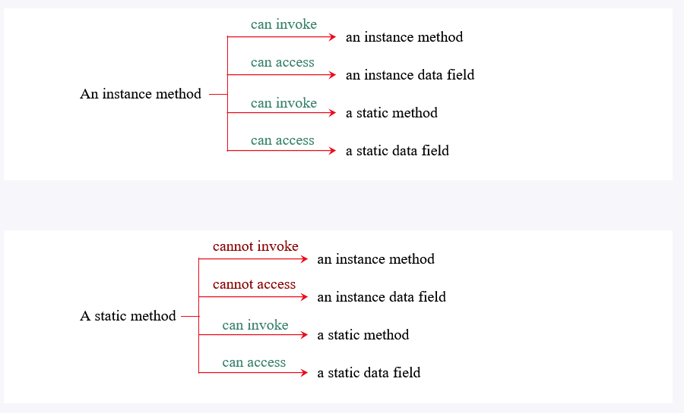
9.7 Static Variables, Constants, and Methods
A static variable is shared by all objects of a class. A static method cannot access instance members of a class
TestCircle.java
StaticCircle.java
Notes:
Show the example of adding a range

Slide 18
9.8 Visibility Modifiers
Visibility Modifiers can be used to specify the visibility of a class and its members
No Visibility – package level access
Public – visibility from any other class
Private – visibility of fields and methods from within its own class
Protected – Chapter 11
Notes:
Show the example of adding a range

Slide 19
9.9 Data Field Encapsulation
Making data fields private protects data and makes the class easy to maintain.
Refactor Circle.java
Notes:
Show the example of adding a range

Slide 20
9.10 Passing Objects to Method
Passing an object to a method is to pass the reference to the object.
Refactor Circle.java
Notes:
Show the example of adding a range

Slide 21
9.11 Array of Objects
An array can hold objects as well as primitive-type values.
Circle[] circleArray = new Circle[10];
For(int i=0; i<circleArray.length ; i++){
circleArray[i] = new Circle();
}
TotalArea.java
Notes:
Show the example of adding a range

Slide 22
9.12 Immutable Objects and Classes
You can define immutable classes to create immutable objects. The contents of immutable objects cannot change.
Class fields are marked private
No setter method
Data initialization happens within the constructor
Istudent.java
Notes:
Show the example of adding a range

Slide 23
9.13 Variable Scope
The scope of instance and static variable is the entire class, regardless of where the variables are declared.
Declare data fields and methods first by convention
Local variable can have the same name as a class variable
Local variable reference takes precedence (variable hiding)
F.java
Notes:
Show the example of adding a range

Slide 24
9.14 The this Reference
The keyword this refers to the calling object. It can be used inside a constructor to invoke another constructor of the same class
This can be used to reference and objects instance members in a class
Needed to reference
data fields hidden by a method or constructor parameter
Invoke overloaded constructors
Notes:
Show the example of adding a range

Slide 25
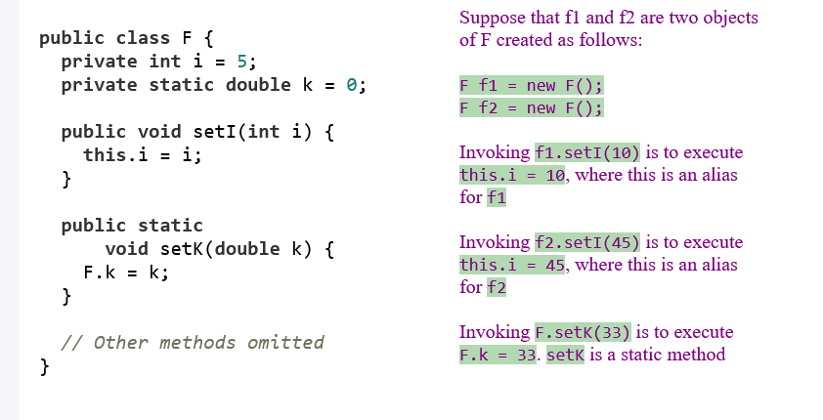
9.14 The this Reference
Referencing hidden data fields
Notes:
Show the example of adding a range

Slide 26
9.14 The this Reference
Invoking other constructors(Chaining)
Notes:
Show the example of adding a range

Slide 27
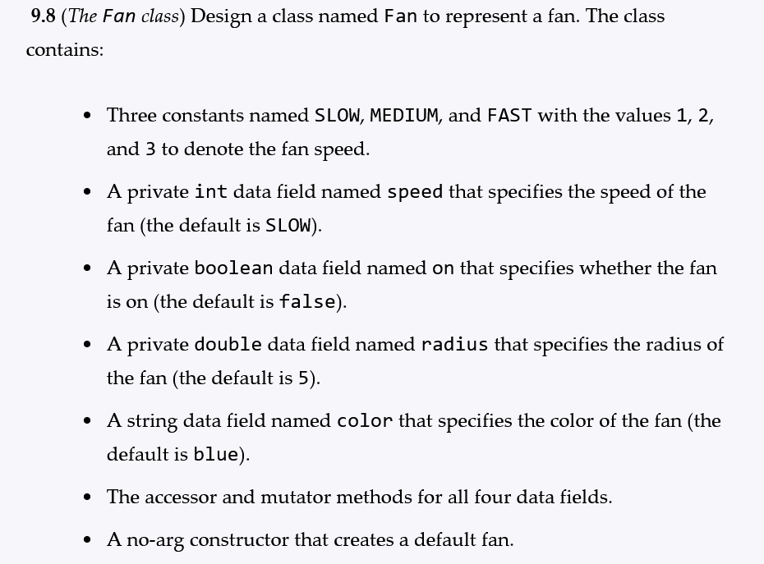
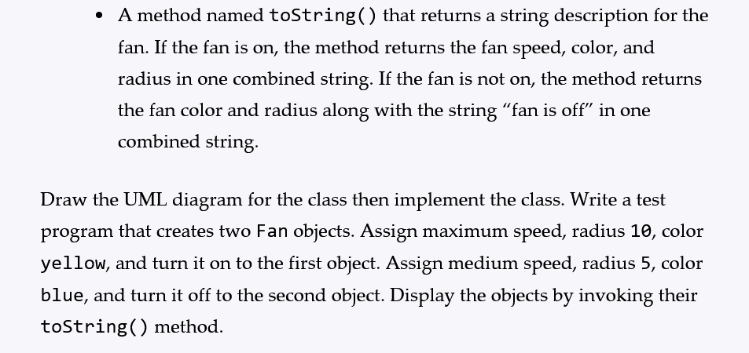
Class Lab

