Slide 1


Java Programming I
Cist2371 – lesson2 (elementary programming)

Slide 2
2.1 Introduction
The focus of this chapter is on learning elementary programming techniques to solve problems using:
primitive data types
variables
constants
operators
expressions
input and output.

Slide 3
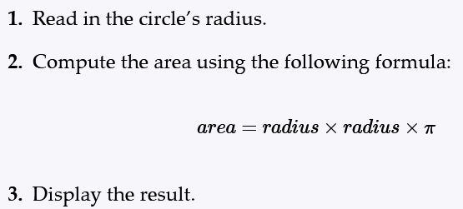
2.2 Writing a simple program
Writing a program involves designing a strategy for solving the problem then using a programming language to implement that strategy.
Designing an algorithm
Problem: Design an application that computes the area of a circle.
Algorithm: Pseudocode that outlines the application workflow
Notes:
Go to the coding exercise.
Foundational components of a simple class
Discuss data types
Tracing code

Slide 4
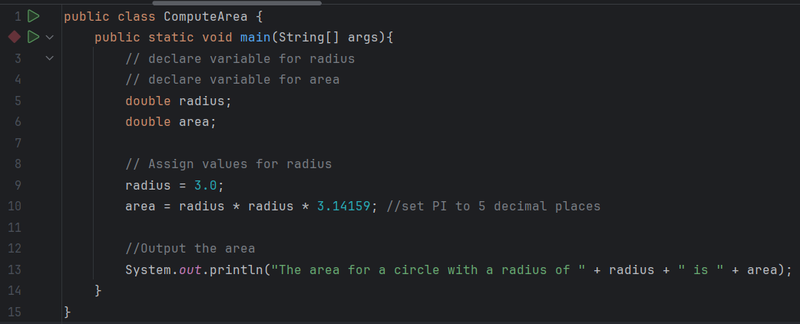
2.2 Writing a simple program
Notes:
Go to the coding exercise.
Foundational components of a simple class
Discuss data types
Tracing code

Slide 5
2.3 Reading input from the console
Reading input from the console enables the program to accept input from the user.
Java achieves this using the Scanner object
Importing packages allows java to use objects outside the base package
Notes:
Go to the coding exercise.
Discuss import and packages
Discuss object instances

Slide 6
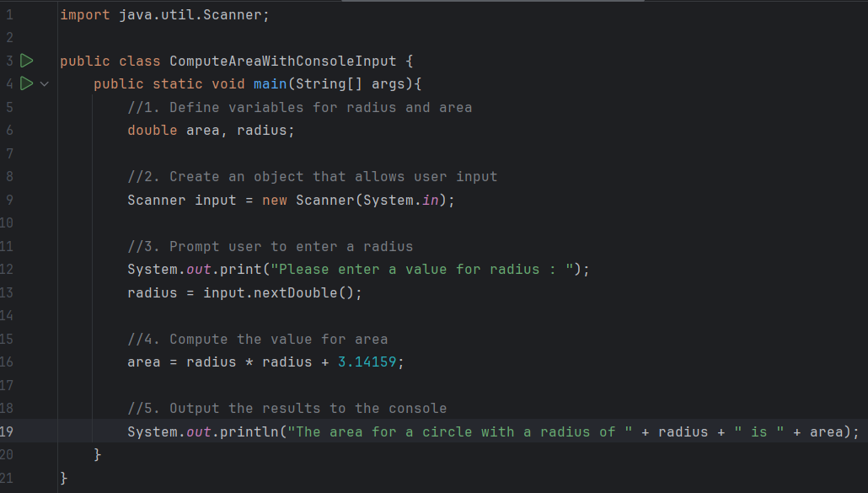
2.3 Reading input from the console
Import statements
Creating new object
Input from a console

Slide 7
2.4 Identifiers
Identifiers are the names that identify the elements such as classes, methods, and variables in a program.
An identifier is a sequence of characters that consists of letters, digits, underscores (_), and dollar signs ($).
An identifier must start with a letter, an underscore (_), or a dollar sign ($). It cannot start with a digit.
An identifier cannot be a reserved word. See Appendix A for a list of reserved words.
An identifier can be of any length.

Slide 8
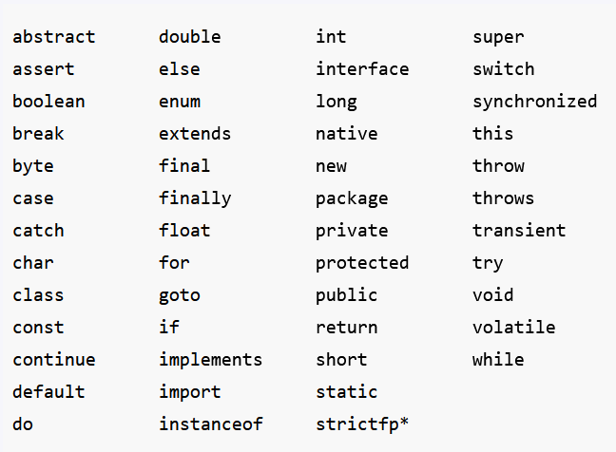










2.4 Identifiers
Java Reserved Words (Appendix A)

Slide 9

2.4 Identifiers
Find the identifiers

Slide 10
2.4 Identifiers
Find the identifiers

Slide 11
2.4 Identifiers
Valid or Invalid?
resultSet
**999
_resultSet
attempt3
0results
$capture

Slide 12
2.5 Variables
Variables are used to represent values that may be changed in the program.
A variable must be declared before it can be assigned a value.
Whenever possible, declare a variable and assign its initial value in one step. This will make the program easy to read and avoid programming errors.

Slide 13
2.5 Variables
Find the Error
1 public class Test {
2 public static void main(String[] args) {
3 int i = k + 2;
4 System.out.println(i);
5 }
6 }
Notes:
Do the coding example and look at the logs

Slide 14
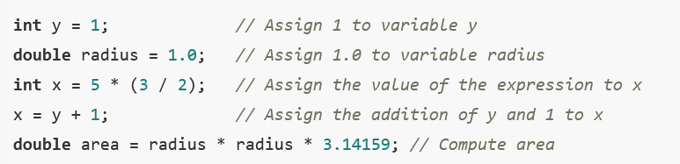


2.6 Assignment statements and Assignment expressions
An assignment statement assigns a value to a variable. An assignment statement can also be used as an expression in Java.
“ = “ is the assignment operator in Java
An expression represents a computation involving values, variables, and operators that, taking them together, evaluates to a value.
Notes:
Go to the coding exercise.
Discuss import and packages
Discuss object instances

Slide 15

2.7 Named Constants
A named constant is an identifier that represents a permanent value.
A constant must be declared and initialized in the same statement. The word final is a Java keyword for declaring a constant.
Notes:
Go to the coding exercise.
Discuss import and packages
Discuss object instances

Slide 16
2.8 Naming Conventions
Sticking with the Java naming conventions makes your programs easy to read and avoids errors.
Choose descriptive names with straightforward meanings for the variables, constants, classes, and methods in your program.
Use lowercase for variables and methods—for example, the variables and , and the method . If a name consists of several words, concatenate them into one, making the first word lowercase and capitalizing the first letter of each subsequent word—for example, the variable . This naming style is known as the camelCase because the uppercase characters in the name resemble a camel’s humps.
Capitalize the first letter of each word in a class name—for example, the class names and .
Capitalize every letter in a constant

Slide 17
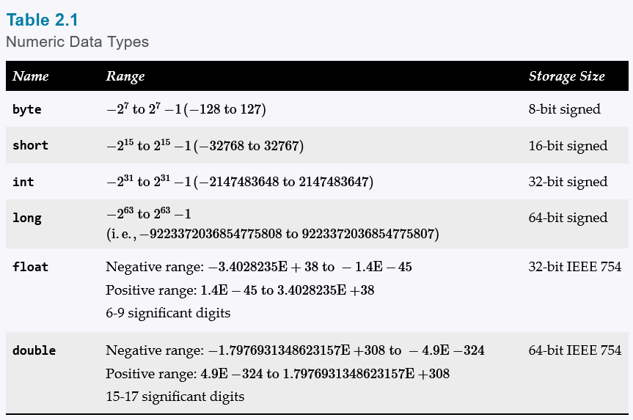
2.8 Numeric Data Types and Operations
Java has six numeric types for integers and floating-point numbers with operators +, -, *, /, and %.

Slide 18
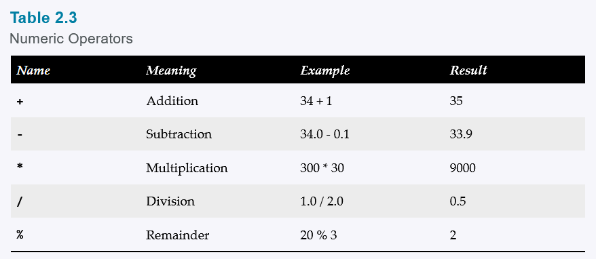
2.9.2 Numeric Operations
Java has six numeric types for integers and floating-point numbers with operators +, -, *, /, and %.

Slide 19
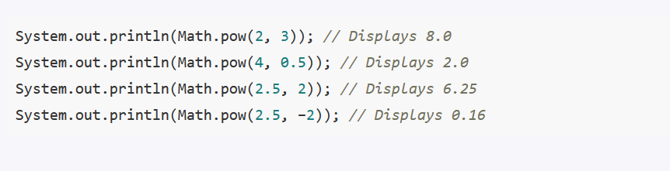
2.9.3 Exponent Operations
Math.pow(a, b) raises a to the b power.

Slide 20
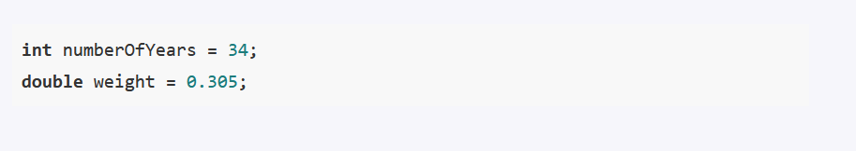
2.10 Numeric Literals
A literal is a constant value that appears directly in a program.
Can be used for all numeric datatypes

Slide 21
2.11 JShell
JShell is a command line tool for quickly evaluating an expression and executing a statement.
Can be launched from the command line
Integrated into IntelliJ

Slide 22
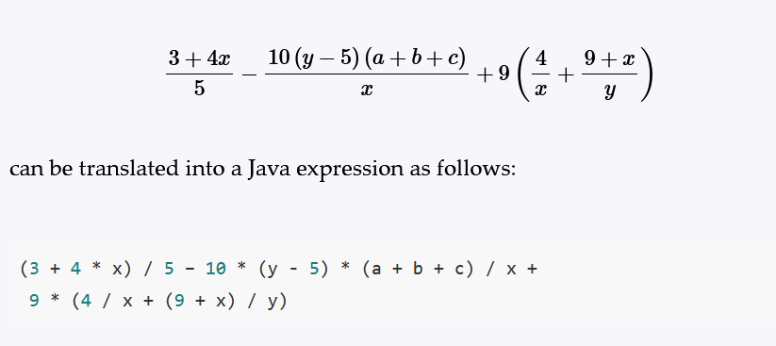
2.12 Evaluating Expressions and Operator Precedence
Java expressions are evaluated in the same way as arithmetic expressions.
Multiplication, division, and remainder operators are applied first. If an expression contains several multiplication, division, and remainder operators, they are applied from left to right.
Addition and subtraction operators are applied last. If an expression contains several addition and subtraction operators, they are applied from left to right.
Notes:
Do F to C exercise.

Slide 23


2.14 Augmented Assignment Operators
The operators +, - , *, / and % can be combined with the assignment operator to form augmented operators.
Java allows you to combine assignment and addition operators using an augmented (or compound) assignment operator.
Notes:
Do F to C exercise.

Slide 24
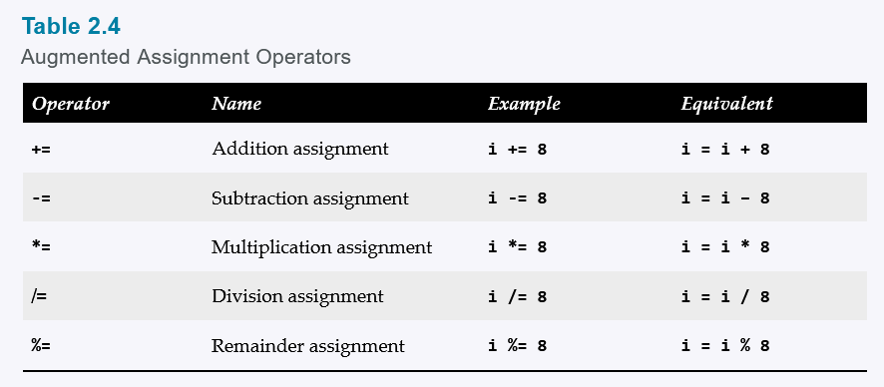
2.14 Evaluating Expressions and Operator Precedence
Notes:
Do F to C exercise.

Slide 25
2.14 Evaluating Expressions and Operator Precedence
The augmented assignment operator is performed last after all the other operators in the expression are evaluated
x /= 4 + 5.5 * 1.5;
x = x / (4 + 5.5 * 1.5);
double x = 50;
x /= 4 + 5.5 * 1.5;
System.out.println(“result “ + x);
Notes:
Run the sample code in the scratch pad

Slide 26
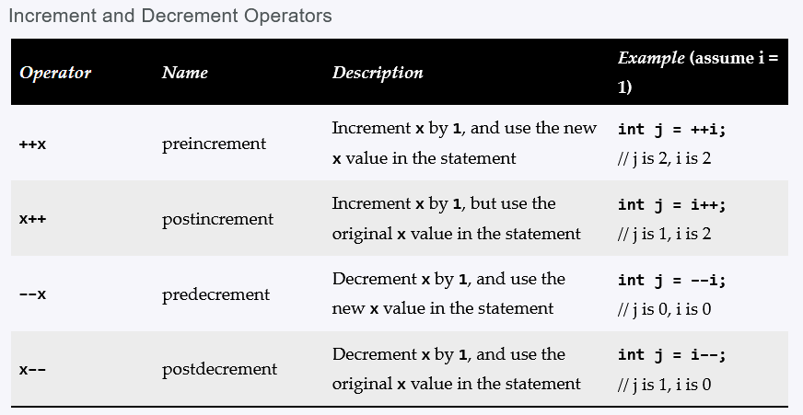
2.15 Increment and Decrement Operators
The increment operator (+ +) and decrement operator (- -) are for incrementing and decrementing a variable by 1.
Postfix operations are pronounced as “i plus plus” or “i minus minus”
Prefix operations evaluate first and updates the variable

Slide 27
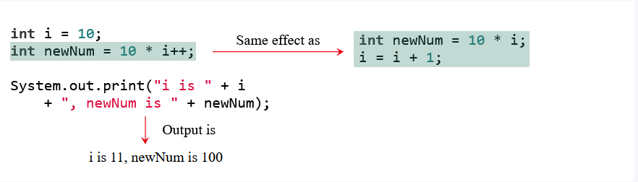
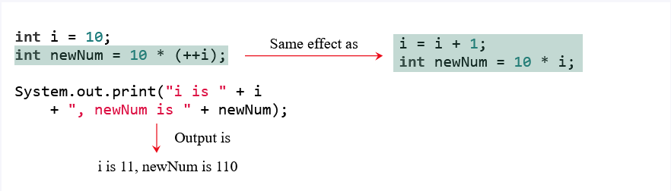
2.15 Increment and Decrement Operators

Slide 28
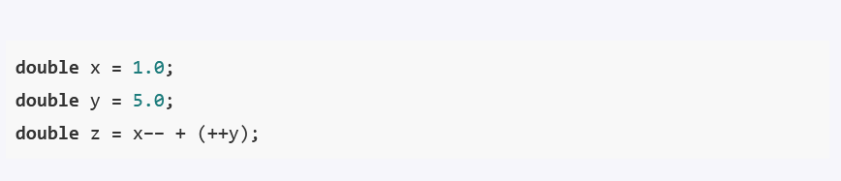
2.15 Increment and Decrement Operators
x = 0.0
y = 6.0
z = 7.0

Slide 29
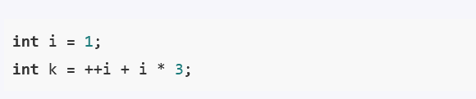
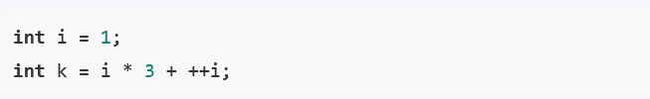
2.15 Increment and Decrement Operators
k = 8
k = 5

Slide 30
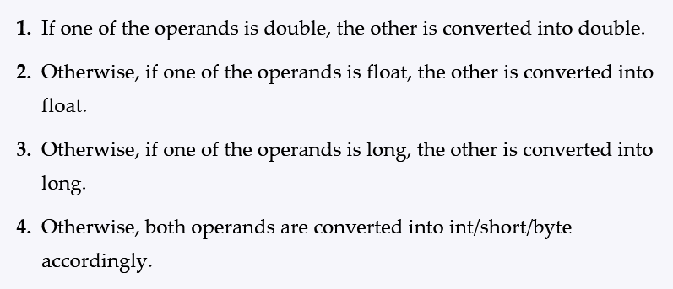
2.16 Numeric Type Conversions and Casting
Floating-point numbers can be converted into integers using explicit casting.

Slide 31
2.16 Numeric Type Conversions and Casting
Casting is an operation that converts a value of one data type into a value of another data type.
Casting a type with a small range to a type with a larger range is known as widening a type.
Casting a type with a large range to a type with a smaller range is known as narrowing a type.

Slide 32
2.16 Numeric Type Conversions and Casting
Casting syntax is achieved by prepending the datatype in parenthesis.
System.out.println((int) 1.7);
System.out.println((double) 1 / 2);

Slide 33
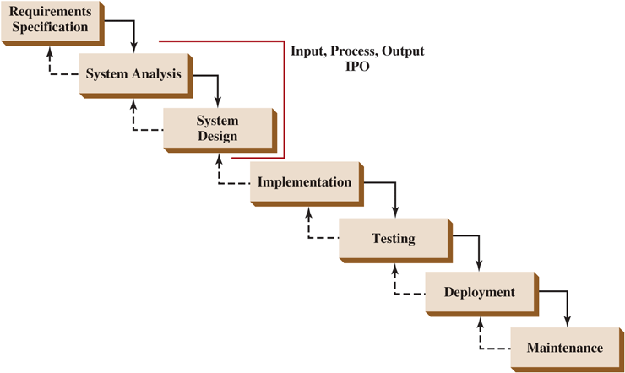
2.17 Software Development Process
The software development life cycle is a multistage process that includes requirements specification, analysis, design, implementation, testing, deployment, and maintenance.

Slide 34
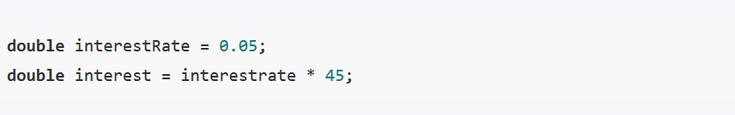
2.19 Common Errors and Pitfalls
Common elementary programming errors often involve undeclared variables, uninitialized variables, integer overflow, unintended integer division, and round-off errors.
Common Error 1: Undeclared/Uninitialized Variables and Unused Variables

Slide 35
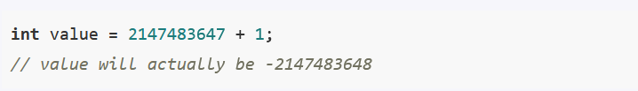
2.19 Common Errors and Pitfalls
Common elementary programming errors often involve undeclared variables, uninitialized variables, integer overflow, unintended integer division, and round-off errors.
Common Error 2: Integer Overflow

Slide 36
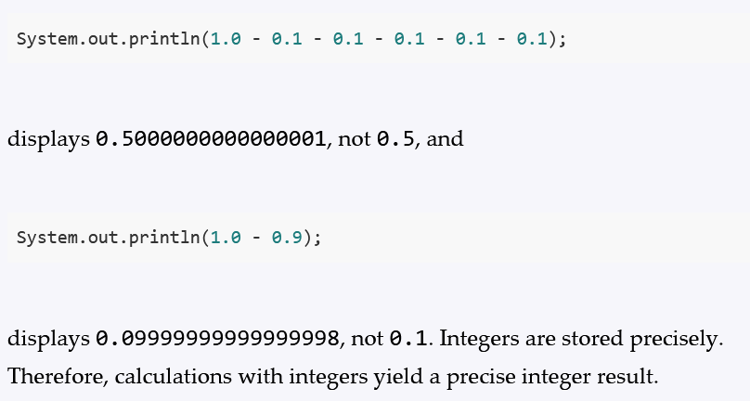
2.19 Common Errors and Pitfalls
Common elementary programming errors often involve undeclared variables, uninitialized variables, integer overflow, unintended integer division, and round-off errors.
Common Error 3: Round-off Errors

Slide 37
2.19 Common Errors and Pitfalls
Common elementary programming errors often involve undeclared variables, uninitialized variables, integer overflow, unintended integer division, and round-off errors.
Common Error 4: Unintended Integer Division
int number1 = 1;
int number2 = 2;
double average = (number1 + number2) / 2;
System.out.println(average); // average is 1
int number1 = 1;
int number2 = 2;
double average = (number1 + number2) / 2.0;
System.out.println(average); // average is 1.5

Slide 38
2.19 Common Errors and Pitfalls
Common elementary programming errors often involve undeclared variables, uninitialized variables, integer overflow, unintended integer division, and round-off errors.
Common Pitfall 1: Redundant Input Objects
Scanner input = new Scanner(System.in);
System.out.print("Enter an integer: ");
int v1 = input.nextInt();
Scanner input1 = new Scanner(System.in); // Bad Code
System.out.print("Enter a double value: ");
double v2 = input1.nextDouble();
Scanner input = new Scanner(System.in);
System.out.print("Enter an integer: ");
int v1 = input.nextInt();
System.out.print("Enter a double value: ");
double v2 = input.nextDouble();

