Slide 1


Java Programming I
Cist2371 – lesson10 (Object oriented thinking)

Slide 2
Objectives
10.1 To apply class abstraction to develop software
10.2 To explore the differences between the procedural paradigm and object-oriented paradigm
10.3 To discover the relationships between classes
10.4 To design programs using the object-oriented paradigm
10.5 To create objects for primitive values using wrapper classes(Byte, Short, Integer, Long, Float, Double, Character, and Boolean.
10.6 To simplify programming using automatic conversion between primitive types and wrapper class types
10.7 To use the BigInteger and BigDecimal classes for computing very large numbers with arbitrary precisions
10.8 The use of the String class to process immutable strings
10.9 To use the StringBuilder and StringBuffer classes to process mutable strings

Slide 3
10.2 Class Abstraction & Encapsulation
Difference between procedural programming and object-oriented programming (OOP)
Class abstraction – hides the details of the implementation
Class encapsulation – Combining methods and data into a single data structure
Notes:
Show the example of adding a range

Slide 4
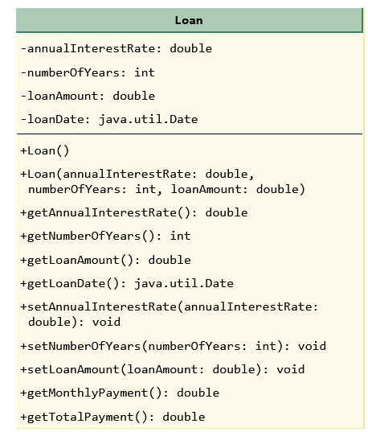
10.2 Class Abstraction & Encapsulation
Code Samples
Notes:
Show the example of adding a range

Slide 5
10.4 Class Relationships
To design classes, you need to explore the relationships among classes. The common relationships among classes are:
association
aggregation
composition
inheritance (Chapter 11).
Notes:
Show the example of adding a range

Slide 6
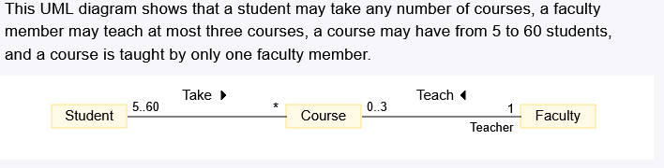
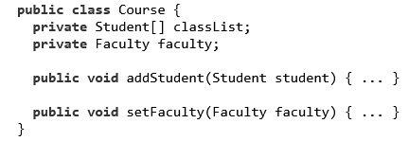
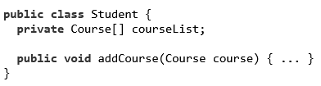
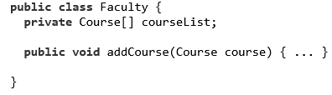
10.4 Class Relationships
Association
Notes:
Show the example of adding a range

Slide 7
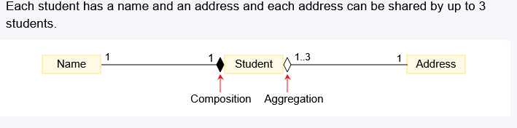



10.4 Class Relationships
Aggregation and Composition
Aggregation represents ownership relationship between two objects (has-a relationships)
Composition the dependency exists between the aggregated and aggregated object
Notes:
Show the example of adding a range

Slide 8
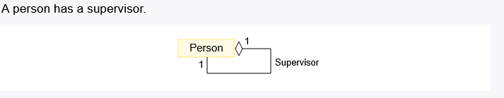
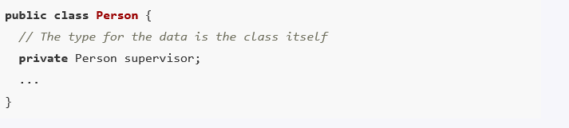
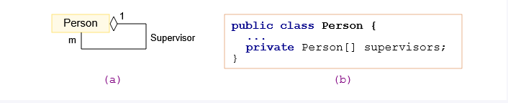
10.4 Class Relationships
Aggregation and Composition
Notes:
Show the example of adding a range

Slide 9
10.7 Wrapper Classes
A primitive-type value is not an object, but it can be wrapped in an object using a wrapper class in the Java API.
Primitive type | Wrapper Class
int | Integer
char | Character
double | Double
float | Float
long | Long
short | Short
byte | Byte
Notes:
Show the example of adding a range

Slide 10
10.9 BigInteger & BigDecimal
The BigDecimal and BigInteger classes can be used to represent integers or decimal numbers of any size and precision.
BigDecimalDemo
Notes:
Show the example of adding a range

Slide 11
10.10 The String object
The String object is immutable; its contents cannot be changes ones the string is created
StringDemo.java
Notes:
Show the example of adding a range

Slide 12
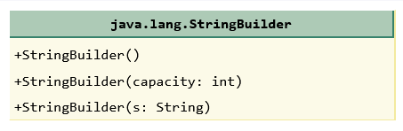
10.11 The StringBuilder and StringBuffer Classes
The StringBuilder and StringBuffer classes are similar to the String class except that the String class is immutable.
Very similar classes
Methods in StringBuffer are synchronized
StringBuilder is good for single tasks
StringBuilderDemo.java
Notes:
Show the example of adding a range

