Slide 1


Java Programming I
Cist2371 – lesson6 (methods)

Slide 2
Objectives
6.1 To define methods with formal parameters (§6.2).
6.2 To invoke methods with actual parameters (i.e., arguments) (§6.2).
6.3 To define methods with a return value (§6.3).
6.4 To define methods without a return value and distinguish the differences between void methods and value-returning methods (§6.4).
6.5 To pass arguments by value (§6.5).
6.6 To develop reusable code that is modular, easy to read, easy to debug, and easy to maintain (§6.6).
6.7 To write a method that converts hexadecimals to decimals (§6.7).
6.8 To use method overloading and understand ambiguous overloading (§6.8).
6.9 To determine the scope of variables (§6.9).
6.10 To apply the concept of method abstraction in software development (§6.10).
6.11 To design and implement methods using stepwise refinement (§6.11).

Slide 3
6.1 Introduction - Methods
A method is a collection of statements grouped together to perform an operation.
Notes:
Show the example of adding a range

Slide 4
6.1 Introduction - Methods
Define reusable code
Organize and simplify coding
Make code easy to maintain
Notes:
Show the example of adding a range

Slide 5
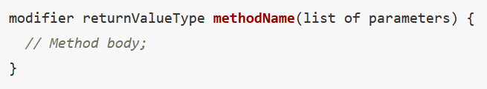
6.2 Defining a Method
A method definition consists of method name, parameters, return value type, and body.
public static int sum(int number1, int number2) {
int result = 0;
for(int i = number1; i <= number2; i++)
result += i;
return result;
}

Slide 6
6.2 Defining a Method
A method definition consists of method name, parameters, return value type, and body.
Modifiers
public static int sum(int number1, int number2) {
int result = 0;
for(int i = number1; i <= number2; i++)
result += i;
return result;
}

Slide 7
6.2 Defining a Method
A method definition consists of method name, parameters, return value type, and body.
ReturnValueType
public static int sum(int number1, int number2) {
int result = 0;
for(int i = number1; i <= number2; i++)
result += i;
return result;
}

Slide 8
6.2 Defining a Method
A method definition consists of method name, parameters, return value type, and body.
Method Name
public static int sum(int number1, int number2) {
int result = 0;
for(int i = number1; i <= number2; i++)
result += i;
return result;
}

Slide 9
6.2 Defining a Method
A method definition consists of method name, parameters, return value type, and body.
List of parameters
public static int sum(int number1, int number2) {
int result = 0;
for(int i = number1; i <= number2; i++)
result += i;
return result;
}

Slide 10
6.2 Defining a Method
A method definition consists of method name, parameters, return value type, and body.
public static int sum(int number1, int number2) {
int result = 0;
for(int i = number1; i <= number2; i++)
result += i;
return result;
}
Method
Body

Slide 11
6.3 Calling a Method
Calling a method executes the code in the method.
Calling/Method Invocation – executes the method
Returns a value OR
int larger = max(3, 4);
Executes a statement
System.out.println(“Welcome to Java”);
Notes:
Demonstrate TestMax.java

Slide 12
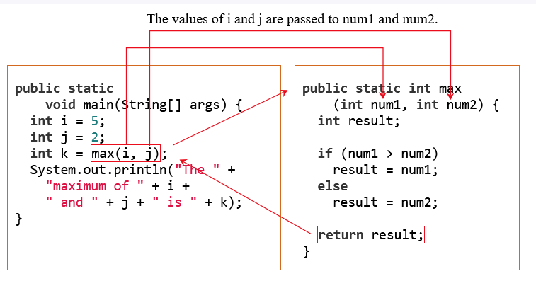
6.3 Calling a Method
Calling a method executes the code in the method.
Notes:
Demonstrate TestMax.java

Slide 13
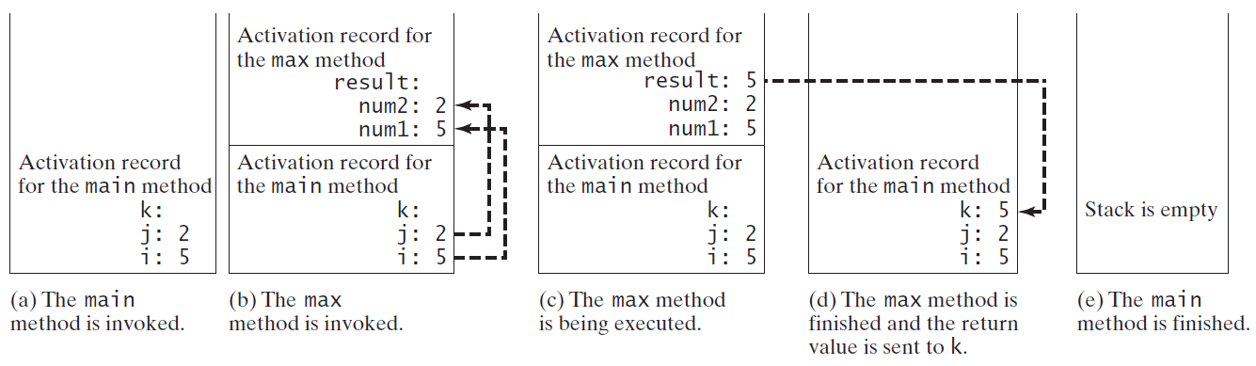
Call Stacks

Slide 14
6.4 void Methods vs. Value-Returning Methods
A void method does not return a value.
Methods do not have to return data back to the caller
These methods use the void return type
Means they don’t return anything
Can still use return keywork to return from a method before reaching the end of the code block
Notes:
Demonstrate PrintGrade.java and PrintGradeWithReturn.java

Slide 15
6.5 Passing Arguments by Values
The arguments are passed by value to parameters when invoking a method.
Parameter order association
The arguments must match the parameters in order, number, and compatible type, as defined in the method signature. Compatible type means you can pass an argument to a parameter without explicit casting, such as passing an int value argument to a double value parameter.
Pass-By-Value
Notes:
Demonstrate TestPassByValue.java

Slide 16
6.6 Modularizing Code
Modularizing makes the code easy to maintain and debug and enables the code to be reused.
Modularity can be achieved by defining methods that perform common operations
Modularity allows code to be reused
Notes:
Demonstrate GreatestCommonDivisor.java and PrimeNumberMethod

Slide 17
6.6 Modularizing Code
Modularizing makes the code easy to maintain and debug and enables the code to be reused.
Modularity can be achieved by defining methods that perform common operations
Modularity allows code to be reused
Notes:
Demonstrate GreatestCommonDivisor.java and PrimeNumberMethod

Slide 18
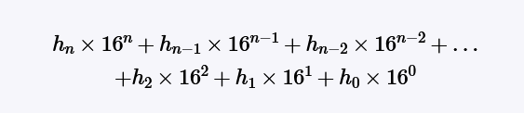
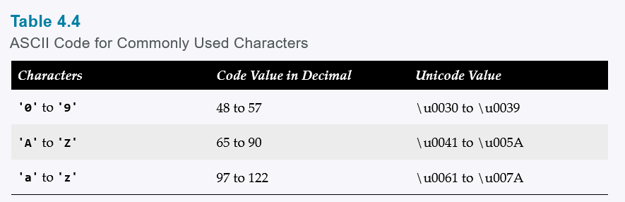
6.7 Case Study: Converting Hexadecimals to Decimals
(hex) F23 = (F*16^2) + (2*16^1) + (3*16^0) =3865(decimal)
Notes:
Demonstrate Hex2Dec

Slide 19
6.8 Overloading Methods
Overloading methods enable you to define the methods with the same name as long as their parameter lists are different.
Overloading - two methods have the same name but different parameter lists within one class.
The Java compiler determines which method to use based on the method signature.
Overloading methods can make programs clearer and more readable.
Overloaded methods must have different parameter lists. You cannot overload methods based on different modifiers or return types.
Ambiguous invocation two or more possible matches for the invocation of a method, but the compiler cannot determine the most specific match.
Notes:
Demonstrate Hex2Dec

Slide 20
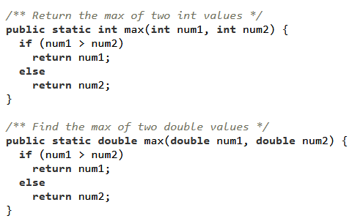
6.8 Overloading Methods
Overloading - two methods have the same name but different parameter lists within one class.
The Java compiler determines which method to use based on the method signature.
Overloading methods can make programs clearer and more readable.
Overloaded methods must have different parameter lists. You cannot overload methods based on different modifiers or return types.
Ambiguous invocation two or more possible matches for the invocation of a method, but the compiler cannot determine the most specific match.
Notes:
Demonstrate TestMethodOverloading.java

Slide 21
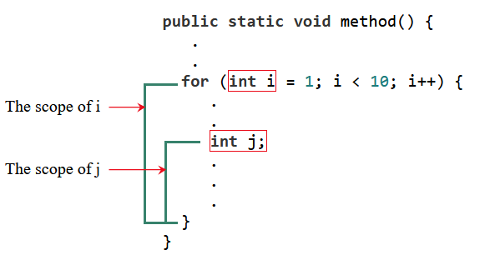
6.9 The Scope of Variables
The scope of a variable is the part of the program where the variable can be referenced.
Local Variables – are defined inside a method
Local Variables must be declared and initialized before they are used
local variables can be declared with the same name in different blocks in a method,
local variables cannot be declared twice in the same block or in nested blocks
Notes:
Demonstrate TestMethodOverloading.java

Slide 22
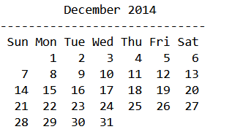
6.11 Method Abstraction and Stepwise Refinement
The key to developing software is to apply the concept of abstraction.
Abstraction - Showing essential features, hiding internal details focuses on what an object does, not how
When writing a large program, you can use the divide-and-conquer strategy, also known as stepwise refinement, to decompose it into subproblems.
Notes:
Demonstrate TestMethodOverloading.java

Slide 23
6.11 Method Abstraction and Stepwise Refinement
Get Input from the user (Year, and monthNumber)
Convert the monthNumber to Month(String)
Print the Calendar
How many days are in the month?
What day of the week does the month start?
Notes:
Demonstrate TestMethodOverloading.java

Slide 24
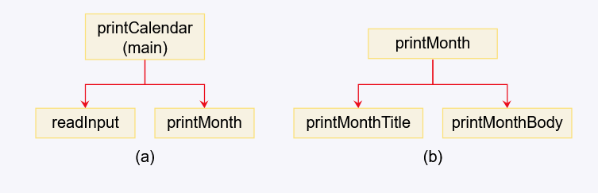
6.11 Method Abstraction and Stepwise Refinement
Notes:
Demonstrate TestMethodOverloading.java

Slide 25
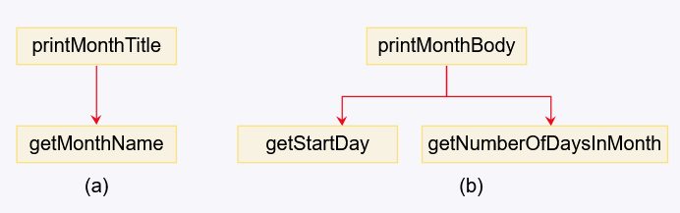
6.11 Method Abstraction and Stepwise Refinement
Notes:
Demonstrate TestMethodOverloading.java

Slide 26
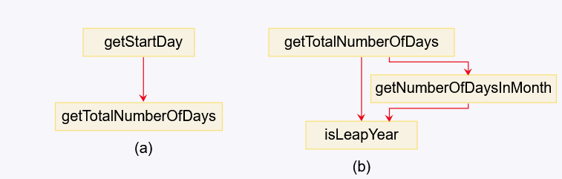
6.11 Method Abstraction and Stepwise Refinement
Notes:
Demonstrate TestMethodOverloading.java

Slide 27
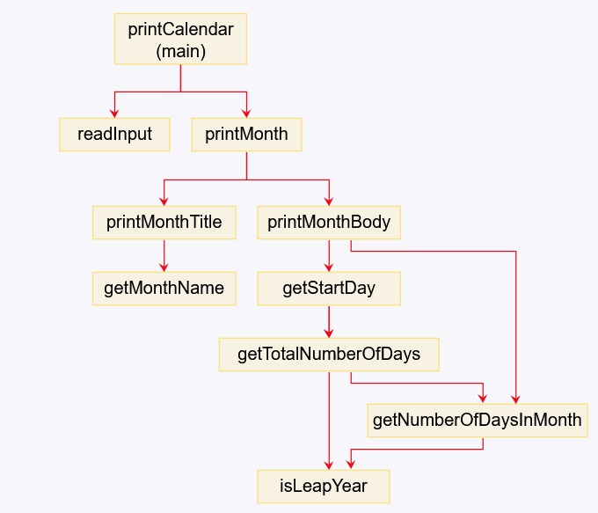
6.11 Method Abstraction and Stepwise Refinement
Notes:
Demonstrate PrintCalendarStub.java

Slide 28
Benefits of Stepwise Refinement
Simpler Program
Reusing Methods
Easier Developing, Debugging, and Testing
Better Facilitating Teamwork

Slide 29
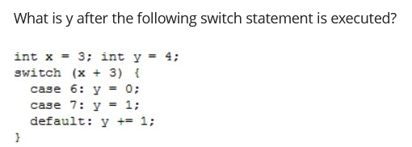
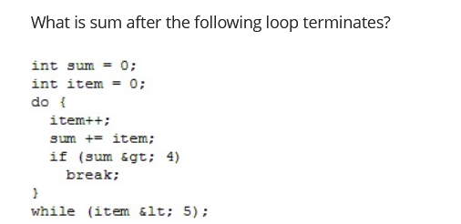
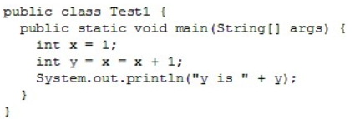
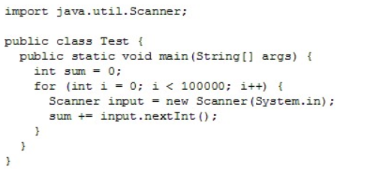


Slide 30
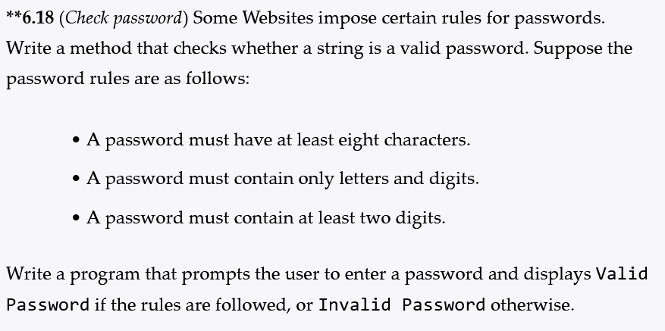
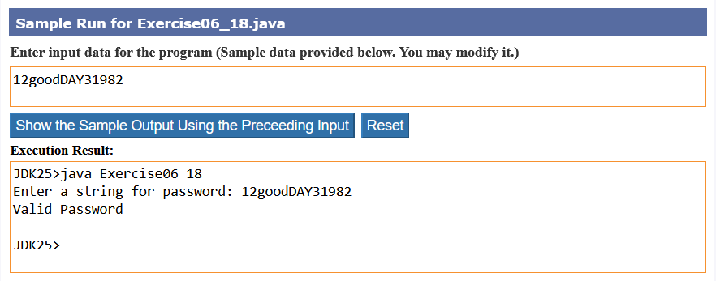
6.11 Lab
Notes:
Demonstrate PrintCalendarStub.java

