Slide 1


Java Programming I
Cist2371 – lesson4 (Mathematical functions, characters, and strings)

Slide 2
4.1 Objectives
4.1 To solve mathematical problems by using the methods in the Math class.
4.2 To represent characters using the char type.
4.3 To encode characters using ASCII and Unicode.
4.4 To represent special characters using the escape sequences.
4.5 To cast a numeric value to a character and cast a character to an integer.
4.6 To compare and test characters using the static methods in the Character class .
4.7 To introduce objects and instance methods.
4.8 To represent strings using the String object.
4.9 To return the string length() using the method.
4.10 To return a character in the string using the charAt(i) method.
4.11 To use the + operator to concatenate strings.

Slide 3
4.1 Objectives (continued)
4.12 To return an uppercase string or a lowercase string and to trim a string.
4.13 To read strings from the console.
4.14 To read a character from the console.
4.15 To compare strings using the equals() and the compareTo() methods.
4.16 To obtain substrings.
4.17 To find a character or a substring in a string using the indexOf method.
4.18 To program using characters and strings (GuessBirthDay).
4.19 To convert a hexadecimal character to a decimal value (HexDigit2Dec).
4.20 To revise the lottery program using strings (LotteryUsingStrings).
4.21 To format output using the System.out.printf method.
4.22 To store a multi-line string using a text block.

Slide 4
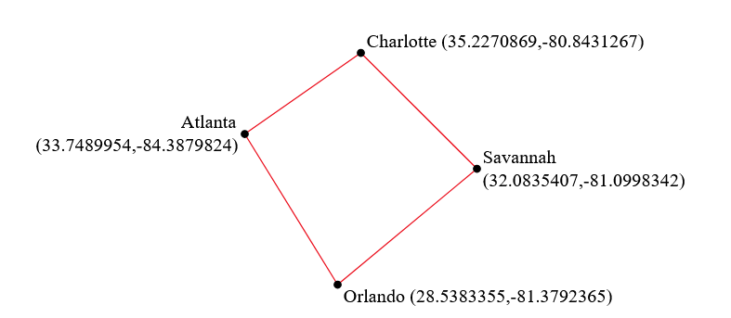
4.1 Introduction The focus of this chapter is to introduce mathematical functions, characters, String objects, and use them to develop programs.
Suppose you need to estimate the area enclosed by four cities, given the GPS locations (latitude and longitude) of these cities, as shown in the following diagram. How would you write a program to solve this problem? You will be able to write such a program after completing this chapter.

Slide 5
4.2 Common Mathematical Functions .
Math Class constants:
PI
E
Class methods:
Trigonometric Methods
Exponent Methods
Rounding Methods
min, max, abs, and random Methods
Notes:
We have looked some of the constants and methods of the Math class

Slide 6
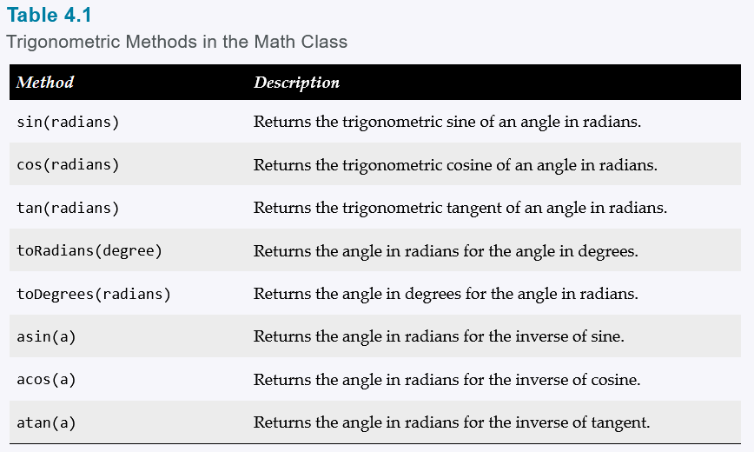
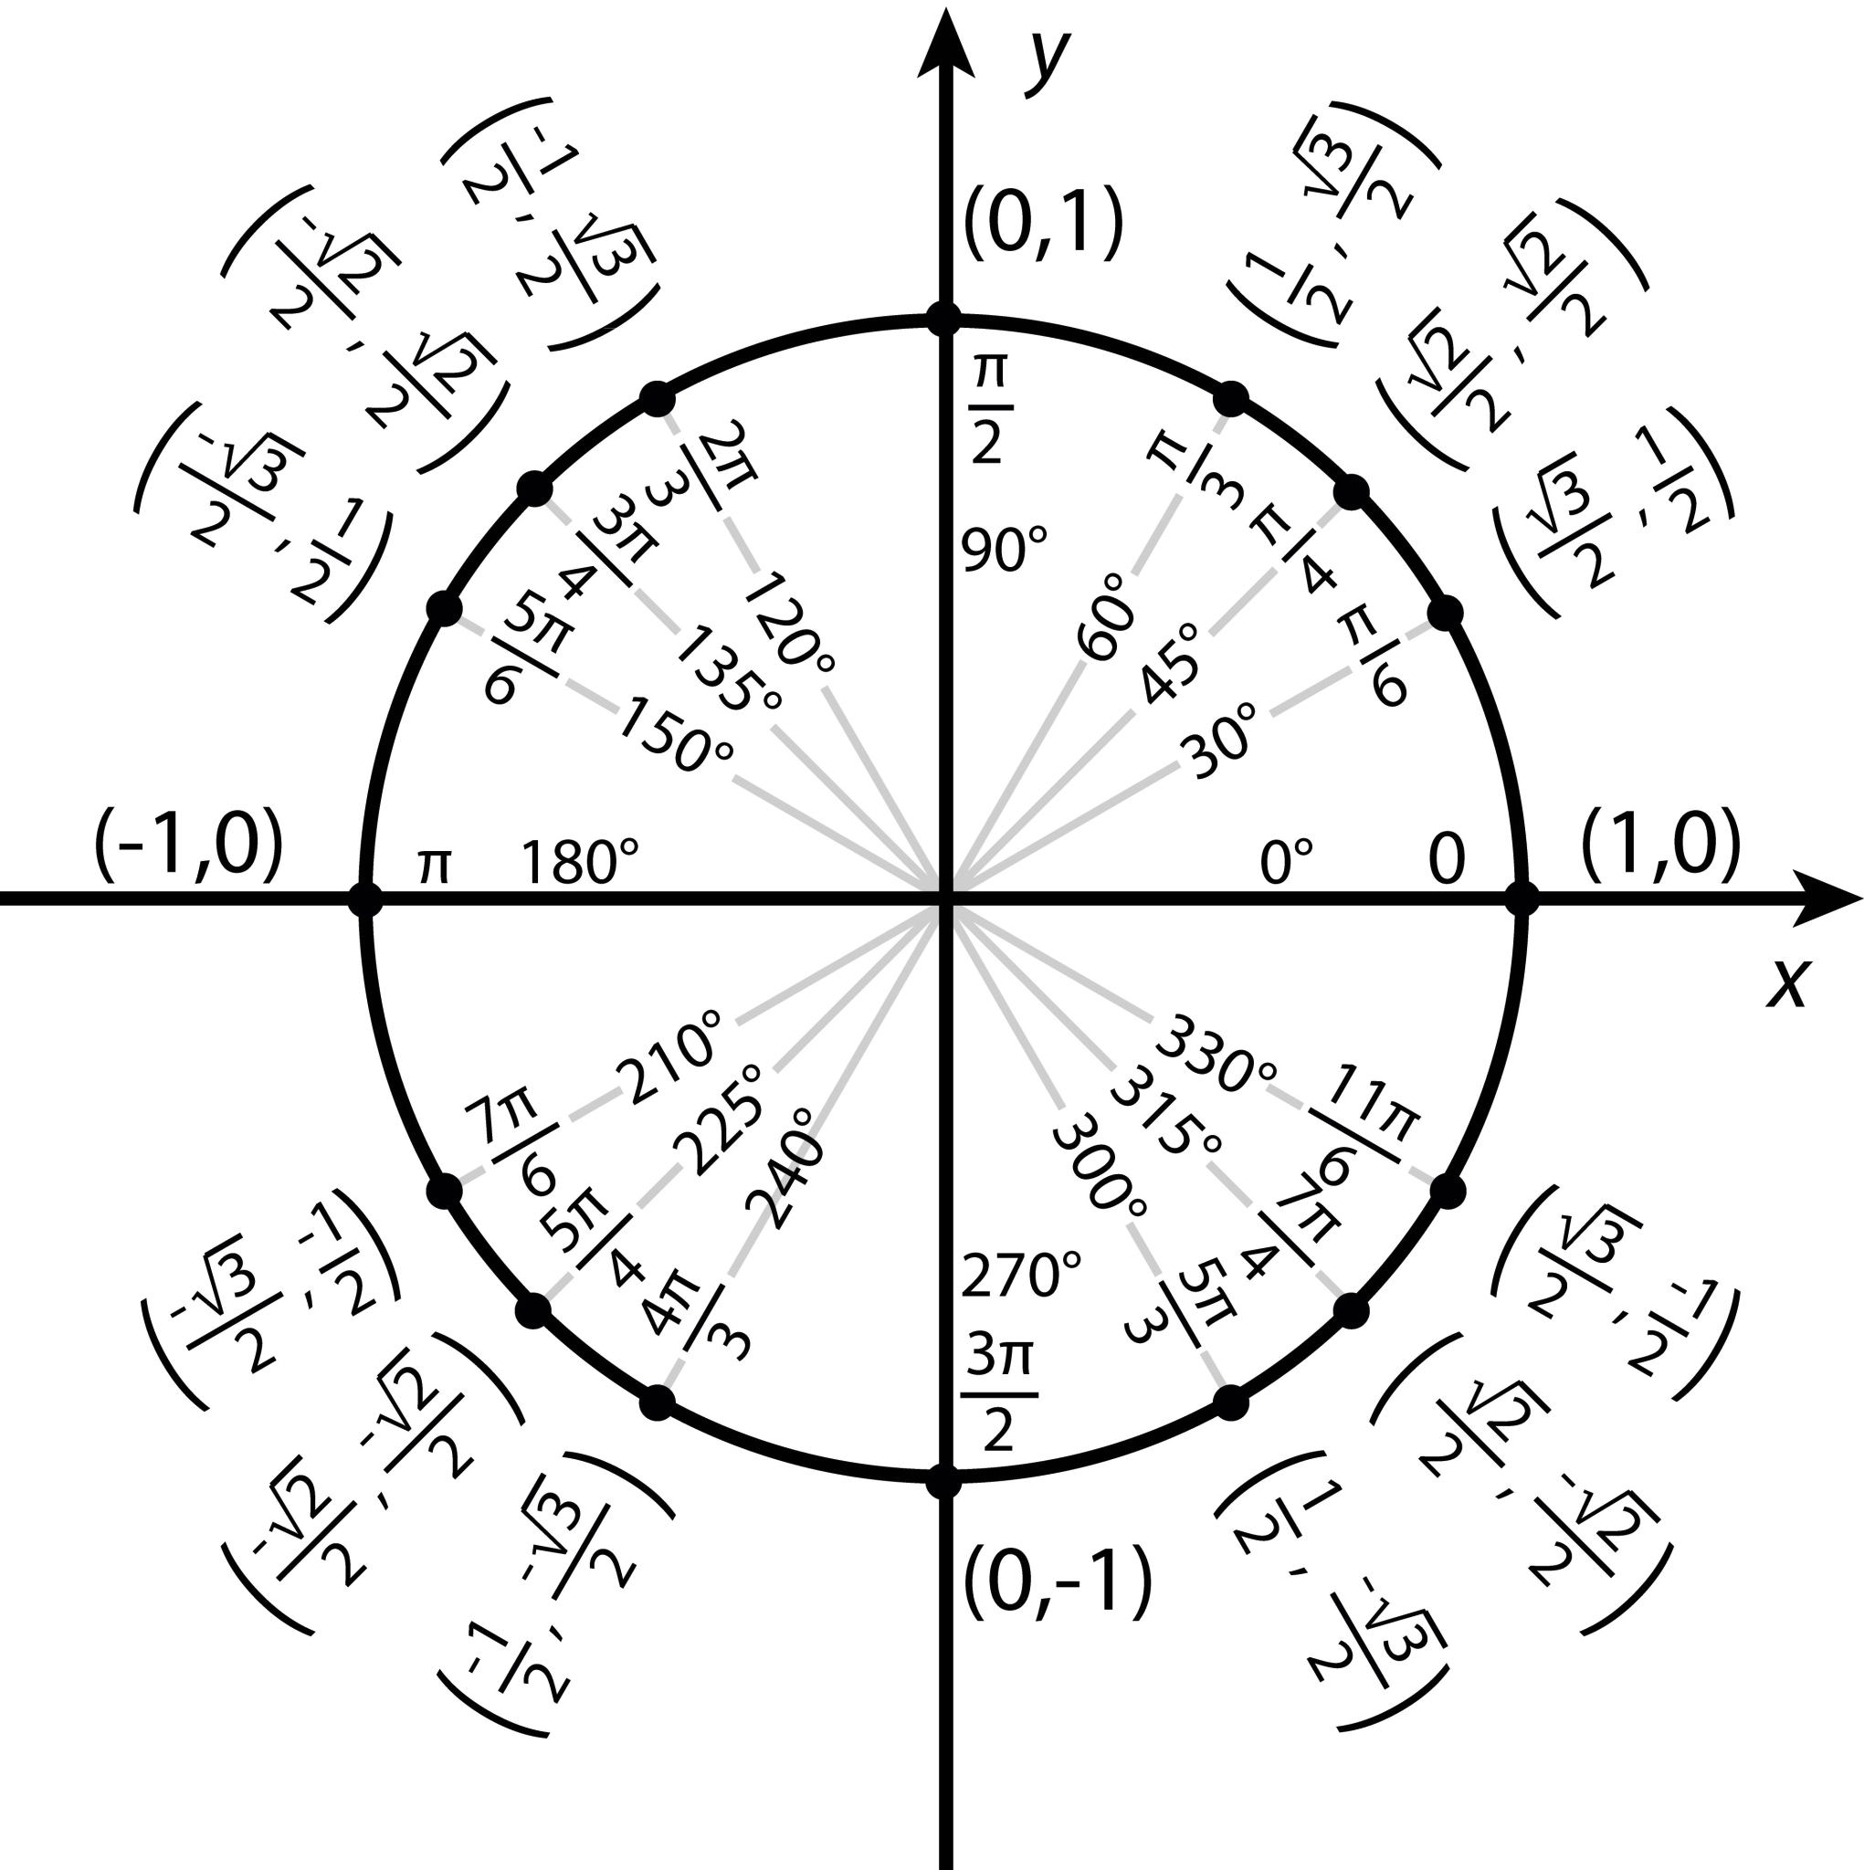
4.2.1 Trigonometric Functions .
Notes:
Go through the methods and refresher on basic trig functions
Go through the TrigonometricFunctions class

Slide 7
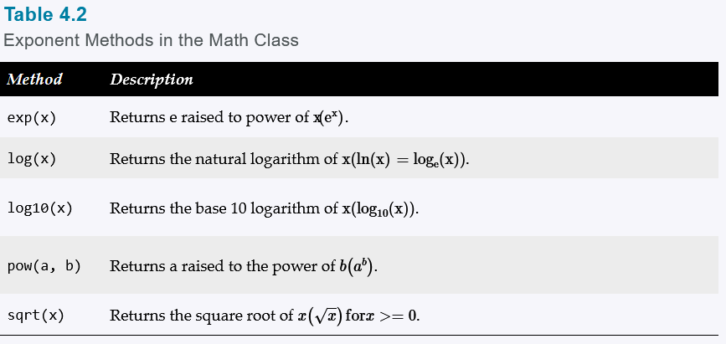
4.2.2 Exponent Functions .
Notes:
Go through the methods and refresher on basic trig functions
Go through the TrigonometricFunctions class

Slide 8
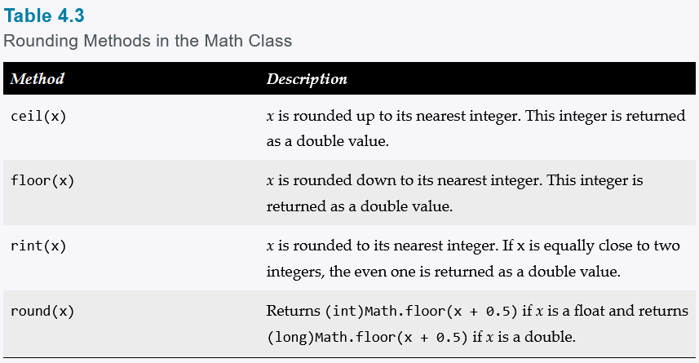
4.2.3 Rounding Functions .
Notes:
Go through the methods and refresher on basic trig functions
Go through the RoundingFunctions class

Slide 9
4.2.4 The min, max, abs Methods .
max(a, b)and min(a, b)
Returns the maximum or minimum of two parameters.
abs(a)
Returns the absolute value of the parameter.
random()
Returns a random double value in the range [0.0, 1.0).
Notes:
Talk about the bullet points and demonstrate the max, min, and random by refactoring the SubtractionQuiz

Slide 10
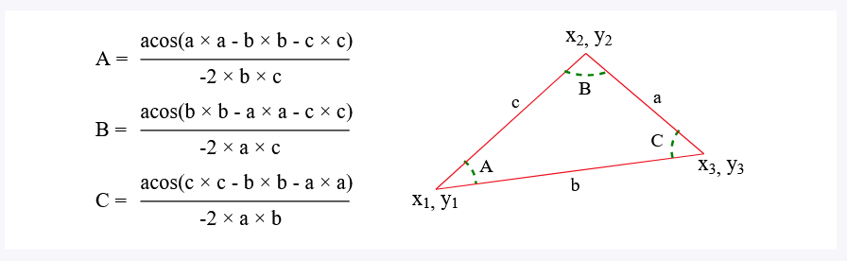

4.2.6 Case Study:Computing Angles of a Triangle .
What will be our inputs?
Notes:
Demonstrate the Compute Angles class

Slide 11
4.3 Character Data Type and Operations .
char is used to represent a single character.
Characters are stored a sequence of binary values (1’s and 0’s)
Encoding is mapping the character to its binary representation
char letter = ‘A’;
char numChar = ‘4’;
Notes:
Demonstrate the Compute Angles class

Slide 12

4.3.1 Unicode and ASCII code.
Encoding – mapping character to its binary representation
ASCII
• 128 characters
• English letters & digits
• Basic symbols
• No emojis
• No non-English languages
char letter = 'A';
char numChar = '4';
Unicode
•All languages & symbols
• Uses code points
• Supports emojis
• Global-ready
char letter = '\u0041’;
char numChar = '\u0034';
Takeaway: ASCII works for basic English. Unicode makes Java global-ready.
Notes:
Demonstrate the Compute Angles class

Slide 13
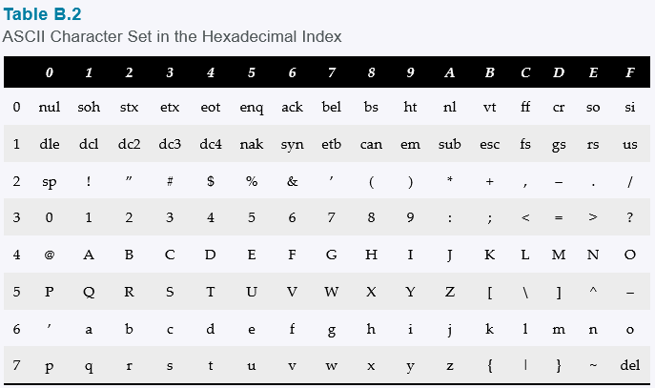



4.3 Unicode and ASCII code.
Notes:
Demonstrate the AsciiAndUnicode

Slide 14
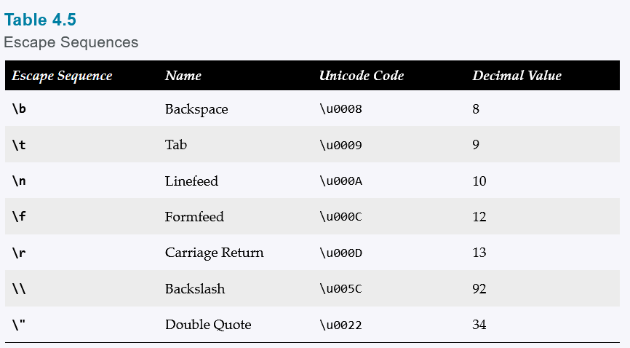
4.3.2 Escape Sequences for Special Characters.
Incorrect
Correct
Notes:
Demonstrate in scratches.

Slide 15
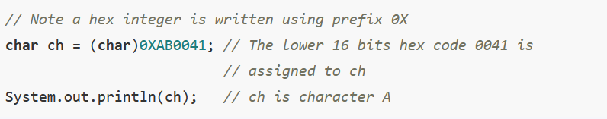
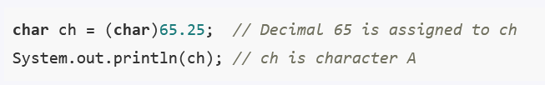
4.3.3 Casting between and Numeric Types.
A char can be cast into any numeric type, and vice versa. When an integer is cast into a , only its lower 16 bits of data are used; the other part is ignored.
Notes:
Demonstrate the CastingCharToNumeric

Slide 16
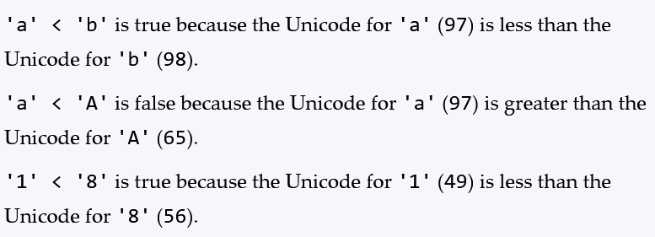
4.3.4 Comparing and Testing Characters.
Two characters can be compared using the relational operators just like comparing two numbers.
Notes:
Demonstrate the Casting class

Slide 17
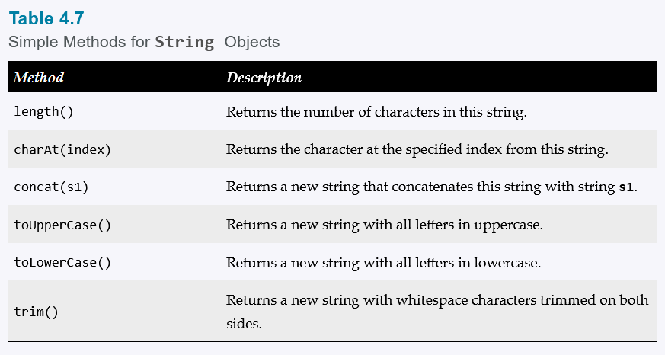
4.3.4 Comparing and Testing Characters.
Wrapper class Character has convenience methods for testing and comparison
Notes:
Demonstrate the CharacterClassDemo.java

Slide 18
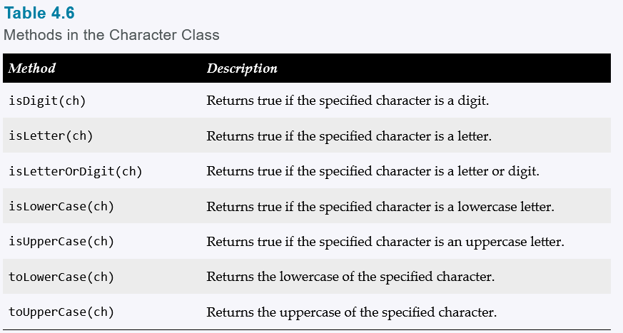
4.4 The String Type
A String is a sequence of characters.
Notes:
Demonstrate the CharacterClassDemo.java

Slide 19
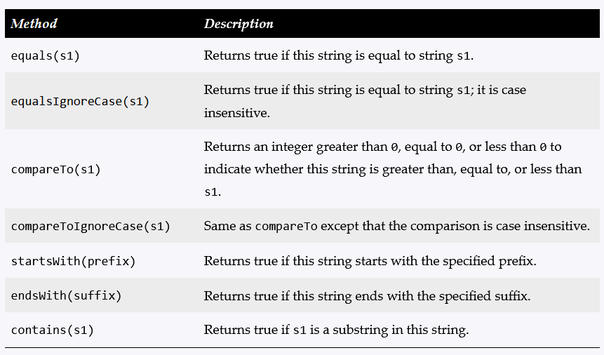
4.4.7 Comparing Strings
Notes:
Demonstrate the StringComparison.java

Slide 20
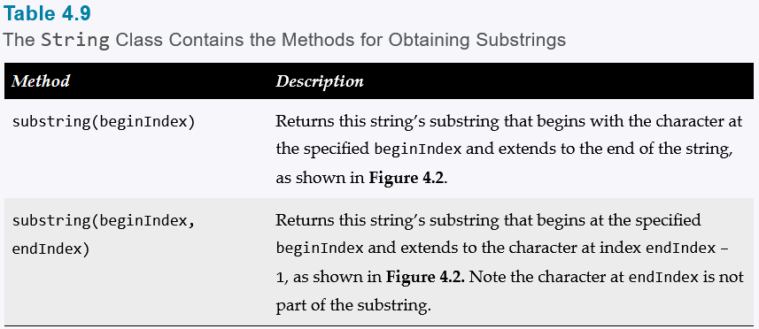

4.4.8 Obtaining Substrings
System.out.println("Welcome to Java".substring(5));
me to Java
System.out.println("Welcome to Java".substring(5, 12));
me to J
Notes:
Explain substrings
Demonstrate the StringComparison.java

Slide 21
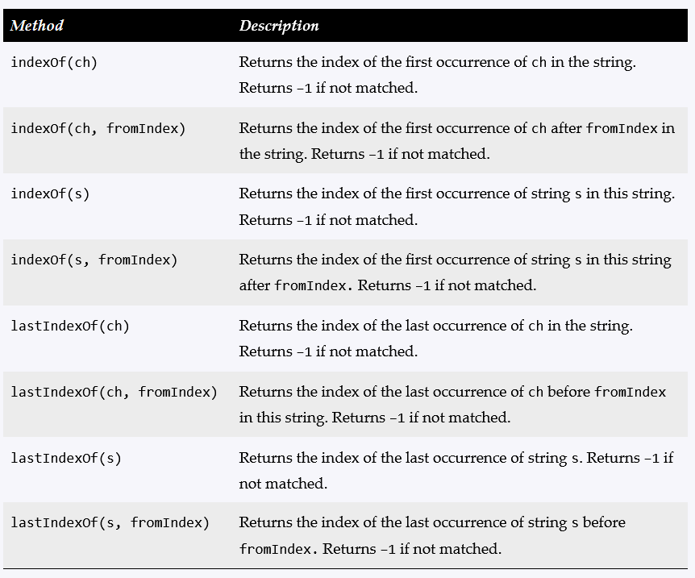
4.4.9 Finding a character in a substring
Notes:
Explain the differences between chars and Strings
Demonstrate the IndexOfExamples.java

Slide 22
4.4.10 Conversion between Strings and Numbers
Interger.parseInt(StringValue)
Example:
int intValue = Integer.parseInt(“123”);
Double.parseDouble(StringValue)
Example:
double doubleValue = Double.parseDouble(“123.45”)
Notes:
Explain the differences between chars and Strings
Demonstrate the IndexOfExamples.java

Slide 23
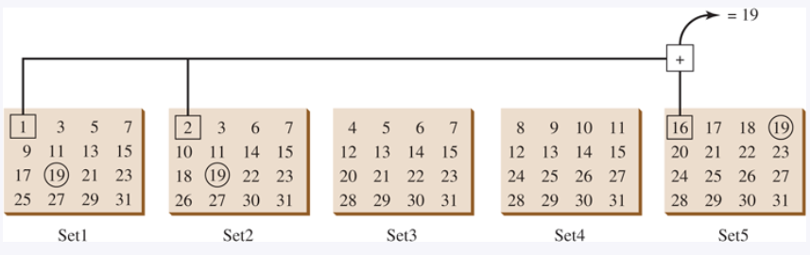
4.5 Case Study
Strings are fundamental in programming. The ability to write programs using strings is essential in learning Java programming.
Notes:
Speak on how Strings are heavily used in Java programming
GuessBirthday

Slide 24
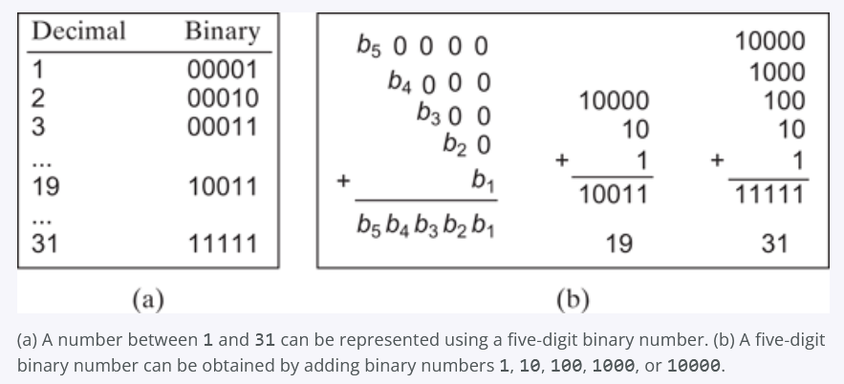
4.5 Case Study
Mathematics Behind the Game
Notes:
Explain the differences between chars and Strings
Demonstrate the IndexOfExamples.java

Slide 25
4.6 Formatting Console Output
You can use the method to display formatted output on the console.
Use the printf statement.
System.out.printf(format, items);
Where format is a string that may consist of substrings and format specifiers. A format specifier specifies how an item should be displayed. An item may be a numeric value, character, boolean value, or a string. Each specifier begins with a percent sign.

Slide 26
4.6 Formatting Console Output
You can use the method to display formatted output on the console.
Specifier Output Example
%b a boolean value true or false
%c a character 'a'
%d a decimal integer 200
%f a floating-point number 45.460000
%e a number in standard scientific notation 4.556000e+01
%s a string "Java is cool"

Slide 27
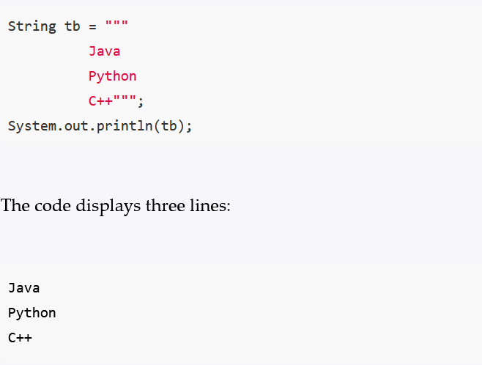
4.7 TextBlocks
Text blocks became a standard feature since Java 15. It enables you to form a multi-line string.

Slide 28
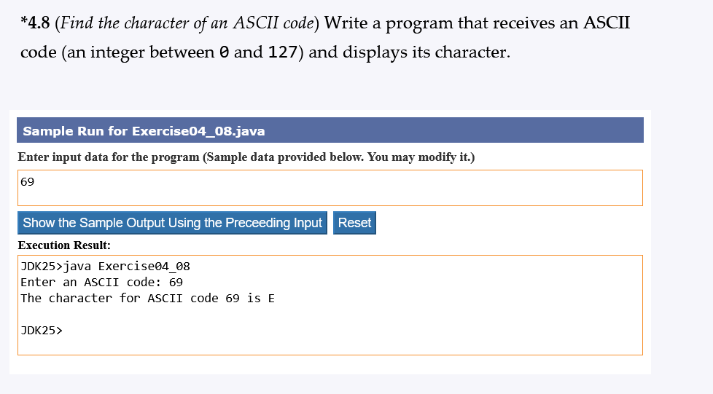
Lab
Submit:
DisplayASCIIChar.java
DisplayASCIIChar.mp4
JavaNotes.docx
Code should be well commented
with a consistent coding style and
defensive coding techniques
prevent erroneous input.

