Slide 1


Java Programming I
Cist2371 – lesson7 (Arrays part ii)

Slide 2
Objectives
Variable Length Argument List
Selection Sort
java.util.Arrays class
Passing arguments to the main method from the command line

Slide 3
7.9 Variable Length Argument List
A variable number of arguments of the same type can be passed to a method and treated as an array.
Only one variable-length parameter specified
Must be the last parameter.
Return type cannot be of variable length
public static void printMax(double... numbers) {
statements;
statements;
statements;
statements;
}
VarArgsDemo.java
Notes:
Show the example of adding a range

Slide 4
7.11 Selection Sort
Intuitive sorting algorithm: selection sort
84
10
13
3
57
3
10
13
84
57
3
10
13
84
57
3
10
13
57
85
3
10
13
57
84
SelectionSort.java
Notes:
Show the example of adding a range

Slide 5
7.12 The Arrays Class
The java.util.Arrays class contains useful methods for common array operations:
Sorting and searching arrays
Comparing arrays
Filling array elements
Returning a string representation of the array
ArraysDemo.java
Notes:
Show the example of adding a range

Slide 6
7.13 Command Line Arguments
The main method can receive string arguments from the command line.
CommandLineDemo.java
Notes:
Show the example of adding a range

Slide 7
Chapter 8 – Multi Dimensional Arrays
8.1 To give examples of representing data using two-dimensional arrays.
8.2 To declare variables for two-dimensional arrays, create arrays, and access array elements in a two-dimensional array using row and column indices.
8.3 To program common operations for two-dimensional arrays (displaying arrays, summing all elements, finding the minimum and maximum elements, and random shuffling).
8.4 To pass two-dimensional arrays to methods.
8.5 To write a program for grading multiple-choice questions using two-dimensional arrays.
8.6 To solve the closest pair problem using two-dimensional arrays.
8.7 To check a Sudoku solution using two-dimensional arrays.
8.8 To use multidimensional arrays.
Notes:
Show the example of adding a range

Slide 8
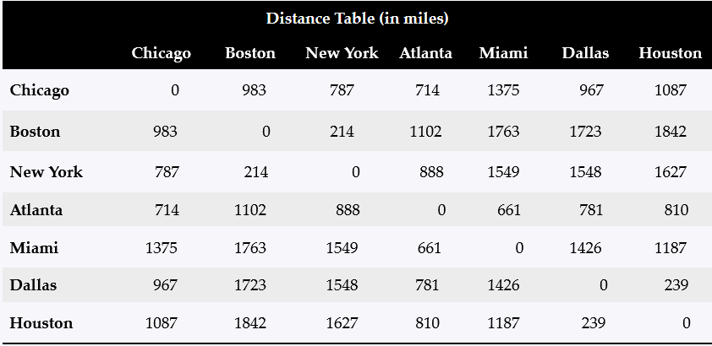
8.1 Introduction
Data in a table or a matrix can be represented using a two-dimensional array.
A two-dimensional array is an array that contains other arrays as its elements.
Notes:
Show the example of adding a range

Slide 9
8.2 The Basics
elementType [][] arrayReferenceName
int [][] matrix;
int [5][5] matrix;
Matrix[2][1] = 7;
[0] [1][2][3][4]
[0] [1][2][3][4]
[0]
[1]
[2]
[3]
[4]
0
0
0
0
0
[0]
[1]
[2]
[3]
[4]
0
0
0
0
0
0
0
0
0
0
0
0
0
0
0
0
0
0
0
0
0
7
0
0
0
0
0
0
0
0
0
0
0
0
0
0
0
0
0
0
0
0
0
0
0
0
Notes:
Show the example of adding a range

Slide 10
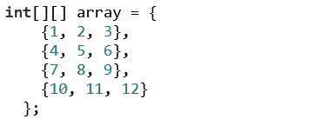
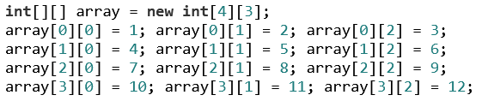
8.2 The Basics
Initializing 2-D arrays
Notes:
Show the example of adding a range

Slide 11
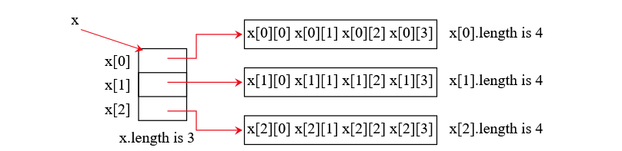
8.2 The Basics
Length of 2-D arrays
int [][] x = new int [3][4];
x.length = 3
x[0].length = 4
x[1].length = 4
x[2].length = 4
Notes:
Show the example of adding a range

Slide 12
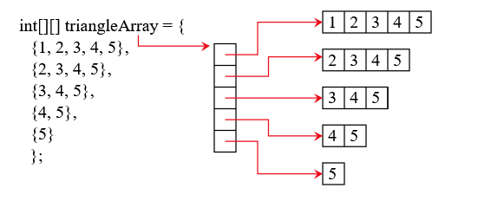
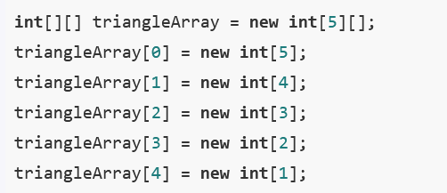
8.2 The Basics
Ragged Arrays
Notes:
Show the example of adding a range

Slide 13
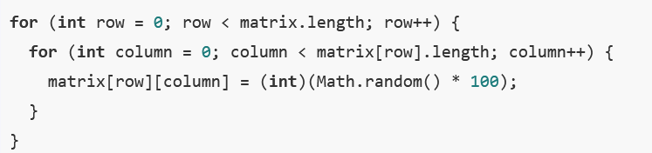
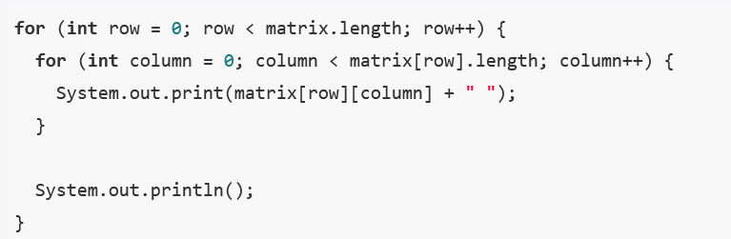
8.8 Processing 2-D Arrays
1. Declare the 2-D Array
int [][] matrix = new int [10][10];
2. Initialize the Array values
3. Print the Values
Notes:
Show the example of adding a range

Slide 14

8.8 Multi Dimensional Arrays
A two-dimensional array is an array of one-dimensional arrays, and a three-dimensional array is an array of two-dimensional arrays.
int [][][] scores = new int [6][5][2];
50
48
Scores – 1D Array(length =2)
Exams – 2D Array(length = 5)
Students – 3D Array(length =6)
Notes:
Show the example of adding a range

Slide 15
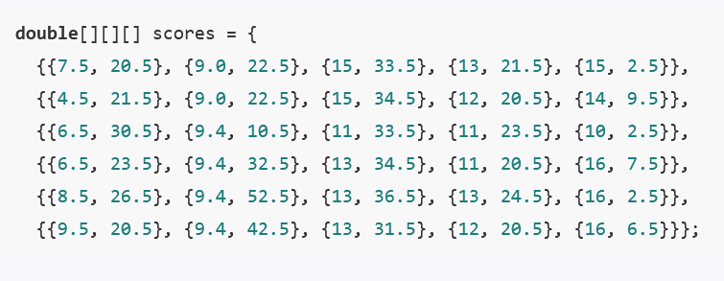
8.8 Multi Dimensional Arrays
A two-dimensional array is an array of one-dimensional arrays, and a three-dimensional array is an array of two-dimensional arrays.
int [][][] scores = new int [6][5][2];
Scores [0][1][0] =
9.0
Scores [0][1][1] =
22.5
Notes:
Show the example of adding a range

Slide 16
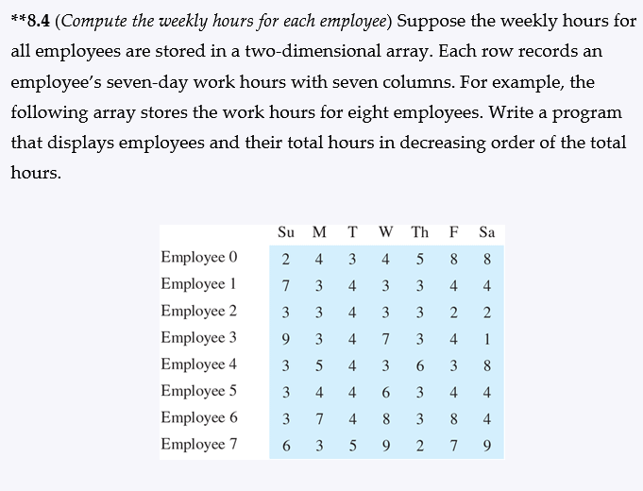
Lab Assignment
WeeklyHours.java
WeeklyHours.mp4
JavaNotes – Chapter 8

