Slide 1
Exam 220-1202
A+ Core 2

Slide 2
Configuring Windows
A+ 220-1202
Module 12

Slide 3
Learning Outcomes
Prepare for A+ Core 2 by:
Configuring Windows user settings
Configuring Windows system settings

Slide 4
Windows User Settings
Lesson 12.1
Notes:
Core 2 Exam Objectives
1.6 Given a scenario, configure Microsoft Windows settings.
Learning Outcomes
How can you adjust the privacy settings in the Windows OS?
How would you change the system date and time?
What options are available under the Ease of Access settings menu?
How can you view hidden files and folders in File Explorer?

Slide 5
Windows Interfaces (Slide 1 of 3)
Windows 10 Desktop
Start button is bottom left on taskbar
Windows 11 Desktop
Start button is center on taskbar
Taskbar search in both OS versions
Notes:
Learners should become familiar with both interfaces.

Slide 6
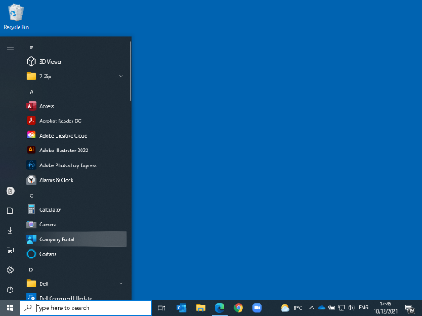
Windows Interfaces (Slide 2 of 3)
Screenshot courtesy of Microsoft.
Notes:
Windows 10 (21H2) desktop and Start menu

Slide 7
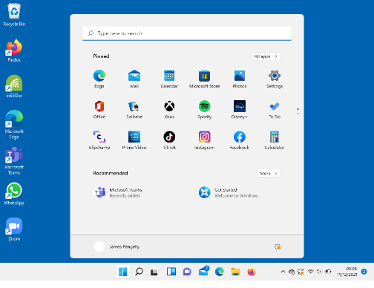
Windows Interfaces (Slide 3 of 3)
Screenshot courtesy of Microsoft.
Notes:
Windows 11 desktop and Start menu

Slide 8
Windows Settings and Control Panel (Slide 1 of 4)
Settings
A touch-enabled modern interface
Control Panel
A legacy interface using applets to navigate to various settings menus
Notes:
Learners should spend some time exploring both options to ensure they are familiar with the location of different options they may be required to change.

Slide 9
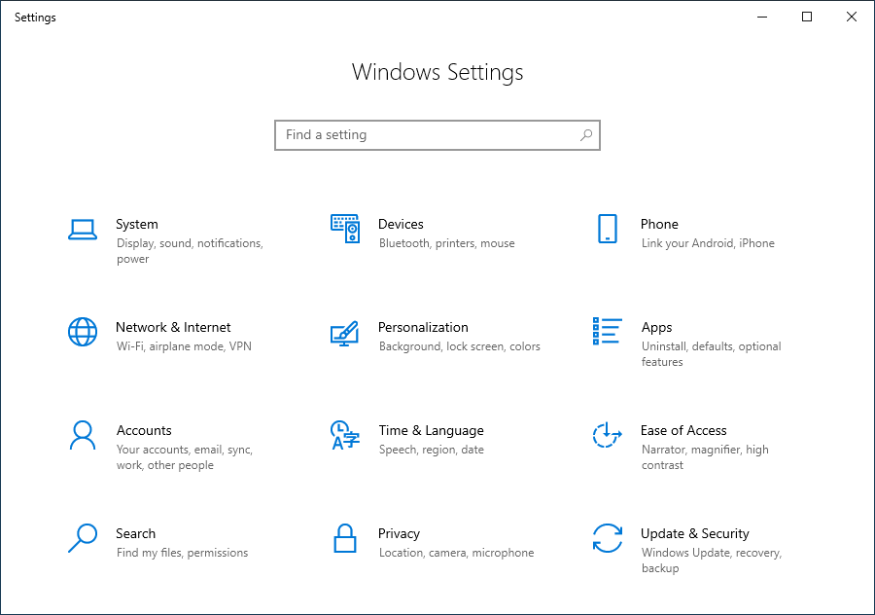
Windows Settings and Control Panel (Slide 2 of 4)
Screenshot courtesy of Microsoft.
Notes:
Home page in the Windows 10 Settings app showing the top-level configuration headings or groups.

Slide 10
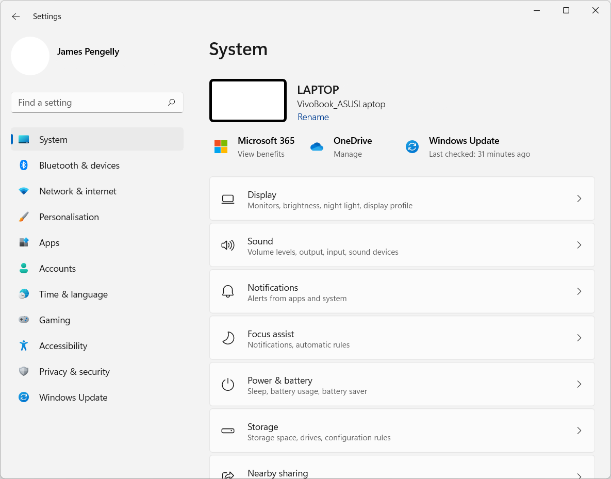
Windows Settings and Control Panel (Slide 3 of 4)
Screenshot courtesy of Microsoft.
Notes:
Settings apps in Windows 11

Slide 11
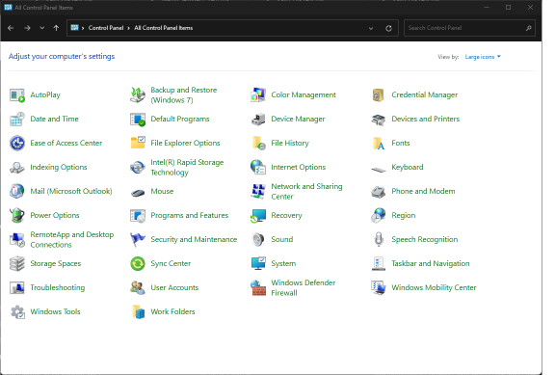
Windows Settings and Control Panel (Slide 4 of 4)
Screenshot courtesy of Microsoft.
Notes:
Windows 11 Control Panel uses applets as pointers to various setting specific menus.

Slide 12
Accounts Settings (Slide 1 of 2)
Profile
The settings and configuration for a specific user
Microsoft account vs. local account
UAC settings
Prevent unauthorized use of administrative privileges
Notes:
Learners should be reminded that local accounts are specific to a single system, whereas a Microsoft account can be used to sign on to any Windows system with Internet access. Consider showing learners the video Using the Windows Desktop Interface to solidify these concepts.

Slide 13
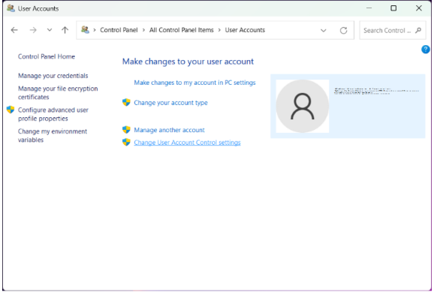
Accounts Settings (Slide 2 of 2)
Screenshot courtesy of Microsoft.
Notes:
User Accounts Applet

Slide 14
Privacy Settings (Slide 1 of 2)
Data collection default opt-in option for Microsoft
Optional for data sharing
Contacts
Calendar
Email
Files
Notes:
Learners should be reminded that if they choose to limit data and information sharing with Microsoft, their experience within Windows will be less personal.

Slide 15
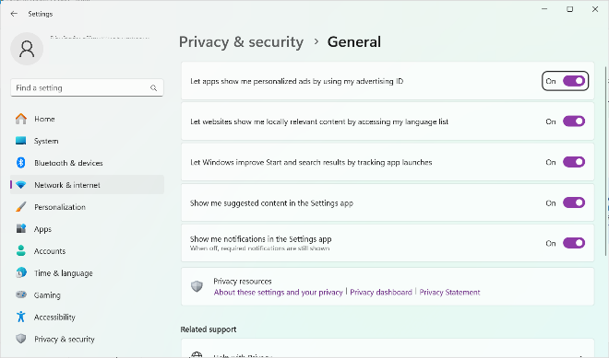
Privacy Settings (Slide 2 of 2)
Screenshot courtesy of Microsoft.
Notes:
General privacy settings in Windows 11

Slide 16
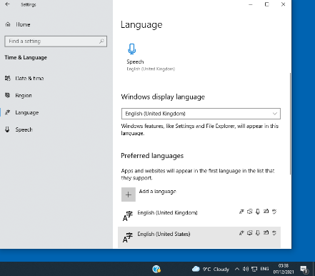
Desktop Settings
Time
Date/time format and time zone
Language
Spelling and localization, keyboard input, and speech recognition
Personalization settings
Themes, wallpaper, screensaver, color scheme, and font
Screenshot courtesy of Microsoft.
Notes:
Language settings

Slide 17
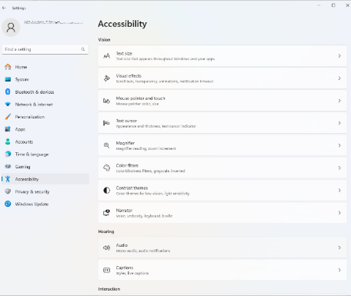
Ease of Access Settings
Vision
Cursor indicators, high-contrast and color-filter modes, and magnifier
Hearing
Volume, mixing, visual notifications, and closed-captioning
Interaction
Keyboard and mouse options, speech and eye-controlled input
Screenshot courtesy of Microsoft.
Notes:
Ease of Access settings are listed under the Accessibility heading in Windows 11.

Slide 18
File Explorer (Slide 1 of 3)
File management via GUI
System objects
User account
OneDrive
This PC
Network
Recycle Bin
Drives and folders
System files
Windows, Program Files/Program Files (x86), and users
Notes:
Learners should become familiar with File Explorer to navigate the directories within the OS.

Slide 19
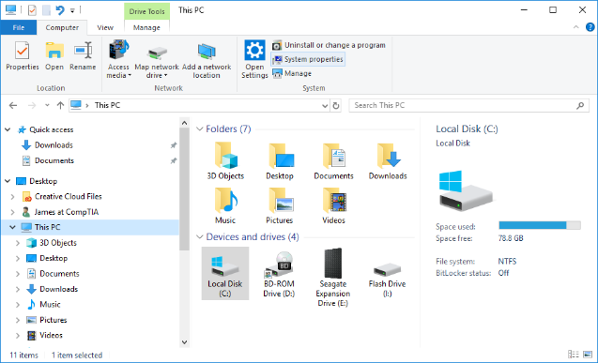
File Explorer (Slide 2 of 3)
Screenshot courtesy of Microsoft.
Notes:
File Explorer in Windows 10

Slide 20
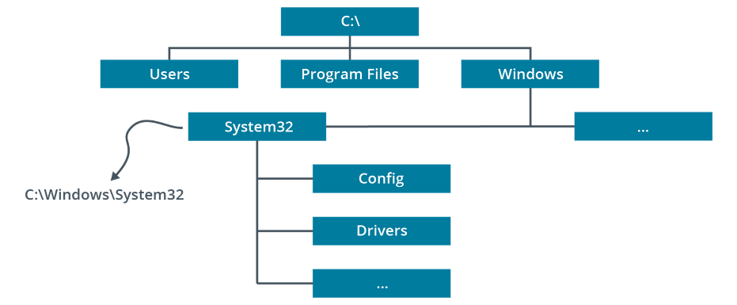
File Explorer (Slide 3 of 3)
Notes:
Typical Windows directory structure. Here, a subdirectory System 32 is highlighted.

Slide 21
File Explorer Options (Slide 1 of 2)
General tab
Layout
Single vs. double-click interactions
View tab
Hide extensions
Hide files and folders
Hide protected OS files
Default folder
Search options and behaviors
Notes:
Learners should explore the Options menu to ensure awareness of different controls and settings that can be used. The Hidden File and Folder option along with Hide Protected OS Files are key for administrators to view certain data files they may need to access during troubleshooting.

Slide 22
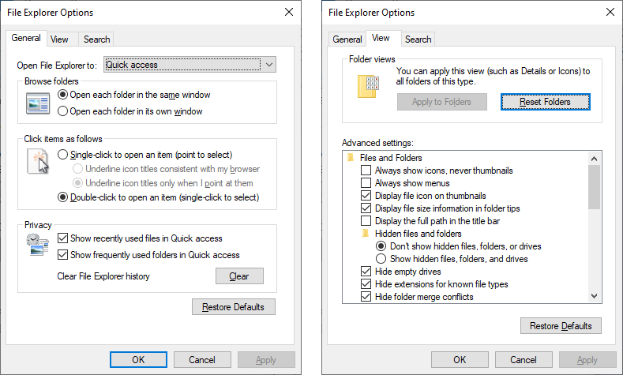
File Explorer Options (Slide 2 of 2)
Screenshot courtesy of Microsoft.
Notes:
General and View configuration settings in the File Explorer Options dialog

Slide 23
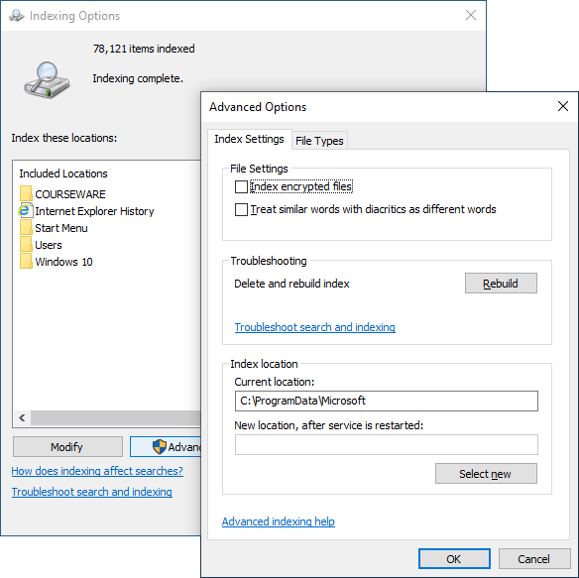
Indexing Options
Sorts and categorizes data within the system
Makes searching system faster
Screenshot courtesy of Microsoft.
Notes:
A corrupted index leads to failure of the search feature within Windows. Deleting and rebuilding the index does take time but can restore the search feature operation.

Slide 24
Lab: Explore Windows Settings (available in CertMaster Learn and CertMaster Perform)
Lab: Require a Screen Saver Password (available in CertMaster Learn and CertMaster Perform)
Applied Live Lab: Configure Desktop Settings (available in CertMaster Perform and CertMaster Labs)

Slide 25
Windows User Settings
Windows Interfaces
Windows Settings and Control Panel
Accounts Settings
Privacy Settings
Desktop Settings
Ease of Access Settings
File Explorer
File Explorer Options
Indexing Options
Notes:
Take some time at the end of each topic to answer questions. You can use the Lesson Review questions for discussion in class or set them for learners to complete individually during or after class.

Slide 26
Windows System Settings
Lesson 12.2
Notes:
Core 2 Exam Objectives
1.6 Given a scenario, configure Microsoft Windows settings.
Learning Outcomes
What information is presented on the System Settings page?
What is the default setting for Windows Update?
What is the difference between the hibernate and sleep power options?
What are the two rule sets listed in Windows Defender Firewall?
How can you access the Administrative Tools menu in Windows?

Slide 27
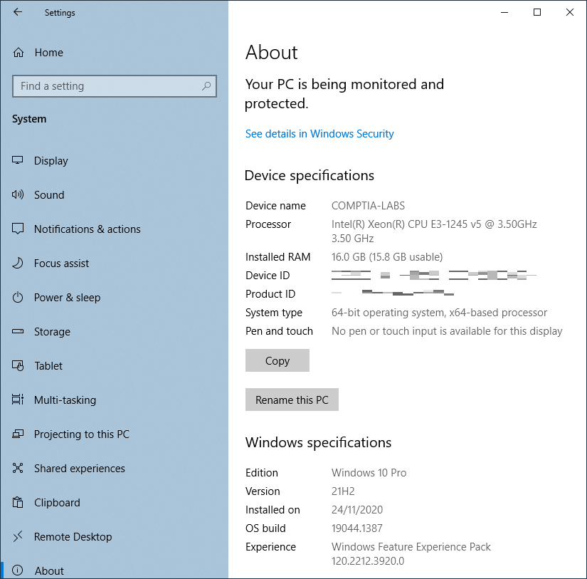
System Settings
Input/output devices
Power
Remote desktop
Notifications
Clipboard
About
Screenshot courtesy of Microsoft.
Notes:
Windows 10. The About section should be explored by learners. This information is valuable when troubleshooting the operating system and its hardware.

Slide 28
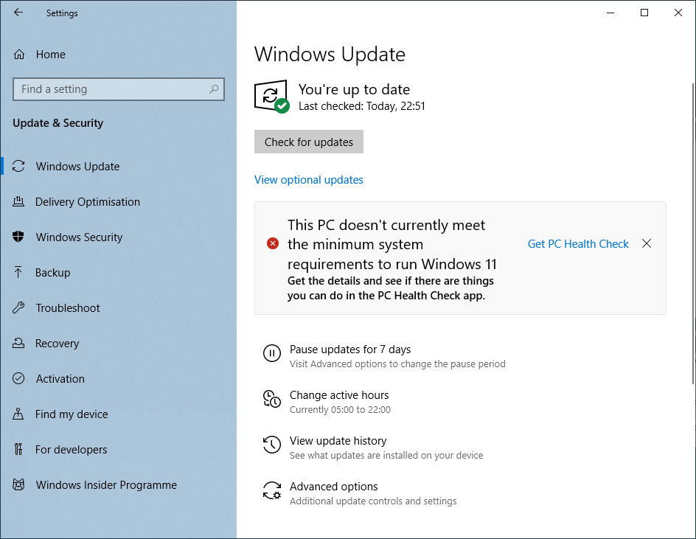
Update and Security Settings
Update
Updates OS and associated Microsoft products (ex: Office) and hardware drivers
Patch
Minor fix for issue in program or OS code
Security
Includes Windows Defender antivirus, threat protection, and firewall
Activation
Activates product with Microsoft for anti-piracy
Screenshot courtesy of Microsoft.
Notes:
The Activation area is where a user could change the product key to upgrade the Windows OS from one version to another. For example, updating from Windows 10 to 11 or from Home to Pro editions.

Slide 29
Device Settings (Slide 1 of 3)
System settings
Display and sound
Bluetooth & devices
Input and output devices with Bluetooth or USB connectivity
Mobile devices
Smartphone device management
Devices and printers (Control Panel)
Manually add devices
Notes:
Instructors may wish to walk learners through each menu option to explore the differences in the Settings and Control Panel areas. Instructors may also want to showcase the Device Manager, which provides an advanced device management interface.

Slide 30
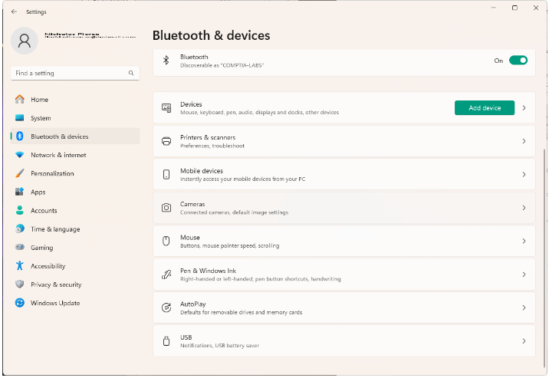
Device Settings (Slide 2 of 3)
Screenshot courtesy of Microsoft.
Notes:
Device settings in Windows 11

Slide 31
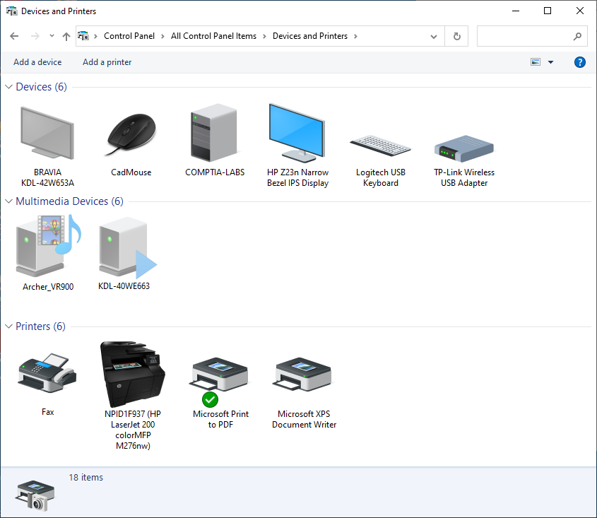
Device Settings (Slide 3 of 3)
Screenshot courtesy of Microsoft.
Notes:
Devices and Printers applet in Control Panel

Slide 32
Display and Sound Settings (Slide 1 of 3)
Scale
Changes size proportions for large screens
Color
Changes monitor calibration for color matching
Multiple displays
Set up multiple screens and/or projector configuration
Notes:
Learners should become familiar with the multiple display area of the Display Settings menu, as it is a common troubleshooting item for enterprise environments. Learners should understand the difference between Mirror and Extend options.

Slide 33
Display and Sound Settings (Slide 2 of 3)
Resolution and refresh rate
Resolution
Pixel by pixel
Refresh rate
Speed of entire display refresh
Expressed in Hz
Sound
Output and input device selection
Level adjustment
Notes:
Learners should become familiar with the multiple display area of the Display Settings menu, as it is a common troubleshooting item for enterprise environments. Learners should understand the difference between Mirror and Extend options.

Slide 34
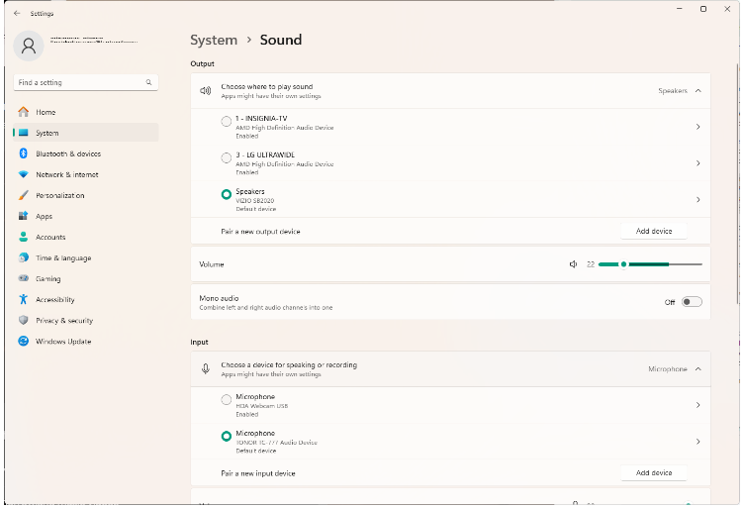
Display and Sound Settings (Slide 3 of 3)
Screenshot courtesy of Microsoft.
Notes:
Describe the image as settings for output and input audio devices. Consider showing learners the video Introduction to Customizing Windows Settings to solidify these concepts.

Slide 35
Power Options (Slide 1 of 2)
Standby/suspend
Removes power to most devices but maintains power to memory (RAM)
Hibernate/suspend
Removes power from all components
Saves memory data to disk
Power options
Change power button functionality
Power saver
Balanced
High performance
Notes:
Individual device power options can be managed from the Device Manager area under the Power tab of the device Properties menu.

Slide 36
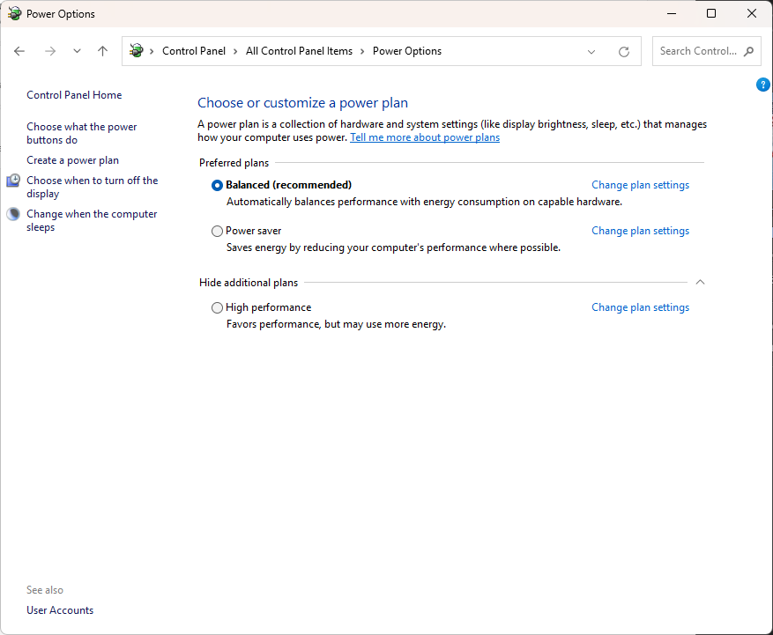
Power Options (Slide 2 of 2)
Screenshot courtesy of Microsoft.
Notes:
Configuring power settings via the Power Options applet in Control Panel

Slide 37
Apps, Programs, and Features
Features
Windows components of the OS that may be enabled/disabled
Store apps
Run in restricted sandbox to prevent system-wide changes
Do not require admin privileges
Windows Subsystem for Linux (WSL)
Installation of Linux distribution without using a virtual machine

Slide 38
Apps Settings (Slide 1 of 2)
Menu to view and uninstall applications and Windows features
Configure default apps
Auto-startup apps
Programs and Features
Legacy interface
Mail
Manage mail accounts for Microsoft Outlook
Gaming for game mode on/off
Suspends Windows updates and improves 3-D performance and frame rate for graphics

Slide 39
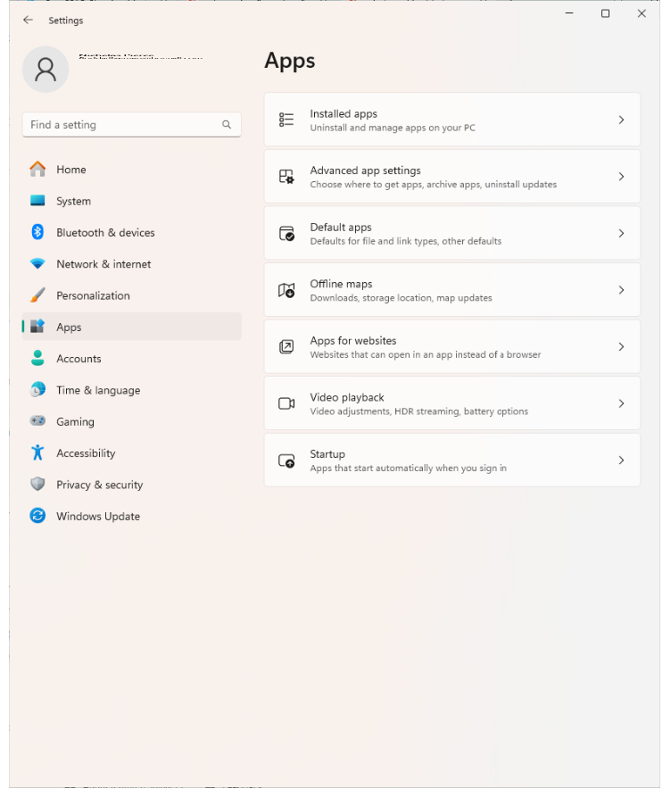
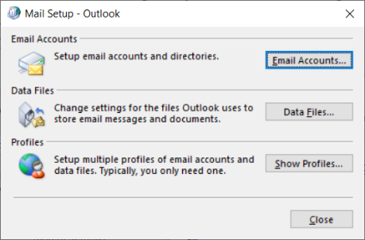
Apps Settings (Slide 2 of 2)
Screenshot courtesy of Microsoft.
Screenshot courtesy of Microsoft.
Notes:
A screenshot of the Apps section in Windows settings (left) and A screenshot of the Mail Setup - Outlook window (right)

Slide 40
Network Settings (Slide 1 of 2)
Network and Internet Settings
Network status, IP properties, and other tools
Network Connections
Change IP properties of network adapters
Use Network and Sharing Center
See status information
Notes:
These are on the Control Panel.

Slide 41
Network Settings (Slide 2 of 2)
Advanced sharing
Configure network discovery options and file/printer sharing
Windows Defender Firewall
Internet options
System-wide web browser settings
Notes:
These are on the Control Panel. Remind learners that many web browsers now include their own settings menu that is managed separately from the Internet Options applet.

Slide 42
Administrative Tools (Slide 1 of 4)
Computer Management (compmgmt.msc)
Defragment and Optimize Drives (dfrgui.exe)
Disk Cleanup (cleanmgr.exe)
Event Viewer (eventvwr.msc)
Local Security Policy (secpol.msc)
Notes:
Instructors should take the time to explore these tools and showcase their differences. Learners should understand how to access these Tools from the Admin Tools menu or using the Run dialog.

Slide 43
Administrative Tools (Slide 2 of 4)
Resource Monitor (resmon.exe)
Performance Monitoring (perfmon.msc)
Registry Editor (regedit.exe)
Services console (services.msc)
Task Scheduler (taskschd.msc)
Notes:
Instructors should take the time to explore these tools and showcase their differences (especially Resmon and PerfMon). Learners should understand how to access these tools from the Admin Tools menu or using the Run dialog. Consider showing the video Administrator Tool Settings in the GUI on this page.

Slide 44
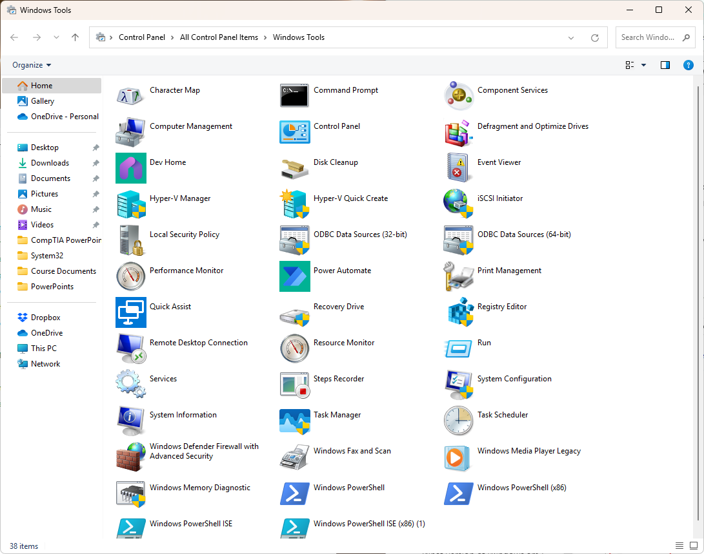
Administrative Tools (Slide 3 of 4)
Screenshot courtesy of Microsoft.
Notes:
Windows Tools folder Windows 11

Slide 45
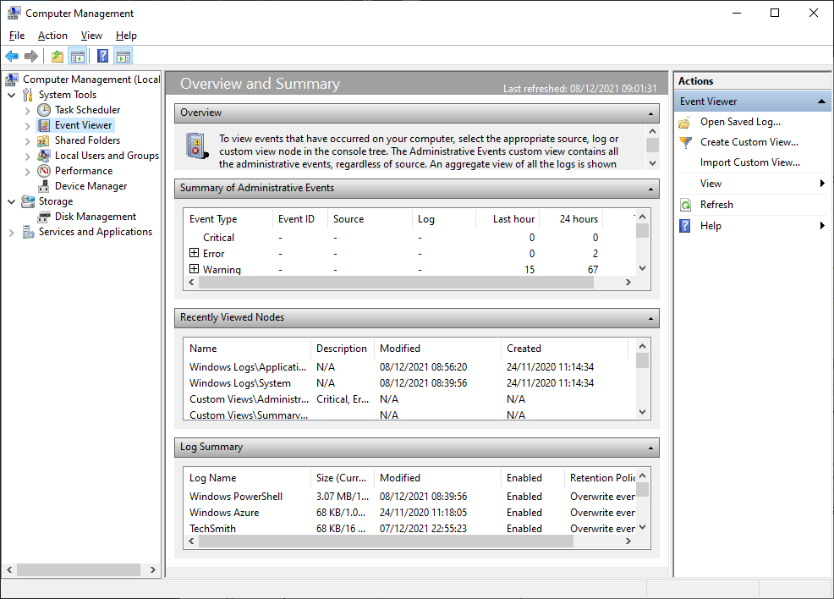
Administrative Tools (Slide 4 of 4)
Screenshot courtesy of Microsoft.
Notes:
The default Computer Management console in Windows 10 with the configuration snap-ins shown on the left.

Slide 46
Management Shortcuts (Slide 1 of 3)
Windows + X
Right-click start button
Instant search
Run dialog box
Notes:
Have learners practice opening the menu and tools through various methods. Instructors should inform learners that there may be multiple ways to access a setting or modify the system, and they should be aware of this when taking the exam.

Slide 47
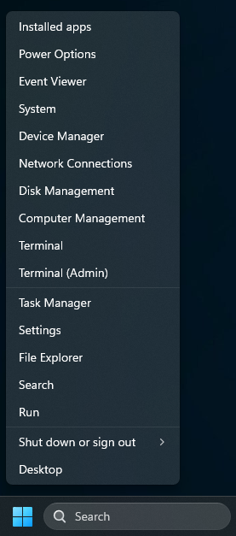
Management Shortcuts (Slide 2 of 3)
Screenshot courtesy of Microsoft.
Notes:
Windows 11 WinX menu (right-click the Windows button)

Slide 48
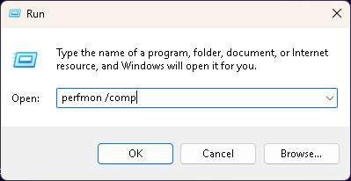
Management Shortcuts (Slide 3 of 3)
Screenshot courtesy of Microsoft.
Notes:
The Run dialog allows you to execute a command with switches.

Slide 49
Lab: Configure Windows Update (available in CertMaster Learn and CertMaster Perform)
Lab: Edit Power Options (available in CertMaster Learn and CertMaster Perform)

Slide 50
Windows System Settings
System Settings
Update and Security Settings
Device Settings
Display and Sound Settings
Power Options
Apps, Programs, and Features
Apps Settings
Network Settings
Administrative Tools
Management Shortcuts
Notes:
Take some time at the end of each topic to answer questions. You can use the Lesson Review questions for discussion in class or set them for learners to complete individually during or after class.

Slide 51
Install and Configure Applications
Lesson 12.3
Notes:
Core 2 Exam Objectives
1.10 Given a scenario, install applications according to requirements.
Learning Outcomes
What requirements are included in the listing for minimum system requirements?
What are common application distribution methods for applications?
What considerations should be evaluated before installing an application?
Are there any risks involved with installation of applications? If so, what are they?

Slide 52
System Requirements for Applications (Slide 1 of 2)
CPU
Clock speed, number of cores, architecture
Memory
Speed and minimum requirements
Storage
Minimum storage
Graphics
External hardware token
Smart card or USB for authentication
Notes:
Instructors should review that the minimum requirements are to simply get the application running. Consideration should be made to operate a system above these minimums for optimum operation.

Slide 53
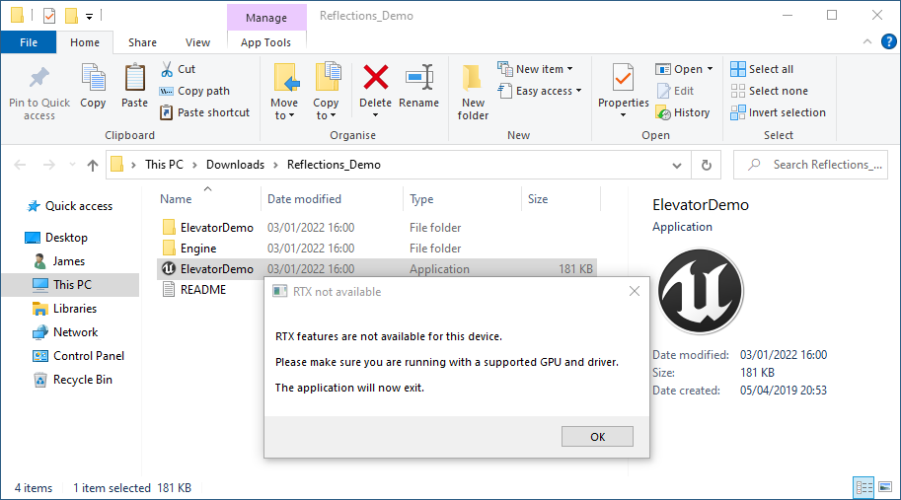
System Requirements for Applications (Slide 2 of 2)
Screenshot courtesy of Microsoft.
Notes:
This computer's graphics adapter does not meet the minimum specification, so setup cannot proceed

Slide 54
OS Requirements for Applications
OS compatibility
64-bit vs. 32-bit

Slide 55
Distribution Methods (Slide 1 of 2)
Physical media
CD/DVD
USB drive
Download from the Internet
Mount ISO file directly in Windows
UAC confirmation of changes

Slide 56
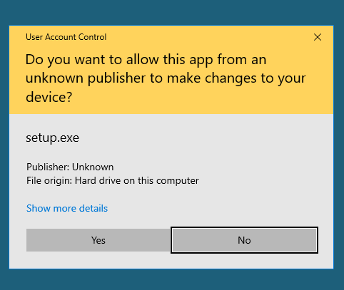
Distribution Methods (Slide 2 of 2)
Screenshot courtesy of Microsoft.

Slide 57
Other Considerations
Business impacts
Licensing, support, training needs
Operation impacts
Deployment, updating, maintenance
Device and network impacts
Use of limited local system resources
Use of network resources and bandwidth

Slide 58
Applied Live Lab: Configure Windows Apps (available in CertMaster Perform and CertMaster Labs)

Slide 59
Install and Configure Applications
System Requirements for Applications
OS Requirements for Applications
Distribution Methods
Other Considerations
Notes:
Take some time at the end of each topic to answer questions. You can use the Lesson Review questions for discussion in class or set them for learners to complete individually during or after class.

Slide 60
Cloud-Based Applications
Lesson 12.4
Notes:
Core 2 Exam Objectives
1.11 Given a scenario, install and configure cloud-based productivity tools.
Learning Outcomes
What is a cloud-based application?
How do cloud-based applications work in comparison to local installation of the application?
What benefits and drawbacks exist with the utilization of cloud-based applications?
What are some examples of cloud-based applications used today?

Slide 61
Email Systems
Outlook Web in Microsoft 365
Gmail in Google Workspace
Notes:
Many personal email accounts are considered cloud-based since they are accessed through a web browser. As corporations move their on-premise configurations into the cloud, they are also moving the email server itself or transitioning to a fully supported cloud alternative like Office 365 and Azure Active Directory setups.

Slide 62
Storage (Slide 1 of 2)
OneDrive, Google Drive, Apple iCloud
Data storage and synchronization across multiple platforms

Slide 63
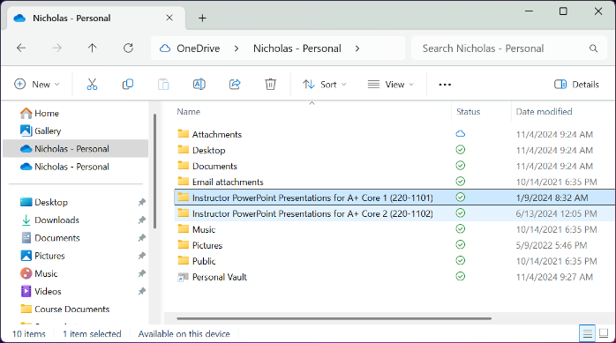
Storage (Slide 2 of 2)
Screenshot courtesy of Microsoft.
Notes:
Microsoft OneDrive­® folder in File Explorer. Note the green check mark symbol showing the files are synchronized to the cloud.

Slide 64
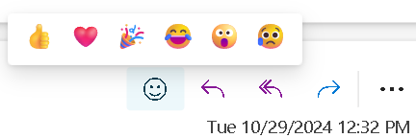
Collaboration Tools
Documents
Office 365 or GoogleDocs and Slides
Multiple users with simultaneous access and editing capability
Changes synchronize in near real-time with tracking
Videoconferencing
Video, audio, and text-based chat features
Zoom, Slack, Teams
Screenshot courtesy of Microsoft.

Slide 65
User Licensing (Slide 1 of 2)
Licensing terms
Personal vs. commercial use
Multi-user access
Enterprise management
Admin portal for issuing licenses to individual accounts

Slide 66
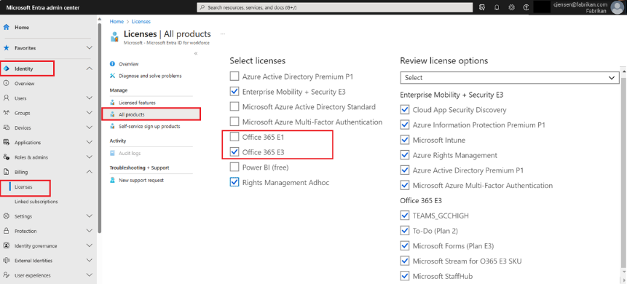
User Licensing (Slide 2 of 2)
Screenshot courtesy of Microsoft.
Notes:
Microsoft Entra administration center license assignment window

Slide 67
Identity Synchronization (Slide 1 of 2)
Cloud identity account
Used across platforms and applications
Single account
Used to access multiple applications
Used for federated access or single sign-on configurations

Slide 68
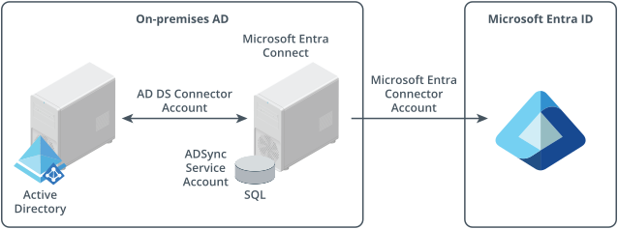
Identity Synchronization (Slide 2 of 2)
Screenshot courtesy of Microsoft.
Notes:
Microsoft Entra Connect synchronization

Slide 69
Lab: Create Azure Storage Account (available in CertMaster Learn and CertMaster Perform)

Slide 70
Cloud-Based Applications
Email Systems
Storage
Collaboration Tools
User Licensing
Identity Synchronization
Notes:
Take some time at the end of each topic to answer questions. You can use the Lesson Review questions for discussion in class or set them for learners to complete individually during or after class.

