Slide 1
Exam 220-1202
A+ Core 2

Slide 2
Supporting Mobile Software
A+ 220-1202
Module 20

Slide 3
Learning Outcomes
Prepare for A+ Core 2 by:
Configuring mobile OS security
Troubleshooting mobile OS and app software
Troubleshooting mobile OS and app security

Slide 4
Mobile OS Security
Lesson 20.1
Notes:
Core 2 Exam Objectives
2.1 Summarize various security measures and their purposes.
2.8 Given a scenario, apply common methods for securing mobile devices.
Learning Outcomes
What are the different types of screen locks available on mobile devices, and how do they contribute to device security?
How does mobile security software protect against malware and phishing attacks?
What is the importance of keeping the mobile OS and apps updated with the latest patches?
How can antivirus and anti-malware apps enhance the security of mobile devices?
How can Mobile Device Management (MDM) software enforce security policies on mobile devices?

Slide 5
Screen Locks (Slide 1 of 2)
Swipe to access
No authentication
PIN
4–6-digit numerical access code
Password/Passphrase is preferred
Fingerprint
Facial recognition
Pattern lock
Connect the dots on screen in a pattern
Failed login attempts
Locks device for a period after failed login attempts
Notes:
Learners should be reminded that while a primary method to access the device should be configured for authenticated access, they may want to (or be required to) set a backup access method as well. For example, the facial recognition system does not recognize your face, and it prompts for an access PIN.

Slide 6
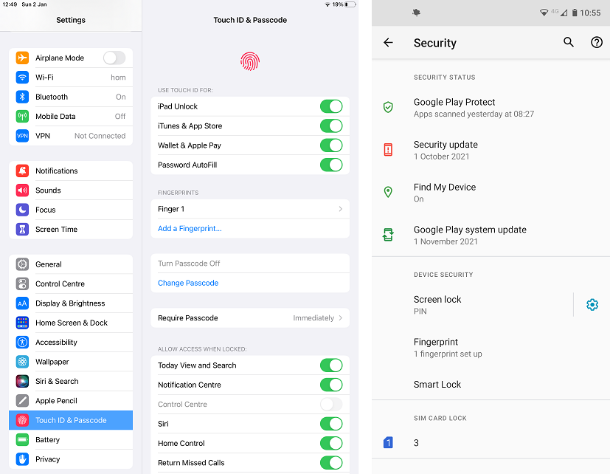
Screen Locks (Slide 2 of 2)
Screenshots reprinted with permission from Apple Inc. and Android platform, a trademark of Google LLC.

Slide 7
Mobile Security Software (Slide 1 of 2)
Patching/OS updates
Regular updates of OS and applications
Antivirus/anti-malware
Firewall
Notes:
The same security practices implemented on desktops can be implemented on mobile devices. Many software developers now have mobile versions of their applications available for download.

Slide 8
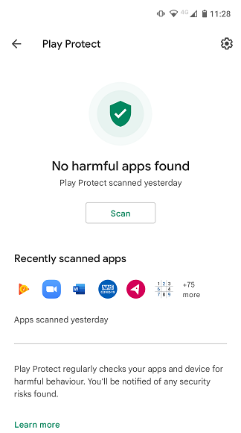
Mobile Security Software (Slide 2 of 2)
Screenshot courtesy of Google Play Store, a trademark of Google LLC.

Slide 9
Enterprise Mobility Management (Slide 1 of 3)
EMM allows remote management and control of device
BYOD
Personal device connected to corporate network and systems
Could require access to the device for monitoring by company
COBO
Business owned and for business use only

Slide 10
Enterprise Mobility Management (Slide 2 of 3)
COPE
Business owned, but personal activities like social media are allowed under AUP
CYOD
COPE but user can select the device type they prefer (Android or iPhone)

Slide 11
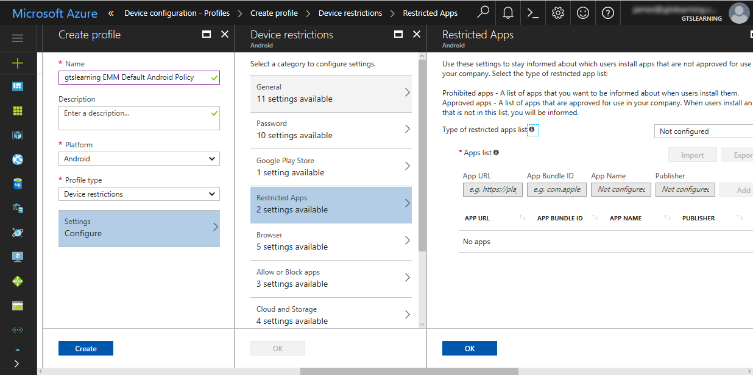
Enterprise Mobility Management (Slide 3 of 3)
Screenshot courtesy of Microsoft.

Slide 12
Mobile Device Management (Slide 1 of 2)
MDM applies security policy to the mobile device
MDM can:
Manage device settings
Enforce security policies
Control app installations and permissions
Regulate network access
Monitor compliance
Facilitate remote management

Slide 13
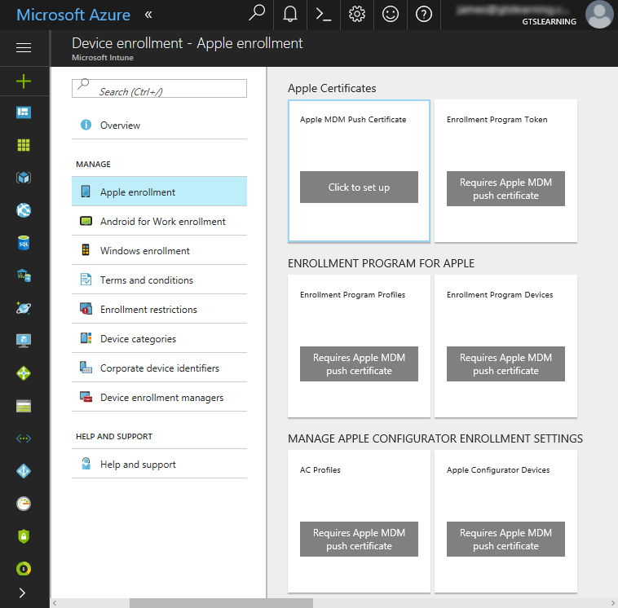
Mobile Device Management (Slide 2 of 2)
Screenshot courtesy of Microsoft.

Slide 14
Two-factor Authentication (Slide 1 of 2)
Two different authentication credentials
Something you are and something you have, etc.
Push notification or authenticator application
Microsoft and Google both have their own authenticator apps
Many third-party services are available like RSA's SecureID

Slide 15
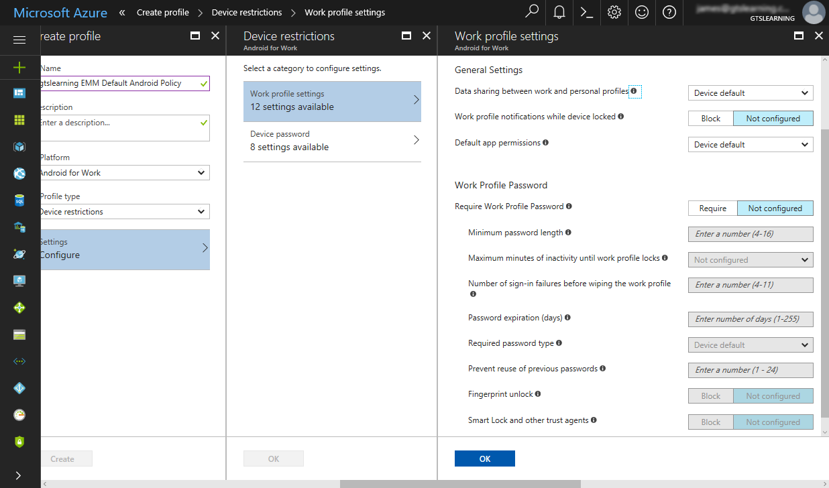
Two-factor Authentication (Slide 2 of 2)
Screenshot courtesy of Microsoft.

Slide 16
Mobile Data Security (Slide 1 of 3)
Device encryption
Apple- default on and cannot be switched off
Android- default for file level encryption
Remote backup applications
Cloud services
iCloud
Google Drive
Microsoft OneDrive
DropBox
Backup to local computer

Slide 17
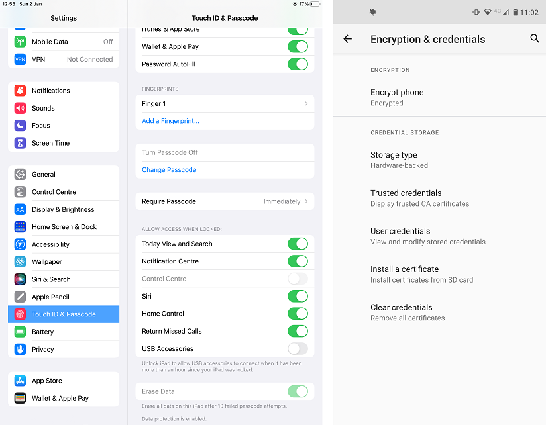
Mobile Data Security (Slide 2 of 3)
Screenshots reprinted with permission from Apple Inc. and Android platform, a trademark of Google LLC.

Slide 18
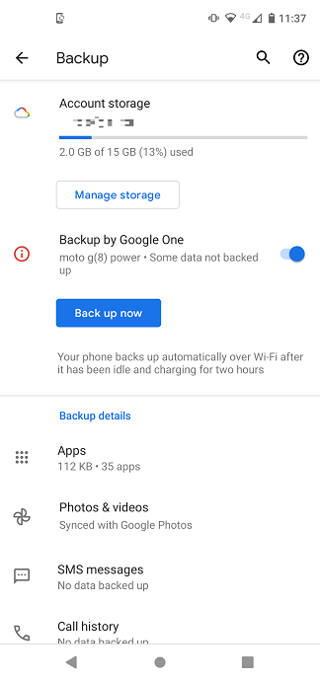
Mobile Data Security (Slide 3 of 3)
Screenshot courtesy of Google One™ subscription service, a trademark of Google LLC

Slide 19
Locator Apps and Remote Wipe (Slide 1 of 2)
GPS/IPS/Wi-fi/Cellular location services
"Find My Phone/Device" apps for both Apple and Android
Remotely
Lock
Play sound
Wipe device
Notes:
Learners may already know about locator apps and may have used them in the past. Invite learners to share quick stories about their experience.

Slide 20
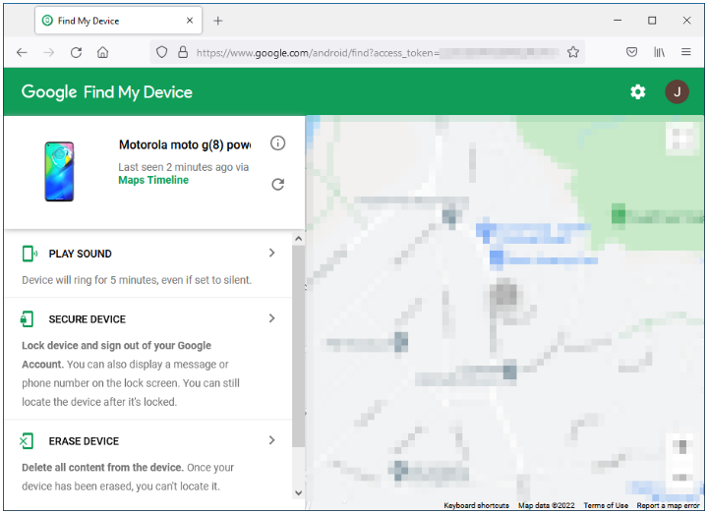
Locator Apps and Remote Wipe (Slide 2 of 2)
Screenshot courtesy of Google, a trademark of Google LLC.

Slide 21
Lab: Configure Remote Wipe (available in CertMaster Learn and CertMaster Perform)

Slide 22
Mobile OS Security
Screen Locks
Mobile Security Software
Enterprise Mobility Management
Mobile Device Management
Two-factor Authentication
Mobile Data Security
Locator Apps and Remote Wipe
Notes:
Take some time at the end of each topic to answer questions. You can use the Lesson Review questions for discussion in class or set them for learners to complete individually during or after class.

Slide 23
Troubleshoot Mobile OS and App Software
Lesson 20.2
Notes:
Core 2 Exam Objectives
3.2 Given a scenario, troubleshoot common mobile OS and application issues.
Learning Outcomes
What are the common troubleshooting steps for resolving performance issues on mobile devices?
How can rebooting a mobile device help resolve temporary performance or stability issues?
What is the process for performing a factory reset on iOS and Android devices, and when should it be used?
How can you identify and address battery life issues on mobile devices?
What steps should you take if an OS update fails to install on a mobile device?
How can you troubleshoot app issues, such as apps failing to launch or crashing frequently?

Slide 24
Mobile Device Troubleshooting Tools (Slide 1 of 2)
Settings app
Down from Top
Up from Bottom
Reboot
Factory reset
Battery life
Battery health report
Smart Charge technology
Notes:
Reinforce the CompTIA Troubleshooting Methodology for all issues. Instructors may wish to review the 7-step process with learners.

Slide 25
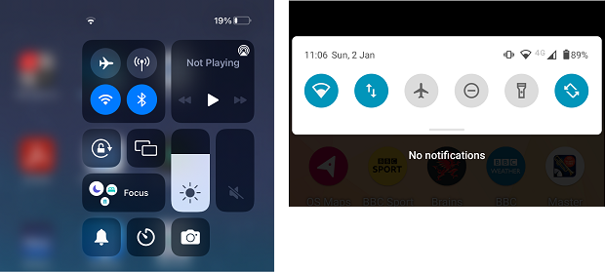
Mobile Device Troubleshooting Tools (Slide 2 of 2)
Screenshots reprinted with permission from Apple Inc., and Android platform, a trademark of Google LLC.
Notes:
Note: Access the iOS Control Center (left) by swiping from the top-right and Android notification drawer by swiping from the top

Slide 26
Troubleshoot Device and OS Issues (Slide 1 of 2)
OS fails to update
Device randomly reboots
Device slow to respond
Auto-rotate screen not working
Notes:
Note: While vendors aim to support devices for as long as possible, major or minor OS updates can significantly affect performance on older models. Unfortunately, rollback options for updates are typically unavailable, so reporting the issue and awaiting a vendor fix is often the only recourse.

Slide 27
Troubleshoot Device and OS Issues (Slide 2 of 2)
Screenshots reprinted with permission from Apple Inc., and Android platform, a trademark of Google LLC.
Notes:
Note: In iOS (left), enabling the rotation lock from Control Center prevents the device from autorotating. In Android (right), enabling the autorotate button allows the screen to reorient automatically, while disabling it locks the orientation

Slide 28
Troubleshoot App Issues (Slide 1 of 2)
Fail to launch, close, or crashes
Android- Settings > Apps > Force Stop or Disable
Apple- swipe up from bottom of screen, swipe app card up to close
Clear cache
Fail to install
Verify storage and permissions
Corporate devices may have restrictions
Confirm connectivity or restriction to download only over wi-fi

Slide 29
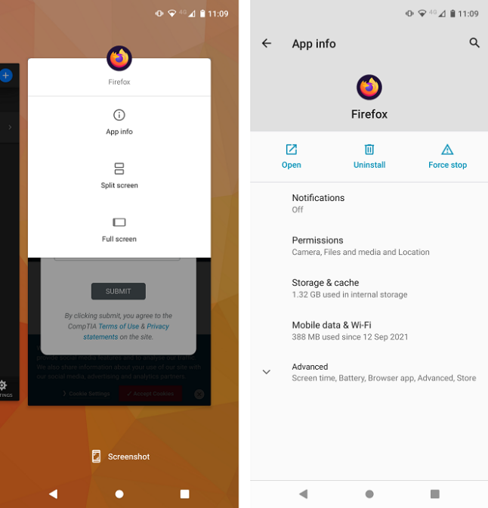
Troubleshoot App Issues (Slide 2 of 2)
Screenshot courtesy of Android platform, a trademark of Google LLC.

Slide 30
Troubleshoot Connectivity Issues
Signal strength and interference
Configuration issues
Troubleshooting NFC
Troubleshooting AirDrop
Everyone, Contacts Only, Off
Verify range to device
Bluetooth
Android has a feature like AirDrop called Nearby Share
Notes:
Learners should verify devices are connected to the network and do not have airplane mode enabled. Airplane mode restricts network access to cellular, wi-fi, Bluetooth, and NFC connections.

Slide 31
Lab: Connect to WiFi (available in CertMaster Learn and CertMaster Perform)

Slide 32
Mobile OS and App Software
Mobile Device Troubleshooting Tools
Troubleshoot Device and OS Issues
Troubleshoot App Issues
Troubleshoot Connectivity Issues
Notes:
Take some time at the end of each topic to answer questions. You can use the Lesson Review questions for discussion in class or set them for learners to complete individually during or after class.

Slide 33
Troubleshoot Mobile OS and App Security
Lesson 20.3
Notes:
Core 2 Exam Objectives
3.3 Given a scenario, troubleshoot common mobile OS and application security issues.
Learning Outcomes
What are the security concerns associated with root access and jailbreaking on mobile devices?
How can Mobile Device Management (MDM) solutions detect and prevent access to rooted or jailbroken devices?
What are the risks of installing apps from untrusted sources, and how can they be mitigated?
What steps should you take to address unexpected application behavior that may indicate a security threat?
How can you protect against data leakage and unauthorized location tracking on mobile devices?

Slide 34
Root Access Security Concerns
Root
Primarily refers to Android OS root level access to bypass controls
Jailbreak
Primarily refers to iOS device administrative access to bypass controls
Developer mode
This is not rooting or jailbreaking
Specifically used for diagnostic data access and advanced configuration settings
Notes:
Some manufacturers or providers may limit warranty coverage on rooted or jailbroken devices.

Slide 35
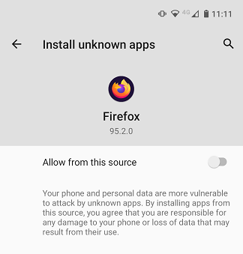
Mobile App Source Security Concerns
App spoofing
Enterprise apps
APK sideloading
Bootleg app stores
Users should only download apps from trusted sources and verify the app digital signature, if possible
Screenshot courtesy of Android platform, a trademark of Google LLC and Mozilla.
Notes:
Android has the ability to sideload apps from third-party downloads and stores. iOS is restricted to App Store downloads as the preference. Although, this is slowly changing with recent developments(2023) in the European Union where third-party app stores must be allowed on iOS devices.

Slide 36
Mobile Security Symptoms (Slide 1 of 2)
Excessive ads, fake security warnings
Unexpected app behavior
Leaked personal files/data
Location services
Geotagging photos and videos

Slide 37
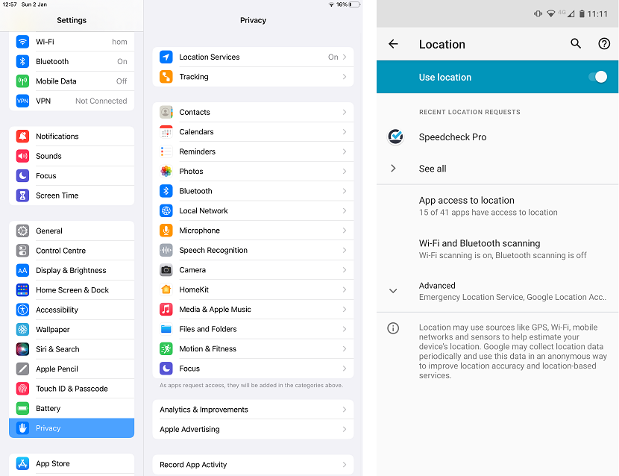
Mobile Security Symptoms (Slide 2 of 2)
Screenshots reprinted with permission from Apple Inc., and Android platform, a trademark of Google LLC
Notes:
Note: Criminals can also obtain location information from geotagged online photos. They can determine where someone lives and identify vacation times from social media posts. Users should be trained to remove geotagging information from images before posting them online to mitigate these risks.

Slide 38
Mobile OS and App Security
Root Access Security Concerns
Mobile App Source Security Concerns
Mobile Security Symptoms
Notes:
Take some time at the end of each topic to answer questions. You can use the Lesson Review questions for discussion in class or set them for learners to complete individually during or after class.

