Slide 1
Exam 220-1202
A+ Core 2

Slide 2
Managing Windows
A+ 220-1202
Module 13

Slide 3
Learning Outcomes
Prepare for A+ Core 2 by:
Using management consoles
Using performance and troubleshooting tools
Using command-line tools

Slide 4
Use Management Consoles
Lesson 13.1
Notes:
Core 2 Exam Objectives
1.4 Given a scenario, use Microsoft Windows operating system features and tools.
Learning Outcomes
How can you disable a malfunctioning device in Device Manager to prevent it from affecting system performance?
How do you initialize a new disk using the Disk Management console?
What is the difference between a primary partition and a logical partition in Disk Management?
How can you expand an existing partition if there is unallocated space available on the disk?
How can you create a new user account and assign it to a security group using the Local Users and Groups console?

Slide 5
Device Manager (Slide 1 of 3)
Updating devices
Driver information
Troubleshooting malfunctioning devices
Built-in troubleshooter to assist in diagnosis and correction of issues
Removing devices
Uninstalling devices
Disabling devices
Some hardware devices can be disabled in the BIOS/UEFI menus
Notes:
Ensure learners understand that while some devices are hot swappable, some are not. The system may need to be powered off to physically install or remove a device.

Slide 6
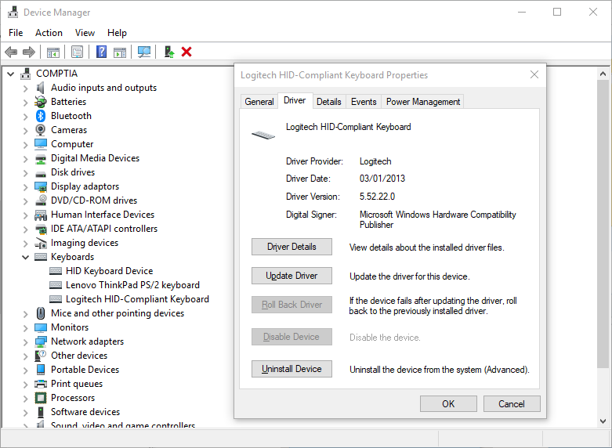
Device Manager (Slide 2 of 3)
Screenshot courtesy of Microsoft.

Slide 7
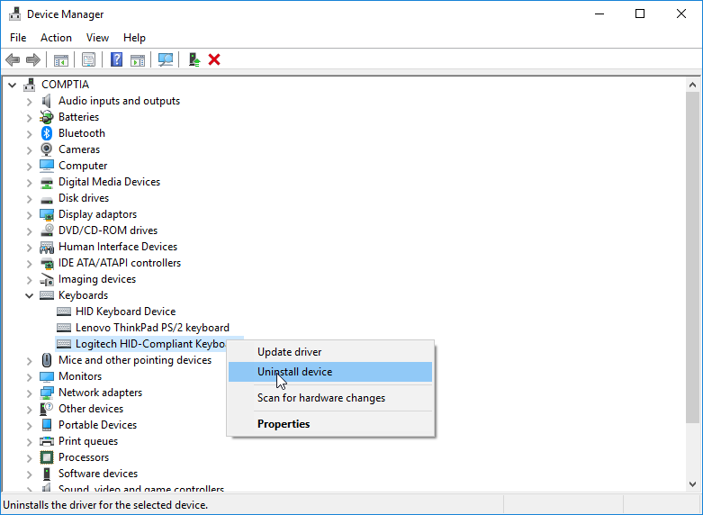
Device Manager (Slide 3 of 3)
Screenshot courtesy of Microsoft.

Slide 8
Disk Management Console (Slide 1 of 2)
Manage fixed and removable disks and partitions
HDD, SSD, and optical drives
Disk management tasks
Initialize
Partition
Format
Repartition
Notes:
Remind learners that new versions of the Windows OS no longer support dynamic discs and the replacement feature is known as Storage Spaces for implementing software RAID.

Slide 9
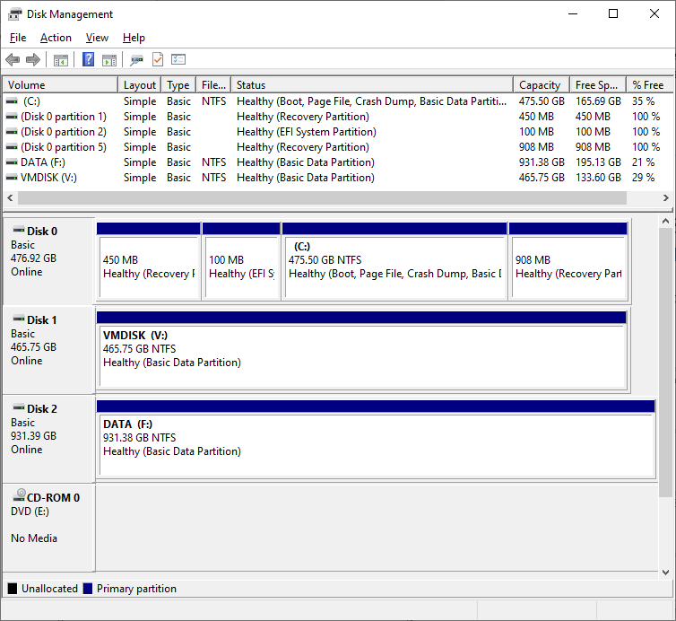
Disk Management Console (Slide 2 of 2)
Screenshot courtesy of Microsoft.

Slide 10
Disk Maintenance Tools (Slide 1 of 2)
Disk DeFragmenter
HDD
Reorganizes data into contiguous clusters to improve access timelines
SSD
Performs a trim operation to reduce cell degradation
Disk Clean-up
Removes temporary files and files marked for deletion
Can remove old Windows installation files and updates no longer needed by the OS
Notes:
Instructors may want to show learners these two tools. Recommend that they run Disk Clean-up first, then Defragment and Optimize.

Slide 11
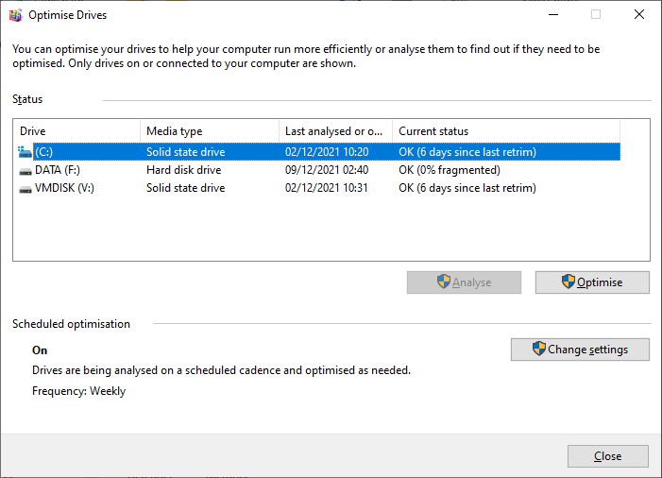
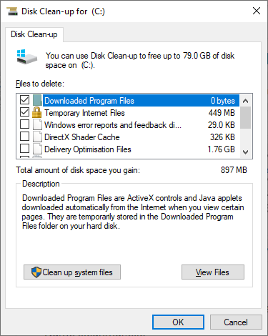
Disk Maintenance Tools (Slide 2 of 2)
Screenshot courtesy of Microsoft.
Screenshot courtesy of Microsoft.

Slide 12
Task Scheduler (Slide 1 of 2)
Automates operations run at specific intervals or based on a trigger
Logging
Allows troubleshooting when task failure
Schedules tasks
Updates, backups, and synchronizing data

Slide 13
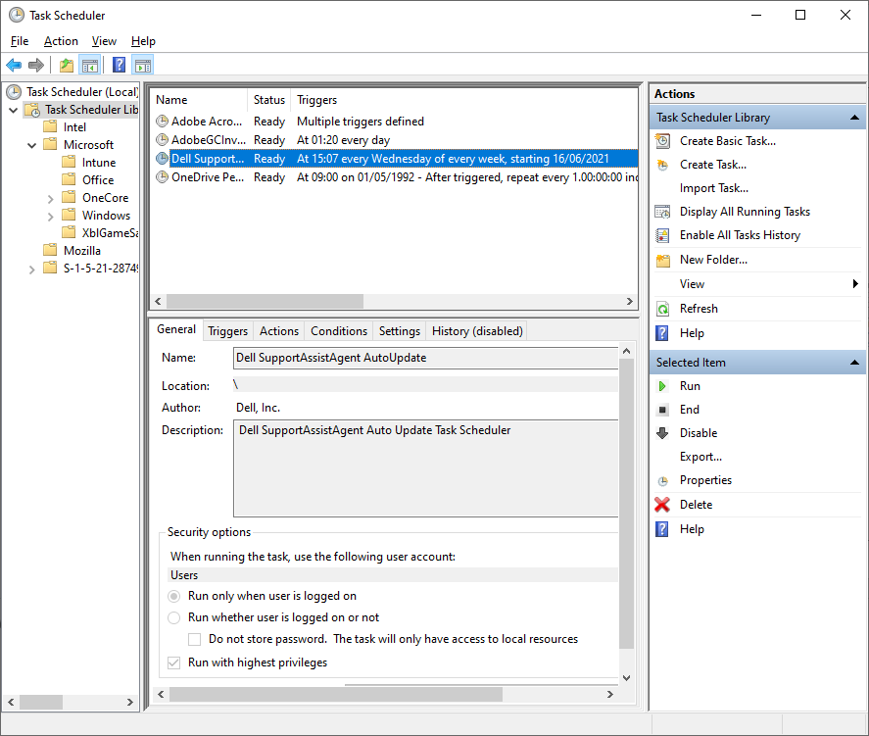
Task Scheduler (Slide 2 of 2)
Screenshot courtesy of Microsoft.

Slide 14
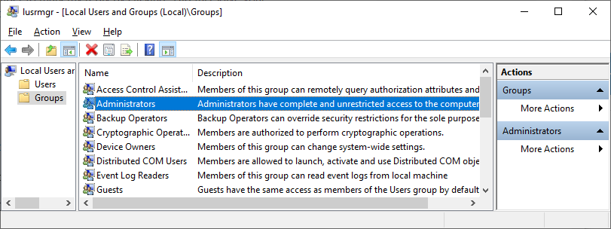
Local Users and Groups Console
Advanced interface for managing user accounts on the local system
Create and modify security groups for easier permissions management
Screenshot courtesy of Microsoft.
Notes:
While Local Users and Groups looks a lot like Active Directory Users and Computers (ADUC), it is used to only manage local users on the single system. ADUC is for domain-wide account and computer management.

Slide 15
Certificate Manager (Slide 1 of 2)
Manage digital certificates for identify of users, computers, or services
Facilitates verification of certificate information
Certmgr.msc (current user) or certlm.msc (computer certificates)
Notes:
Remind learners that deleting or revoking the trust of a certificate or CA within Certificate Manager is not reversable. Caution should be taken in Certificate Manager.

Slide 16
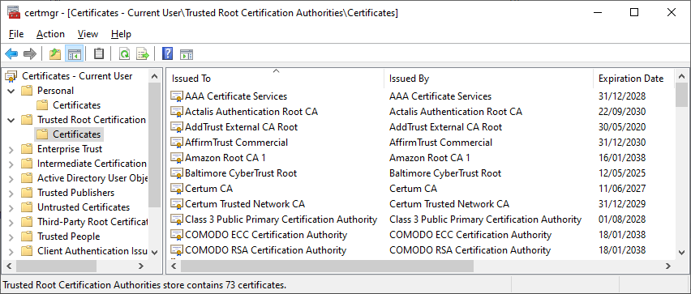
Certificate Manager (Slide 2 of 2)
Screenshot courtesy of Microsoft.
Notes:
Remind learners that deleting or revoking the trust of a certificate or CA within Certificate Manager is not reversable. Caution should be taken in Certificate Manager.

Slide 17
Group Policy Editor (Slide 1 of 2)
Manage local policies for users and computers
Configure Windows settings without direct registry changes
Apply settings efficiently system-wide

Slide 18
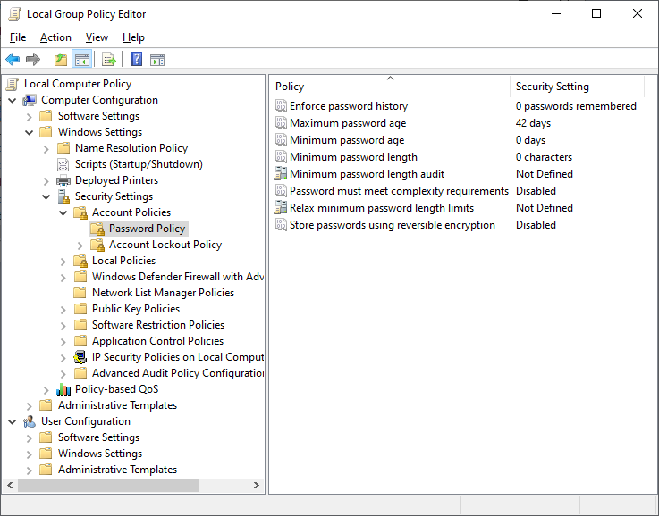
Group Policy Editor (Slide 2 of 2)
Screenshot courtesy of Microsoft.

Slide 19
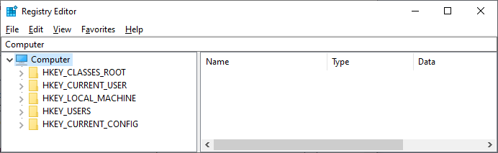
Registry Editor (Slide 1 of 2)
Five root keys
Screenshot courtesy of Microsoft.
Notes:
CAUTION! Instructors should caution learners about possible permanent damage to the system if registry settings are changed improperly! Exporting and backing up the registry should be completed before making any changes.

Slide 20
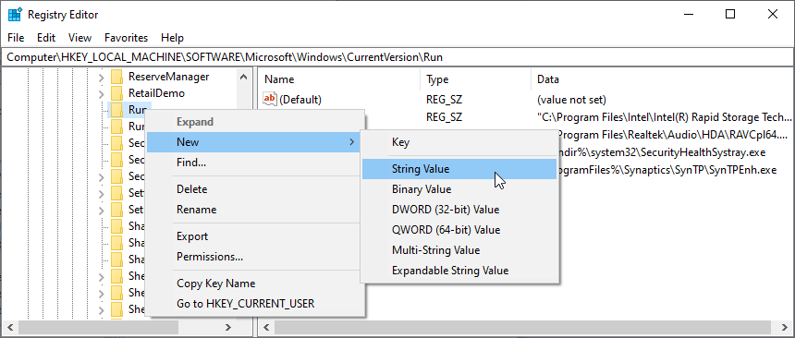
Registry Editor (Slide 2 of 2)
Edit settings and configurations of user accounts, hardware, applications, and operating system
Screenshot courtesy of Microsoft.
Notes:
Instructors should caution learners about possible permanent damage to the system if registry settings are changed improperly! Exporting and backing up the registry should be completed before making any changes.

Slide 21
Custom Microsoft Management Consoles (Slide 1 of 2)
Container for various snap-ins
Place all necessary snap-ins needed for job in one location
Notes:
Learners should practice creating custom MMCs. Instructors can utilize the Additional Resource Exercise: Create a Custom MMC Console Capstone to guide their learners.

Slide 22
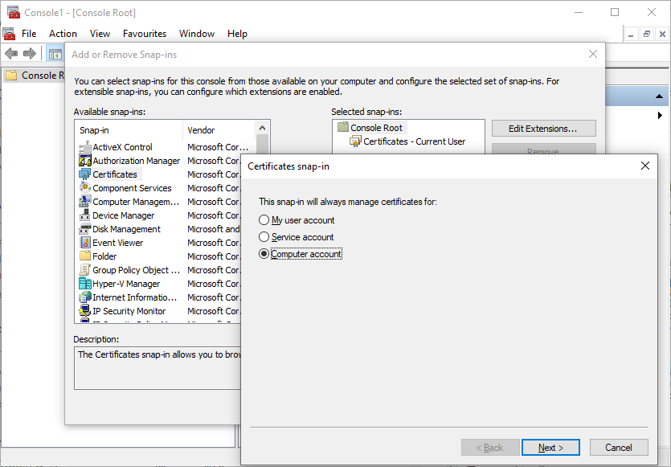
Custom Microsoft Management Consoles (Slide 2 of 2)
Screenshot courtesy of Microsoft.

Slide 23
Lab: Disk Management (available in CertMaster Learn and CertMaster Perform)
Lab: Users and Groups (available in CertMaster Learn and CertMaster Perform)
Applied Live Lab: Manage User Accounts (available in CertMaster Perform and CertMaster Labs)

Slide 24
Management Consoles
Device Manager
Disk Management Console
Disk Maintenance Tools
Task Scheduler
Local Users and Groups Console
Certificate Manager
Group Policy Editor
Registry Editor
Custom Microsoft Management Consoles
Notes:
Take some time at the end of each topic to answer questions. You can use the Lesson Review questions for discussion in class or set them for learners to complete individually during or after class.

Slide 25
Command-Line Tools
Lesson 13.2
Notes:
Core 2 Exam Objectives
1.5 Given a scenario, use the appropriate Microsoft command-line tools.
Learning Outcomes
What command would you use to copy files from one directory to another while preserving the directory structure?
How can you view detailed help information for a specific command in Command Prompt?
How can you assign a new drive letter to a volume using the diskpart command?
What switch would you use with the chkdsk command to fix file system errors?
How can you use the whoami command to display the security groups the current user belongs to, and why is this information useful for troubleshooting permission issues?

Slide 26
Command Prompt (Slide 1 of 2)
"Run As Administrator" option for elevated permissions
Syntax
order of command, switches, and arguments
CTRL+C
stop command execution
Help
command /? Or help command
Notes:
Learners should practice each command. Remind learner of the core commands but also the options for each command. Learners should be able to interpret on-screen results that will aid in troubleshooting issues.

Slide 27
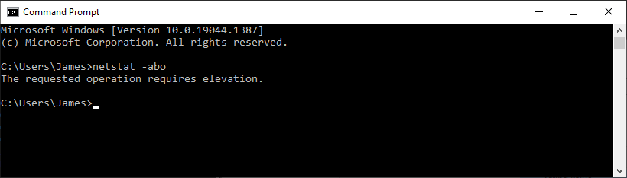
Command Prompt (Slide 2 of 2)
Screenshot courtesy of Microsoft.
Notes:
Learners should practice each command. Remind learner of the core commands but also the options for each command. Learners should be able to interpret on-screen results that will aide in troubleshooting issues.

Slide 28
Navigation Commands (Slide 1 of 2)
Dir
/o: (n, s, e, d)
/t: (c, a, w)
/a: (r, h, s, a)
Cd
..
\
Change drive
Type drive letter then : (D: or E:)

Slide 29
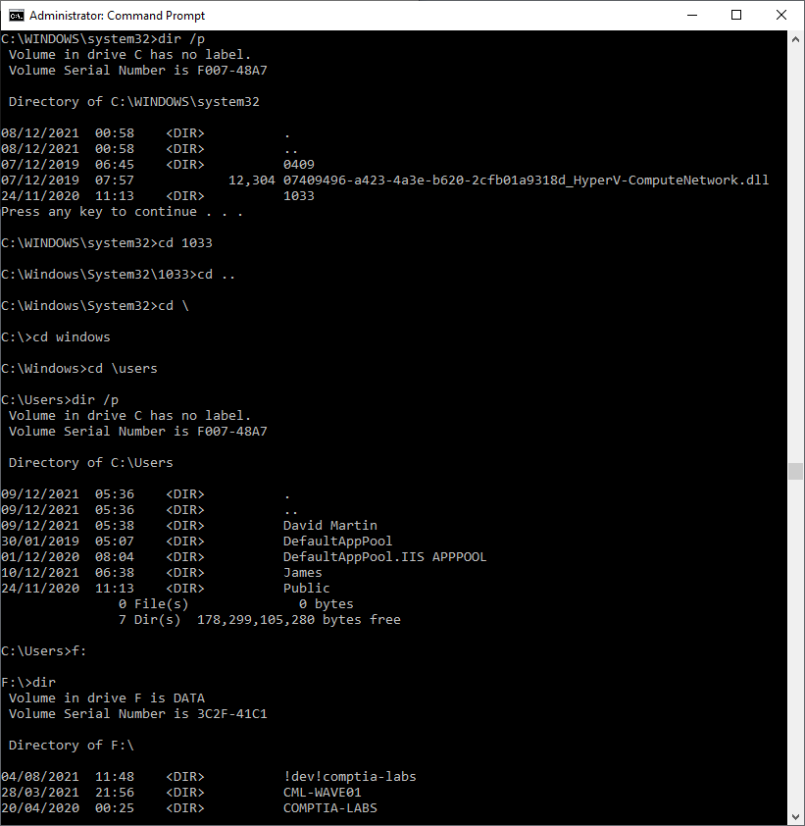
Navigation Commands (Slide 2 of 2)
Screenshot courtesy of Microsoft.

Slide 30
File Management Commands
move
copy
robocopy
Recommended for long filenames and NTFS attribute handling
md or mkdir
rd or rmdir

Slide 31
Disk Management Commands (Slide 1 of 2)
Diskpart
command line Disk Management tool
select disk x
detail disk
select partition x
assign, delete, extend
exit
format
Erases and reformats the drive
chkdsk
Scans file system and sectors for faults and attempts to repair
Notes:
Instructors should demo and consider learners’ practicing of these commands.

Slide 32
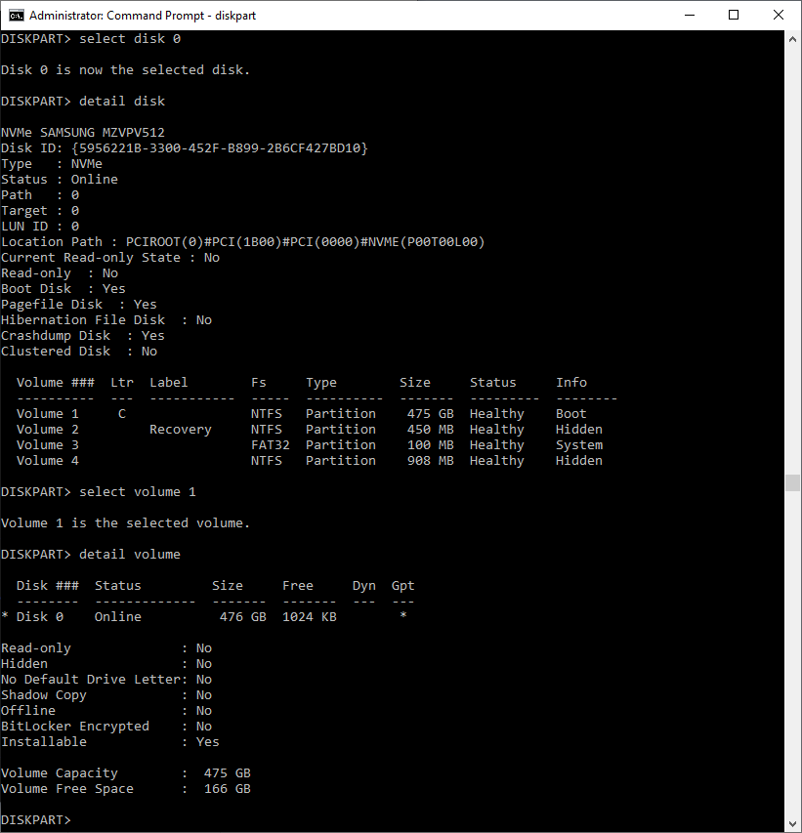
Disk Management Commands (Slide 2 of 2)
Screenshot courtesy of Microsoft.

Slide 33
System Management Commands (Slide 1 of 3)
shutdown
/s shutdown
/h hibernate
/l log off
/r restart
/t assign a delay to the shutdown command execution
Example: shutdown /r /t 45 will restart the system after 45 seconds

Slide 34
System Management Commands (Slide 2 of 3)
sfc
System file checker to fix corrupt or damaged system files
winver
Displays Windows version information
whoami
Displays current user who is logged in

Slide 35
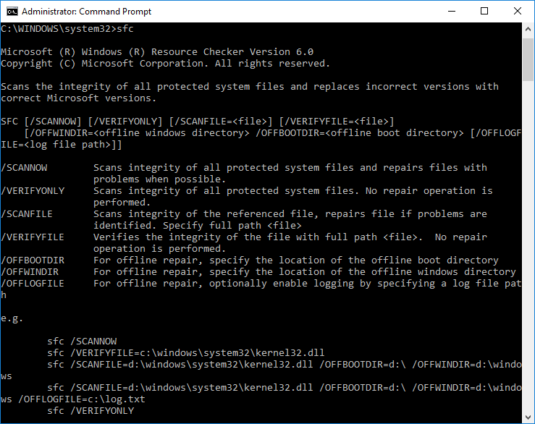
System Management Commands (Slide 3 of 3)
Screenshot courtesy of Microsoft.
Notes:
Describe the image as the System File Checker utility.
Consider showing the video Use System Management Commands to reinforce these concepts.

Slide 36
Lab: Manage Files and Folders (available in CertMaster Learn and CertMaster Perform)
Applied Live Lab: Configure File Storage (available in CertMaster Perform and CertMaster Labs)

Slide 37
Command-Line Tools
Command Prompt
Navigation Commands
File Management Commands
Disk Management Commands
System Management Commands
Notes:
Take some time at the end of each topic to answer questions. You can use the Lesson Review questions for discussion in class or set them for learners to complete individually during or after class.

Slide 38
Windows Networking
Lesson 13.3
Notes:
Core 2 Exam Objectives
1.7 Given a scenario, configure Microsoft Windows networking features on a client/desktop.
Learning Outcomes
How can you manually configure a wireless network connection if the SSID broadcast is suppressed?
What is the role of the 802.11 standard in wireless network connections?
How is a subnet mask used to distinguish between the network and host portions of an IP address?
How can you configure a static IP address for a network adapter in Windows?
How can you allow a specific application through the Windows Defender Firewall?

Slide 39
Windows Network Connection Types (Slide 1 of 3)
Wired
EthernetX, where x is the number of the interface
Configure by navigating to Device Manager > Properties > Advanced tab
Wireless
Scan for network or enter SSID manually
Connect automatically selection
Only for trusted networks
Notes:
While many learners may be familiar with connecting to wireless networks, instructors should still demonstrate both the auto and manual connection methods.

Slide 40
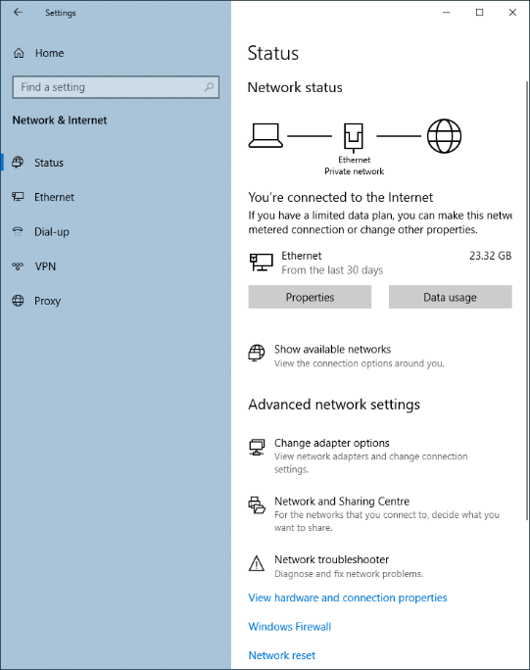
Windows Network Connection Types (Slide 2 of 3)
Screenshot courtesy of Microsoft.

Slide 41
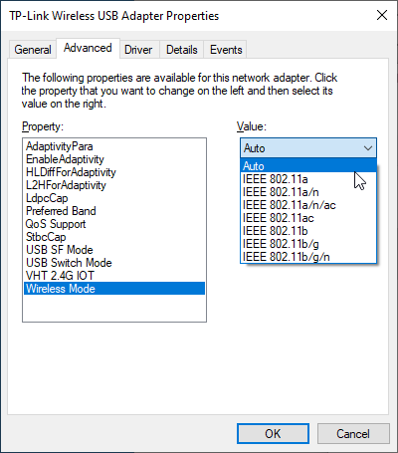
Windows Network Connection Types (Slide 3 of 3)
Screenshot courtesy of Microsoft.

Slide 42
IP Addressing Schemes
Configuration requirements
IP address
v4- 32-bit address
dotted decimal
v6- 128-bit address
hex notation
Subnet mask
Default gateway
DNS server IP
Static vs dynamic (DHCP)
Notes:
This may be a good time to review IP addressing basics from Module 6: Configuring Network Addressing and Internet Connections with learners. Networking concepts appear on both Core 1 and Core 2 exams.

Slide 43
Windows Client Configuration (Slide 1 of 3)
Network & Internet settings or Network Connections applet
DHCP is default configuration for adapters
Installed by default
Microsoft Networks
File and Printer Sharing for Microsoft Networks
IPv4 and IPv6
Link-layer Topology Discovery
Network mapping and discovery function

Slide 44
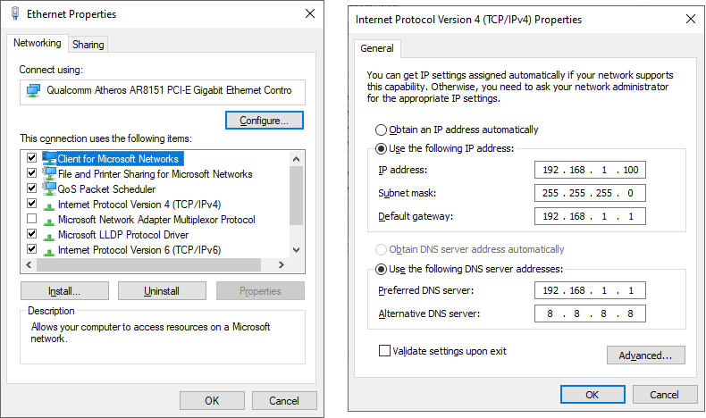
Windows Client Configuration (Slide 2 of 3)
Screenshot courtesy of Microsoft.

Slide 45
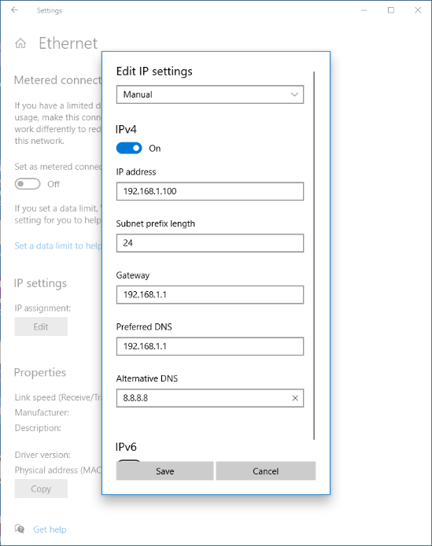
Windows Client Configuration (Slide 3 of 3)
Screenshot courtesy of Microsoft.

Slide 46
Network Location (Slide 1 of 3)
Firewall controlled by Windows Defender Firewall
Unless third party firewall is installed
Public, private, domain profiles
Public system
Not discoverable on network and sharing disabled
Private system
Discoverable on network and file and printer sharing
Domain
Used in enterprise environments
Firewall managed through a group policy
Notes:
Have learners try the interactive activity Network Location to check their understanding of public and private networks.

Slide 47
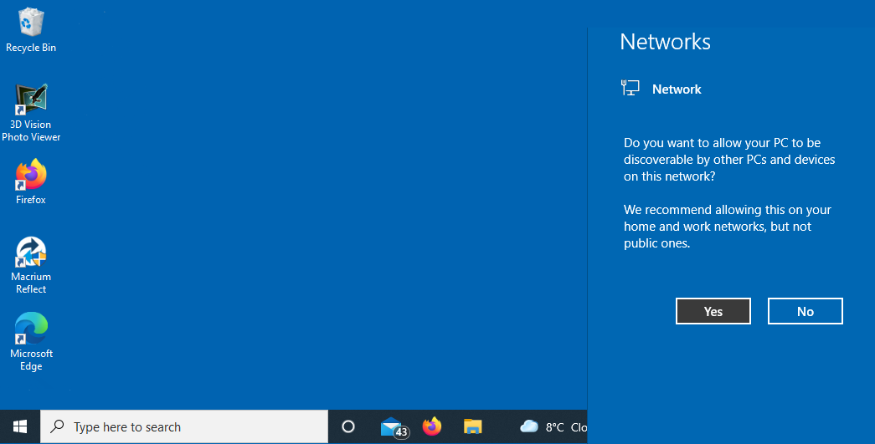
Network Location (Slide 2 of 3)
Screenshot courtesy of Microsoft.
Notes:
Set Network Location prompt

Slide 48
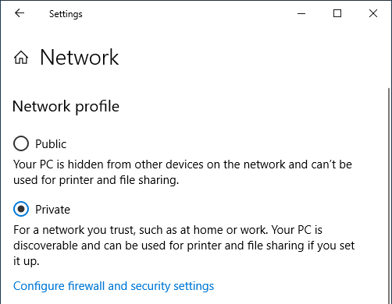
Network Location (Slide 3 of 3)
Screenshot courtesy of Microsoft.
Notes:
Using Network & Internet settings to change the network profile

Slide 49
Windows Defender Firewall Configuration (Slide 1 of 3)
Windows Security Center
Set firewall and network protection
Allow or Block program or communication protocols
Notes:
Learners should familiarize themselves with firewall operations and how to setup rules in the ACL.

Slide 50
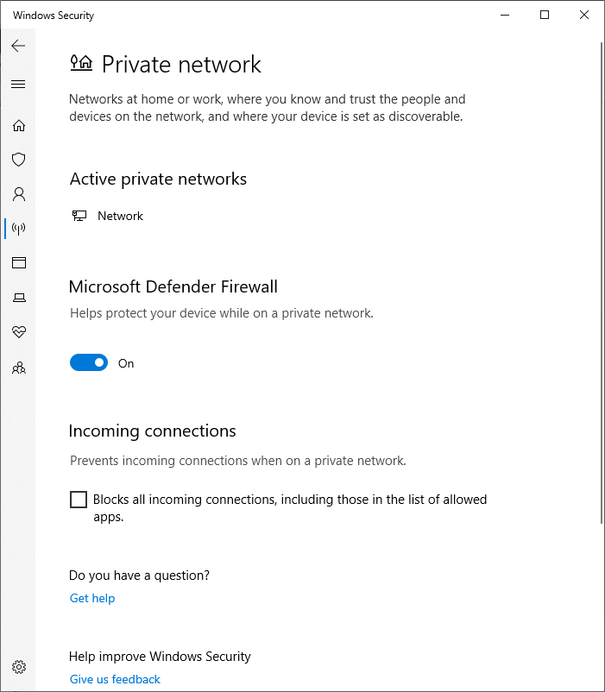
Windows Defender Firewall Configuration (Slide 2 of 3)
Screenshot courtesy of Microsoft.
Notes:
Setting the firewall state via the Windows Security Center

Slide 51
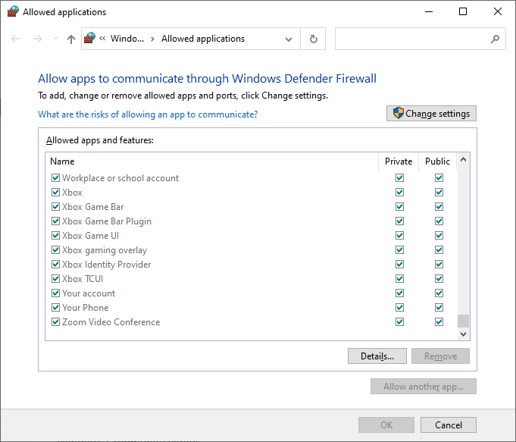
Windows Defender Firewall Configuration (Slide 3 of 3)
Screenshot courtesy of Microsoft.
Notes:
Windows Firewall Allowed Applications

Slide 52
VPN and WWAN Connection Types (Slide 1 of 3)
Connects components together via a secure encrypted connection
Various options are available for VPN type
Third-party VPN apps for specific software
NordVPN, ExpressVPN, etc.
Wireless wide area networks
Cellular access card
Metered connection setting
Notes:
Instructors may wish to demonstrate VPN use through a third-party or the Windows VPN connection tool if they have access to a VPN. Learners can also practice using the Lab: Configure a VPN Connection in CertMaster.

Slide 53
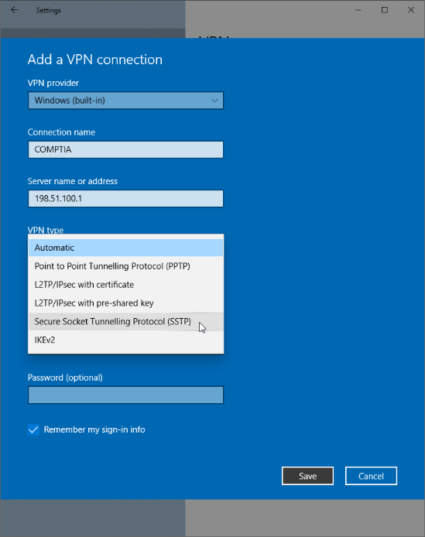
VPN and WWAN Connection Types (Slide 2 of 3)
Screenshot courtesy of Microsoft.
Notes:
Configuring a new VPN connection

Slide 54
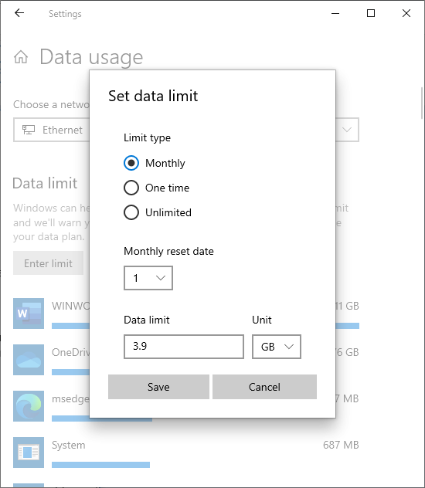
VPN and WWAN Connection Types (Slide 3 of 3)
Screenshot courtesy of Microsoft.
Notes:
Configuring a data limit for a metered network.

Slide 55
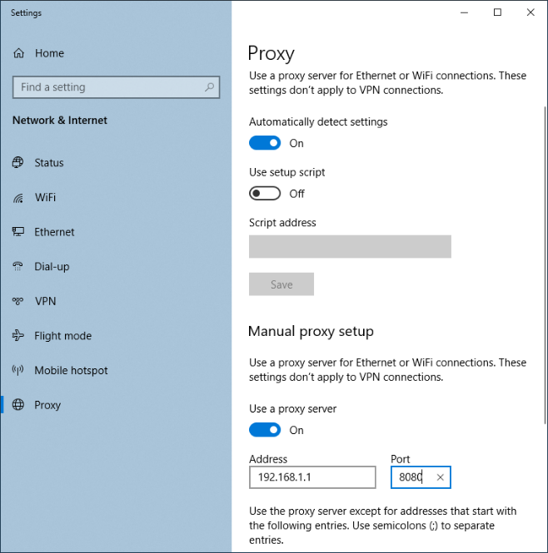
Proxy Settings
Improves performance and security
Saves bandwidth through local cache of web content
IP and port of proxy server
Port 8080 is common
Screenshot courtesy of Microsoft.
Notes:
Use the Settings app to apply a manual proxy setup

Slide 56
Lab: Configure a VPN Connection (available in CertMaster Learn and CertMaster Perform)
Lab: Local Firewall Settings (available in CertMaster Learn and CertMaster Perform)
Lab: Configure TCP/IP Settings on Windows 10 (available in CertMaster Learn and CertMaster Perform)
Lab: Configure TCP/IP Settings on Windows 11 (available in CertMaster Learn and CertMaster Perform)
Applied Live Lab: Manage Network and Security Settings (available in CertMaster Perform and CertMaster Labs)

Slide 57
Challenge Live Lab: Manage Windows Workstations (available in CertMaster Perform and CertMaster Labs)
Challenge Live Lab: Set Up Windows Workstations (available in CertMaster Perform and CertMaster Labs)

Slide 58
Windows Networking
Windows Network Connection Types
IP Addressing Schemes
Windows Client Configuration
Network Location
Windows Defender Firewall Configuration
VPN and WWAN Connection Types
Proxy Settings
Notes:
Take some time at the end of each topic to answer questions. You can use the Lesson Review questions for discussion in class or set them for learners to complete individually during or after class.

