Slide 1
Exam 220-1202
A+ Core 2

Slide 2
Securing Windows
A+ 220-1202
Module 15

Slide 3
Learning Outcomes
Prepare for A+ Core 2 by:
Configuring Windows networking
Troubleshooting Windows networking
Configuring Windows security settings
Managing Windows shares

Slide 4
Logical Security Concepts
Lesson 15.1
Notes:
Core 2 Exam Objectives
1.5 Given a scenario, use the appropriate Microsoft command-line tools.
2.1 Summarize various security measures and their purposes.
2.2 Given a scenario, configure and apply basic Microsoft Windows OS security settings.
Learning Outcomes
What is the CIA Triad?
What is Identity and Access Management?
What is the difference between a local account and a Microsoft account?
How does Just-In-Time access work?
What is zero trust?

Slide 5
Logical Security Controls
IAM
Identification, Authentication, Authorization, Access Control
Access control lists
Implicit deny
Deny everything unless a rule says to allow it
Least privilege
Provide the right access for each user or system
Nothing more, nothing less
Notes:
Instructors should differentiate the IAAA shown here from the AAA (Authentication, Authorization, Accounting) acronym.

Slide 6
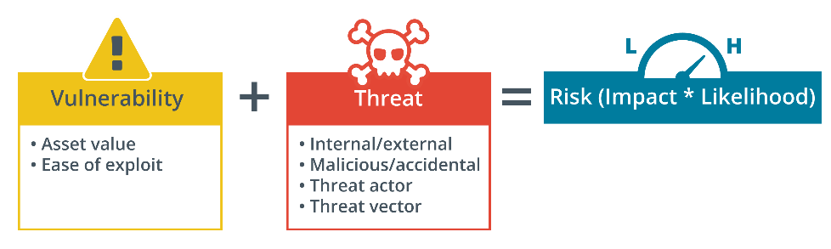
Information Security
Vulnerability
Any weakness that, if exploited, could cause damage or a security breach
Threat
Potential to exploit a vulnerability and breach the system
Risk
Likelihood and impact of threat actor exercising vulnerability
Notes:
Instructors should define each of the terms on the slide. Learners should be able to provide examples of each. Vulnerability, exploit, threat actor, threat vector, and risk are key principles of security.

Slide 7
Hashing and Encryption Concepts
Symmetric
Single key
Asymmetric
Key pair
Hash
Function takes any amount of data and produces a fixed length output (digest)
Does NOT contain the actual data
Used primarily for integrity checks
Notes:
Instructors need to ensure learners understand each style of cryptography and the difference between encryption and hashing algorithms.

Slide 8
Digital Signatures and Key Exchange
Digital signature
Proves a message or digital certificate has not been altered or spoofed
Key exchange
Allows two systems to exchange a key used for encryption
Asymmetric algorithm keys used to encrypt symmetric keys for the exchange

Slide 9
User and Group Accounts (Slide 1 of 2)
Local
Only used for accessing a single system or entity
Microsoft account
Profile can sync through an online portal
Security groups
Collection of accounts that will be assigned similar permissions
Administrator group
All files and objects in system
Guest group
Legacy group with same permissions as User group
Power user group
Between Users group and full administrator
Notes:
Instructors should inform learners that the Power User group only exists today for legacy account configurations; Windows 10/11 assigns the same permissions as the standard Users group.

Slide 10
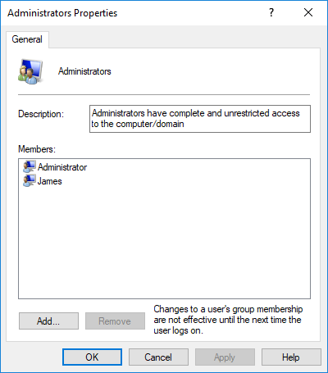
User and Group Accounts (Slide 2 of 2)
Local Users and Groups
net user commands
Manage accounts using command line utility
Screenshot courtesy of Microsoft.
Notes:
Learners should practice with the net user command.

Slide 11
User Account Control (Slide 1 of 3)
Just-in-Time access
Privileged Access Management
UAC provides implementation of JIT and PAM in Windows
User must confirm UAC pop up for change to be made
Notes:
Learners should be made aware that the built-in Administrator user account for Windows has UAC disabled.

Slide 12
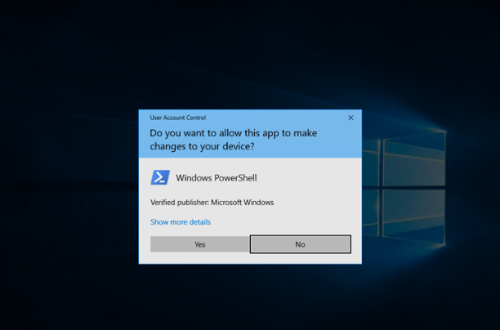
User Account Control (Slide 2 of 3)
Screenshot courtesy of Microsoft.
Notes:
UAC requires confirmation of the use of administrator privileges.

Slide 13
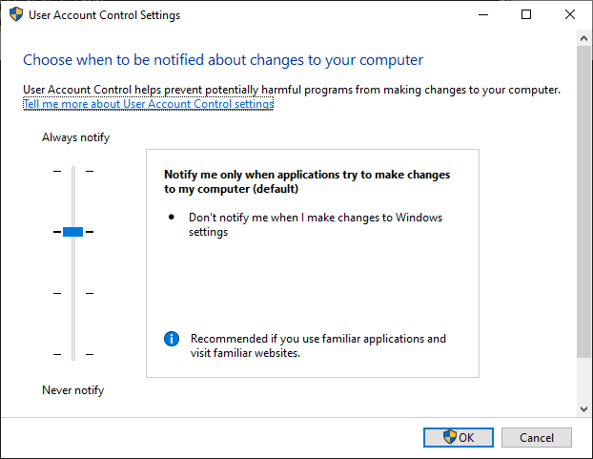
User Account Control (Slide 3 of 3)
Screenshot courtesy of Microsoft.
Notes:
Configuring UAC notifications

Slide 14
Authentication Methods
Proving you are what you say you are
Zero trust framework
No automatic trust of user or device
Multifactor authentication
Something you know, something you have, something you are, something you do, somewhere you are/aren't
2-step verification
One-time passwords
Authenticator applications
Hard token authentication
Notes:
Instructors should provide examples of each authentication factor type. Consider showing learners the Authentication video to reinforce these concepts.

Slide 15
Lab: Create User Accounts (available in CertMaster Learn and CertMaster Perform)

Slide 16
Logical Security Concepts
Logical Security Controls
Information Security
Hashing and Encryption Concepts
Digital Signatures and Key Exchange
User and Group Accounts
User Account Control
Authentication Methods
Notes:
Take some time at the end of each topic to answer questions. You can use the Lesson Review questions for discussion in class or set them for learners to complete individually during or after class.

Slide 17
Windows Security Settings
Lesson 15.2
Notes:
Core 2 Exam Objectives
1.5 Given a scenario, use the appropriate Microsoft command-line tool.
2.1 Summarize various security measures and their purposes.
2.2 Given a scenario, configure and apply basic Microsoft Windows OS security settings.
Learning Outcomes
What is the principle that states that a user should be granted the minimum possible rights necessary to perform the job?
When are security groups typically used?
What command would be used to add a new user account and force the user to choose a new password at first login?
What are the types of authentication factors?
Which Windows login option uses either a PIN, biometrics, or a security key?
What type of software is designed to apply security policies to the use of mobile devices in the enterprise?

Slide 18
Windows Login Options (Slide 1 of 2)
Local, Windows network, remote login
Username and password
Windows Hello
Pin
Fingerprint
Facial recognition
Security key
Single sign-on
Security Assertions Markup Language (SAML)

Slide 19
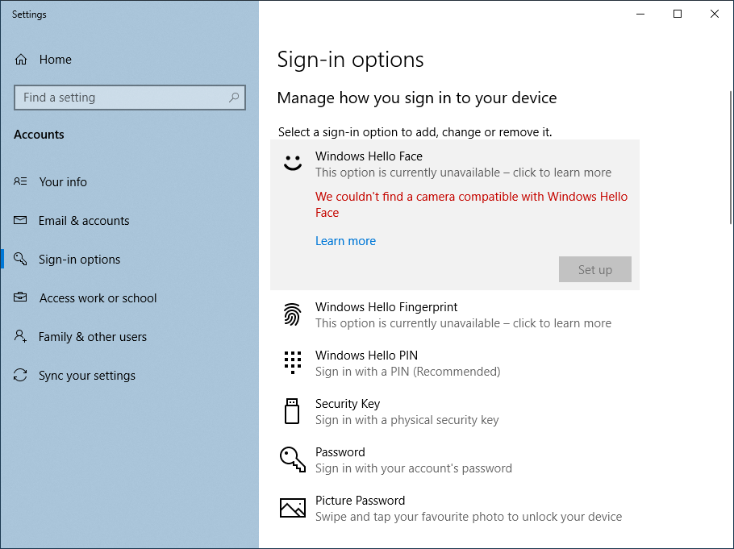
Windows Login Options (Slide 2 of 2)
Screenshot courtesy of Microsoft.
Notes:
Configuring Windows Hello sign-in options

Slide 20
Windows Domains and Active Directory (Slide 1 of 2)
Domain controllers
Server that stores a copy of the network information for Active Directory
Member servers
Servers that are members of the domain but do not store a copy of Active Directory info
Security groups
Organizational units (OUs)
Notes:
Learners should be directed to the Lab: Create OUs to practice with Active Directory environments. Consider showing learners the video Managing People and Security at Company Scale to reinforce these concepts.

Slide 21
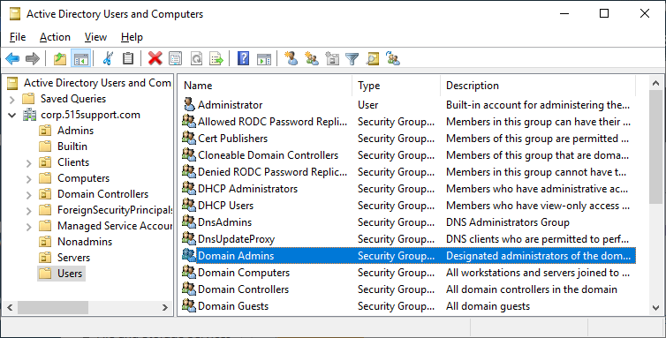
Windows Domains and Active Directory (Slide 2 of 2)
Screenshot courtesy of Microsoft.
Notes:
Security groups in Active Directory

Slide 22
Group Policy and Login Scripts (Slide 1 of 2)
Group Policy Management console
Update policy
gpupdate command
gpresult command
Login scripts
Notes:
Learners should be directed to the Lab: Use System Commands

Slide 23
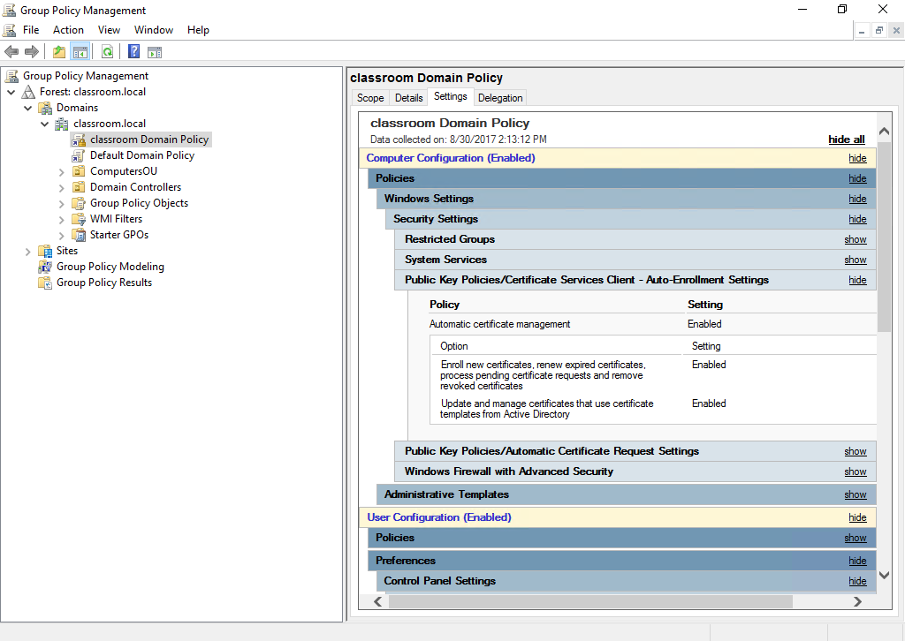
Group Policy and Login Scripts (Slide 2 of 2)
Screenshot courtesy of Microsoft.
Notes:
Group Policy Management

Slide 24
Lab: Create OUs (available in CertMaster Learn and CertMaster Perform)
Lab: Use System Commands (available in CertMaster Learn and CertMaster Perform)
Lab: Group Policy Management (available in CertMaster Learn and CertMaster Perform)

Slide 25
Windows Security Settings
Windows Login Options
Windows Domains and Active Directory
Group Policy and Login Scripts
Notes:
Take some time at the end of each topic to answer questions. You can use the Lesson Review questions for discussion in class or set them for learners to complete individually during or after class.

Slide 26
Windows Shares
Lesson 15.3
Notes:
Core 2 Exam Objectives
1.5 Given a scenario, use the appropriate Microsoft command-line tools.
1.7 Given a scenario, configure Microsoft Windows networking features on a client/desktop.
2.2 Given a scenario, configure and apply basic Microsoft Windows OS security settings.
Learning Outcomes
What network type must be selected to make the computer discoverable and allow sharing?
What tab in the folder's Properties dialog can be used to customize permissions, change the share name, and limit the number of simultaneous connections?
What is the process to map a network drive?
Which permission would take precedence - Explicit Deny or Explicit Allow?
What is a home folder?

Slide 27
Workgroup Setup (Slide 1 of 2)
Join a workgroup
System Properties menu
Network discovery and advanced sharing
File sharing
Printer sharing

Slide 28
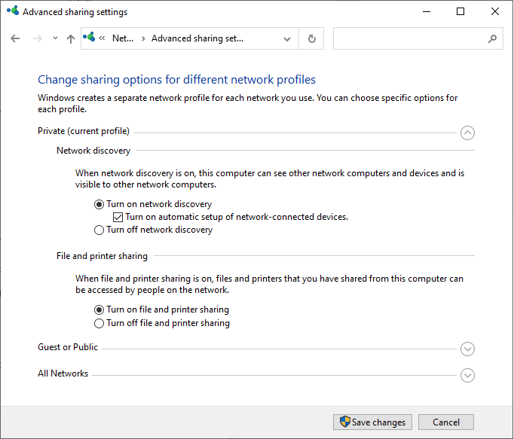
Workgroup Setup (Slide 2 of 2)
Screenshot courtesy of Microsoft.
Notes:
Advanced sharing settings

Slide 29
File Share Configuration (Slide 1 of 2)
Right-click item and select Give access to
Select account, and then permissions
Customize permissions
Properties menu
Share tab
Notes:
Instructors should demonstrate the process to grant permissions.

Slide 30
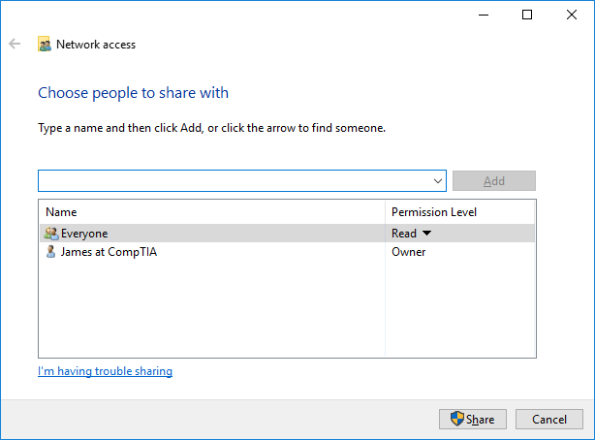
File Share Configuration (Slide 2 of 2)
Screenshot courtesy of Microsoft.
Notes:
Configuring a file share

Slide 31
Network Browsing and Mapping Drives (Slide 1 of 3)
Network object in File Explorer
Shows any networked device connected to the same network
Mapped Drives
Network shares that can be reconnected every time a user logs in
net and net use command
Notes:
Instructors should demonstrate the net view and net use commands.

Slide 32
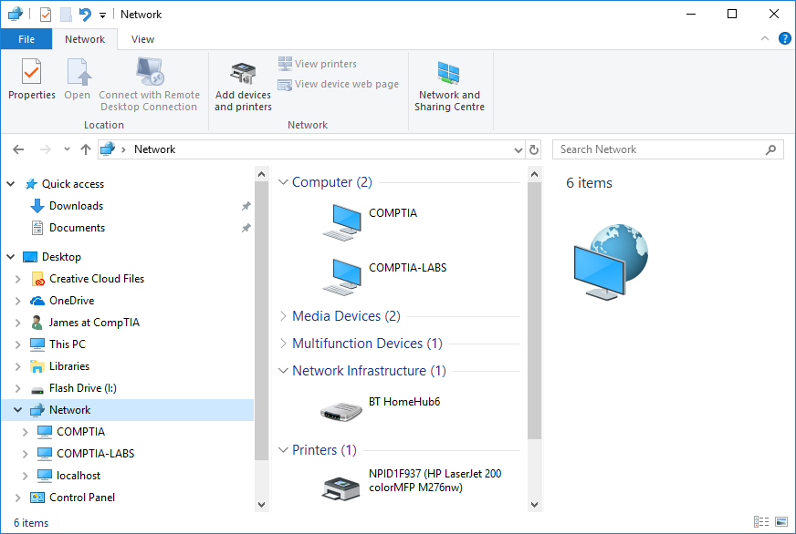
Network Browsing and Mapping Drives (Slide 2 of 3)
Screenshot courtesy of Microsoft.
Notes:
Viewing devices in a workgroup network

Slide 33
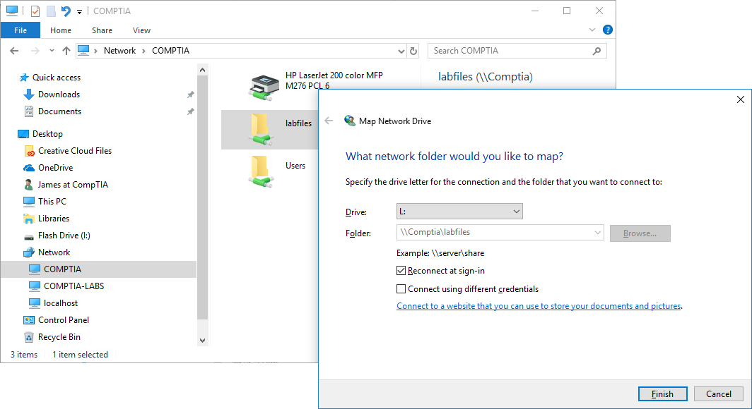
Network Browsing and Mapping Drives (Slide 3 of 3)
Screenshot courtesy of Microsoft.
Notes:
Mapping a network drive to a LABFILES share hosted on COMPTIA (\\COMPTIA\labfiles)

Slide 34
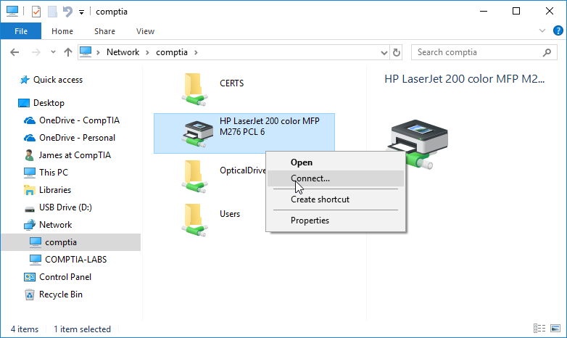
Printer Sharing
Printer Properties > Sharing tab
Additional drivers should be made available for different OSs that may connect to printer
Screenshot courtesy of Microsoft.
Notes:
Image of connecting to a printer shared via the COMPTIA PC

Slide 35
NTFS versus Share Permissions (Slide 1 of 2)
Share permissions only apply when accessed over a network
NTFS permissions are applied to the resource on local and network access
NTFS permissions are set on Security tab of Properties dialog
Read, write, execute
Explicit vs implicit deny or allow
Notes:
Learners can be directed to the Lab: Permissions Inheritance.

Slide 36
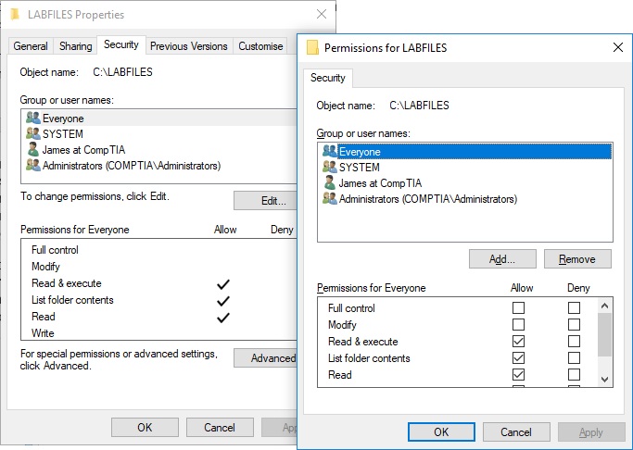
NTFS versus Share Permissions (Slide 2 of 2)
Screenshot courtesy of Microsoft.
Notes:
Configuring NTFS permissions via the Security tab for a folder

Slide 37
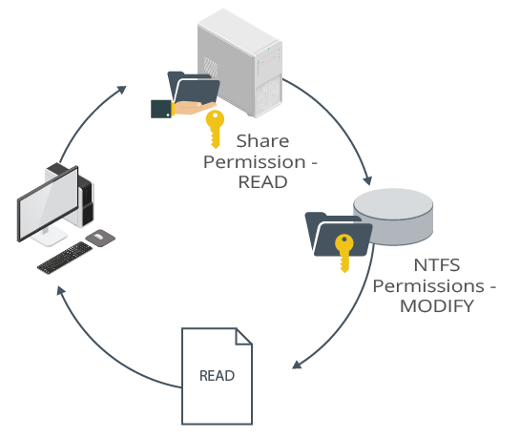
Permissions Inheritance
Parent folder permissions trickle down to child subfolders and files
Share permissions for across network access
NTFS permissions enforced for network and local access
Most restrictive permission becomes effective permission
If one permission not allowed, the other allow, then not allow will be effective
Image © 123RF.com.
Notes:
Instructors should ensure learners understand that inheritance is on by default but can be disabled under the security permission settings of the item.

Slide 38
Domain Setup (Slide 1 of 3)
Control and permissions set through group policy and domain security policy
Account settings app
Access work or school option
Can also use System Properties menu

Slide 39
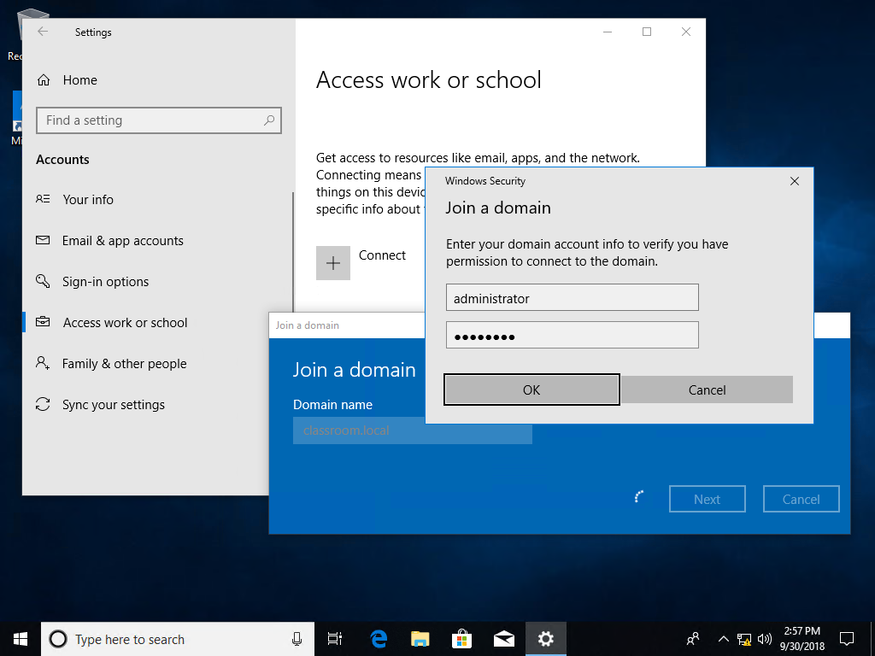
Domain Setup (Slide 2 of 3)
Screenshot courtesy of Microsoft.
Notes:
Joining a domain using the Settings app

Slide 40
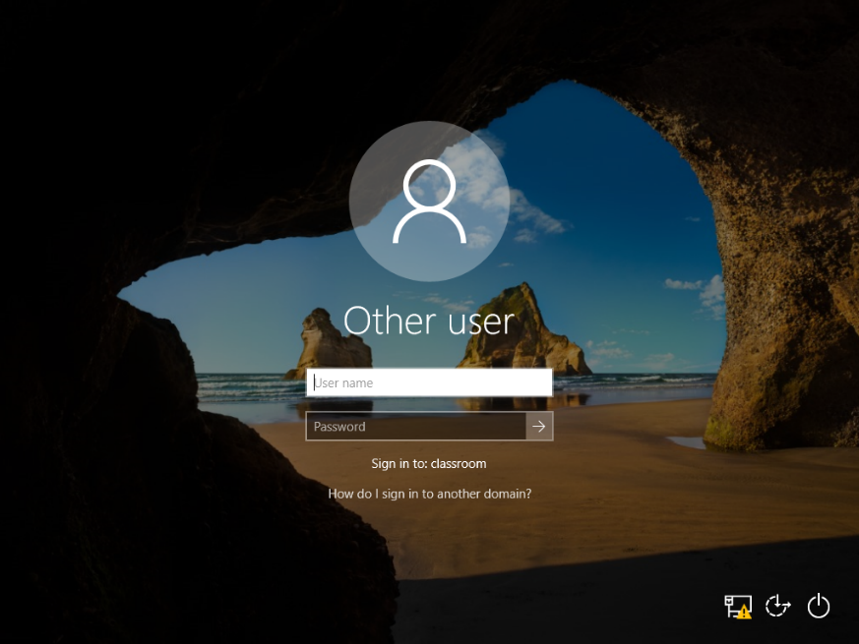
Domain Setup (Slide 3 of 3)
Screenshot courtesy of Microsoft.
Notes:
Signing in to a domain

Slide 41
Home Folders (Slide 1 of 3)
Store files on server rather than local workstation
Centralized storage allows monitoring and regular back up
Can be mapped using the profile settings of user account

Slide 42
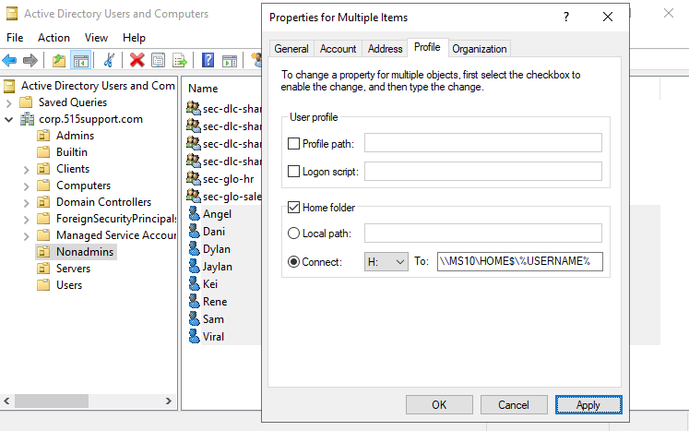
Home Folders (Slide 2 of 3)
Screenshot courtesy of Microsoft.
Notes:
When the user signs in, the home folder appears under This PC with the allocated drive letter.

Slide 43
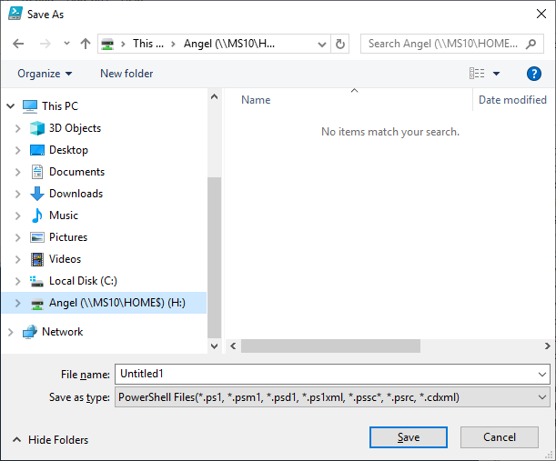
Home Folders (Slide 3 of 3)
Screenshot courtesy of Microsoft.
Notes:
Using the home folder location to save a file

Slide 44
Roaming Profiles and Folder Redirection (Slide 1 of 2)
Allows users to log in anywhere on network and have access to their files, applications, and settings
Redirect profile folders to server-based storage for resiliency

Slide 45
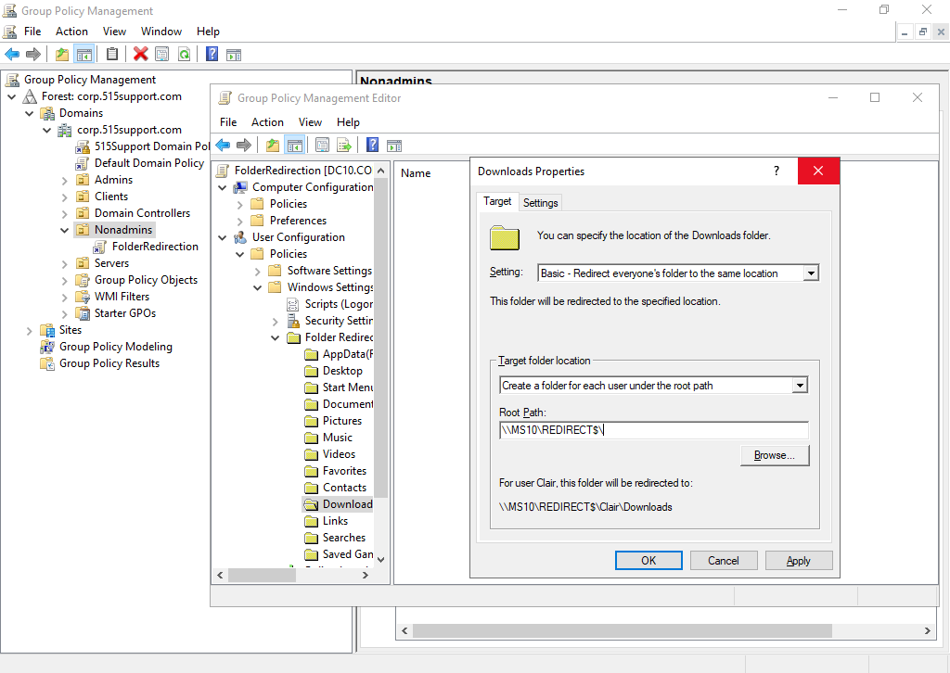
Roaming Profiles and Folder Redirection (Slide 2 of 2)
Screenshot courtesy of Microsoft.
Notes:
Using GPO to redirect the Nonadmins OU Download folder to a network file server

Slide 46
Lab: Configure NTFS Permissions (available in CertMaster Learn and CertMaster Perform)
Lab: Support AD Domain Networking (available in CertMaster Learn and CertMaster Perform)
Challenge Live Lab: Manage Domain Accounts (available in CertMaster Perform and CertMaster Labs)

Slide 47
Windows Shares
Workgroup Setup
File Share Configuration
Network Browsing and Mapping Drives
Printer Sharing
NTFS versus Share Permissions
Permissions Inheritance
Domain Setup
Home Folders
Roaming Profiles and Folder Redirection
Notes:
Take some time at the end of each topic to answer questions. You can use the Lesson Review questions for discussion in class or set them for learners to complete individually during or after class.

