Slide 1
Exam 220-1202
A+ Core 2

Slide 2
Managing Security Settings
A+ 220-1202
Module 19

Slide 3
Learning Outcomes
Prepare for A+ Core 2 by:
Configuring workstation security
Configuring browser security
Troubleshooting workstation security issues

Slide 4
Account Security
Lesson 19.1
Notes:
Core 2 Exam Objectives
2.7 Given a scenario, apply workstation security options and hardening techniques.
Learning Outcomes
What considerations should be made when selecting a password?
How does encryption of your data make it more difficult to access?
What best practices should be enabled on your personal accounts? Are they the same for corporate accounts?
What methods can be used to restrict access to the system and the data it contains?
What applications manage security policies in an Active Directory environment?

Slide 5
Password Best Practices (Slide 1 of 2)
Make password sufficiently long
Use passphrase, rather than password
NO personal info
Expiration requirements
Notes:
Learners should be reminded that the National Institute of Standards of Technology (NIST) have established password recommendations under SP-800-63 Appendix A and the International Organization of Standards (ISO) established their recommendations under ISO 27001:2022 Annex A:9 Access Control.
NIST no longer recommends changing passwords at regular intervals. They recommend only changing a password if it is known or thought to be compromised.

Slide 6
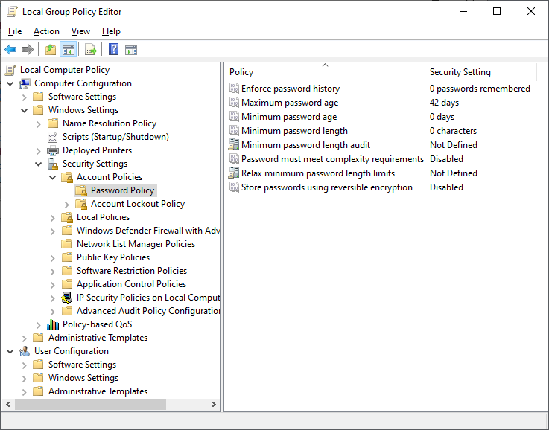
Password Best Practices (Slide 2 of 2)
Screenshot courtesy of Microsoft.

Slide 7
End User Best Practices
Log off when not using system
START+ L keys
Secure critical systems from theft
Secure PII and passwords
Use password manager
Notes:
Note: Personal data is typically protected by regulations and legislation. Making any sort of unauthorized copy of this data is often illegal. It should only typically be stored and processed in systems that are configured and monitored by a data owner.

Slide 8
Restrict User Permissions
Least privilege principle
Fewest number of accounts with administrative rights as possible
Ensure UAC or sudo features are enabled

Slide 9
Change Default Administrator Account and Password
"Administrator" in WINDOWS and root in Linux/Unix; accounts should be changed and disabled from use
If not possible, change the default password
Create unique accounts with administrative access for admin use
Separation of duties

Slide 10
Disable Guest Account
Guest accounts do not require authentication
Disable all guest account use
Accountability for all users with unique accounts for each user

Slide 11
Account Policies (Slide 1 of 2)
Restrict login times
Working hours/logon hours
Account expiration
Failed login attempt lockout
Concurrent logins
Use timeout/screen locks
Notes:
Note: These tools are not available in the Home edition of Windows.

Slide 12
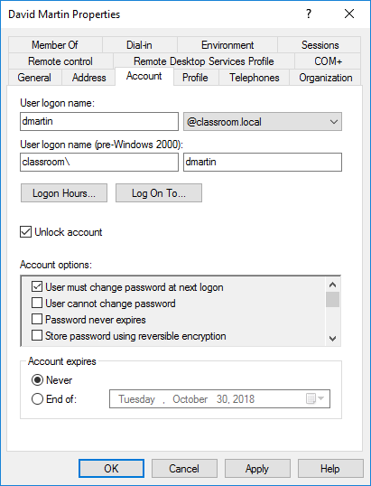
Account Policies (Slide 2 of 2)
Screenshot courtesy of Microsoft.

Slide 13
Unused Services
Disable all unused services
Includes wi-fi, Bluetooth, and NFC connections
Disable file and print services not necessary to operation of the system

Slide 14
Lab: Enforce Password Settings (available in CertMaster Learn and CertMaster Perform)
Lab: User Policy Management (available in CertMaster Learn and CertMaster Perform)
Applied Live Lab: Configure Domain Account Security (available in CertMaster Perform and CertMaster Labs)

Slide 15
Account Security
Password Best Practices
End User Best Practices
Restrict User Permissions
Change Default Administrator Account and Password
Disable Guest Account
Account Policies
Unused Services
Notes:
Take some time at the end of each topic to answer questions. You can use the Lesson Review questions for discussion in class or set them for learners to complete individually during or after class.

Slide 16
Workstation Security
Lesson 19.2
Notes:
Core 2 Exam Objectives
2.2 Given a scenario, configure and apply basic Microsoft Windows OS security settings.
2.7 Given a scenario, apply workstation security options and hardening techniques.
Learning Outcomes
What protections does the Windows Defender application provide to a workstation?
What type of firewall is Windows Defender Firewall?
What encryption programs are available within the Windows operating system environment?

Slide 17
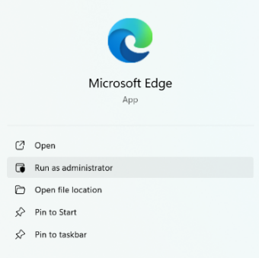
Execution Control
Restrict use of elevated permissions
"Run As administrator"
UAC warning
Asmin account login requirement
Screenshot courtesy of Microsoft.

Slide 18
Trusted/Untrusted Software Sources
Download from trusted sources
Scan all downloads
Verify digital signatures and/or file hash
Remove all unnecessary software applications

Slide 19
AutoRun and AutoPlay (Slide 1 of 2)
Disable Autorun and AutoPlay
Autorun.inf
Configured under a drive's property dialog box
Notes:
Prevents auto execution or installation of files, programs, and applications.

Slide 20
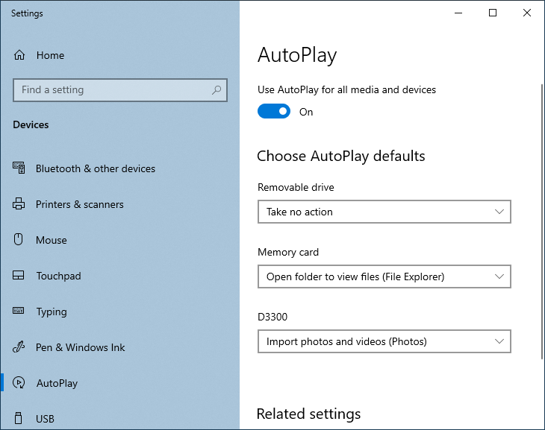
AutoRun and AutoPlay (Slide 2 of 2)
Screenshot courtesy of Microsoft.

Slide 21
Windows Defender Antivirus (Slide 1 of 2)
Detect and prevent execution of malware
Host-based system
Settings and rules are only for that single node, unless managed through group policy
Notes:
Instructors may want to review host-based vs. network-based solutions along with false positive and false negative indications.

Slide 22
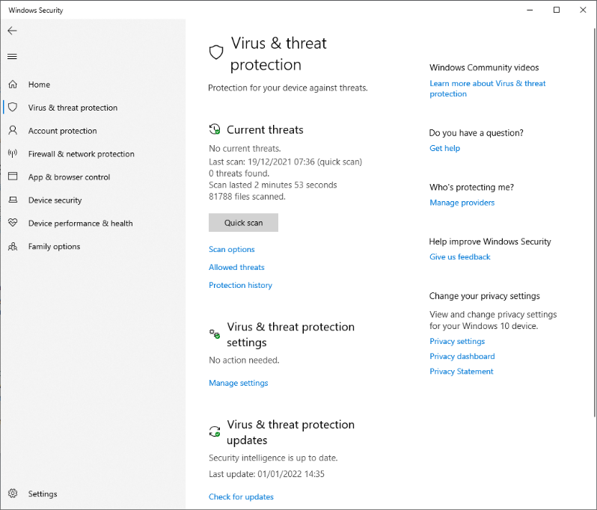
Windows Defender Antivirus (Slide 2 of 2)
Screenshot courtesy of Microsoft.

Slide 23
Windows Defender Antivirus Updated Definitions
Definitions
Identify malware using signatures and heuristic models
Daily and sometimes hourly updates
Scan engine
Improves software performance

Slide 24
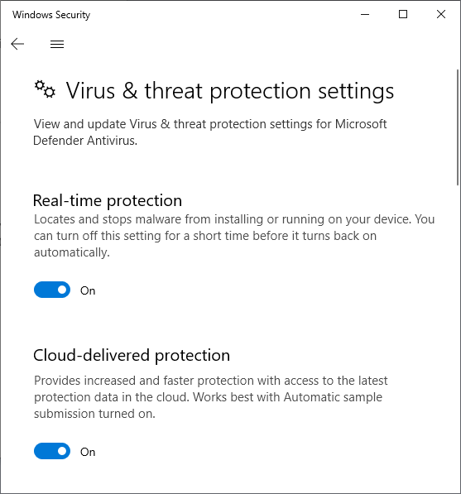
Activating and Deactivating Windows Defender Antivirus
Temporary disable
Real-time protection slider
Third-party antivirus/ antimalware software installed
Screenshot courtesy of Microsoft.

Slide 25
Windows Defender Firewall (Slide 1 of 3)
Inbound/outbound Rules
Port security
Application security
Triggers
Notes:
Learners should practice creating rules within Windows Defender.

Slide 26
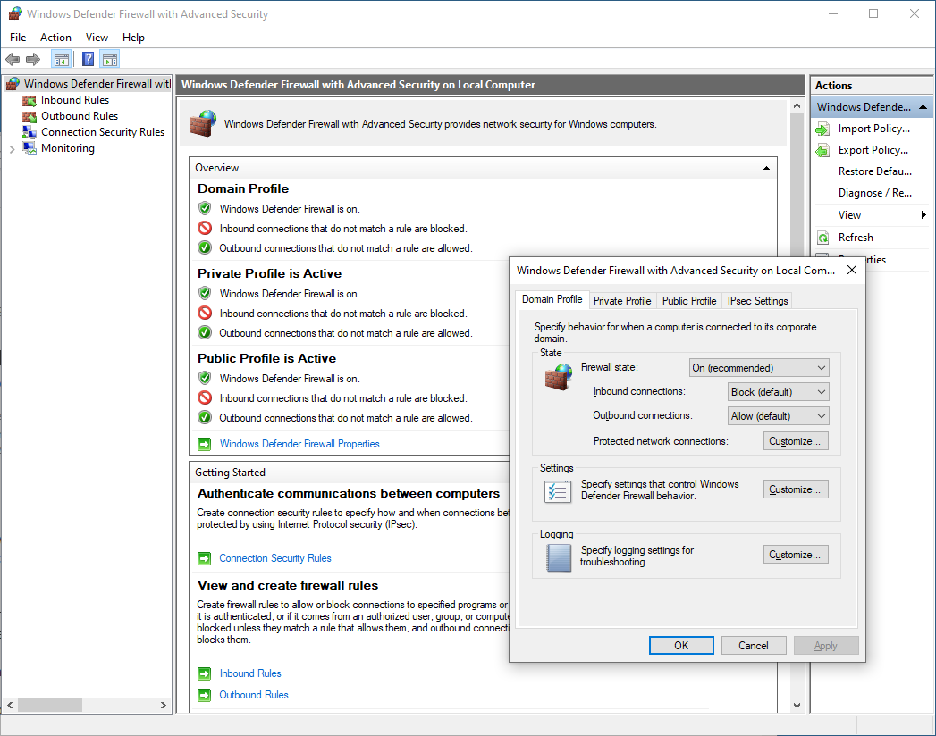
Windows Defender Firewall (Slide 2 of 3)
Screenshot courtesy of Microsoft.
Notes:
Note: Block stops traffic unless a specific rule allows it. Conversely, Allow accepts all traffic unless a specific rule blocks it. You can also use Block all connections to stop inbound connections regardless of the rules set up.

Slide 27
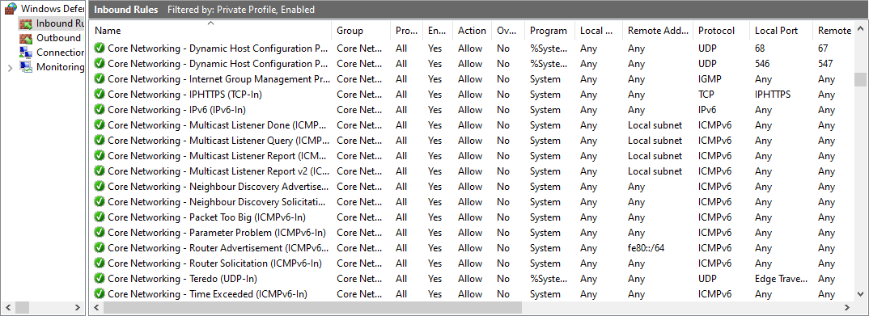
Windows Defender Firewall (Slide 3 of 3)
Screenshot courtesy of Microsoft.

Slide 28
Encrypting File System (Slide 1 of 3)
Built into Windows to protect data at rest
Not available on Home Edition
Advanced button of file's property dialog box
Notes:
Learners can practice on their own Windows system or utilize the Lab: Encrypt Files with EFS in CertMaster.

Slide 29
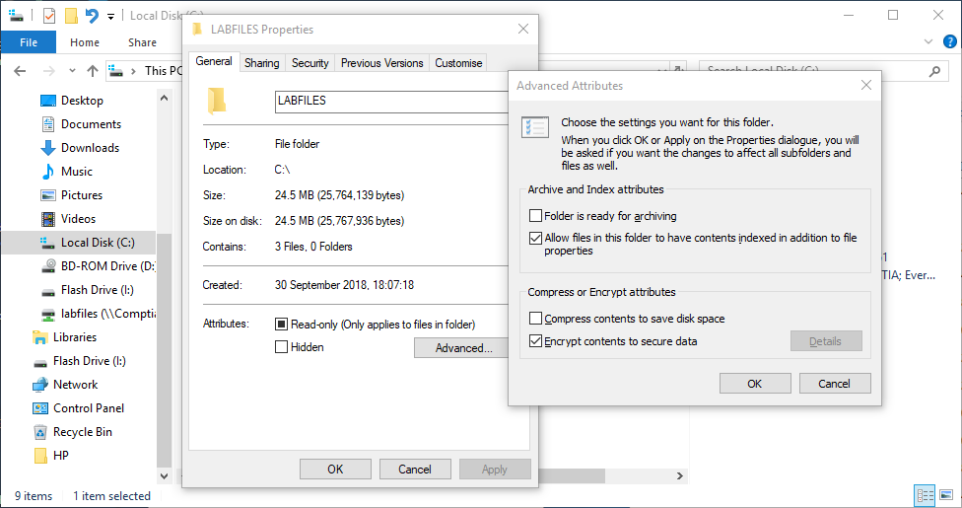
Encrypting File System (Slide 2 of 3)
Screenshot courtesy of Microsoft.

Slide 30
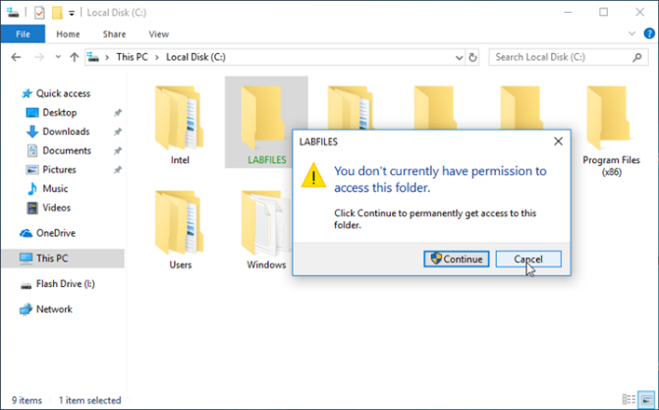
Encrypting File System (Slide 3 of 3)
Screenshot courtesy of Microsoft.

Slide 31
Windows BitLocker and BitLocker To Go (Slide 1 of 3)
Included with all versions of Windows except Home edition
Full disk encryption software
Password protected
Recovery Key backup- safe location outside of the disk being protected
TPM can be used
To Go- removable drive version

Slide 32
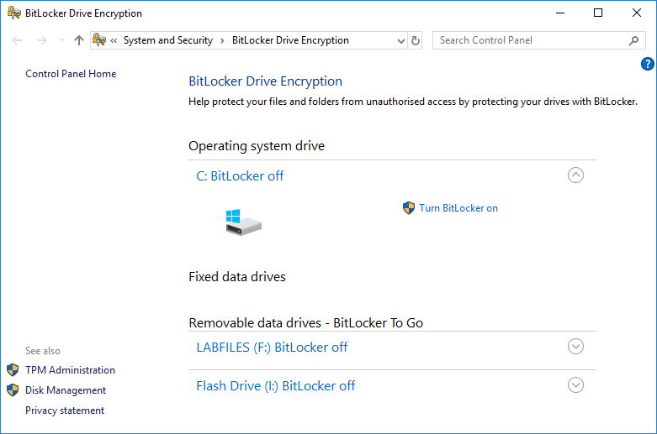
Windows BitLocker and BitLocker To Go (Slide 2 of 3)
Screenshot courtesy of Microsoft.

Slide 33
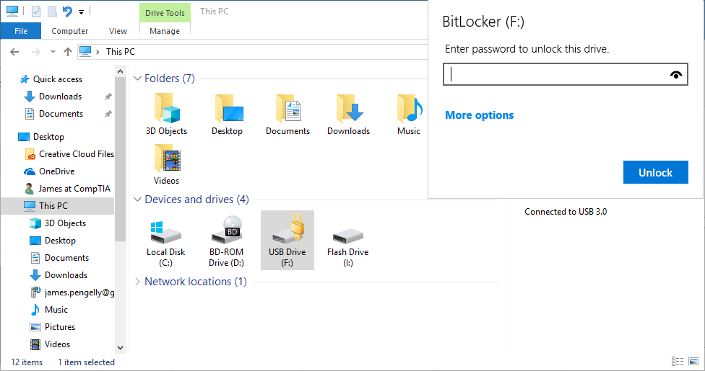
Windows BitLocker and BitLocker To Go (Slide 3 of 3)
Screenshot courtesy of Microsoft.
Notes:
Note: The TPM must be configured with an owner password (often the system password set in firmware). You can manage TPM settings from Windows using the TPM Management snap-in (select ​​​TPM Administration​ from the BitLocker applet).

Slide 34
Lab: Configure Microsoft Defender Antivirus (available in CertMaster Learn and CertMaster Perform)
Lab: Encrypt Files with EFS (available in CertMaster Learn and CertMaster Perform)
Lab: Configure BitLocker with a TPM (available in CertMaster Learn and CertMaster Perform)
Applied Live Lab: Analyze Workstation Security Settings (available in CertMaster Perform and CertMaster Labs)

Slide 35
Workstation Security
Execution Control
Trusted/Untrusted Software Sources
AutoRun and AutoPlay
Windows Defender Antivirus
Windows Defender Antivirus Updated Definitions
Activating and Deactivating Windows Defender Antivirus
Windows Defender Firewall
Encrypting File System
Windows BitLocker and BitLocker To Go
Notes:
Take some time at the end of each topic to answer questions. You can use the Lesson Review questions for discussion in class or set them for learners to complete individually during or after class.

Slide 36
Browser Security
Lesson 19.3
Notes:
Core 2 Exam Objectives
2.11 Given a scenario, configure relevant security settings in a browser.
Learning Outcomes
How can you verify a downloaded browser has not been tampered with?
Why might you consider using an untrusted source to download and install a plug-in or extension?
Why might you consider clearing your cache and browsing data on a system?
What does private-browsing mode mean?

Slide 37
Browser Selection and Installation (Slide 1 of 2)
Trusted sources
Verify download using hash or digital signature
Untrusted sources
May expose system to malware including advertising spam
Should not be used
Notes:
Learners should be reminded that downloading from the software developer's website is a best practice.
Mozilla.org
Chrome.com
Opera.com

Slide 38
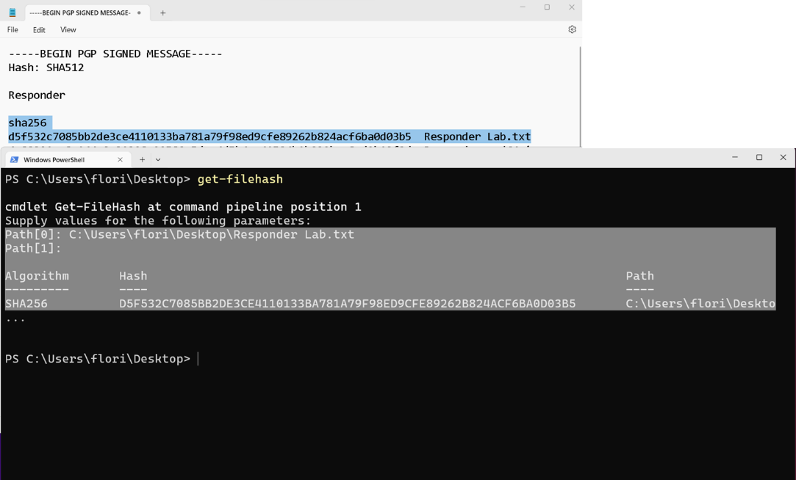
Browser Selection and Installation (Slide 2 of 2)
Screenshot courtesy of Microsoft.
Notes:
Note: Software that cannot definitively be classified as malicious but that does have increased privacy risks is often categorized as a potentially unwanted application (PUA).

Slide 39
Browser Settings (Slide 1 of 2)
Sign-in and data sync
Cross platform and device sync
Password manager
Holds passwords securely and can sync across devices
Notes:
Note: The Internet Explorer browser functionality remains available as a compatibility mode in Microsoft Edge. The settings are configured via the Edge Settings and More menu.

Slide 40
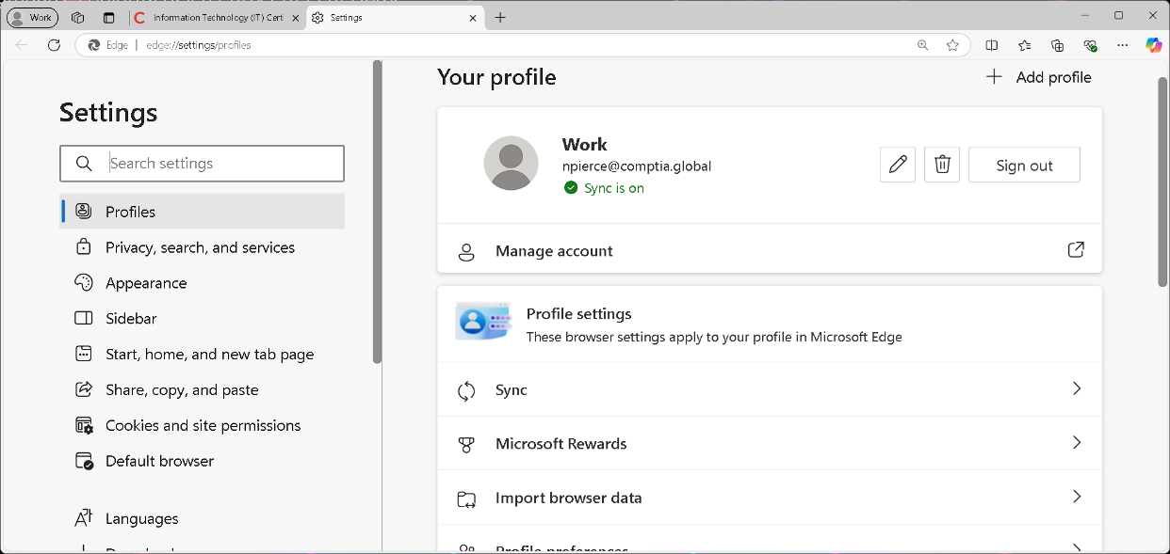
Browser Settings (Slide 2 of 2)
Screenshot courtesy of Microsoft.

Slide 41
Browser Extensions and Plug-ins (Slide 1 of 2)
Extension- Add or change a feature
Plug-in- Support various types of content
Trusted sources
Browser web store
Only enable when needed
Notes:
Instructors should show various extensions and add-ins. Also should showcase how to obtain them from each browsers "store"

Slide 42
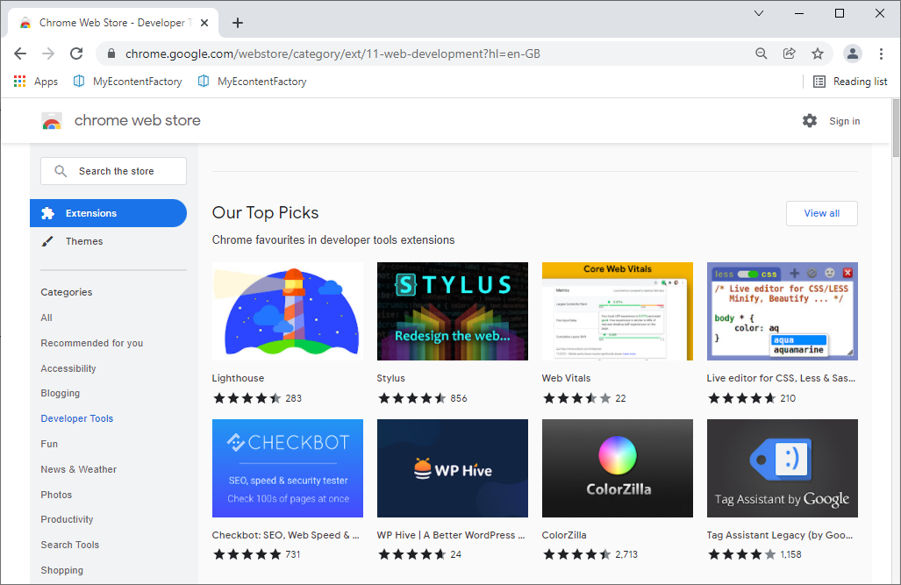
Browser Extensions and Plug-ins (Slide 2 of 2)
Screenshot courtesy of Google, a trademark of Google LLC.

Slide 43
Browser Patching
Updates- processed through OS updates or separately
Auto update upon launch
About menu

Slide 44
Secure Connections and Valid Certificates (Slide 1 of 3)
SSL/TLS certificate
Certificate Authority (CA)
Validity
Asymmetric Algorithm
RSA
ECC
Notes:
Instructors should walk users through how to view a website certificate and identify various components of the certificate including the Issued By and Issued to, certificate validity dates, and the public key and algorithm. Instructors may also wish to show the Certificate Manager (certmgr.msc) within Windows.

Slide 45
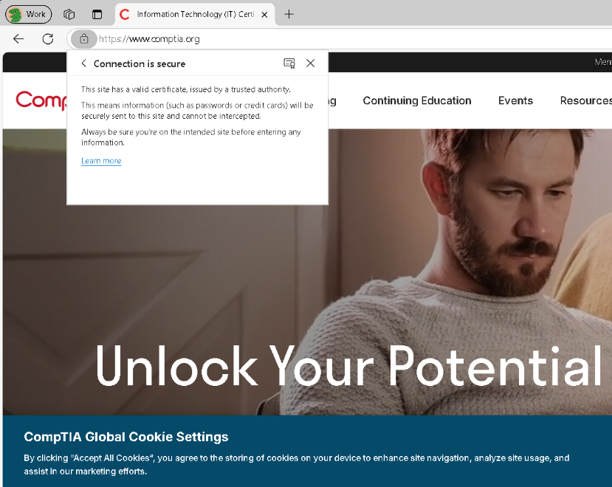
Secure Connections and Valid Certificates (Slide 2 of 3)
Screenshot courtesy of CompTIA and Edge.

Slide 46
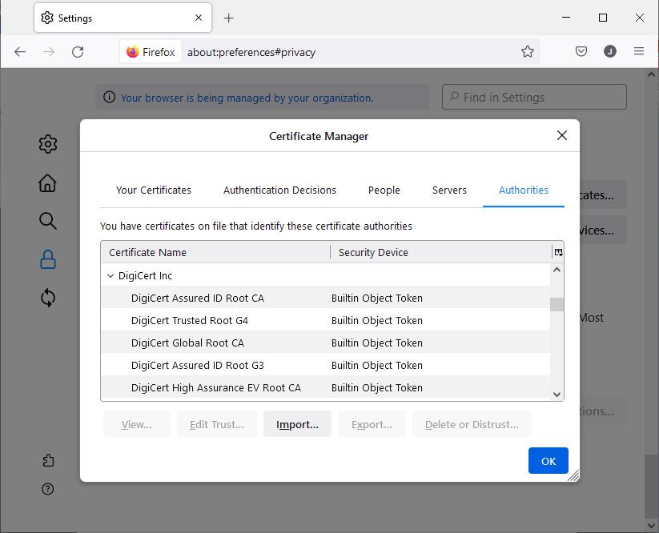
Secure Connections and Valid Certificates (Slide 3 of 3)
Screenshot courtesy of Mozilla.

Slide 47
Browser Privacy Settings (Slide 1 of 2)
Cookies
Pop-up blockers
Ad blockers
Proxy settings
Clearing cache
Private browsing
Does not hide your web browsing from your ISP!
Notes:
Consider showing the video Clear Browser History to reinforce the concepts in this lesson.

Slide 48
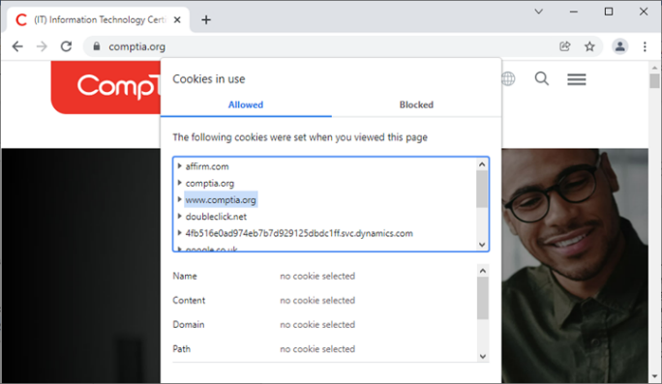
Browser Privacy Settings (Slide 2 of 2)
Screenshot courtesy of CompTIA and Google, a trademark of Google, LLC.

Slide 49
Lab: Practice Installing & Removing Browser Software (available in CertMaster Learn and CertMaster Perform)
Lab: Safe Browsing Best Practices (available in CertMaster Learn and CertMaster Perform)
Applied Live Lab: Configure Browser Security (available in CertMaster Perform and CertMaster Labs)

Slide 50
Browser Security
Browser Selection and Installation
Browser Settings
Browser Extensions and Plug-ins
Browser Patching
Secure Connections and Valid Certificates
Browser Privacy Settings
Notes:
Take some time at the end of each topic to answer questions. You can use the Lesson Review questions for discussion in class or set them for learners to complete individually during or after class.

Slide 51
Troubleshoot Workstation Security
Lesson 19.4
Notes:
Core 2 Exam Objectives
2.4 Summarize types of malware and tools/methods for detection, removal, and prevention.
2.6 Given a scenario, implement procedures for basic small office/home office (SOHO) malware removal.
3.4 Given a scenario, troubleshoot common PC security issues.
Learning Outcomes
How does a malware vector differ from malware payloads?
What is ransomware?
What are best practices to combat malware and its undesired side effects?
What steps should be taken to troubleshoot security issues within a workstation?

Slide 52
Malware Vectors
Virus
Boot sector virus
Trojan
Worm
Fileless malware
Lives in memory, not within a file
Notes:
Instructors may wish to provide real-world examples of each type of malware.

Slide 53
Malware Payloads (Slide 1 of 2)
Actions does the malware accomplish
Backdoor
Ports, services, accounts
Adware
Spyware and keyloggers
Rootkits

Slide 54
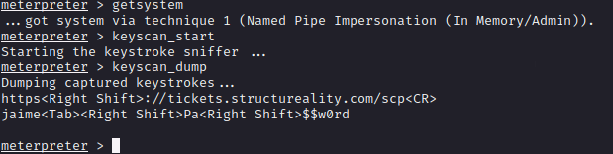
Malware Payloads (Slide 2 of 2)
Notes:
Note: Using the Metasploit Meterpreter remote access tool to dump keystrokes from the victim machine, revealing the password used to access a web app.

Slide 55
Ransomware and Cryptominers (Slide 1 of 2)
Hold data "hostage" until ransom is paid
Mine cryptocurrency using host resources such as CPU and GPU

Slide 56

Ransomware and Cryptominers (Slide 2 of 2)
Screenshot courtesy of Wikimedia.

Slide 57
Troubleshoot PC Security Symptoms
Performance symptoms
Application crashes
Service issues
File system errors and anomalies
Notes:
Learners should be able to provide examples of symptoms of malware infection.

Slide 58
Desktop Alerts and Notifications
Push notifications to the OS
False or fake alerts that confuse user
Notes:
Fake OS support notifications or cold calls are common.

Slide 59
Endpoint Monitoring Solutions
Monitor for changes on endpoint nodes
Provide early alerts that something may be wrong
EDR/MDR/XDR

Slide 60
Troubleshoot Browser Symptoms (Slide 1 of 2)
Redirection to another webpage or website
Certificate warnings
Not necessarily an indication of malicious website, but should be looked at closely before proceeding
Notes:
Some certificate warnings are not indicators of malicious intent. Certificate warnings may pop up if a certificate is nearing expiration or if the certificate was issued to a parent domain and is being used by a child domain. IE certificate issued to comptia.org but is used by store.comptia.org. This mismatch could generate a warning message.

Slide 61
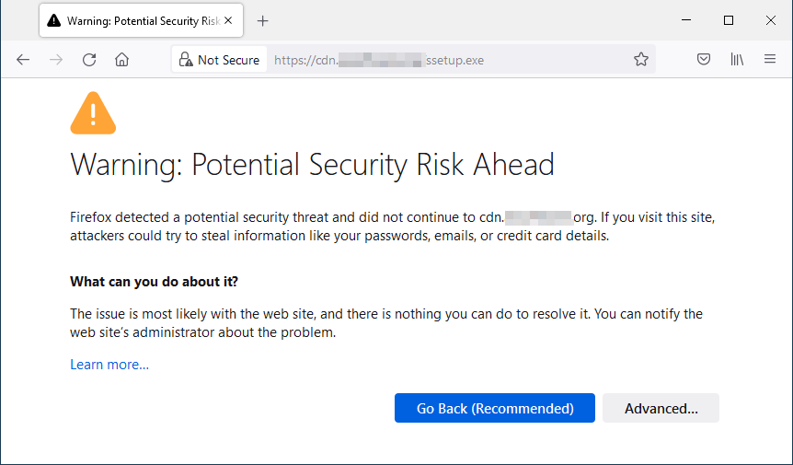
Troubleshoot Browser Symptoms (Slide 2 of 2)
Screenshot courtesy of Mozilla.

Slide 62
Best Practices for Malware Removal (Slide 1 of 4)
Investigate and verify malware symptoms.
Quarantine infected systems.
Disable System Restore in Windows.
Remediate infected systems:
Update anti-malware software.
Scanning and removal techniques (e.g., safe mode, Reimage/ Reinstall environment).
Schedule scans and run updates.
Notes:
Learners should become familiar with this 7-step process.

Slide 63
Best Practices for Malware Removal (Slide 2 of 4)
Enable System Restore and create a restore point in Windows.
Newer Windows OS prefer that a user use the File History or Reset Windows options instead of using system restore.
Educate the end user.
Most malware is discovered via on-access scanning by an antivirus product. If the malware is sophisticated enough to evade automated detection, the symptoms listed above may lead you to suspect infection.
Notes:
Learners should become familiar with this 7-step process.

Slide 64
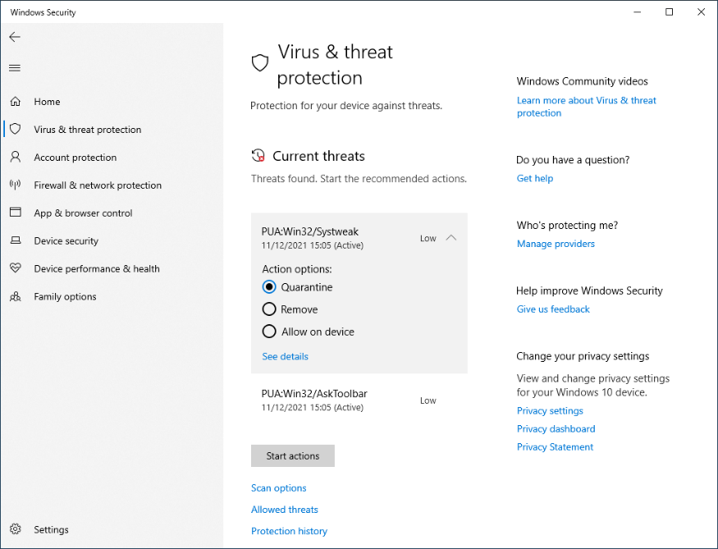
Best Practices for Malware Removal (Slide 3 of 4)
Screenshot courtesy of Microsoft.

Slide 65
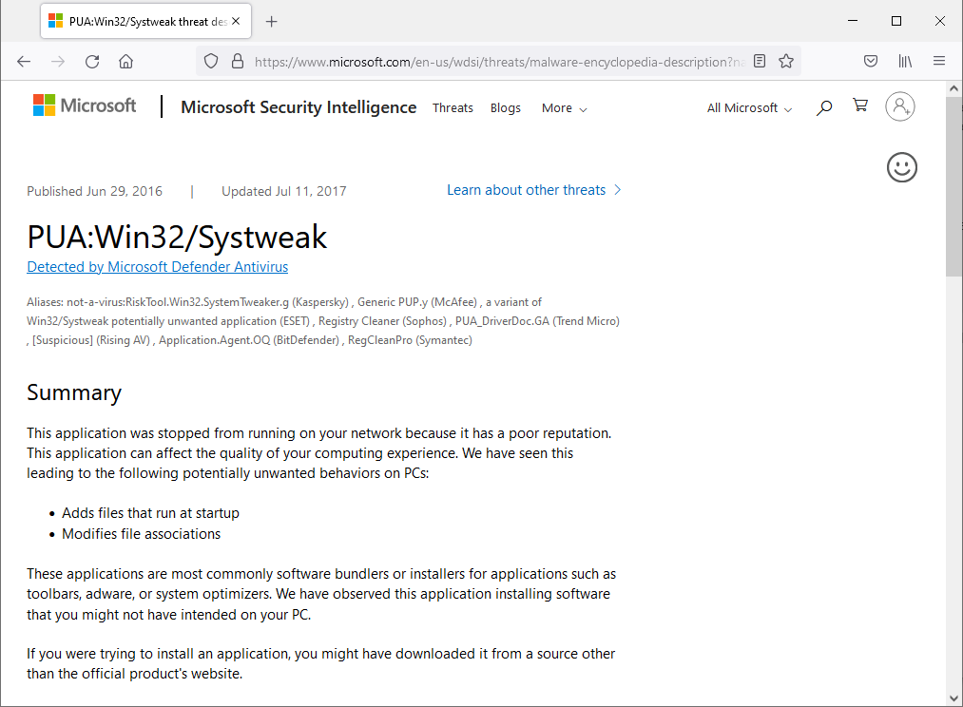
Best Practices for Malware Removal (Slide 4 of 4)
Screenshot courtesy of Microsoft.

Slide 66
Infected Systems Quarantine
Quarantine is not removal
Isolate the system from the network
Physical isolation, if possible, logical isolation at a minimum
Disable System Restore

Slide 67
Malware Removal Tools and Methods (Slide 1 of 2)
Updated antivirus/anti-malware software
Use of a third-party application or removal tool
Scan from another system
Recovery options
WinRE, restore from backup
Backups should be carefully evaluated, as they may also contain the malware
OS reinstallation
Erase, repartition, reinstall

Slide 68
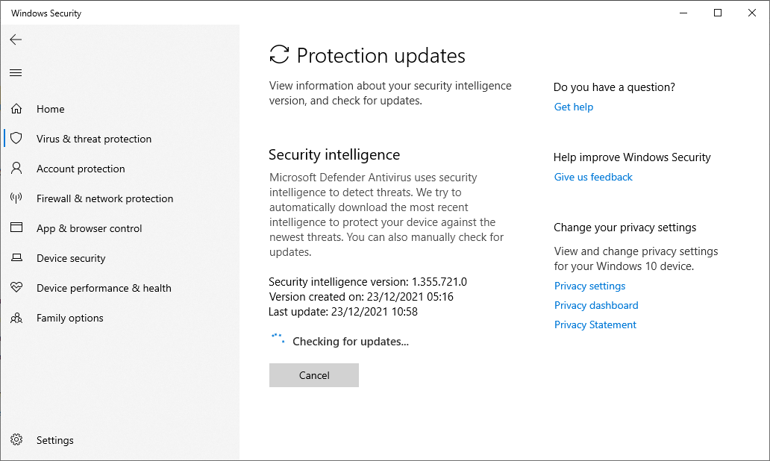
Malware Removal Tools and Methods (Slide 2 of 2)
Screenshot courtesy of Microsoft.

Slide 69
Malware Infection Prevention
On-access scanning
Schedule regular scans
Re-enable System Restore and Services
Educate end user
Do not assign blame
Educate not alienate
Notes:
Education of the end user is key to future success. Train on what indicators they should look for, policy they should understand, and best practices they can implement. IT administrators can also use this to improve identification and response procedures and policy changes.

Slide 70
Challenge Lab: Resolve Security Tickets (available in CertMaster Perform and CertMaster Labs)

Slide 71
Workstation Security (Slide 1 of 2)
Malware Vectors
Malware Payloads
Ransomware and Cryptominers
Troubleshoot PC Security Symptoms
Desktop Alerts and Notifications
Endpoint Monitoring Solutions
Troubleshoot Browser Symptoms
Best Practices for Malware Removal
Infected Systems Quarantine
Notes:
Take some time at the end of each topic to answer questions. You can use the Lesson Review questions for discussion in class or set them for learners to complete individually during or after class.

Slide 72
Workstation Security (Slide 2 of 2)
Malware Removal Tools and Methods
Malware Infection Prevention
Notes:
Take some time at the end of each topic to answer questions. You can use the Lesson Review questions for discussion in class or set them for learners to complete individually during or after class.

