Slide 1
Exam 220-1202
A+ Core 2

Slide 2
Configuring SOHO Network Security
A+ 220-1202
Module 18

Slide 3
Learning Outcomes
Prepare for A+ Core 2 by:
Explaining attacks, threats, and vulnerabilities
Comparing wireless security protocols
Configuring SOHO router security
Summarizing security measures

Slide 4
Attacks, Threats, and Vulnerabilities
Lesson 18.1
Notes:
Core 2 Exam Objectives
2.5 Compare and contrast common social engineering attacks, threats, and vulnerabilities.
Learning Outcomes
What makes a zero-day vulnerability so unique?
Why is having a system that is beyond its End of Life a security vulnerability?
Why would someone go dumpster diving?
What encryption method uses the same key to encrypt and decrypt data?
What are digital signatures used for?

Slide 5
Vulnerabilities
Non-compliant systems
Deviations from baselines
Unprotected systems
Missing or improperly configured security controls
Software
Application code issues
Zero-Day vulnerabilities
Unpatched and End of Life OS's
No updates or no longer supported by developer
Bring Your Own Device
Personal devices may not be maintained by owner
Notes:
Zero-day vulnerabilities are those vulnerabilities that are previously unknown to the developer.

Slide 6

Social Engineering
Hacking the human
Manipulation or intimidation of users to reveal confidential info
Impersonation
Dumpster diving
Shoulder surfing
Tailgating/piggybacking
Photo by Uros Jovicic on Unsplash.
Notes:
Learners should be able to provide examples and scenarios of social engineering.

Slide 7
Phishing and Evil Twins (Slide 1 of 2)
Phishing
Spear phishing- targeted phishing campaign
Whaling- executives and those with influence within the organization
Vishing- voice call to illicit confidential information
SMiShing- use of SMS or text messages
Quishing- use of fake QR codes to trick targets
Evil Twin- similar SSID for wi-fi network that allows attacker to snoop on network traffic

Slide 8
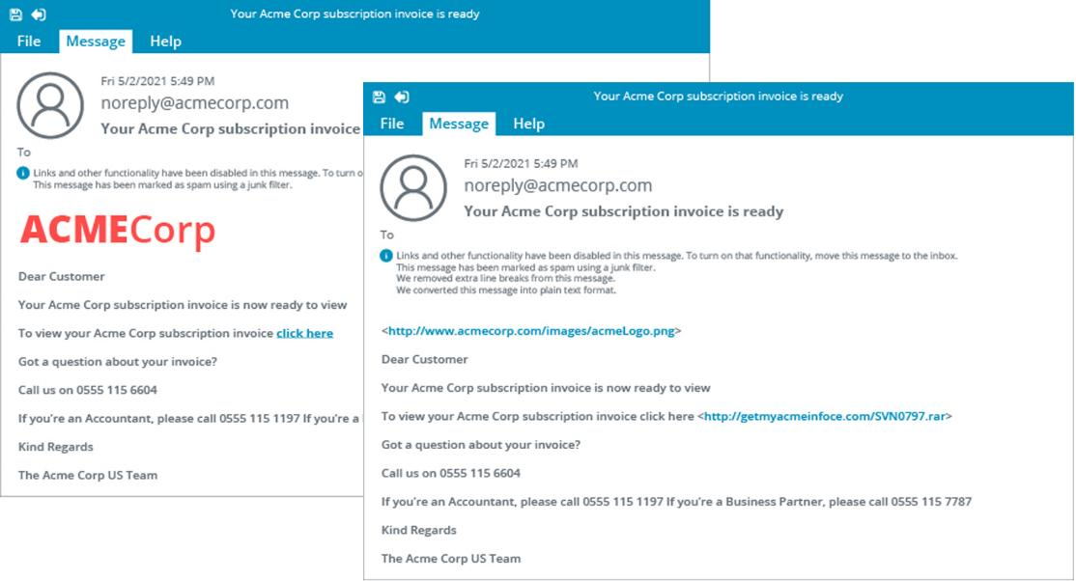
Phishing and Evil Twins (Slide 2 of 2)
Screenshot courtesy of CompTIA.

Slide 9
Threat Types (Slide 1 of 2)
External
Internal
Footprinting
Gathering information about the organization
Spoofing
Masquerade as a trusted user or system
IP and MAC spoofing
On-path attacks
DoS/DDoS botnet attacks
Notes:
Learners should be able to provide examples of threats based on their mode of operation and objective. Instructors can provide examples of these threats from the real world. Examples may include:
Internal Threat- https://cert.europa.eu/publications/threat-intelligence/threat-memo-190802-1/pdf
On-path- https://www.csoonline.com/article/567833/equifax-data-breach-faq-what-happened-who-was-affected-what-was-the-impact.html
DDos/Botnet- https://www.cybersecuritydive.com/news/massive-iran-botnet-ddos-telecom/741359/
DDoS/Botnet- https://cloud.google.com/blog/products/identity-security/google-cloud-mitigated-largest-ddos-attack-peaking-above-398-million-rps

Slide 10
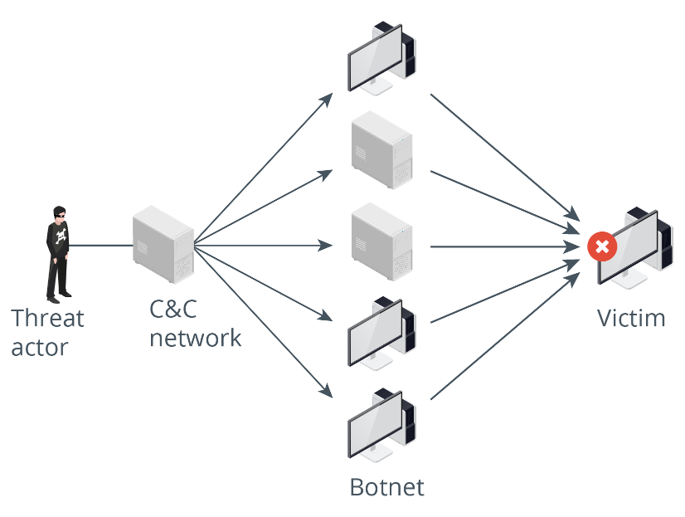
Threat Types (Slide 2 of 2)

Slide 11
Password Attacks (Slide 1 of 3)
Plaintext passwords
Services like Telnet do NOT encrypt traffic
Dictionary- use of a dictionary list to crack passwords
RockYou.txt file contains over 14 million passwords
New "RockYou2024" contains over 10 billion passwords
Brute force
Any means necessary; every possible combination and substitution
Notes:
Instructors may want to mention tools that facilitate password attacks such as: Aircrack, Brutus, L0phtCrack, John the Ripper, etc.

Slide 12
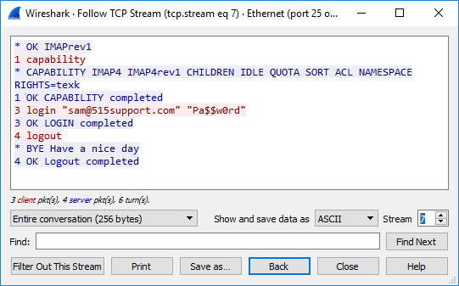
Password Attacks (Slide 2 of 3)
Screenshot courtesy of Wireshark.

Slide 13
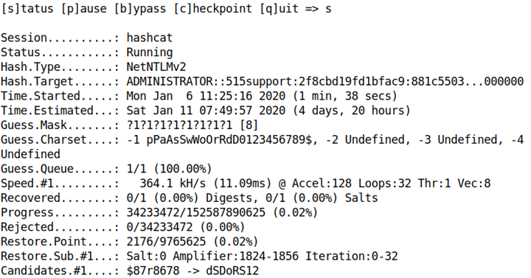
Password Attacks (Slide 3 of 3)

Slide 14
Cross-site Scripting Attacks
Exploits trust of scripts that appear to originate from website being visited
Malicious script is inserted into the site and is executed by the browser, as it thinks the malicious script originated from the trusted website

Slide 15
SQL Injection Attacks
Structured Query Language used to query database systems
SELECT, INSERT, DELETE, UPDATE
Manipulates database into an undesired operation
Prevention
Input validation and sanitization
Parameterized queries
Stored procedures- precompiled SQL code
Notes:
Instructors may wish to utilize the Lab: Explore SQL Injection Flaws to further illustrate this attack type.

Slide 16
Lab: Respond to Social Engineering Exploits (available in CertMaster Learn and CertMaster Perform)
Lab: Explore SQL Injection Flaws (available in CertMaster Learn and CertMaster Perform)

Slide 17
Attacks, Threats, and Vulnerabilities
Vulnerabilities
Social Engineering
Phishing and Evil Twins
Threat Types
Password Attacks
Cross-site Scripting Attacks
SQL Injection Attacks
Notes:
Take some time at the end of each topic to answer questions. You can use the Lesson Review questions for discussion in class or set them for learners to complete individually during or after class.

Slide 18
Wireless Security Protocols
Lesson 18.2
Notes:
Core 2 Exam Objectives
2.3 Compare and contrast wireless security protocols and authentication methods.
Learning Outcomes
Which wireless encryption method should be used with WPA2 and WPA3?
What protocol is typically deployed with AES?
What protocol replaced the 4-way handshake in WPA3?
Which enterprise authentication method is typically used with wireless networks?

Slide 19
Wi-Fi Protected Access (Slide 1 of 2)
TKIP- Temporal Key Integrity Protocol
RC4 encryption of traffic; replaced by AES in WPA2
AES- Advanced Encryption Standard
Symmetric encryption algorithm
WPA2-
Uses AES vice RC4; CCMP replaced TKIP
WPA3
SAE authentication
AES CCMP replaced by AES GCMP encryption
Notes:
Instructors should mention the WPA should not be used. The minimum recommendation for modern networks is WPA2.

Slide 20
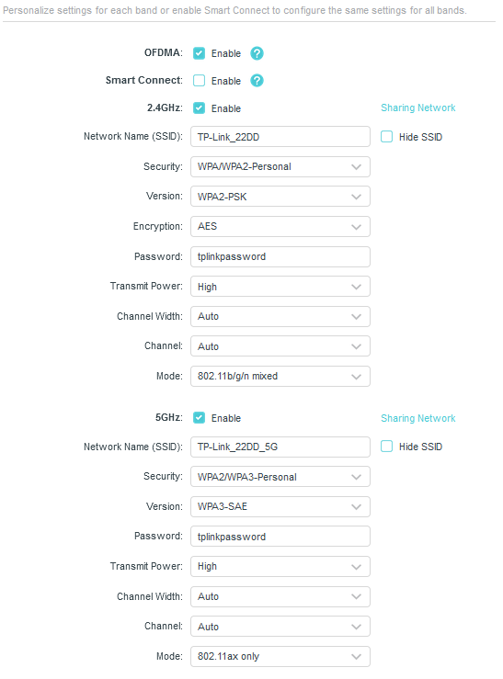
Wi-Fi Protected Access (Slide 2 of 2)
Screenshot courtesy of TP-Link.

Slide 21
Wi-Fi Authentication Methods (Slide 1 of 2)
WPA2 pre-shared key (PSK)
Passphrase is used to securely join network
WPA3 personal
Passphrase is still used
Perfect forward secrecy
Compromised keys cannot be used to crack previously encrypted traffic as keys change with every transmission

Slide 22
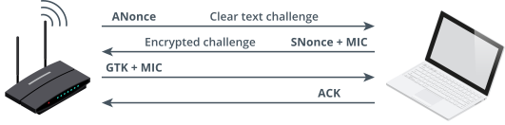
Wi-Fi Authentication Methods (Slide 2 of 2)
Image © 123RF.com

Slide 23
Enterprise Authentication Protocols (Slide 1 of 2)
ENT or Enterprise
Uses IEEE 802.1x Extensible Authentication Protocol (EAP)
AAA server can be used to authenticate users or devices before allowing connection to network
RADIUS and TACACS+ are popular solutions
Multifactor authentication can also be implemented

Slide 24
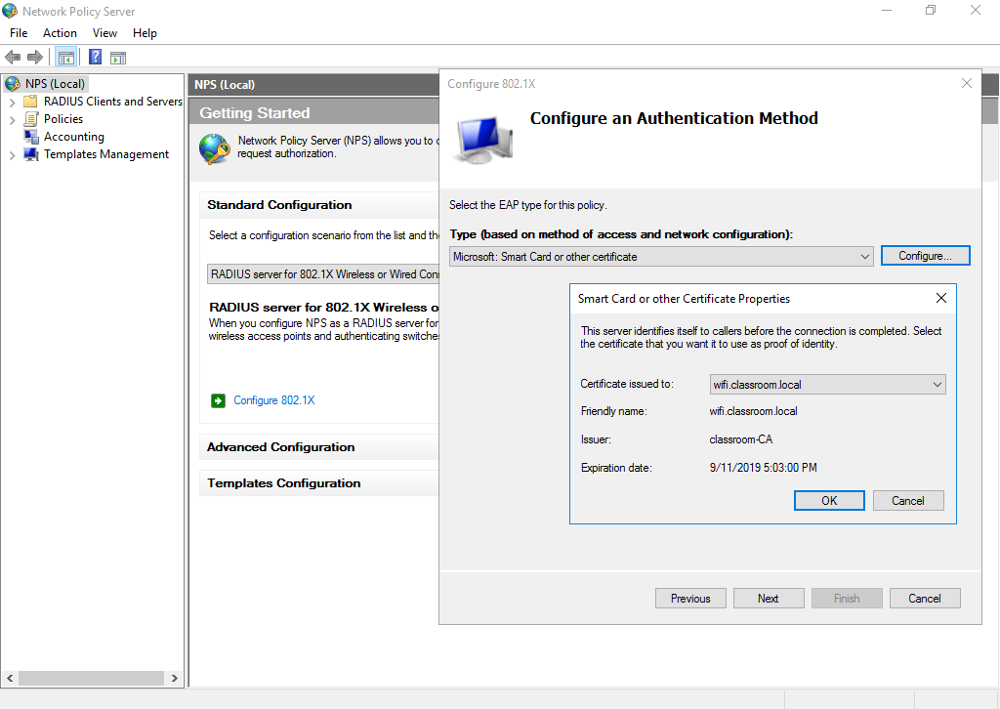
Enterprise Authentication Protocols (Slide 2 of 2)
Screenshot courtesy of Microsoft.
Notes:
Note: Other methods of EAP use a certificate on the AAA server only. The AAA server uses the certificate to create an encrypted tunnel for the supplicant to send a username/password credential securely.
Consider showing the video Authentication Methods to reinforce these concepts.

Slide 25
RADIUS, TACACS+, and Kerberos
Remote Access Dial In User Service
Uses UDP port 1812 to forward user credentials to server for authentication
Terminal Access Controller Access Control System Plus
Uses TCP port 49 to authenticate users
Primarily used for device remote access authentication
Kerberos
Proprietary Microsoft user authentication service
UDP port 88, but can be implemented using TCP, if necessary
Notes:
Learners should understand that RADIUS is NOT for dial up internet connections; it is for remote (dial in) authentication.

Slide 26
Wireless Security Protocols
Wi-Fi Protected Access
Wi-Fi Authentication Methods
Enterprise Authentication Protocols
RADIUS, TACACS+, and Kerberos

Slide 27
SOHO Router Security
Lesson 18.3
Notes:
Core 2 Exam Objectives
2.10 Given a scenario, apply security settings on SOHO wireless and wired networks.
Learning Outcomes
Typically, where should a SOHO router be physically placed?
What are some of the key steps that should be taken when securing access to the router management interface?
What is the purpose of the SSID?
In what situation would you configure port-forwarding?
What type of devices would typically be placed in a screened subnet?

Slide 28
Home Router Setup
Physical placement
Highest elevation to avoid furniture and human interference
Centralized in office or home to provide best coverage
ISP connection to WAN port, then plug in power
Login portal
Web-based utility or wizard to aide in setup
Change the default password after login
Notes:
While many learners may be familiar with setting up a SOHO router in their own home or office, learners should be reminded to pay close attention to detail when it comes to selecting specific settings if given a scenario.

Slide 29
Firmware Update (Slide 1 of 2)
Firmware and driver should be kept updated
You can manually download and apply the update; otherwise, there may be a menu option to update it through the web GUI
Power to device should be maintained throughout the process

Slide 30
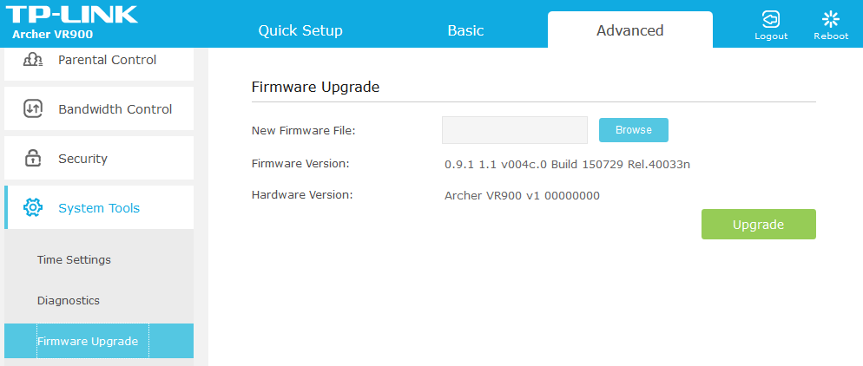
Firmware Update (Slide 2 of 2)
Screenshot courtesy of TP-Link.

Slide 31
Home Router LAN and WLAN Configuration (Slide 1 of 2)
SSID- network name
Encryption Selection
WPA2 or WPA3 should be used
Strong passphrase
Disable guest access
Select channels to minimize interference, or leave on auto
Notes:
Note: Hiding the SSID does not secure the network; you must enable encryption. Even when broadcast is disabled, the SSID can still be detected using packet sniffing tools and Wi-Fi analyzers.

Slide 32
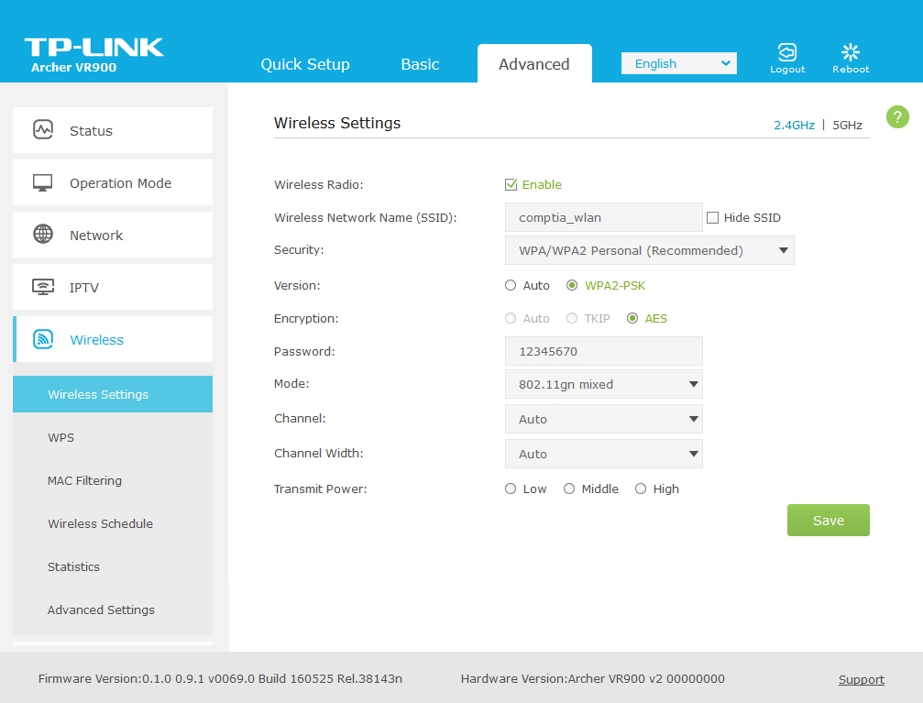
Home Router LAN and WLAN Configuration (Slide 2 of 2)
Screenshot courtesy of TP-Link.

Slide 33
Home Router Firewall Configuration (Slide 1 of 2)
Inbound and outbound ACL's
Rules may be based on:
IP source or destination
Port source or destination
Content filtering

Slide 34
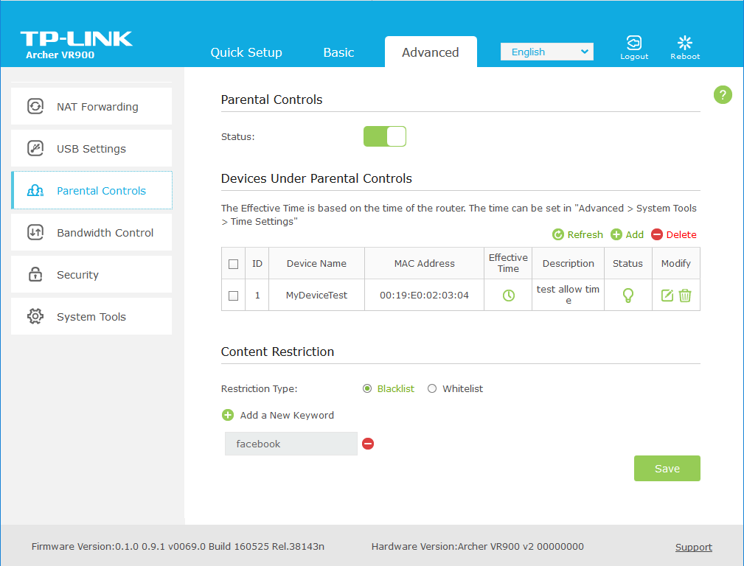
Home Router Firewall Configuration (Slide 2 of 2)
Screenshot courtesy of TP-Link.

Slide 35
Home Router Port Forwarding Configuration (Slide 1 of 2)
Static vs DHCP reservations
Port forwarding
Traffic from an internet facing port directed to specific host on internal network
Can also forward traffic to specific internal port
Disable all unused ports

Slide 36
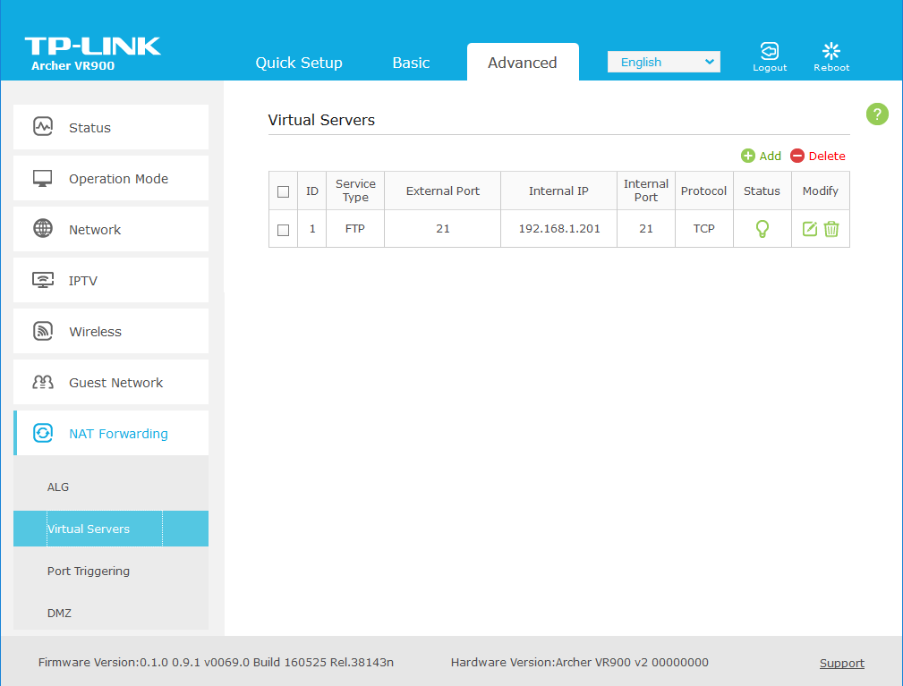
Home Router Port Forwarding Configuration (Slide 2 of 2)
Screenshot courtesy of TP-Link.

Slide 37
Universal Plug-and-Play (Slide 1 of 2)
Allows devices the ability to configure ACL rules for their own communications traffic
If not required, disable this option

Slide 38
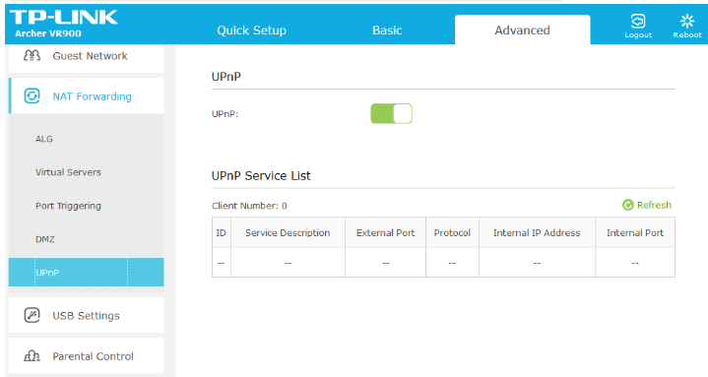
Universal Plug-and-Play (Slide 2 of 2)
Screenshot courtesy of TP-Link.
Notes:
Note: Also, make sure that UPnP is disabled on client devices unless you have confirmed that the implementation is secure. As well as game consoles, vulnerabilities have been found in UPnP running on devices such as printers and webcams.

Slide 39
Screened Subnets (Slide 1 of 3)
Formally known as DMZ's
Allows administrators to direct traffic to specific logical segments of the network
Can be used to isolate web facing hosts on network, while preventing internal network access from the internet
Notes:
Consider showing the video Secure a Small Wireless Network to reinforce the concepts in this lesson.

Slide 40
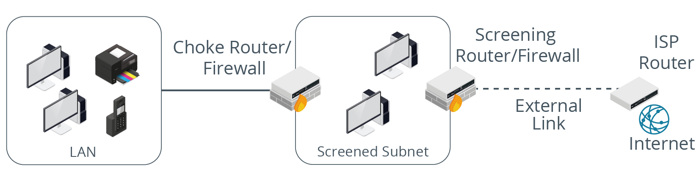
Screened Subnets (Slide 2 of 3)
Images © 123RF.com.

Slide 41
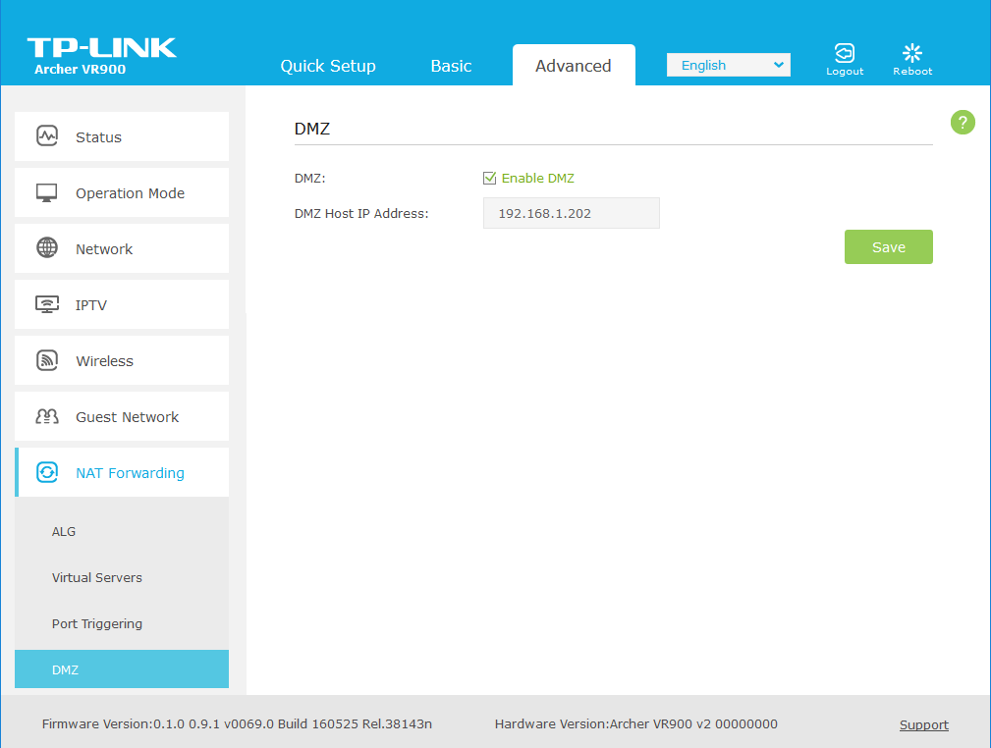
Screened Subnets (Slide 3 of 3)
Screenshot courtesy of TP-Link.

Slide 42
Lab: SOHO Router Configuration (available in CertMaster Learn and CertMaster Perform)

Slide 43
SOHO Router Security
Home Router Setup
Firmware Update
Home Router LAN and WLAN Configuration
Home Router Firewall Configuration
Home Router Port Forwarding Configuration
Universal Plug-and-Play
Screened Subnets
Notes:
Take some time at the end of each topic to answer questions. You can use the Lesson Review questions for discussion in class or set them for learners to complete individually during or after class.

Slide 44
Additional Security Measures
Lesson 18.4
Notes:
Core 2 Exam Objectives
2.1 Summarize various security measures and their purposes
Learning Outcomes
What security measures should be implemented to prevent tailgating or piggybacking?
What type of door lock uses a user's physical characteristics to unlock the door?
What type of lock is typically used to secure a laptop to a table?
Which alarm system uses RFID tags?

Slide 45
Physical Access Control
Perimeter security
Access control vestibule
Two door access system, only one door can be opened at a time
Magnetometers
Metal detectors
Security Guards

Slide 46
Lock Types
Key
Electronic
Badge reader
NFC, RFID, magnetic
Mobile digital key
Commonly seen in hotel apps
Biometric
Fingerprint, Palm, Retina, Facial, Voice
Type 1 vs Type 2 errors
Kensington lock, chassis lock, lockable equipment racks
Notes:
Instructors may want to ask learners to research different lock types. Instructors should also inform learners about errors with biometric systems. Type 1(FRR) errors are where authorized individuals are denied access. Type 2(FAR) errors are more critical in that unauthorized users are granted access. Most biometric systems should provide estimates of these errors.

Slide 47
Alarms and Surveillance
Circuit
Motion
Proximity
Duress
Panic button
Video
CCTV, Wireless, or cabled IP cameras
Lighting
Illuminates' area for better surveillance

Slide 48
Lab: Implement Physical Security (available in CertMaster Learn and CertMaster Perform)
Challenge Live Lab: Resolve SOHO Network Issues (available in CertMaster Perform and CertMaster Labs)

Slide 49
Additional Security Measures
Physical Access Control
Lock Types
Alarms and Surveillance
Notes:
Take some time at the end of each topic to answer questions. You can use the Lesson Review questions for discussion in class or set them for learners to complete individually during or after class.

