Slide 1
Exam 220-1202​
A+ Core 2​

Slide 2
Supporting Windows
A+ 220-1202
Module 14

Slide 3
Learning Outcomes
Prepare for A+ Core 2 by:
Performing OS installations and upgrades
Installing and configuring applications
Troubleshooting Windows OS problems

Slide 4
Troubleshoot Windows Networking
Lesson 14.1
Notes:
Core 2 Exam Objective
1.5 Given a scenario, use the appropriate Microsoft command-line tools.
Learning Outcomes
Which command would be utilized in a Windows environment to view the IP configuration of your NIC?
Which command can be used to test local connectivity to a printer on the network?
Which command would be utilized to test connectivity to a remote resource?
Which command would be utilized to retrieve the name service records for a given domain?
Which command could be utilized to view active TCP and UDP connections from your local system?

Slide 5
Troubleshoot IP Configuration (Slide 1 of 2)
Limited IP connectivity
Verify IP config
DHCP Settings and server availability (APIPA)
No Internet access
IP configuration
IP/Subnet Mask/Gateway
DNS server configuration
ipconfig command
/all, /release, /renew, /displaydns, and /flushdns
hostname command
Notes:
Instructors should remind learners that practicing these commands on a system to interpret the data and configuration will be key to understanding them.

Slide 6
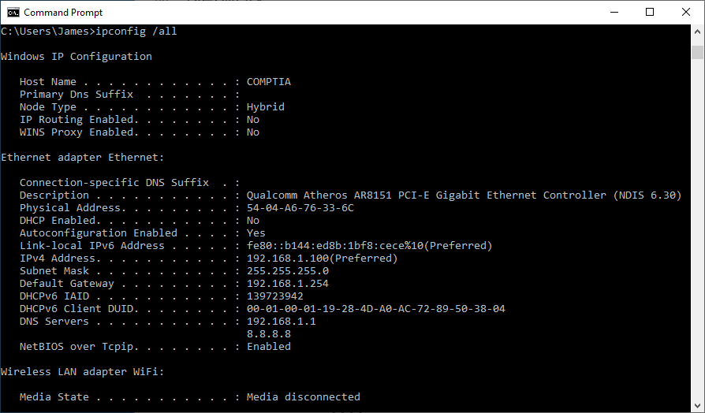
Troubleshoot IP Configuration (Slide 2 of 2)
Screenshot courtesy of Microsoft.
Notes:
Using ipconfig

Slide 7
Troubleshoot Local Network Connectivity (Slide 1 of 3)
Connectivity test
Ping command
Loopback IP, local workstation IP, then gateway IP, then remote system FQDN or IP
Local loopback or local workstation IP unreachable
Troubleshoot network adapter configuration
Gateway IP unreachable
DHCP server options configured correctly
Router IP configuration done correctly
Remote system FQDN or IP unreachable
Verify resource exists
Verify DNS settings
Notes:
Learners can be provided with several public-facing DNS servers than can be pinged to test remote connectivity. 8.8.8.8, 8.8.4.4, and even 1.1.1.1 can be used for this purpose.

Slide 8
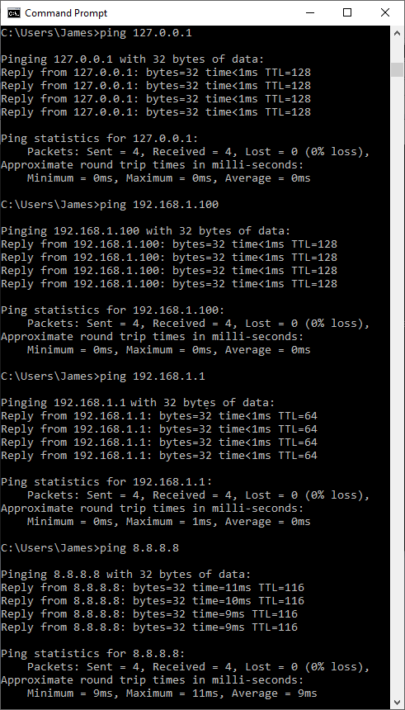
Troubleshoot Local Network Connectivity (Slide 2 of 3)
Screenshot courtesy of Microsoft.
Notes:
Troubleshooting with ping

Slide 9
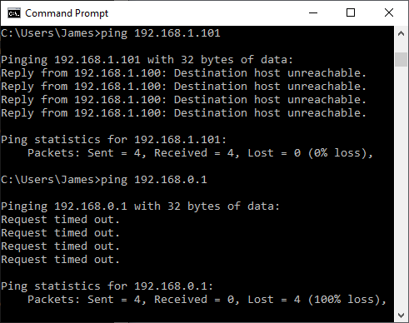
Troubleshoot Local Network Connectivity (Slide 3 of 3)
Screenshot courtesy of Microsoft.
Notes:
Examples of error messages using ping

Slide 10
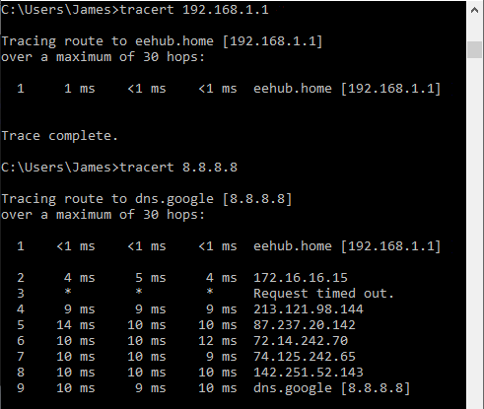
Troubleshoot Remote Network Connectivity
tracert command
RTT per hop
pathping command
Can show latency and packet loss per hop
Screenshot courtesy of Microsoft.
Notes:
Using tracert in Windows

Slide 11
Troubleshoot Name Resolution (Slide 1 of 2)
Connection via FQDN vs. connection with IP address directly
nslookup command
-type=<resourcerecordtype> where <resourcerecordtype> = A, AAAA, MX, NS, PTR, CNAME etc.

Slide 12
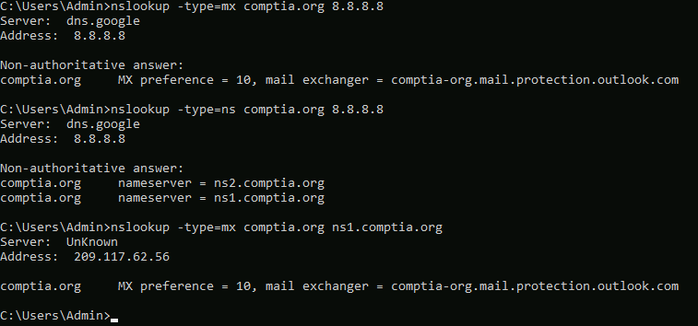
Troubleshoot Name Resolution (Slide 2 of 2)
Screenshot courtesy of Microsoft.
Notes:
Using nslookup to query the mail server configured for the comptia.org domain name using Google's public DNS servers (8.8.8.8)

Slide 13
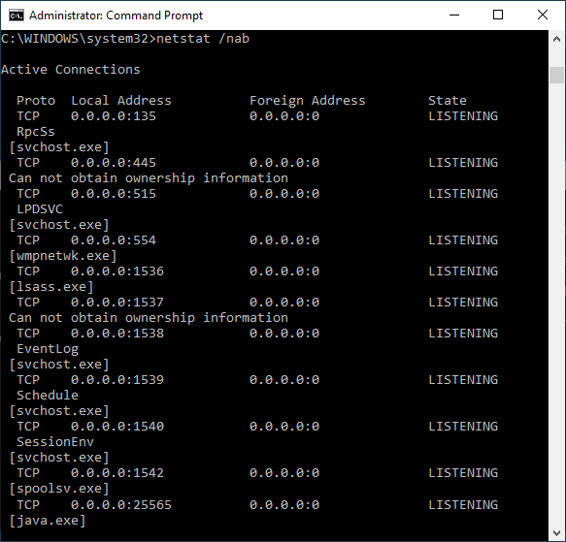
Troubleshoot Network Ports
netstat command
-a include UDP connections
-b show process that opened port
-n numerical format
-e report ethernet statistics
-s report protocol statistics
Screenshot courtesy of Microsoft.
Notes:
Learners should practice each command option to determine the different data they can acquire with each option. Image of listening connections and the processes that opened each port with netstat.

Slide 14
Lab: Assisted Troubleshooting (available in CertMaster Learn and CertMaster Perform)
Lab: Troubleshoot Physical Connectivity (available in CertMaster Learn and CertMaster Perform)
Lab: Connectivity (available in CertMaster Learn and CertMaster Perform)
Lab: Services/Name Resolution (available in CertMaster Learn and CertMaster Perform)

Slide 15
Troubleshoot Windows Networking
Troubleshoot IP Configuration
Troubleshoot Local Network Connectivity
Troubleshoot Remote Network Connectivity
Troubleshoot Name Resolution
Troubleshoot Network Ports
Notes:
Take some time at the end of each topic to answer questions. You can use the Lesson Review questions for discussion in class or set them for learners to complete individually during or after class.

Slide 16
Remote Access Technologies
Lesson 14.2
Notes:
Core 2 Exam Objective
4.9 Given a scenario, use remote access technologies.
Learning Outcomes
What is the native remote administration GUI application in the Windows OS?
What are the security implications of using remote administration tools? How can you protect against them?
How does the Microsoft Remote Assistance differ from the Remote Desktop Connection application?
What tool or application can be used to transfer files to a remote system?
How do VPNs provide security to network connections?

Slide 17
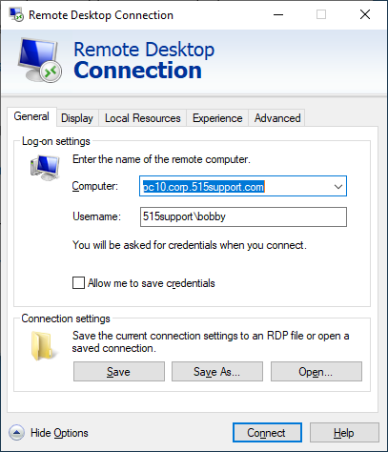
Remote Desktop Tools
Remote Desktop Protocol (RDP)
Remote Desktop Connection application (mstsc.exe)
TCP port 3389
Encrypted authentication and session
IP or FQDN of remote system needed
Credentials to log in
Virtual Network Computing (VNC)
TCP port 5900
Screenshot courtesy of Microsoft.
Notes:
If the instructor has access to a remote desktop to enable server, they should demonstrate the connection using RDC. This illustrates to learners the real process and options for connections. Image of Remote Desktop Connection client (mstsc.exe)

Slide 18
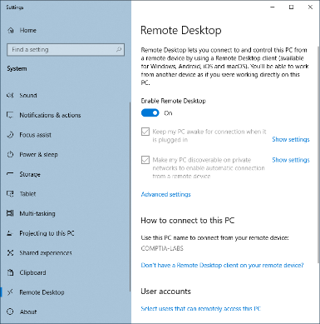
RDP Server and Security Settings
Settings > Remote Desktop
Client available in all editions
RDP Server only available in Pro and Enterprise editions
Screenshot courtesy of Microsoft.
Notes:
Home edition can upgrade to Pro or Enterprise edition for a fee. Image of configuring Remote Desktop server settings

Slide 19
Microsoft Remote Assistance (Slide 1 of 2)
Initiated by invite only
Includes chat feature and remote-control capability
Ephemeral port use (49152-65535)
Quick Assist
Facilitates Remote Assistance without reconfiguring firewall using TCP port 443 (HTTPS)
Notes:
Learners should know that RA and QA will still need a user with access to the system for any UAC notification confirmations. The alternative is to disable the UAC notifications or lower the level, thus increasing security risk.

Slide 20
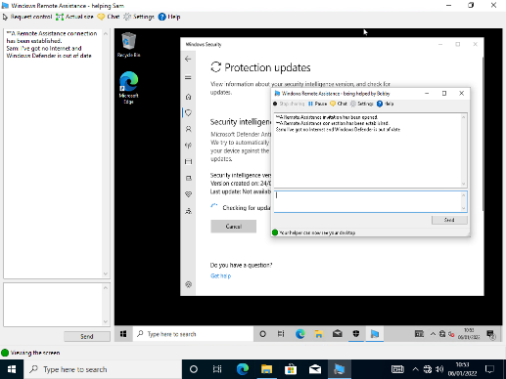
Microsoft Remote Assistance (Slide 2 of 2)
Screenshot courtesy of Microsoft.

Slide 21
WinRM
Uses SOAP-based communication
Allows access and exchange of management information across network
Interoperability between different hardware and software platforms using HTTP/HTTPS
Can be easily used in PowerShell scripts

Slide 22
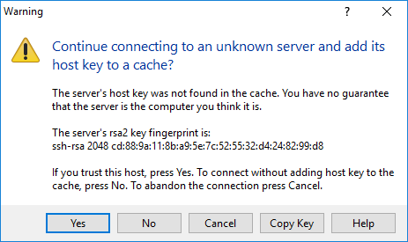
Secure Shell
TCP port 22
Encrypted
Password or key-based authentication methods
Screenshot courtesy of Microsoft.
Notes:
Instructors may want to let their learners know about Telnet on port 23. Security risks associated with Telnet's lack of encryption should also be mentioned.

Slide 23
Desktop Management and Remote Monitoring Tools
Remote monitoring and management (RMM)
Primarily an MSP tool for remote support
Desktop management and MDM
Management of device belonging to a single organization
Endpoint Detection and Response (EDR) capability
Security tool for scans and reporting of issues with pre-programmed responses

Slide 24
Simple Protocol for Independent Computing Environments (SPICE)
Remote display to monitor and interact with a VM
Authentication support for Kerberos and others
TLS encryption of communication

Slide 25
Other Remote Access Tools
Screen sharing
TeamViewer or LogMeIn
Video conferencing tools
Microsoft Teams or Zoom
Screen share capabilities
File transfer software
AirDrop for Apple
Nearby Sharing for Microsoft
Nearby Share for Android
VPN
Encrypted tunnel to connect to internal systems through the VPN gateway/server

Slide 26
Lab: Configure Remote Services (available in CertMaster Learn and CertMaster Perform)
Applied Live Lab: Provide Remote Support (available in CertMaster Perform and CertMaster Labs)

Slide 27
Remote Access Technologies
Remote Desktop Tools
RDP Server and Security Settings
Microsoft Remote Assistance
WinRM
Secure Shell
Desktop Management and Remote Monitoring Tools
Simple Protocol for Independent Computing Environments (SPICE)
Other Remote Access Tools
Notes:
Take some time at the end of each topic to answer questions. You can use the Lesson Review questions for discussion in class or set them for learners to complete individually during or after class.

Slide 28
Performance and Troubleshooting Tools
Lesson 14.3
Notes:
Core 2 Exam Objective
1.4 Given a scenario, use Microsoft Windows operating system features and tools.
Learning Outcomes
What information does the system information tool provide the user?
What are the various logs that are created by default within the Windows operating system?
What performance monitors are available within Task Manager?
What is the difference between the performance monitors in Task Manager and those within the Performance Monitor tool?

Slide 29
System Information (Slide 1 of 2)
msinfo32.exe
System resources
Firmware version
OS version
Hardware
Environment variables
Network status
Notes:
Instructors should walk learners through accessing and identifying key items in the System Information report.

Slide 30
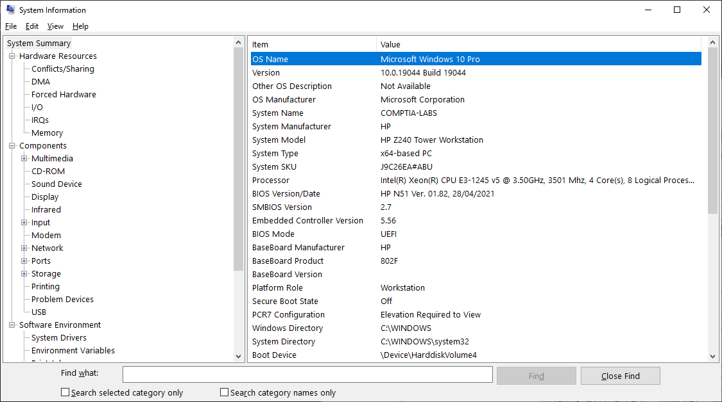
System Information (Slide 2 of 2)
Screenshot courtesy of Microsoft.

Slide 31
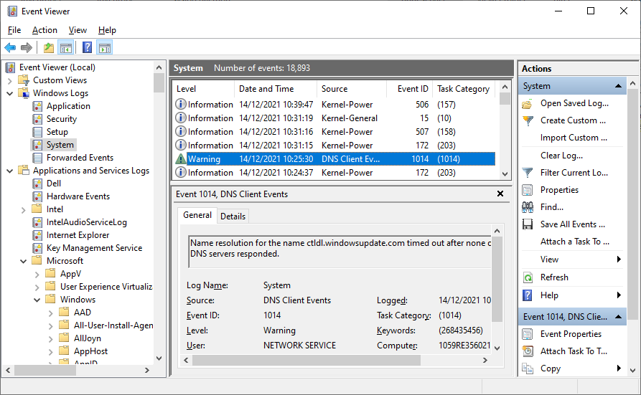
Event Viewer
Eventvwr.msc
Windows Log viewing
Application
Security
Setup
System
Forwarded Events
Severity Levels
Information, Warning, Error, Critical
Screenshot courtesy of Microsoft.
Notes:
Instructors should walk learners through event viewer to view various events that are logged by Windows. Instructors can also note that the Forwarded Events will likely be empty unless they are using a remote logging system such as syslog.

Slide 32
Task Manager Process Monitoring (Slide 1 of 2)
CTRL+SHIFT+ESC
CTRL+ALT+DEL then select Task Manager
Right-click Start button or the taskbar
Processes
Details
Set Priority
Notes:
Learners should explore the Task Manager and its processes tab.

Slide 33
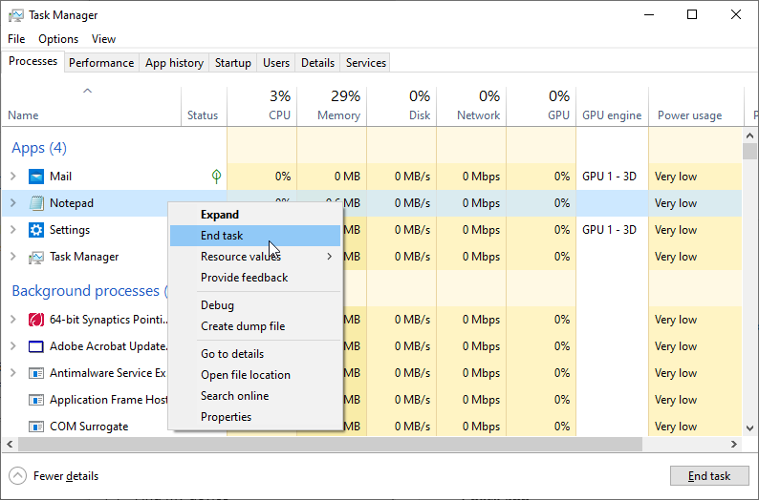
Task Manager Process Monitoring (Slide 2 of 2)
Screenshot courtesy of Microsoft.

Slide 34
Task Manager Performance Monitoring (Slide 1 of 2)
App history
Windows Store apps
Disk monitoring
Network monitoring
Notes:
Learners should explore the Task Manager and its Performance tab. The difference between this performance monitoring and PerfMon mentioned later in the Module can also be discussed.

Slide 35
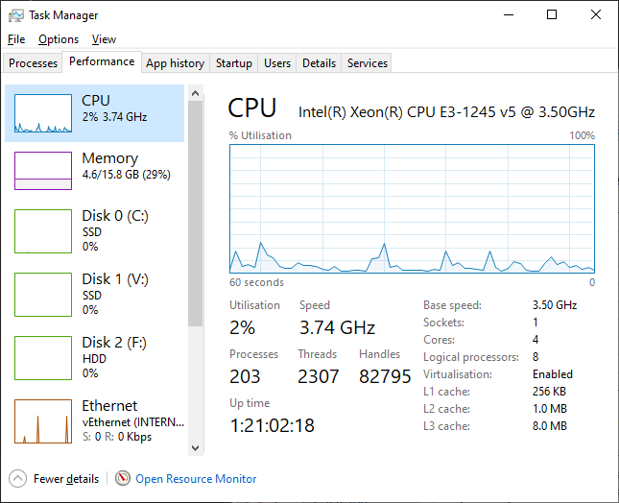
Task Manager Performance Monitoring (Slide 2 of 2)
Screenshot courtesy of Microsoft.

Slide 36
CPU and GPU Monitoring
CPU
Cores and logical processors (HyperThreading)
Virtualization status
GPU
Dedicated graphics adapter monitoring
Graphics memory monitor
Notes:
Consider showing learners the video Understanding Performance in Computers to reinforce these concepts.

Slide 37
Memory Monitoring
In use
Committed
Cached
Paged pool/non-paged pool
High utilization can be normal to maximize performance
Notes:
Consider showing learners the video Importance of Memory in Computers to reinforce these concepts.

Slide 38
Disk and Network Monitoring
Disk
Type, capacity, and statistics
Network
IP and MAC information along with statistics
SSID, signal strength, and standard for Wi-Fi connections
Notes:
Consider showing learners the video Monitoring Disk Usage to reinforce these concepts.

Slide 39
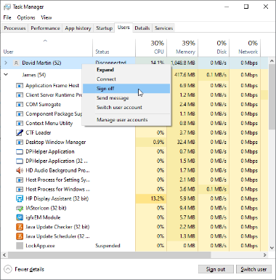
Task Manager User Monitoring
View logged-in users
Send messages
Sign out users
View running processes for users
Resource monitoring on per-user basis
Screenshot courtesy of Microsoft.

Slide 40
Startup Processes and Services Console (Slide 1 of 2)
Startup allows disabling programs from starting when Windows launches
Services allows for monitoring of background services
Disable non-essential services for better performance and security
Notes:
Learners should be reminded that stopping certain services can cause issues for programs, applications, or even the OS functionality. Careful research should be done before disabling services.

Slide 41
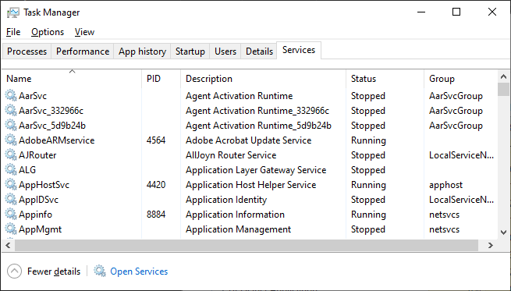
Startup Processes and Services Console (Slide 2 of 2)
Screenshot courtesy of Microsoft.

Slide 42
Resource Monitor and Performance Monitor (Slide 1 of 2)
Resource Monitor (resmon.exe)
Advanced monitoring of resources beyond Task Manager's capabilities
Performance Monitor (perfmon.exe)
Real-time statistic charts and logs for long-term analysis
Counter logs
Trace logs

Slide 43
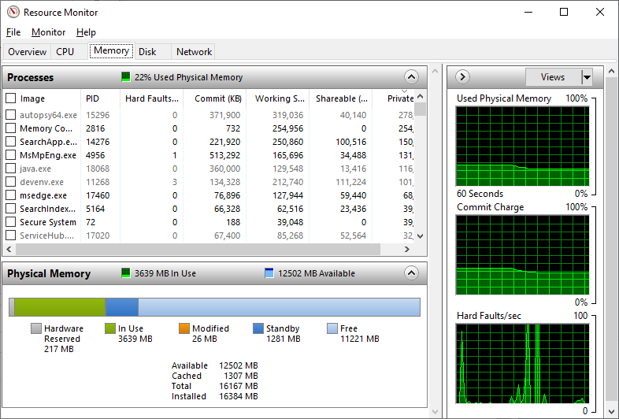
Resource Monitor and Performance Monitor (Slide 2 of 2)
Screenshot courtesy of Microsoft.

Slide 44
Performance Counters (Slide 1 of 2)
Specific monitoring metrics to be used in Performance Monitor utility
Examples
% processor time
Average disk queue length
Memory pages/sec
Paging file % usage

Slide 45
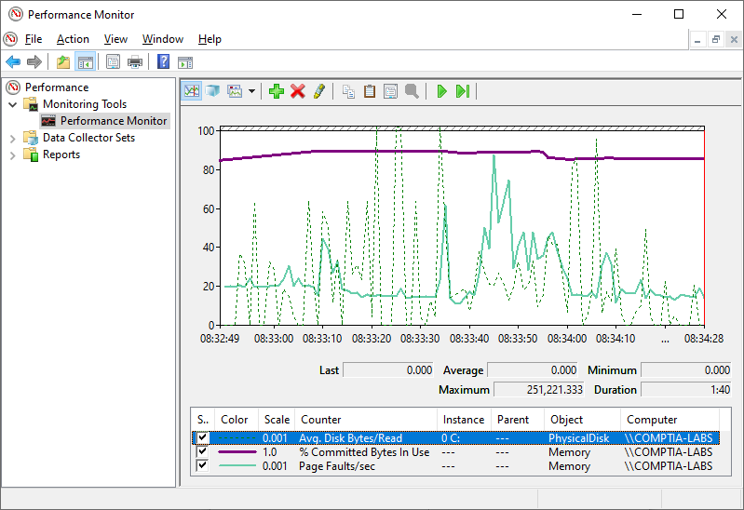
Performance Counters (Slide 2 of 2)
Screenshot courtesy of Microsoft.

Slide 46
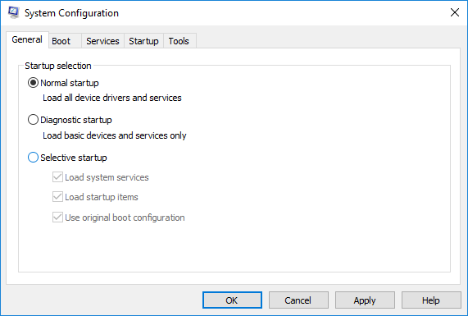
System Configuration Utility
General
Boot
Services
Tools
Screenshot courtesy of Microsoft.
Notes:
Learners should note that the Startup tab is no longer functional. This data is now in Task Manager under the Startup section.

Slide 47
Lab: Manage Applications (available in CertMaster Learn and CertMaster Perform)

Slide 48
Performance and Troubleshooting Tools
System Information
Event Viewer
Task Manager Process Monitoring
Task Manager Performance Monitoring
CPU and GPU Monitoring
Memory Monitoring
Disk and Network Monitoring
Task Manager User Monitoring
Startup Processes and Services Console
Resource Monitor and Performance Monitor
Performance Counters
System Configuration Utility
Notes:
Take some time at the end of each topic to answer questions. You can use the Lesson Review questions for discussion in class or set them for learners to complete individually during or after class.

Slide 49
Troubleshoot Windows OS Problems
Lesson 14.4
Notes:
Core 2 Exam Objective
3.1 Given a scenario, troubleshoot common Windows OS issues.
Learning Outcomes
What is the normal boot process for BIOS and UEFI configurations?
What tools are available for troubleshooting boot process issues?
What options are available under the System Restore mode?
What information may be found on the BSOD?

Slide 50
Boot Process
BIOS
POST
Boot loader- BOOTMGR.EXE
WINLOAD.EXE
Kernel
HAL.DLL
Drivers
UEFI
POST
GPT read
BCD and BOOTMGFW.EFI
Kernel
HAL.DLL
Drivers

Slide 51
Boot Recovery Tools (Slide 1 of 4)
Advanced Boot Options
Interrupt boot process
Hold shift while selecting restart from power menu in Windows
Troubleshoot
WinRE
Start-up repair
Advanced options

Slide 52
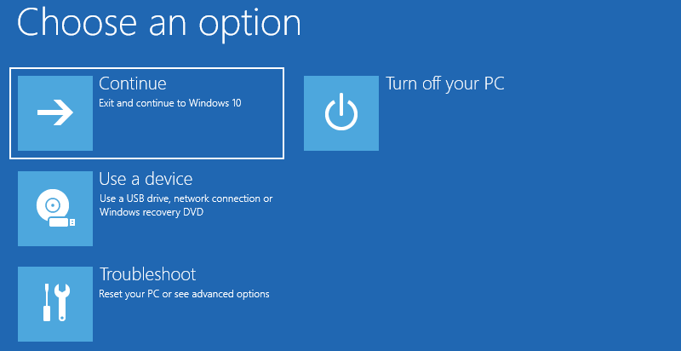
Boot Recovery Tools (Slide 2 of 4)
Screenshot courtesy of Microsoft.

Slide 53
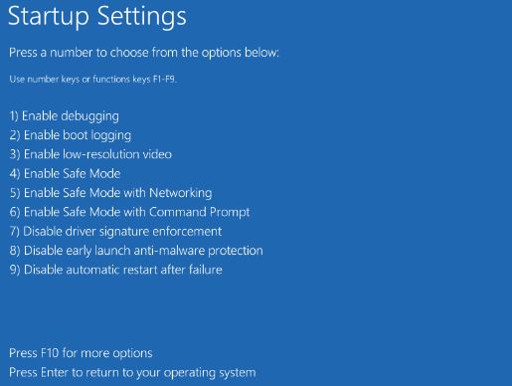
Boot Recovery Tools (Slide 3 of 4)
Screenshot courtesy of Microsoft.

Slide 54
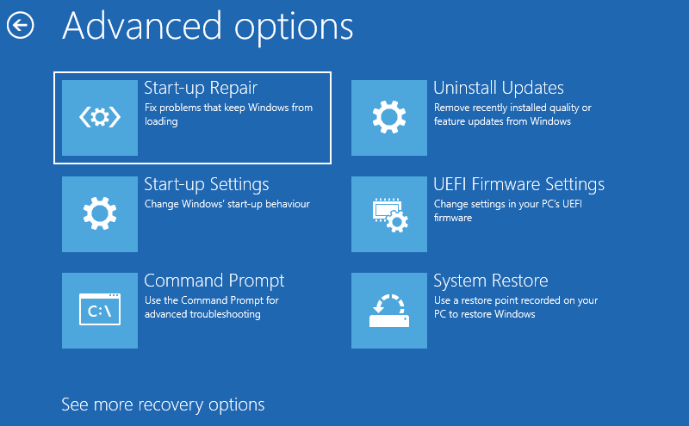
Boot Recovery Tools (Slide 4 of 4)
Screenshot courtesy of Microsoft.

Slide 55
System Restore (Slide 1 of 3)
Configure system protection
Restore point
Disk space usage
Using system restore
Notes:
Learners should be able to complete Lab: Create a Restore Point from CertMaster to examine this process hands-on.

Slide 56
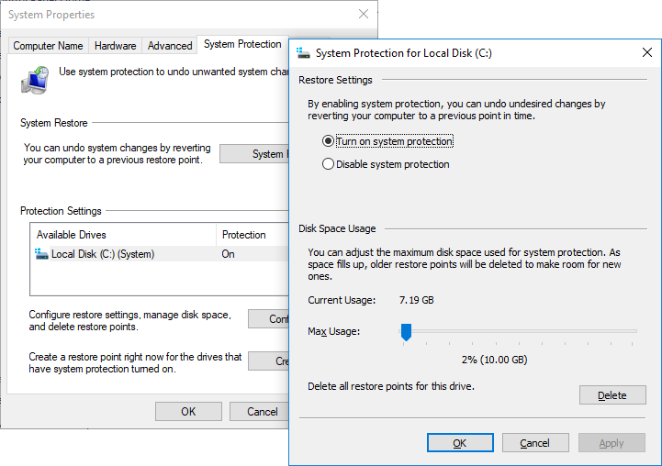
System Restore (Slide 2 of 3)
Screenshot courtesy of Microsoft.

Slide 57
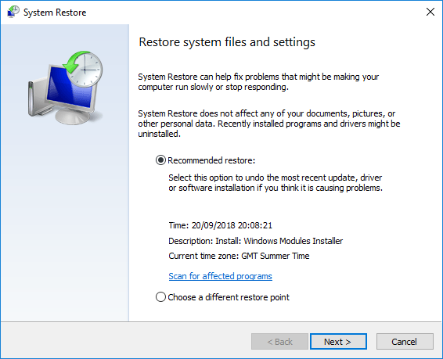
System Restore (Slide 3 of 3)
Screenshot courtesy of Microsoft.

Slide 58
Update and Driver Roll Back (Slide 1 of 3)
Programs and Features applet > view installed updates > select update and then uninstall
Device Manager > Properties > Driver > Roll Back Driver

Slide 59
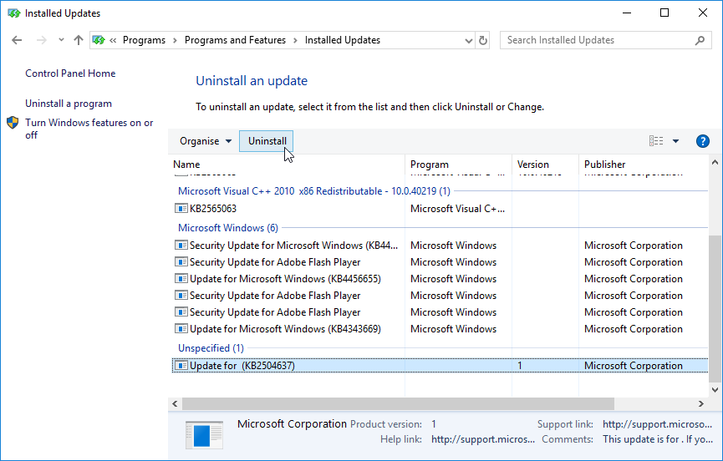
Update and Driver Roll Back (Slide 2 of 3)
Screenshot courtesy of Microsoft.

Slide 60
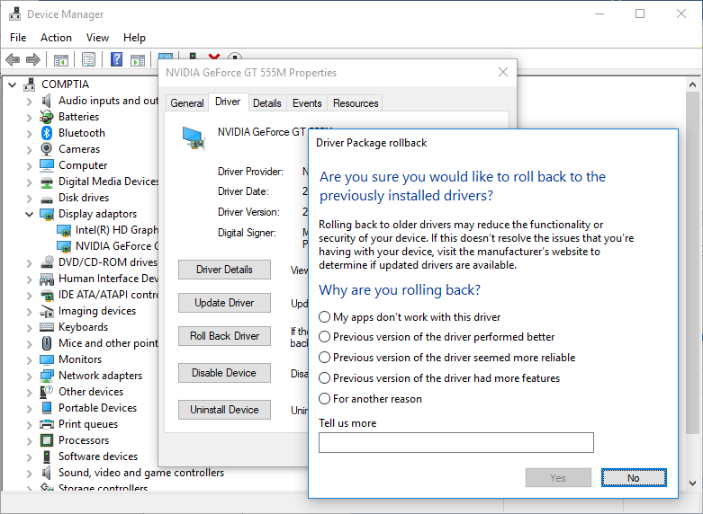
Update and Driver Roll Back (Slide 3 of 3)
Screenshot courtesy of Microsoft.

Slide 61
System Repair, Reinstall, and Reimage (Slide 1 of 2)
Recovery image
Backup of the system used to restore system config and files
Reinstall Windows
Reset this PC option in WinRE
Keep data files or remove everything
Notes:
Learners should be informed that before they sell, trade, or otherwise give up ownership of their Windows PC, they should perform a Reinstallation of Windows and select the Remove Everything option.

Slide 62
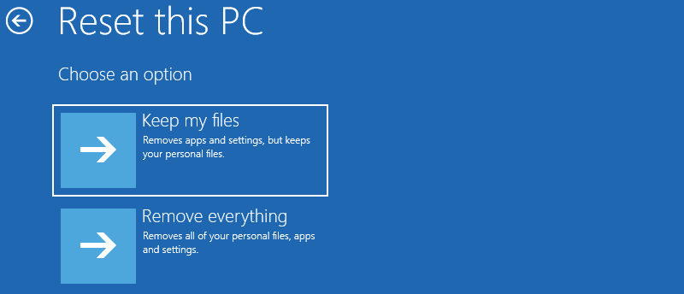
System Repair, Reinstall, and Reimage (Slide 2 of 2)
Screenshot courtesy of Microsoft.

Slide 63
Troubleshoot Boot Issues
Failure to boot
Verify no floppy disk is installed or USB is plugged in still and set to boot
No OS Found
Use chkdsk and bootrec commands from the command prompt
diskpart could also be used to verify system partition is set to active
GUI Fails to Load
Verify monitor turned on and connected to correct video port
Verify input selection
Boot to Safe Mode
Notes:
Learners can use the key sequence WINDOWS+CTRL+SHIFT+B to test whether the system is responsive if the GUI will not load. The system should beep upon execution of this key sequence.

Slide 64
Troubleshoot Profile Issues
Display highly detailed status messages
Verify drivers and services set to load immediately after startup
Rebuild the local profile, if necessary

Slide 65
Troubleshoot Performance Issues
Degraded Performance
Task Manager, PerfMon, and ResMon can be used to verify utilization
Reboot the system
Update OS, applications, and drivers as they may improve performance by fixing known issues
Scan for malware and verify antivirus/antimalware updates
Power management issues

Slide 66
Troubleshoot System Fault Issues (Slide 1 of 2)
Blue Screen of Death (BSOD)
Research indicated problem from details on screen or using QR code
System instability
Frequent unplanned shutdowns
Overheating or corruption of system files
USB Issues
Controller resource issues

Slide 67
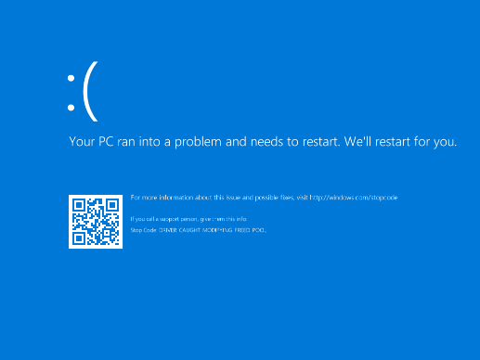
Troubleshoot System Fault Issues (Slide 2 of 2)
Screenshot courtesy of Microsoft.

Slide 68
Troubleshoot Application and Service Fault Issues
Application crashes
Update
If no change, uninstall and reinstall
Services not starting
Verify service is set to automatically start, if necessary
Time drift
Replace RTC battery (CR 2032)
Synchronize clock with known good source (NTP server)

Slide 69
Lab: Boot into the Windows Recovery Environment (available in CertMaster Learn and CertMaster Perform)
Lab: Create a Restore Point (available in CertMaster Learn and CertMaster Perform)
Lab: Configure the Boot Order (available in CertMaster Learn and CertMaster Perform)
Applied Live Lab: Support Windows OS (available in CertMaster Perform and CertMaster Labs)
Challenge Live Lab: Resolve Troubleshooting Tickets (available in CertMaster Perform and CertMaster Labs)
Challenge Live Lab: Resolve Network Troubleshooting Tickets (available in CertMaster Perform and CertMaster Labs)

Slide 70
Troubleshoot Windows OS Problems
Boot Process
Boot Recovery Tools
System Restore
Update and Driver Roll Back
System Repair, Reinstall, and Reimage
Troubleshoot Boot Issues
Troubleshoot Profile Issues
Troubleshoot Performance Issues
Troubleshoot System Fault Issues
Troubleshoot Application and Service Fault Issues
Notes:
Take some time at the end of each topic to answer questions. You can use the Lesson Review questions for discussion in class or set them for learners to complete individually during or after class.

