Slide 1
Exam 220-1202
A+ Core 2

Slide 2
Installing Operating Systems
A+ 220-1202
Module 16

Slide 3
Learning Outcomes
Prepare for A+ Core 2 by:
Explaining OS types
Comparing Windows editions

Slide 4
Windows Editions
Lesson 16.1
Notes:
Core 2 Exam Objectives
1.3 Compare and contrast basic features of Microsoft Windows editions
Learning Outcomes
What are the key differences between Windows Home and Windows Pro editions, and which edition supports domain network integration?
How does the 64-bit version of Windows differ from the 32-bit version in terms of RAM support and application compatibility?
What licensing options are available for Windows Home, and how do they affect the ability to transfer the OS between devices?
What are the benefits of using Windows Enterprise edition for large organizations, and what licensing model is it typically available through?
What is the significance of the N versions of Windows, and how do they comply with European Union regulations?

Slide 5
Windows Versions
32-bit vs 64-bit
Windows 11 only in 64-bit edition
Home, Pro, Pro for Workstations, Enterprise, Education
N versions compliant with EU regulations

Slide 6
Windows Home Edition
Designed for SOHO use
Internet connection required for Microsoft account login and activation
Licensing
OEM
Retail
Limitations
64 cores
Single CPU
128 GB RAM (64-bit)

Slide 7
Work and Education Features
Pro, Enterprise, and Education editions
Domain support
Group Policy Editor
BitLocker
Disk encryption for hard drives and USB (not in Home edition)
RDP
Client and server (Home only has RDP Client)
Notes:
Learners should learn the various features that are available in these editions when compared to Home edition.

Slide 8
Windows Pro and Enterprise Editions (Slide 1 of 2)
Pro
OEM, retail, volume licensing
Pro for Workstations is same as Pro but support for larger memory and advanced hardware
Enterprise and Education
Volume licensing only
DirectAccess VPN, AppLocker, MS Desktop Optimization Pack
128 core max (Pro and Education)
256 core max (Pro for Workstations and Enterprise)
2TB RAM (Pro and Education)
6TB RAM (Pro for Workstations and Enterprise)

Slide 9
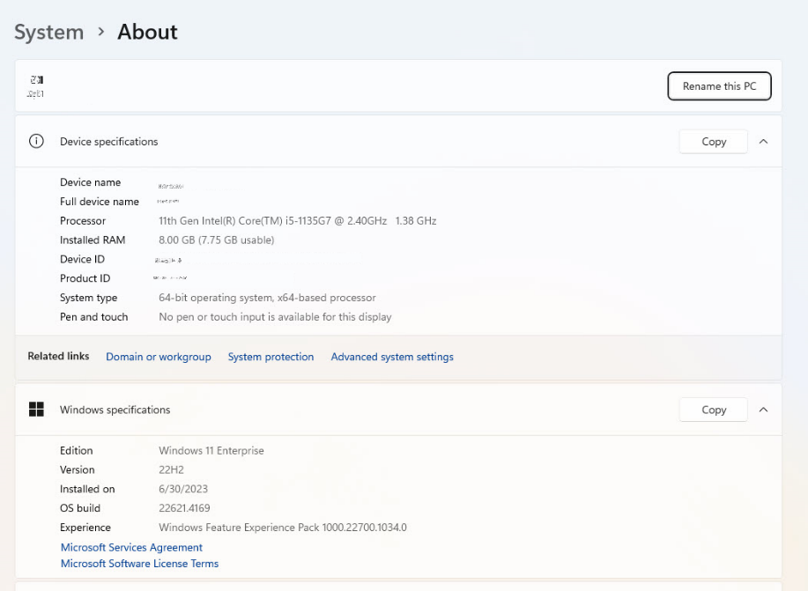
Windows Pro and Enterprise Editions (Slide 2 of 2)
Screenshot courtesy of Microsoft.
Notes:
Use the About settings page to report the edition that is installed

Slide 10
Windows Upgrade Paths and Feature Updates
From Windows 10 to 11
TPM 2.0, UEFI with Secure Boot, supported processor
Upgrade with same edition or from Home to Pro
Need license to update from Home to Enterprise
Downgrade from Pro to Home
Win 10
Semi-annual feature updates
Microsoft support ends Oct 2025
Win 11
Annual feature update cycle
Notes:
Purchasing of new licenses for Windows are available through the Microsoft website. Enterprise licenses can only be volume purchased.

Slide 11
Lab: Windows 11 Features/Desktop (available in CertMaster Learn and CertMaster Perform)

Slide 12
Windows Editions
Windows Versions
Windows Home Edition
Work and Education Features
Windows Pro and Enterprise Editions
Windows Upgrade Paths and Feature Updates
Notes:
Take some time at the end of each topic to answer questions. You can use the Lesson Review questions for discussion in class or set them for learners to complete individually during or after class.

Slide 13
OS Installations and Upgrades
Lesson 16.2
Notes:
Core 2 Exam Objectives
1.2 Given a scenario, perform OS installations and upgrades in a diverse OS environment.
Learning Outcomes
What are the main differences between a clean install and an in-place upgrade, and when would you choose one over the other?
How do you verify hardware compatibility before performing an OS upgrade, and what tools can assist in this process?
What is the role of an answer file in unattended installations, and how does it streamline the deployment process?
How does the GUID Partition Table (GPT) differ from the Master Boot Record (MBR) in terms of partition support and boot method requirements?
What are the advantages of using network-based deployment for OS installations in large organizations, and how does it differ from using physical media?
How does a multiboot installation work, and what are the key considerations for setting up multiple operating systems on a single computer?

Slide 14
Installation and Upgrade Considerations
Clean install
Repartition and reformat drive then install
In-place upgrade
Updates existing OS install with new OS
User data remains on system
Considerations
Hardware compatibility
Application and driver support
Backup files and user preferences
Third-party drivers
Feature updates

Slide 15
Unattended Installations (Slide 1 of 2)
Image deployment with answer file
Network-pushed installation
Zero-touch install
Remote install using cloud-based service to deploy the image onto hardware
Notes:
Instructors should inform learners that "pushing" an installation to many systems should be done at times where network workload is lowest. After hours or weekend pushes are a normal method to ensure that upgrade does not disrupt business operations.

Slide 16
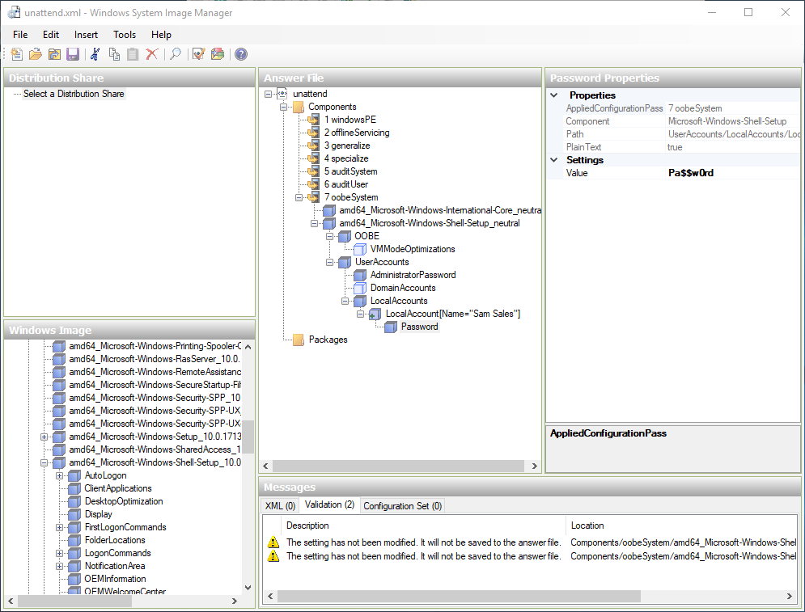
Unattended Installations (Slide 2 of 2)
Screenshot courtesy of Microsoft.
Notes:
Answer file creation using WSIM.

Slide 17
Boot Devices (Slide 1 of 2)
Configured in BIOS/UEFI config
Optical media
USB, external drive, flash drive, hot-swappable drive
Network boot
PXE boot (pronounced "pixie")
DHCP server required
Internet-based boot
Internal drive
Multiboot
Multiple OSs installed on their own partition
OS selection menu shows up during boot

Slide 18
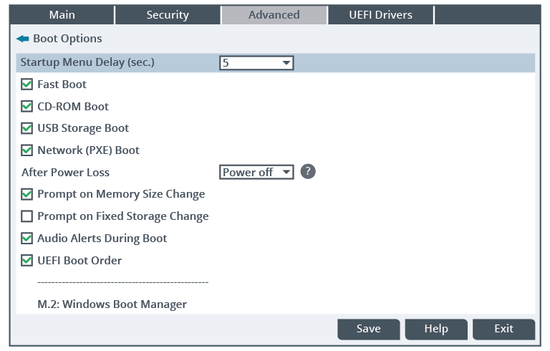
Boot Devices (Slide 2 of 2)
Notes:
Configuring boot devices and priority in a computer's firmware setup program

Slide 19
Disk Configuration (Slide 1 of 2)
MBR-style partition
Master boot record takes first 512-byte to store the partition table
GPT-Style partition
GUID partition table
Larger number of partitions (128 in Windows) and larger partition size (over 2TB)
Drive Format
NTFS for Windows
APFS for macOS
ext3/4 for Linux
Notes:
ReFS can also be used for Windows but is not as popular as NTFS, especially in SOHO environment.

Slide 20
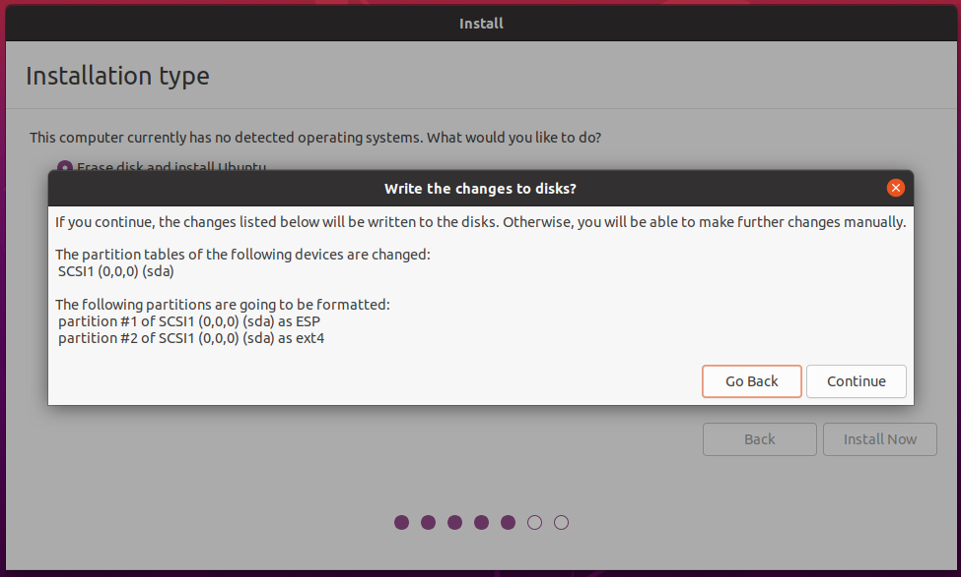
Disk Configuration (Slide 2 of 2)
Notes:
Default choices made by the guided setup program for Ubuntu Linux

Slide 21
Repair Installation
Recovery partition
OEM created on drive
Reset Windows
Refresh reinstalls system files and resets most settings to default
Reset erases all user data and resets the system for fresh installation

Slide 22
Applied Live Lab: Perform a Remote Network Installation (available in CertMaster Perform and CertMaster Labs)
Challenge Live Lab: Support Windows Installation and Upgrade Issues (available in CertMaster Perform and CertMaster Labs)

Slide 23
OS Installations and Upgrades
Installation and Upgrade Considerations
Unattended Installations
Boot Devices
Disk Configuration
Repair Installation
Notes:
Take some time at the end of each topic to answer questions. You can use the Lesson Review questions for discussion in class or set them for learners to complete individually during or after class.

