Slide 1
Exam 220-1202
A+ Core 2

Slide 2
Implementing Operational Procedures
A+ 220-1202
Module 22

Slide 3
Learning Outcomes
Prepare for A+ Core 2 by:
Implementing best practice documentation to track assets
Using common safety and environmental procedures
Explaining basic scripting constructs and use cases

Slide 4
Change and Inventory Management
Lesson 22.1
Notes:
Core 2 Exam Objectives
4.1 Given a scenario, implement best practices associated with documentation and support systems information management.
4.2 Given a scenario, apply change management procedures.
Learning Outcomes
What is a change request?
What purpose does a change advisory board serve?
What is an asset?
What information should be included in an inventory of assets?
Why must a technician understand the warranty process for a particular system?

Slide 5
Change Requests
Policies and procedures that reduce risk of outages caused by changes
Should include:
Purpose, scope, type, timeline, effect
Notes:
Many organizations utilize a documented process to request to implement changes and also have an approval process to do so.

Slide 6
Risk Analysis
Identify possible issues with implementation
What controls or monitors can be implemented to reduce the risk
Identify cause and effect
Qualitative and quantitative analysis

Slide 7
Change Board Approvals
Change advisory board (CAB)
Officially approves changes after request is thoroughly reviewed
Some changes may not need full approval of board, especially during incident response or emergency procedures

Slide 8
Implementation and Acceptance
Implement change
Rollback and/or backup plan
End-user acceptance

Slide 9
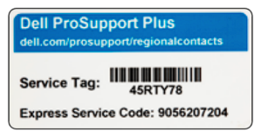
Asset Management
Inventory
Name, make, model
Asset ID
Tag or barcodes are popular
Manufacturer
Specifications
Dates
Warranty, purchase, etc.
Cost
Configuration management database (CMDB)
Lifecycle
Procurement through disposal/destruction
Notes:
The Notes section should refer to any inline or standalone videos, interactive activities, or additional resources that instructors should review or demonstrate to support learners.

Slide 10
Warranty and Licensing
Invoice documentation
Warranty timelines and paperwork
Document limits and license allocations/use

Slide 11
Change and Inventory Management
Change Requests
Risk Analysis
Change Board Approvals
Implementation and Acceptance
Asset Management
Warranty and Licensing
Notes:
Take some time at the end of each topic to answer questions. You can use the Lesson Review questions for discussion in class or set them for learners to complete individually during or after class.

Slide 12
Common Safety and Environmental Procedures
Lesson 22.2
Notes:
Core 2 Exam Objectives
4.4 Given a scenario, use common safety procedures.
4.5 Summarize environmental impacts and local environmental controls.
Learning Outcomes
Why is electrical safety important?
What purpose do fuses and grounding straps serve?
What precautions should be taken with hazardous materials?
What causes ESD and how can it be minimized?

Slide 13
Compliance with Regulations
Health and safety
Building codes
Fire and electrical system protection
Environmental regulations
Waste disposal like chemicals and lithium batteries
Notes:
Safety should be stressed to all learners!

Slide 14
Electrical Safety (Slide 1 of 2)
Current- amps
Voltage- volts
Resistance- ohms
Tools
Voltage testers
Fuses
Grounding
Power handling
Electrical fire safety- CO2 or powder extinguishers vice water
Equipment placement considerations
Notes:
It is a matter of life and death when working with electrical systems. Company policy may prohibit live electrical system work.

Slide 15
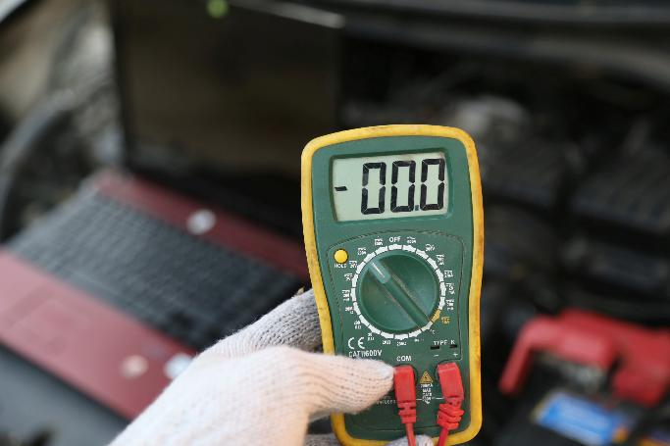
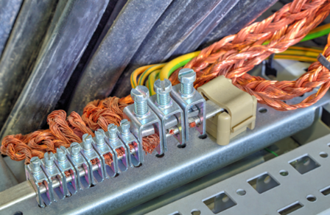
Electrical Safety (Slide 2 of 2)
Image © macmackyky 123RF.com
Image by phadventure © 123RF.com
Notes:
Note: Electrical currents can pass through metal and most liquids, so neither should be allowed to come into contact with any electrical device installations. Damaged components or cables are also a risk and should be replaced or isolated immediately. It is important to test electrical devices regularly. The frequency will depend on the environment in which the device is used. In some countries, portable appliance testing (PAT) carried out by a qualified electrician or technician ensures that a device is safe to use.

Slide 16
Other Safety Hazard Mitigations
Trip hazards
Lifting techniques
Legs not back
Use multiple people when needed
Safety goggles and mask

Slide 17

Environmental Impacts
Dust cleanup
Mask, vacuum, compressed air
Temperature
Humidity
Ventilation
Image © 123RF.com
Notes:
Note: Do not use compressed air blasters to clean up a toner spill or a laser printer within an office-type area. You will blow fine toner dust into the atmosphere and create a health hazard.
Note: A PC vacuum can be used to deal with toner spills only if the filter and bag are fine enough to contain toner particles. Such vacuums should be labeled as toner-safe. Ideally, move the printer to a maintenance room with filters to contain airborne particles. Alternatively, a toner cloth is a special cloth for wiping up loose toner. Be careful if you are using it inside the printer so that the cloth does not get caught on any components and leave fibers behind.

Slide 18
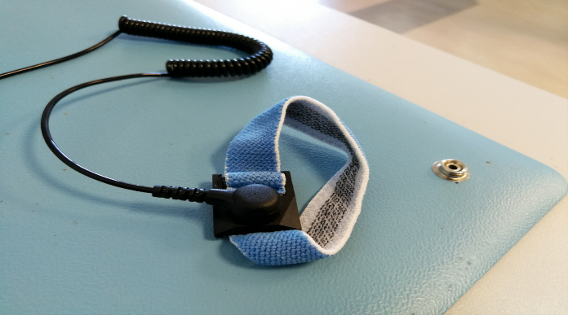
Electrostatic Discharge Mitigation (Slide 1 of 2)
ESD can damage components
ESD strap, mat, workbench
Antistatic bag or dissipative packaging for component storage
Image by Audrius Merfeldas ©123RF.com.
Notes:
Note: Ensure that the strap has a working current-limiting resistor for safety (straps should be tested daily). Do not use a grounding plug if there is any suspicion of a fault in the socket or the building’s electrical wiring or if the wiring is not regularly inspected and tested.

Slide 19
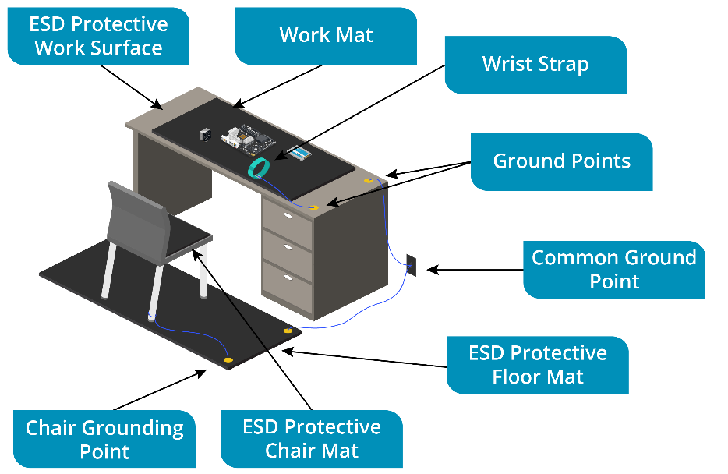
Electrostatic Discharge Mitigation (Slide 2 of 2)
Image by Audrius Merfeldas ©123RF.com.

Slide 20
Building Power Issues and Mitigations (Slide 1 of 2)
Surge, under-voltage, failure
Surge suppressors
Battery backups or uninterruptable power supply (UPS)
Not meant for long term secondary power
Generator
Gas, Diesel, Propane, Natural gas

Slide 21
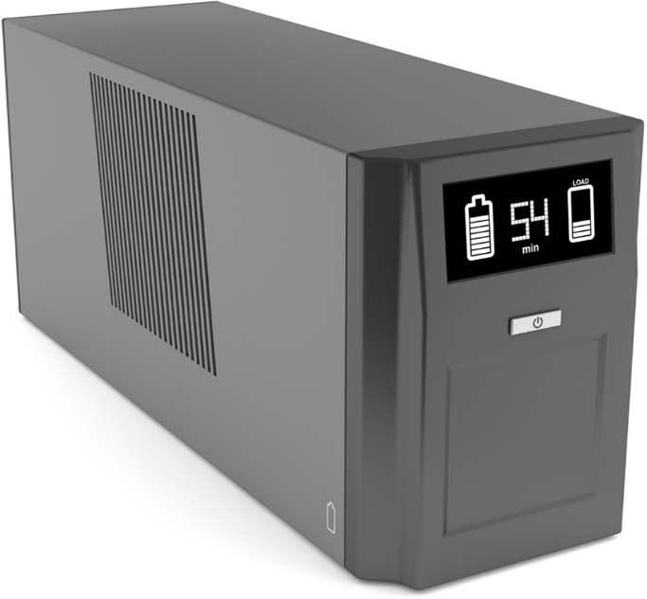
Building Power Issues and Mitigations (Slide 2 of 2)
Image by magraphics© 123RF.com.

Slide 22
Materials Handling and Responsible Disposal
Material safety data sheet (MSDS)
Hazards and cleanup/safety requirements
Proper disposal
Battery
Toner
Chemicals
Devices and assets

Slide 23
Lab: Install a UPS (available in CertMaster Learn and CertMaster Perform)

Slide 24
Common Safety and Environmental Procedures
Compliance with Regulations
Electrical Safety
Other Safety Hazard Mitigations
Environmental Impacts
Electrostatic Discharge Mitigation
Building Power Issues and Mitigations
Materials Handling and Responsible Disposal
Notes:
Take some time at the end of each topic to answer questions. You can use the Lesson Review questions for discussion in class or set them for learners to complete individually during or after class.

Slide 25
Scripting Basics
Lesson 22.3
Notes:
Core 2 Exam Objectives
4.8 Identify the basics of scripting
Learning Outcomes
What is a script?
What are the common scripting languages and file types?
What are some examples of tasks that can be completed using a script?

Slide 26
Shell Scripts (Slide 1 of 2)
Specific to an OS
Script
Series of commands that are executed in order
Integrated development environment (IDE)
Linux shell .sh
Bash (Bourne Again Shell)
Ksh (Korn Shell)

Slide 27
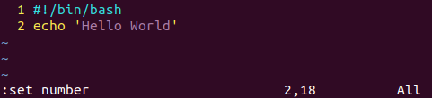
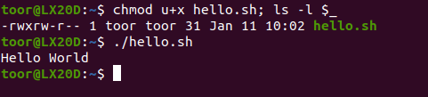
Shell Scripts (Slide 2 of 2)

Slide 28
Basic Script Constructs (Slide 1 of 2)
Comments
Not read by compiler or interpreter
Variables
Branches
Loops
Operators
Notes:
Learners should be able to define each term and identify them within an example script.

Slide 29
Basic Script Constructs (Slide 2 of 2)
Symbol Notation | Switch Notation | Usage
== | -eq | Is equal to (returns TRUE if both conditions are the same)
!= | -ne | Is not equal to (returns FALSE if both conditions are the same)
< | -lt | Is less than
> | -gt | Is greater than
<= | -le | Is less than or equal to
>= | -ge | Is greater than or equal to
&& | AND | If both conditions are TRUE, then the whole statement is TRUE
|| | OR | If either condition is TRUE, then the whole statement is TRUE

Slide 30
Windows Scripts (Slide 1 of 2)
PowerShell .ps1
VBScript .vbs
Batch file .bat
Notes:
Instructors may want to demonstrate the Windows PowerShell ISE with their learners.

Slide 31
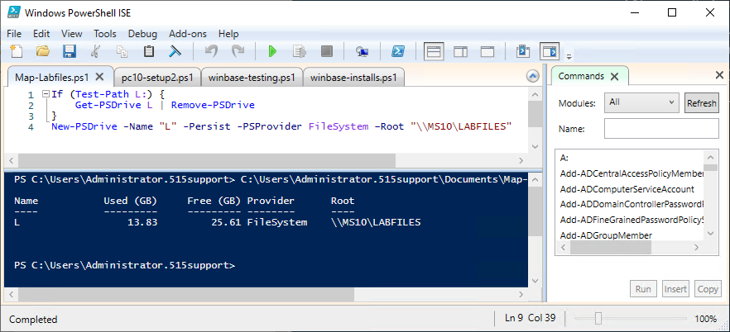
Windows Scripts (Slide 2 of 2)
Screenshot courtesy of Microsoft.

Slide 32
JavaScript and Python (Slide 1 of 3)
JavaScript .js
Web content and apps
Python .py
General purpose primarily used in automation and software apps
Python IDLE

Slide 33
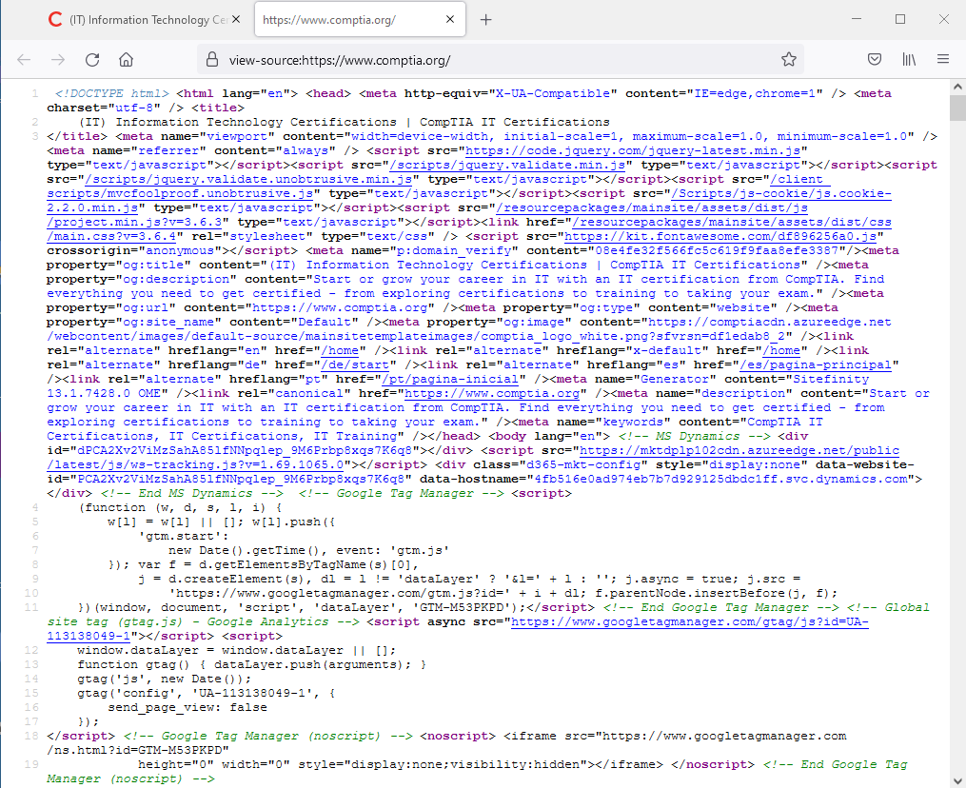
JavaScript and Python (Slide 2 of 3)
Screenshot courtesy of Mozilla.

Slide 34
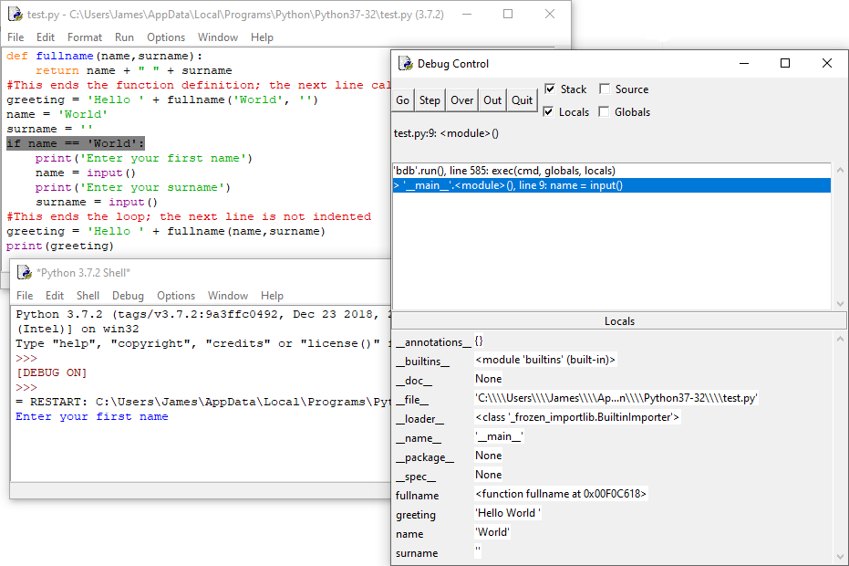
JavaScript and Python (Slide 3 of 3)
Notes:
Note: There are two major versions of Python: version 2 and version 3. Both to be installed at the same time. In Linux, using the keyword ​python​ executes a script as version 2, while ​python3​ executes a script in the version 3 interpreter. As of 2020, Python 2 is end of life (EOL), so scripts should be updated to version 3 syntax.

Slide 35
Use Cases for Scripting
API use
Restarting machines
Remapping network drives
Installation of applications
Updating system OS and apps
Automated backups
Information gathering
Inventory
Notes:
Examples of various scripts in different languages should be reviewed and explained by instructor. Learners may be asked to identify components or functionality of a script as part of interviewing processes and potential employers.

Slide 36
Scripting Best Practices and Considerations
Malware risk
Inadvertent system/settings changes
Browser or system crash due to resource mishandling

Slide 37
Lab: JavaScript (available in CertMaster Learn and CertMaster Perform)
Live Lab: Implement a PowerShell Script (available in CertMaster Perform and CertMaster Labs)
Live Lab: Implement a Bash Script (available in CertMaster Perform and CertMaster Labs)

Slide 38
Scripting Basics
Shell Scripts
Basic Script Constructs
Windows Scripts
JavaScript and Python
Use Cases for Scripting
Scripting Best Practices and Considerations
Notes:
Take some time at the end of each topic to answer questions. You can use the Lesson Review questions for discussion in class or set them for learners to complete individually during or after class.

