Slide 1
Exam 220-1202
A+ Core 2

Slide 2
Using Data Security
A+ 220-1202
Module 21

Slide 3
Learning Outcomes
Prepare for A+ Core 2 by:
Implementing backup and recovery
Explaining data handling best practices
Explaining the basics of Artificial Intelligence

Slide 4
Data Backup and Recovery
Lesson 21.1
Notes:
Core 2 Exam Objectives
4.3 Given a scenario, implement workstation backup and recovery methods.
Learning Outcomes
What is the purpose of backing up data?
What are the types of backup chains?
What is the GFS backup scheme?
When would an in-place recovery be used instead of recovering to an alternate location?

Slide 5
Backup Operations (Slide 1 of 2)
Protects against data loss
Backup scheme
Series of backup types and timelines
IE hourly snapshots of VM's and weekly backups of data files
File History
Versioning
Backup and Restore Center

Slide 6
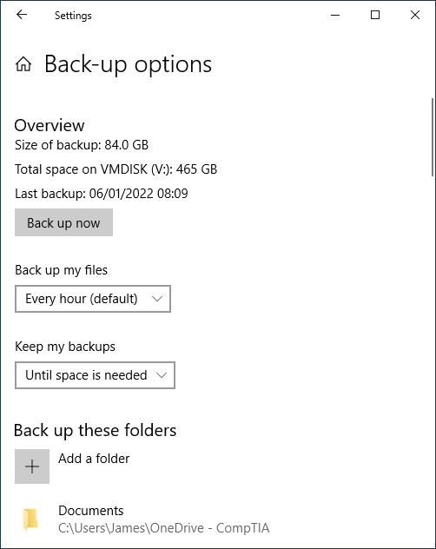
Backup Operations (Slide 2 of 2)
Screenshot courtesy of Microsoft.

Slide 7
Backup Methods (Slide 1 of 2)
Frequency- how often
Retention- how long to hold on to backup file
Backup chains
Full- all data
Incremental- only changes since last backup of any type
Differential- changes since last FULL backup
Synthetic full backup
Series of backups that append changes from incremental backup to the end of the original full backup
IE: Full backup on the first of month at 7am and then incremental backups every 3 hours for remainder of month
Notes:
Instructors may want to provide various backup schemes and scenarios of failure to learners and help identify which backup files would be needed to restore system. IE Backups are completed at 2:00am with a full backup on Sunday, Incremental backups on Monday, Tuesday, Thursday, and Friday, and differentials on Wednesday and Saturday. Failure occurs on XX day at xx:xx time, which files would be needed to restore system.

Slide 8
Backup Methods (Slide 2 of 2)
Type | Data Selection | Backup Job Time and Storage Requirement | Recovery Complexity | Archive Attribute
Full | All selected data regardless of when it was previously backed up | High | Low (single job) | Cleared
Incremental | New files and files modified since last backup job | Low | High (multiple jobs) | Cleared
Differential | New files and files modified since last full backup job | Moderate | Moderate (two jobs) | Not cleared

Slide 9
Backup Media Requirements
Media reuse
Magnetic tape, internal/external hard drives, NAS/SAN, cloud
Grandfather-Father-Son (GFS)
On site vs off site storage
3-2-1 rule
Popular scheme consists of
3 full copies of data(includes production system), 2 different media types, offline and offsite stored backup
IE: Production system, External hard drive backup stored on site, and a backup of data to the cloud

Slide 10
Backup Testing and Recovery Best Practices
Always test backups will provide restoration of data in the event of a loss
Verify data after backup
Test periodically to ensure procedural compliance
Recovery options
In-place
Alternative system/site location

Slide 11
Lab: Back Up the Computer (available in CertMaster Learn and CertMaster Perform)
Lab: Restore Data from File History (available in CertMaster Learn and CertMaster Perform)
Applied Live Lab: Support Backup and Restore Operations (available in CertMaster Perform and CertMaster Labs)

Slide 12
Data Backup and Recovery
Backup Operations
Backup Methods
Backup Media Requirements
Backup Testing and Recovery Best Practices
Notes:
Take some time at the end of each topic to answer questions. You can use the Lesson Review questions for discussion in class or set them for learners to complete individually during or after class.

Slide 13
Data Handling Best Practices
Lesson 21.2
Notes:
Core 2 Exam Objectives
2.1 Summarize various security measures and their purposes.
2.9 Compare and contrast data destruction and disposal methods.
4.6 Explain the importance of prohibited content/activity and privacy, licensing, and policy concepts.
Learning Outcomes
What regulations does healthcare data fall under?
What type of data is considered prohibited?
What are the different software license types?
What is the chain of custody?
How can a mechanical hard drive be destroyed?

Slide 14
Regulated Data Classification
PII
US Privacy Act and GDPR regulatory compliance
PGI
Social security, passport, driver's license
PHI
Protected health information
HIPAA compliance in US
Credit card and bank card transactions
PCI-DSS
Best practices and requirements
Notes:
Learners should be made aware that there may be international, national, state, and even local laws and regulations that protect certain types of data. Careful research and vetting of compliance requirements should be completed to ensure awareness.

Slide 15
Prohibited Content and Licensing Issues
Information not applicable to work
Obscene or illegally copied/pirated
End-user license agreements (EULA)
License compliance
Personal vs corporate use
Single user vs multiple user license
Open-source license
Does not necessarily indicate free cost to use
Digital rights management
Non-disclosure agreement (NDA)

Slide 16
Incident Response
Standard procedures and policy to follow when something occurs like a data breach or system outage
Incident response plan
CIRT/CERT/CSERT
Team of responders identifies specifically to handle various situations

Slide 17
Data Integrity and Preservation
Forensics
Collection of evidence from a computer system or network to a standard that will be accepted in a court of law
Certified technicians and facilities for processing
Document, document, document
Pictures, videos, notes
Order of volatility
Chain of custody
Positive, documented, control over evidence to prevent tampering and documents collection, storage, processing, and even transport of said evidence
Notes:
Learners may be able to remember the order of volatility with a mnemonic. CRASH A- Cache, Registers/RAM, Swap, Hard disk storage, and Archival media

Slide 18
Data Destruction Methods
Sanitization
Re-formatting may not be sufficient
Erasing/wiping
Low level format
Secure erase
Instant secure erase

Slide 19
Disposal and Recycling Outsourcing Concepts
Drilling
Shredding
Incineration
Degaussing
Only works on magnetic media like HDD and magnetic tape, not SSD or optical media
Certificate of destruction/recycling

Slide 20
Data Handling Best Practices
Regulated Data Classification
Prohibited Content and Licensing Issues
Incident Response
Data Integrity and Preservation
Data Destruction Methods
Disposal and Recycling Outsourcing Concepts
Notes:
Take some time at the end of each topic to answer questions. You can use the Lesson Review questions for discussion in class or set them for learners to complete individually during or after class.

Slide 21
Artificial Intelligence
Lesson 21.3
Notes:
Core 2 Exam Objectives
4.10 Explain basic concepts related to artificial intelligence (AI).
Learning Outcomes
What benefits can integrating AI into an application provide?
What should an AUP for AI include?
Why would an AI's output be biased?
Why is data security and privacy a primary concern when it comes to AI?

Slide 22
Application Integration
AI can analyze data and provide recommendations
Use of third-party providers like website add-on chatbot
NLP, ML, Computer Vision
Notes:
Learners may already be familiar with application integrated AI solutions and may have used them in the past. Invite learners to share an example of two.

Slide 23
Policy
Organizational policy should be designed to dictate the legal and ethical use or banning of AI solution use
Acceptable use policy
May restrict what corporate data can and cannot be shared with authorized AI integrations

Slide 24
Limitations
Bias- garbage in, garbage out
Hallucinations- wrong info generated without regard for facts
Accuracy- trust, but verify

Slide 25
Private vs. Public
Private- for the sole use within the organization for business purposes
Public- available for anyone to utilize
CHATGPT, Gemini, and Bard are examples
Notes:
Ask learners about various AI solutions they may have used and why or why not they chose to do so.

Slide 26
Challenge Live Lab: Resolve Incident Response Tickets (available in CertMaster Perform and CertMaster Labs)

Slide 27
Artificial Intelligence
Application Integration
Policy
Limitations
Private vs. Public
Notes:
Take some time at the end of each topic to answer questions. You can use the Lesson Review questions for discussion in class or set them for learners to complete individually during or after class.

