Slide 1
Exam 220-1202
A+ Core 2

Slide 2
Supporting Other OS
A+ 220-1202
Module 17

Slide 3
Learning Outcomes
Prepare for A+ Core 2 by:
Identifying features of Linux
Identifying features of macOS

Slide 4
Linux Features
Lesson 17.1
Notes:
Core 2 Exam Objectives
1.9 Identify common features and tools of the Linux client/desktop operating system.
Learning Outcomes
What are the differences between interactive and non-interactive shell usage, and how can you switch between different shell environments?
How can you configure multiple desktops in a Linux environment to optimize workspace for different tasks?
How do you use the cd command to navigate between directories, and what is the significance of the root directory in Linux?
How do you mount a filesystem in Linux, and what role does the /etc/fstab file play in this process?
How do you use the cp and mv commands to manage files, and what precautions should be taken when using the rm command?

Slide 5
Shells, Terminals, and Consoles (Slide 1 of 2)
Bootloader
Shell and Terminal
Shell provides command line interface for user
Bash, zsh, ksh are popular shells
Terminal application connects to shell interpreter
stdin, stdout, stderr
Desktop environment
GUI for user interaction
Console switching
CTRL+ALT+Fx
Notes:
Learners will need to be familiar with the Linux environment and be able to provide basic support to its users.

Slide 6
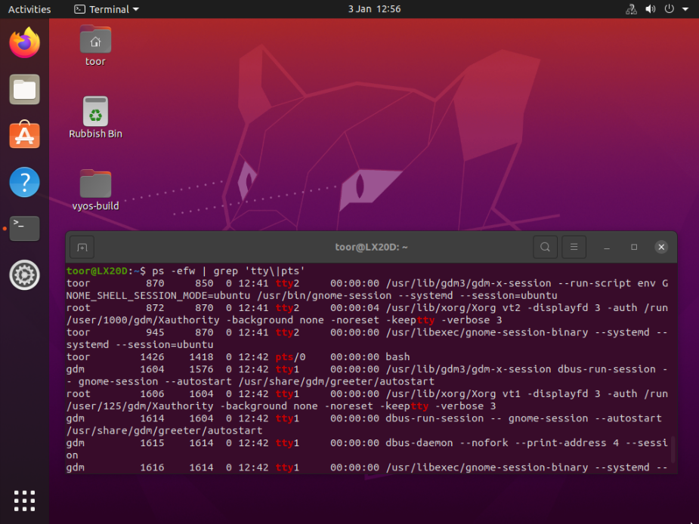
Shells, Terminals, and Consoles (Slide 2 of 2)
Notes:
Ubuntu 20 running the GNOME desktop with a virtual terminal window open to run commands in the Bash command environment

Slide 7
Command Interface (Slide 1 of 2)
Command
Command to be executed
Options
Modification of the command
Arguments
Values that operate the command
Pipes
Redirection of one commands output as the input to second command
String multiple commands
Use semicolon (;) to string commands together
Notes:
Learners should focus on attention to detail when it comes to Linux. Consider showing the video Command Interface.

Slide 8
Command Interface (Slide 2 of 2)
Case sensitivity
Help options
Text Editor
vi
vim
nano
Notes:
Case sensitivity and syntax errors are very common for beginners.

Slide 9
Navigation Commands (Slide 1 of 3)
No drive letters in Linux
Everything is a directory or sub directory of the root of the file system
pwd
Present working directory
Your location currently within the file system
cd
Change directory
ls
List contents of directory
cat
Display the contents of a file
Notes:
Commands should be practiced by learners.

Slide 10
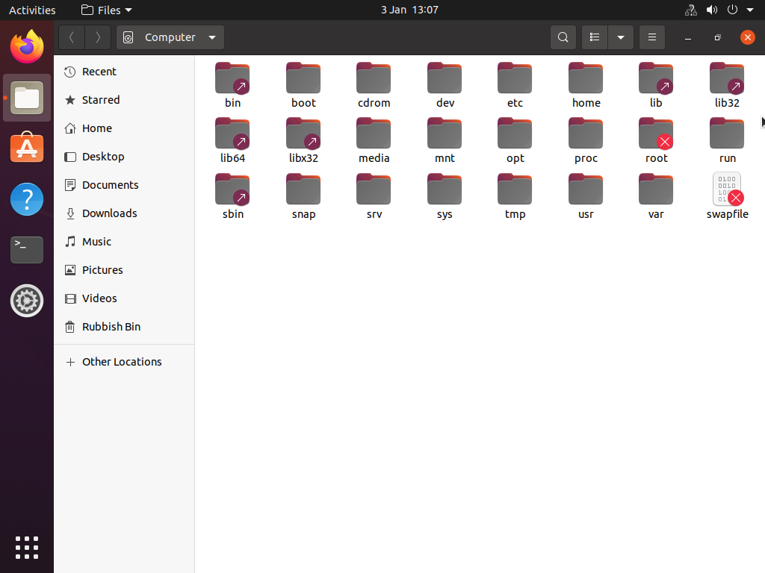
Navigation Commands (Slide 2 of 3)
Notes:
Viewing the root directory and file system hierarchy standard (FHS) subdirectories in Ubuntu Linux

Slide 11
Navigation Commands (Slide 3 of 3)

Slide 12
Search Commands (Slide 1 of 3)
find to search for file by name, owner, size, etc.
grep to search for strings within a file
-i option will ignore case sensitivity
Metacharacters and escaping
* wildcard character
Backslash \
Single and double quotes ' ' or " "

Slide 13
Search Commands (Slide 2 of 3)

Slide 14
Search Commands (Slide 3 of 3)

Slide 15
Filesystem Management
mount
Logical connection of file system to the OS
/etc/fstab
File system information file dictating file system mount points
fsck (File system check)
Check and repair utility

Slide 16
File Management Commands
cp
copy
mv
move
rm
remove
df
disk space free statistics
du
disk space used statistics
Notes:
Learners should practice these commands and understand their output. If they do not have access to a Linux system, the Lab: File Management can be used to practice.

Slide 17
User Account Management
su
switch user
sudo
Run specified commands with elevated permissions
Account must be listed in /etc/sudoers file
/etc/passwd
/etc/shadow
useradd, usermod, userdel
groupadd, groupmod, groupdel
Notes:
Instructors should demonstrate these command to learners.

Slide 18
File Permissions Commands (Slide 1 of 2)
Read, Write, Execute (rwx)
Symbolic mode using rwx designations or - for denied permission
Octal mode
Read (4), Write (2), Execute (1)
chmod
Change or modify permissions
chown
Change ownership of file/directory
Notes:
Instructors should demonstrate the use of these commands while also using ls –l to show the changes being made.

Slide 19
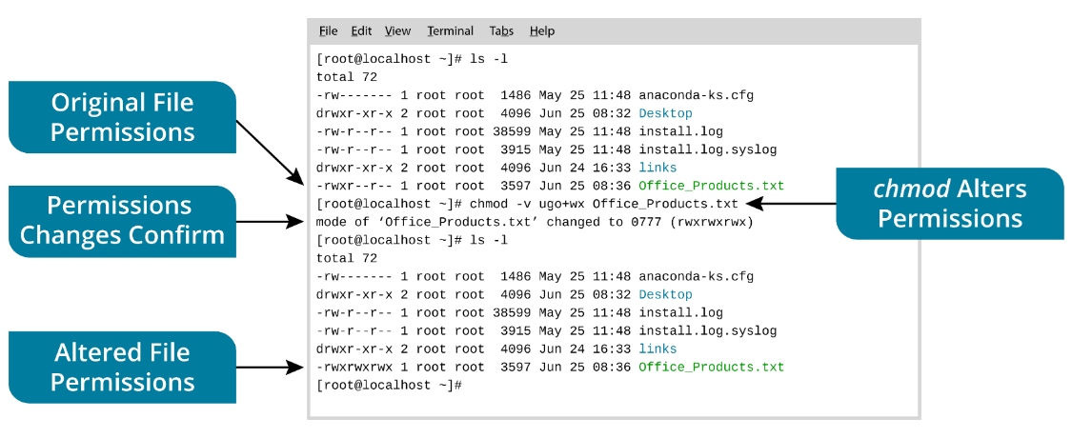
File Permissions Commands (Slide 2 of 2)

Slide 20
Lab: File Management (available in CertMaster Learn and CertMaster Perform)
Lab: Manage Linux File Ownership (available in CertMaster Learn and CertMaster Perform)
Applied Live Lab: Report Linux Configuration Settings (available in CertMaster Perform and CertMaster Labs)

Slide 21
Linux Features
Shells, Terminals, and Consoles
Command Interface
Navigation Commands
Search Commands
Filesystem Management
File Management Commands
User Account Management
File Permissions Commands
Notes:
Take some time at the end of each topic to answer questions. You can use the Lesson Review questions for discussion in class or set them for learners to complete individually during or after class.

Slide 22
Package and Network Management
Lesson 17.2
Notes:
Core 2 Exam Objectives
1.9 Identify common features and tools of the Linux client/desktop operating system.
Learning Outcomes
How do the apt and dnf commands differ in managing software packages, and what are their basic functions?
How do you configure a package manager to access specific software repositories, and why is this important for system updates?
How do the ps and top commands help in monitoring system processes, and what information do they provide?
How do you configure persistent network settings using NetworkManager or systemd-networkd?

Slide 23
Package Management Commands (Slide 1 of 2)
apt Debian based distros
apt update
apt upgrade
apt install
DNF(yum) Red Hat distros
dnf check-update
dnf update
dnf upgrade
dnf install or dnf remove
Updates are retrieved from repositories (repos)
Notes:
Learners should routinely practice using the Terminal to update and upgrade the Linux distribution.

Slide 24
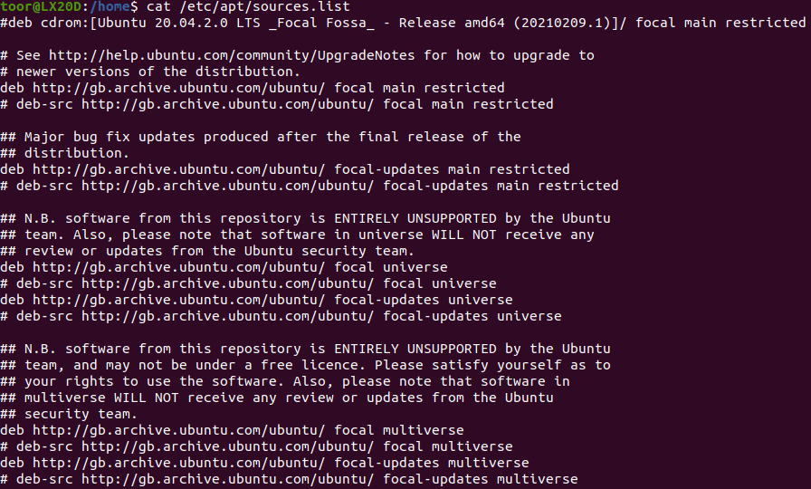
Package Management Commands (Slide 2 of 2)
Notes:
Listing package manager sources in Ubuntu Linux

Slide 25
Process Monitoring Commands (Slide 1 of 3)
ps
Display process table
top
Display all running processes in real time statuses
systemd
Init system and service manager in Linux
systemctl
Used with systemd to start, stop, enable, and disable services
Notes:
Consider showing the video Process Monitoring Commands.

Slide 26
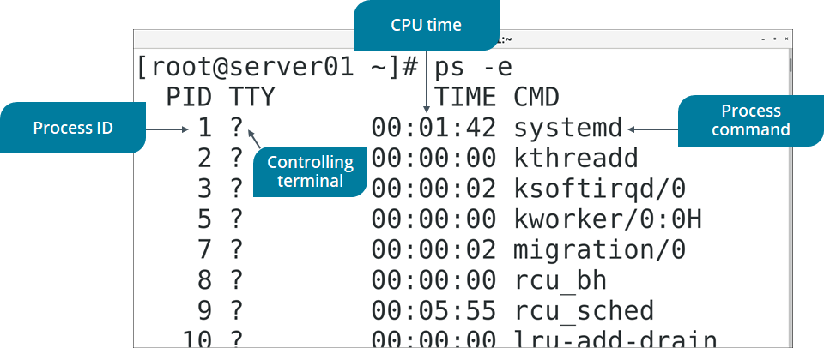
Process Monitoring Commands (Slide 2 of 3)
Notes:
Listing all processes on the system. Note that a question mark indicates that a process has no controlling terminal.

Slide 27
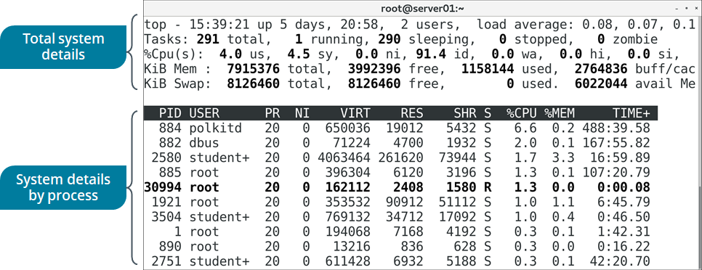
Process Monitoring Commands (Slide 3 of 3)
Notes:
Listing the state of running processes

Slide 28
Network Management Commands (Slide 1 of 2)
ip
ip addr
/etc/hosts
Host name to IP mapping locally; queried before DNS
/etc/resolv.conf
DNS server information
ping
Tests connectivity
Notes:
Practice, Practice, Practice! Learners need to practice commands and be confident in using them to troubleshoot network issues.

Slide 29
Network Management Commands (Slide 2 of 2)
dig
DNS query through CLI
curl
Transfer data from one system to another
traceroute
Network diagnostic tool
Notes:
Practice, Practice, Practice! Learners need to practice commands and be confident in using them to troubleshoot network issues.

Slide 30
Backup and Scheduling Commands
cron job
Task scheduler for Linux
crontab
List of scheduled jobs
Syntax for scheduling jobs
mm hh dd MM
weekday
command

Slide 31
Lab: Informational and Network Tools (available in CertMaster Learn and CertMaster Perform)
Lab: Configure Linux (available in CertMaster Learn and CertMaster Perform)
Applied Live Lab: Manage Linux Apps and Files (available in CertMaster Perform and CertMaster Labs)

Slide 32
Package and Network Management
Package Management Commands
Process Monitoring Commands
Network Management Commands
Backup and Scheduling Commands
Notes:
Take some time at the end of each topic to answer questions. You can use the Lesson Review questions for discussion in class or set them for learners to complete individually during or after class.

Slide 33
macOS Features
Lesson 17.3
Notes:
Core 2 Exam Objectives
1.8 Explain common features and tools of the macOS/desktop operating system.
Learning Outcomes
How can Spotlight Search be used to quickly locate files and applications on macOS?
What are the differences between the Z shell and Bash in macOS, and how do you access the Terminal?
What is the role of the /Library folder in macOS, and how does it differ from the /System folder?
How do you configure input device options in macOS System Preferences, and what are the key differences between Mac and PC keyboards?
How do you link a local macOS account to an Apple ID, and what are the benefits of doing so?

Slide 34
Interface Features (Slide 1 of 3)
Menu bar
Top of screen
Dock
Bottom of screen with one click access to apps and files
Spotlight Search searches content on system
COMMAND+SPACE
Terminal
CLI for macOS
Mission Control
Multiple desktop displays
F3 key to activate
Notes:
While Linux and macOS are not heavily covered in the exam objectives, learners should be reminded that they may be asked to troubleshoot OSs other than Windows in an enterprise or SOHO environment.

Slide 35

Interface Features (Slide 2 of 3)
Screenshot reprinted with permission from Apple Inc.
Notes:
Menu bars with different apps running

Slide 36
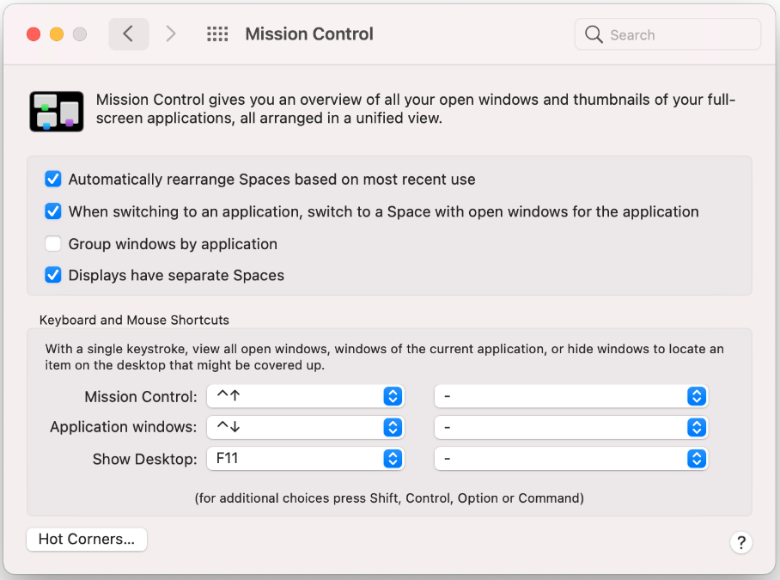
Interface Features (Slide 3 of 3)
Screenshot reprinted with permission from Apple Inc.
Notes:
Mission Control is used to switch between windows and manage multiple desktops.

Slide 37
System Folders and Finder
Everything stems from root of directory
/Applications all applications installed
/Library system-wide resources and settings
/System core system files and resources for operation
/Users user account data
/Users/Library hidden folder for each user's home directory
Finder
File Explorer for macOS

Slide 38
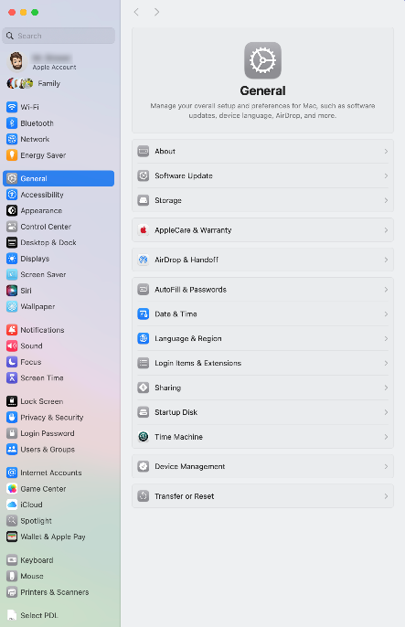
System Settings (Slide 1 of 3)
Settings, network options, and configurations
Apple keyboard differences
COMMAND- CTRL on Windows
OPTION- ALT key
CONTROL
Displays
Scaling and display settings
Accessibility
Vision and sound
Screenshot reprinted with permission from Apple Inc.
Notes:
Consider showing the video Mac System Settings.

Slide 39
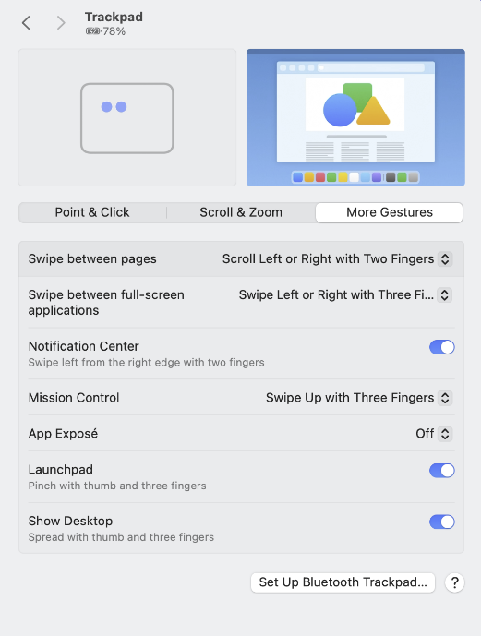
System Settings (Slide 2 of 3)
Screenshot reprinted with permission from Apple Inc.
Notes:
Configuring the trackpad

Slide 40
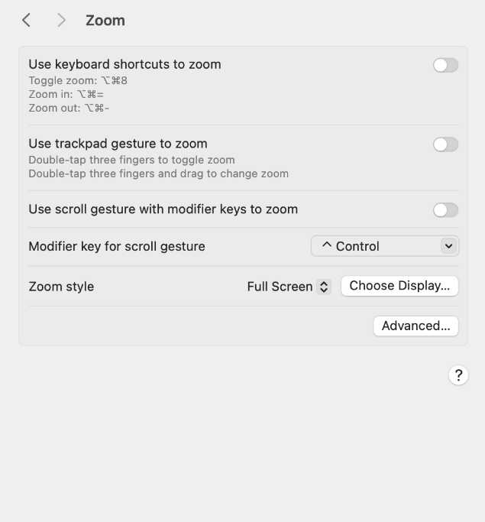
System Settings (Slide 3 of 3)
Screenshot reprinted with permission Apple Inc.
Notes:
Accessibility prefpane showing Zoom options

Slide 41
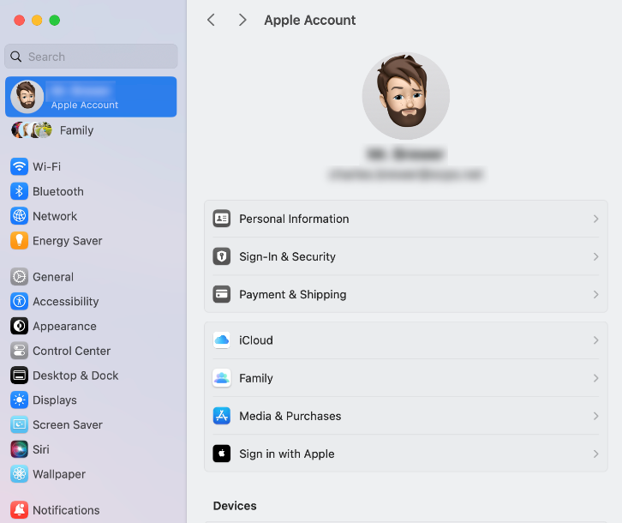
Security and User Management (Slide 1 of 2)
System Settings > Users & Groups
Apple ID
Appstore purchases
iCloud sync and data storage
Screenshot reprinted with permission from Apple Inc.
Notes:
Apple ID is similar to a Microsoft account for data sync between devices and storage using the cloud.

Slide 42
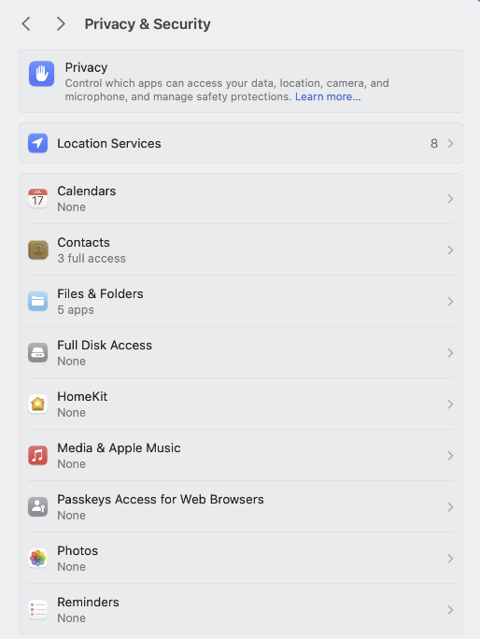
Security and User Management (Slide 2 of 2)
Privacy and Security
Analytics
Telemetry data
Permissions
Internet Accounts
Keychain
File Vault
Disk encryption
Screenshot reprinted with permission from Apple Inc.

Slide 43
iCloud and Continuity (Slide 1 of 2)
Cloud storage including Mail, Contacts, Calendar, Photos, Notes and Reminders
FaceTime
Audio and video call service
iMessage
Apple’s proprietary messaging service
iCloud Drive
Store and access files
Continuity
Switch between devices seamlessly
AirDrop
File sharing service direct between two Apple devices
Notes:
Instructors should review each feature and service with their learners.

Slide 44
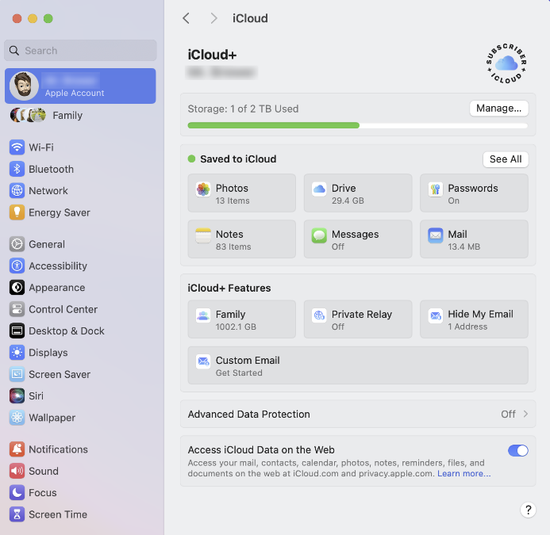
iCloud and Continuity (Slide 2 of 2)
Screenshot reprinted with permission from Apple Inc.
Notes:
Using the Apple ID to configure iCloud synchronization options

Slide 45
App Installation and Management (Slide 1 of 3)
App Store
Applications and OS updates and new releases
Apple ID required
System Settings > Security and Privacy to adjust settings
.dmg
Disk image like Windows .iso files
.pkg
Package files

Slide 46
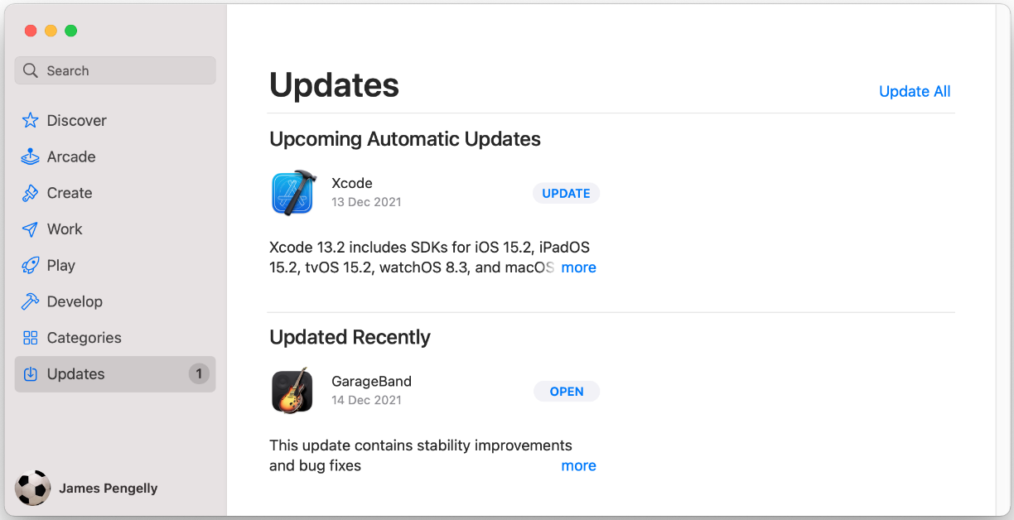
App Installation and Management (Slide 2 of 3)
Screenshot reprinted with permission from Apple Inc.
Notes:
Monitoring the App Store for available updates

Slide 47
App Installation and Management (Slide 3 of 3)
Uninstall
Drag app to Trash
Ensure regular updates are enabled for Antivirus
Corporate Restrictions
Managed in Business Manager portal
Notes:
Consider showing the video App Installation and Management

Slide 48
OS and App Updates (Slide 1 of 2)
App Store
Enable auto download of updates
macOS updates
System Settings > General > Software Update
Rapid Security Response (RSR)
Security updates direct from Apple
Enable automatic install is best practice

Slide 49
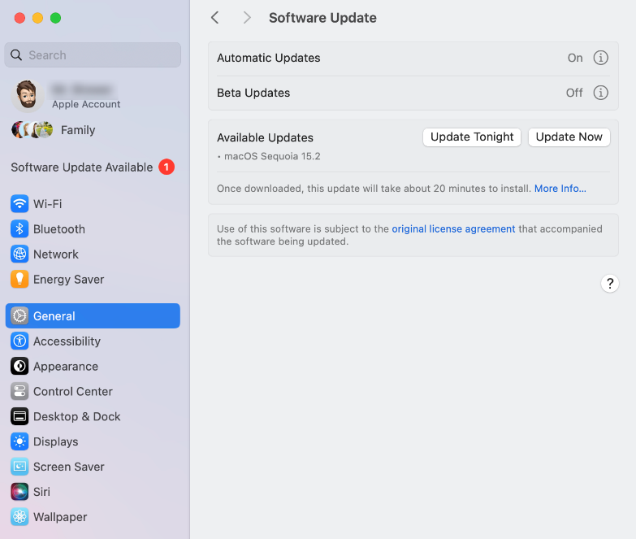
OS and App Updates (Slide 2 of 2)
Screenshot reprinted with permission from Apple Inc.
Notes:
Software Update showing that a macOS version upgrade is available

Slide 50
Network and Device Settings (Slide 1 of 3)
Status menu > Advanced
Configure IP, DNS, and Wi-Fi options
Printers & Scanners
Add and manage devices
Disk Utility used to verify and repair disk or file system
Screenshot reprinted with permission from Apple Inc.
Notes:
Consider showing the video Managing Network Settings.

Slide 51
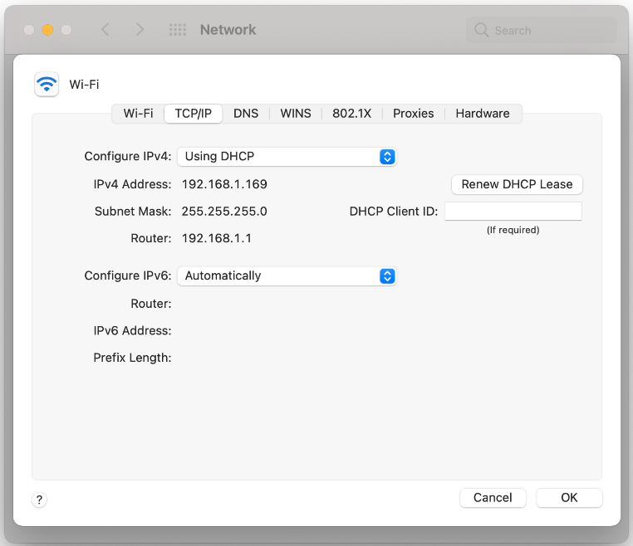
Network and Device Settings (Slide 2 of 3)
Screenshot reprinted with permission from Apple Inc.
Notes:
Select the Advanced button in the Network prefpane to configure Wi-Fi options, IP and DNS settings, and proxy settings.

Slide 52
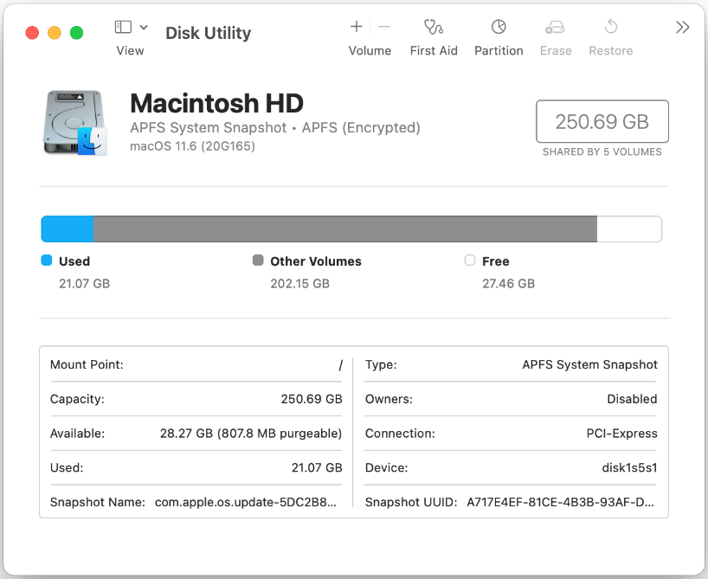
Network and Device Settings (Slide 3 of 3)
Screenshot reprinted with permission from Apple Inc.
Notes:
Use the Disk Utility to report storage status and configure and format volumes

Slide 53
Time Machine Backup (Slide 1 of 2)
Utility that uses a separate physical drive or partition to backup a system
Partition or drive must be formatted using APFS
Auto deletes oldest backup when full
Notes:
Learners should be aware that Time Machine is not turned on by default and must be enabled and configured.

Slide 54
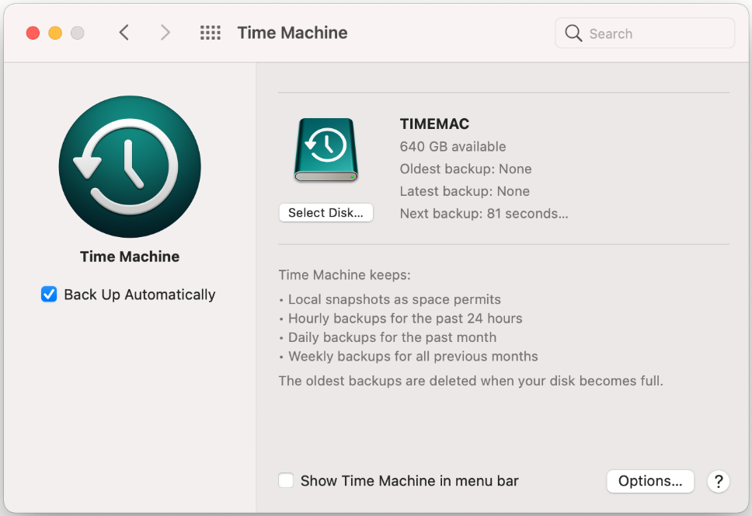
Time Machine Backup (Slide 2 of 2)
Screenshot reprinted with permission from Apple Inc.

Slide 55
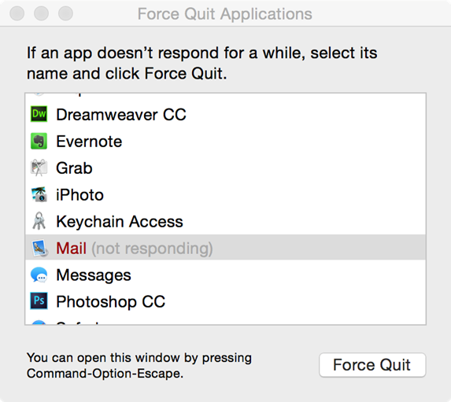
Troubleshoot Crashes and Boot Issues (Slide 1 of 2)
Use Force Quit from Apple menu for unresponsive apps
Recovery Menu
Hold COMMAND+R while powering up Mac until Apple icon appears
If internet access is available, Recovery can download a fresh installation of the OS
Screenshot reprinted with permission from Apple Inc.
Notes:
Instructors should reinforce the CompTIA troubleshooting methodology for all scenarios.

Slide 56
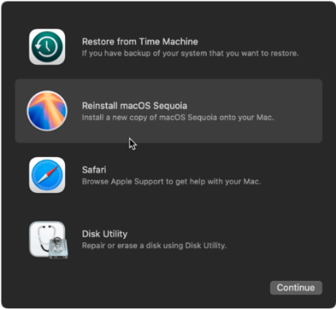
Troubleshoot Crashes and Boot Issues (Slide 2 of 2)
Screenshot reprinted with permission from Apple Inc.
Notes:
macOS Recovery menu

Slide 57
Challenge Live Lab: Install and Support Linux OS (available in CertMaster Perform and CertMaster Labs)

Slide 58
macOS Features
Interface Features
System Folders and Finder
System Settings
Security and User Management
iCloud and Continuity
App Installation and Management
OS and App Updates
Network and Device Settings
Time Machine Backup
Troubleshoot Crashes and Boot Issues
Notes:
Take some time at the end of each topic to answer questions. You can use the Lesson Review questions for discussion in class or set them for learners to complete individually during or after class.

