Slide 1


SoftUni and SoftUni Judge
The Software University / SoftUni The SoftUni Judge System
Programming Basics
Dr. Svetlin Nakov
Co-Founder, Chief Training, Innovation and Inspiration
Software University / SoftUni
https://softuni.org

Slide 2
About SoftUni
SoftUni is the largest training center for software engineers and digital skills in South-Eastern Europe
Software University: high-quality education, profession and job for software engineers
SoftUni Digital: digital marketing academy
SoftUni Creative: design & creative academy
SoftUni Kids: programming for kids
SoftUni Foundation: free and open trainings, content, books
Community of 150,000 students (in 2018)

Slide 3
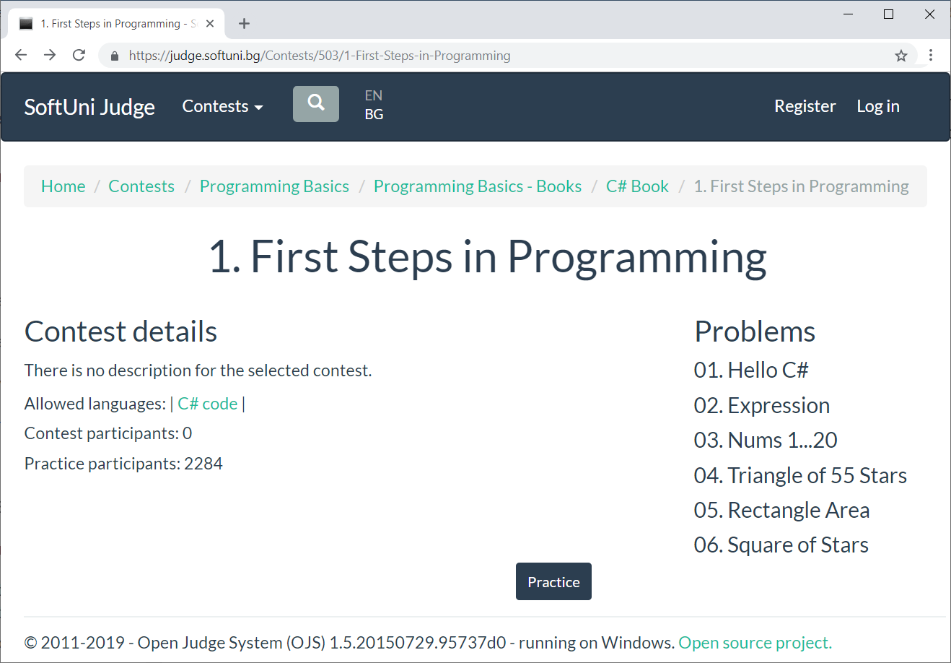
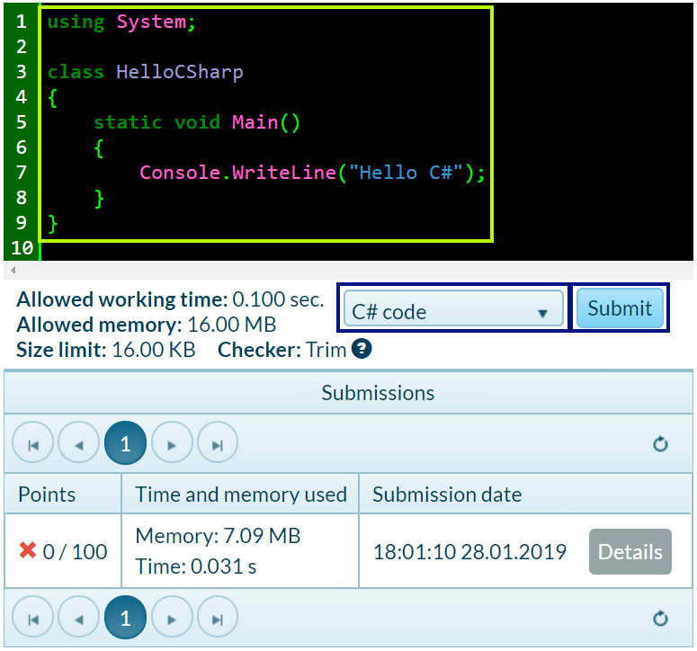
The SoftUni Judge System
Free automated judge system: https://judge.softuni.org
Evaluates the solutions for the exercises

Slide 4

SoftUni and SoftUni Judge
Go Ahead!

