Slide 1
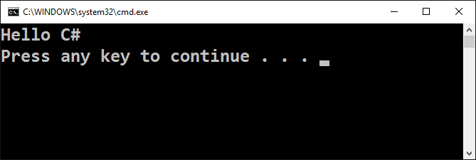
Making our first console application

Slide 2
Integrated Development Environment
In order to program, we need an IDE
For C# →
Visual Studio for Windows
MonoDevelop for Linux / Mac OS
For Java → IntelliJ Idea
For PHP → PHP Storm

Slide 3
Integrated Development Environment
Install Microsoft Visual Studio Community
https://visualstudio.com/products/visual-studio-community-vs
You can use an older version, but it is not recommended
Alternative IDE (online)
C# – .NET Fiddle - https://dotnetfiddle.net/
Java – https://www.compilejava.net/
JavaScript – Directly in the browser terminal

Slide 4
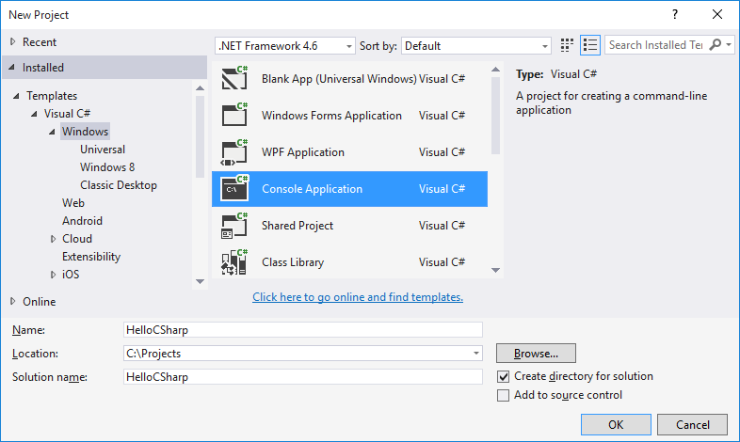
Creating a Console Application
Start Visual Studio
New Console Application– [File]→ [New] → [Project] → [Visual C#] → [Windows] → [Console Application]

Slide 5
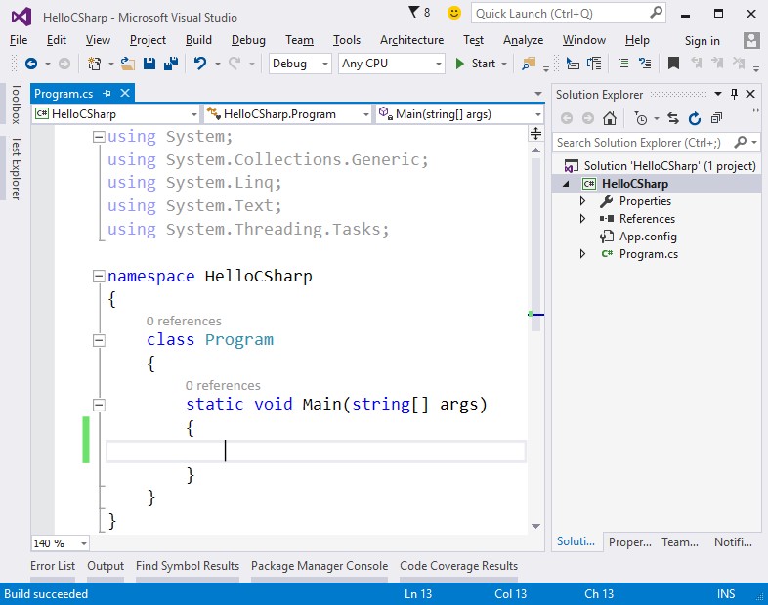
Writing Programming Code
The source code of the program is written in Main(string[] args)
Between the opening and closing curly brackets { }
Press [Enter] after the opening bracket {
The code of the program is written indented once

Slide 6
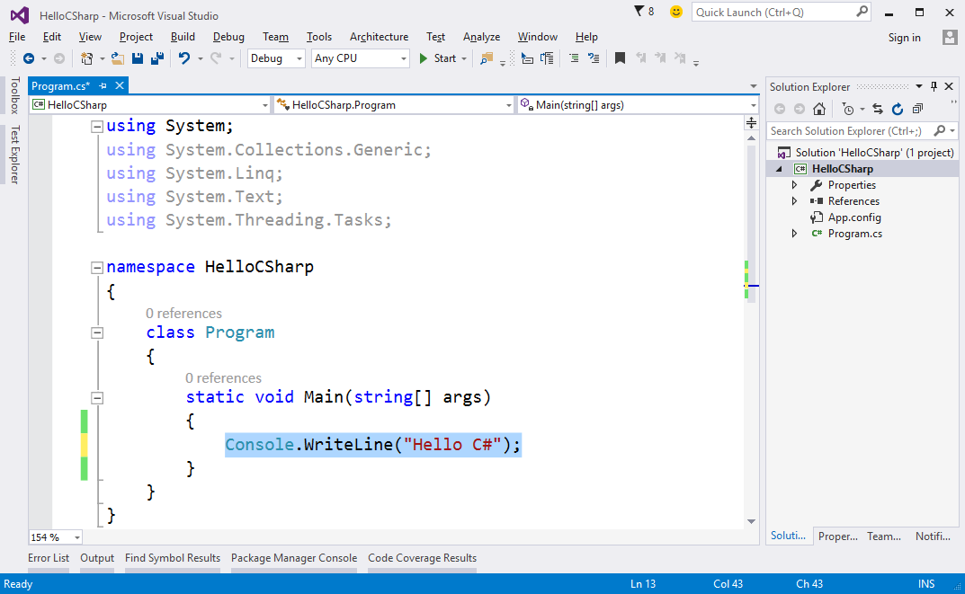
Writing Programming Code (2)
Write the following:
Console.WriteLine("Hello C#");

Slide 7
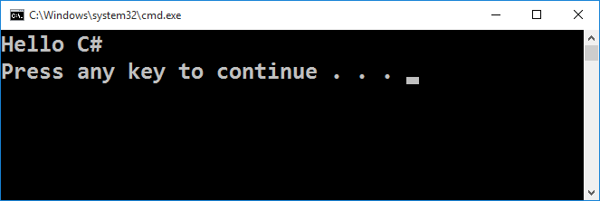
Starting the Program
To start the program, press [Ctrl + F5]
If there are no errors, the program will launch
The result will appear in the terminal window:

Slide 8
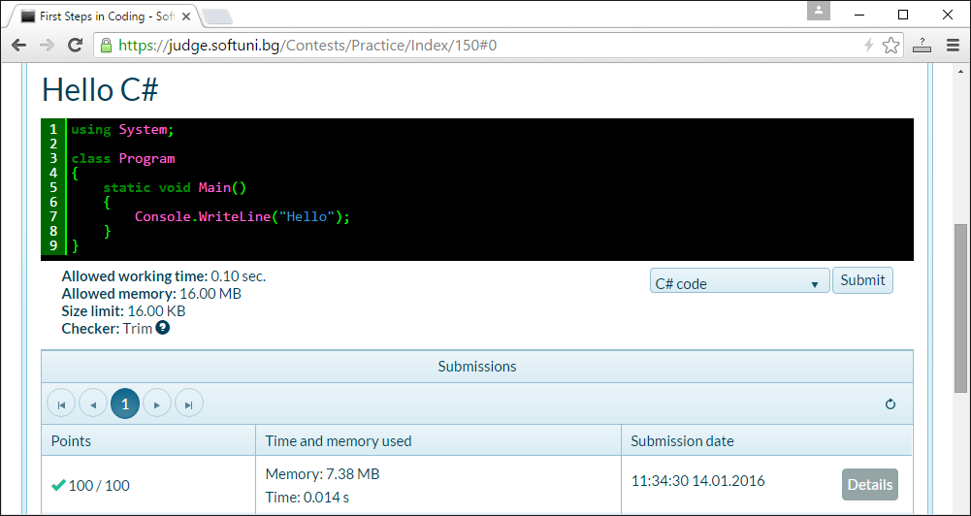
Testing the program in Judge
Test the code in the online Judge system:
https://judge.softuni.bg/Contests/150/First-Steps-in-Coding

Slide 9






Typical mistakes in C# program
Writing outside the Main() method:
Wrong capital/lower casing:
Missing ; at the end of every command
Missing quote " or bracket ( or )

Slide 10

Making our first console application
Try it yourself!

