Slide 1

King County Washington
Housing Dataset Analysis
Author: Brennan Mathis

Slide 2
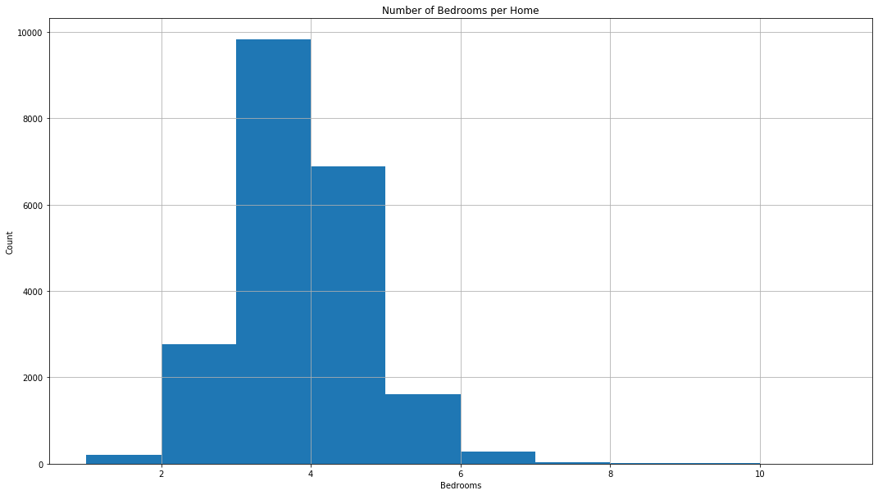
Average Home Price: $540,297 Average Number of Bedrooms: 3.4 Average Price for 3 BR House: $466,294

Slide 3
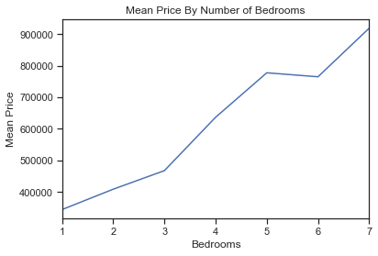
1 Bedroom: $ 318,239 2 Bedroom: $ 401,388 3 Bedroom: $ 466,294 4 Bedroom: $ 635,564 5 Bedroom: $ 786,874 6 Bedroom: $ 825,853
Average Home
Price Per Bedroom

Slide 4
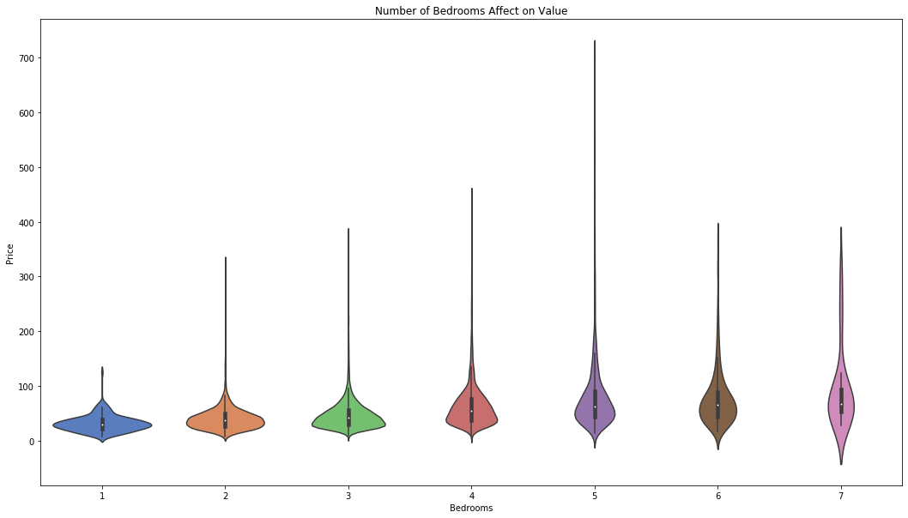
1 Bedroom: $ 318,239 2 Bedroom: $ 200,693 3 Bedroom: $ 155,431 4 Bedroom: $ 158,891 5 Bedroom: $ 157,374 6 Bedroom: $ 137,642
Average Bedroom Price

Slide 5
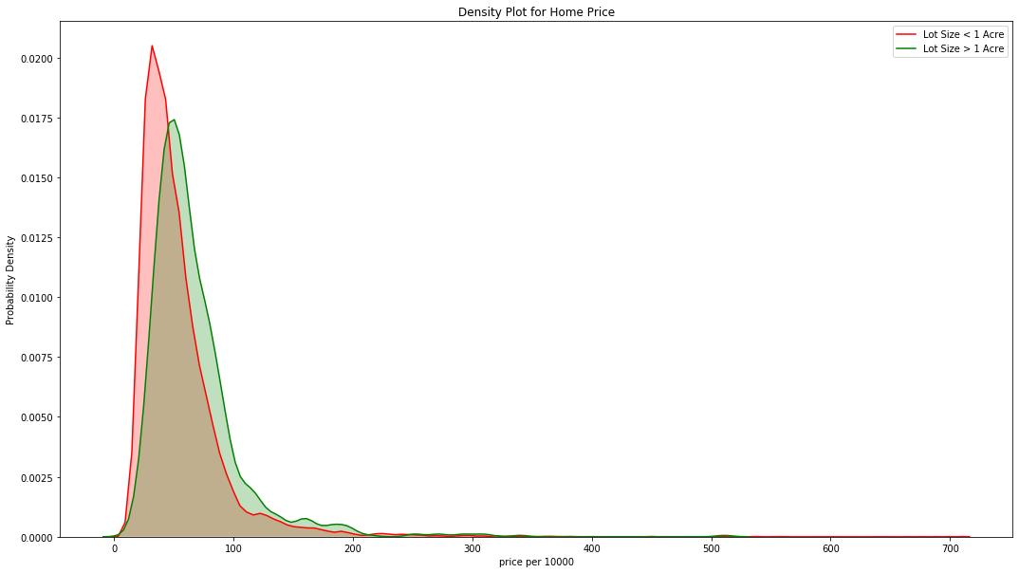
Land Size Effect on Price

Slide 6
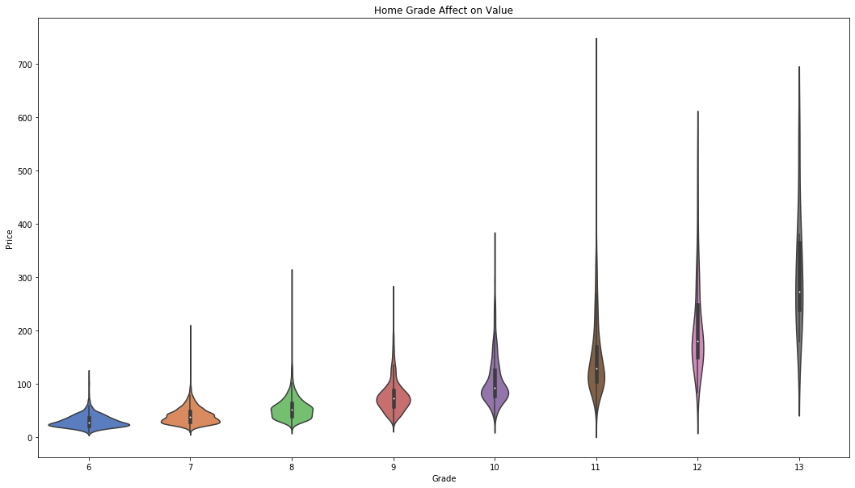
Grade Effect on Price

Slide 7
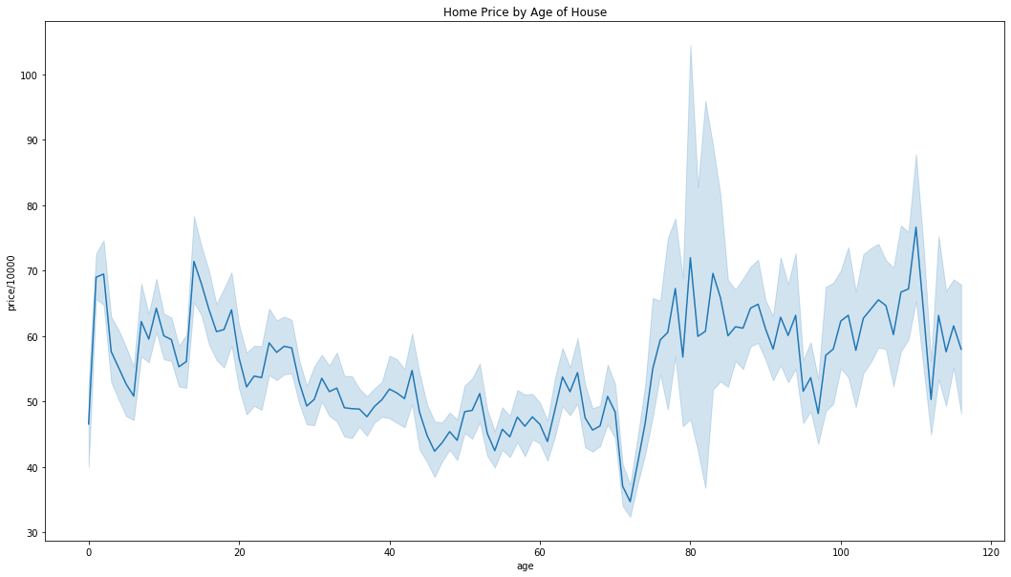
Home Age Affect on Value

Slide 8
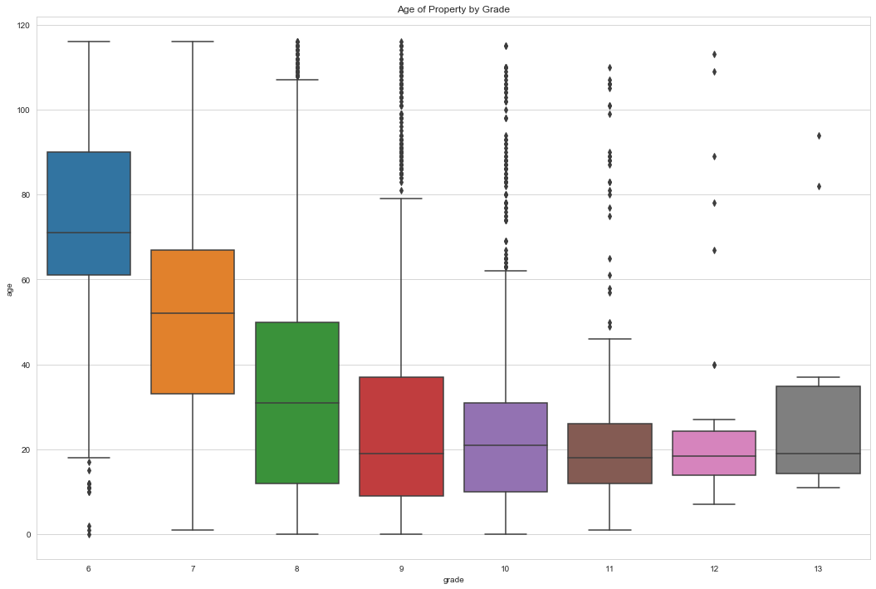
Relationship between Home Grade and Age

Slide 9
Renovated Homes Non-Renovated Homes
Average Price: $ 768,902
Average Grade: 7.75 out of 13
3% of homes are renovated
Average Price : $ 532,140
Average Grade : 7.65 out of 13
97% of homes are not renovated
Average Price for Non-Renovated Homes with Grade over 7: $ 701,337
Renovating your home before selling can increase the value of your home by over $60,000

Slide 10
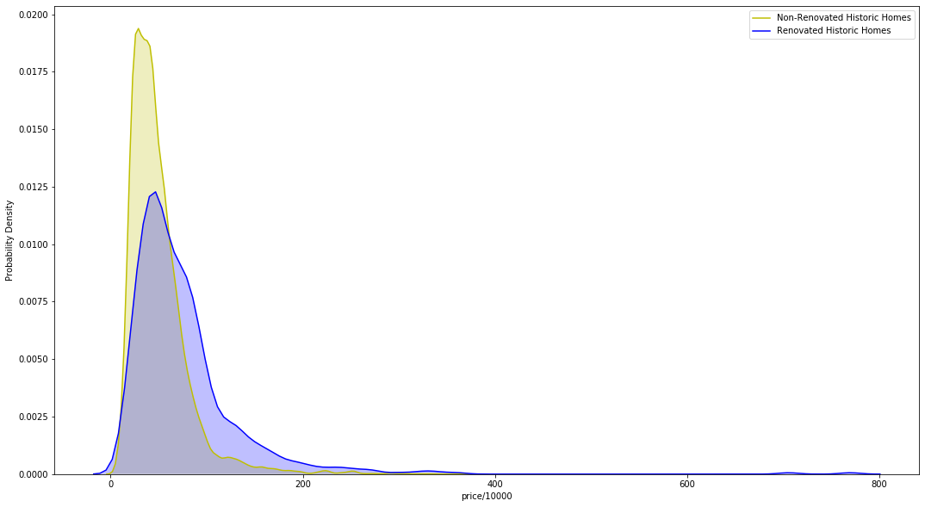
Renovation Effect on Homes Over 50

Slide 11
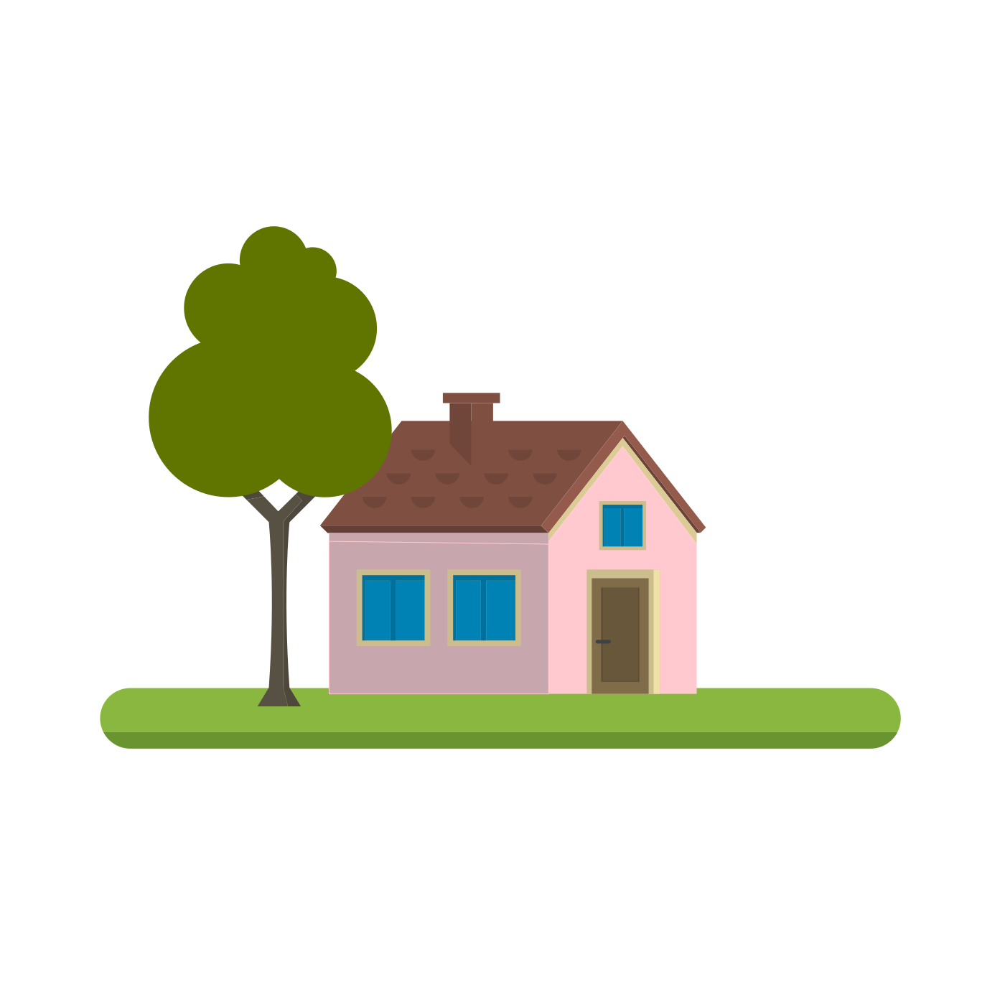
Thank you.

