Slide 1

King County Washington
Housing Analysis & Insights
Author: Brennan Mathis

Slide 2
Problem Statement
Housing markets fluctuate and realtors want to be able to price homes at a value that provides value to the buyer while also providing the seller with a fair offer. Basing this on home features, creating a regression model that can predict the potential prices for these homes.

Slide 3
Business Value
Features influencing sale price
Predict house prices
Increase value
Notes:
Assess predicting factors, and combinations of factors that affect value of home
Create model to predict housing prices based on criteria provided in dataset
Find attributes that increase value of house

Slide 4
Factors Assessed
Bedroom
Bathroom
Living Area
Living Area of Neighbors
Distance to closest city(Seattle)
Grade
Condition
Age of House
Renovation Performed

Slide 5
Methodology
Data
Multiple Regression
Linear Regression(single variable)
Stepwise Regression
Cross-validation
Notes:
Linear Regression model and assessment for all variables seen on factors assessed slide on 1:1 basis, in addition to linear model on price~age/grade/condition
Multiple Regression Model on price~['age', 'sqm_living', 'sqm_living15', 'distance_seattle', 'grade_5', 'grade_6', 'grade_7', 'grade_8', 'grade_9', 'grade_10', 'grade_11', 'grade_12', 'grade_13', 'bed_2', 'bed_3', 'bed_4', 'bed_5', 'bed_6', 'bed_7', 'bed_8', 'bed_9', 'bed_10', 'bed_11', 'bathrooms_2.0', 'bathrooms_3.0', 'bathrooms_4.0', 'bathrooms_5.0', 'bathrooms_6.0', 'bathrooms_7.0', 'bathrooms_8.0', 'condition_2', 'condition_3', 'condition_4', 'condition_5’]
Stepwise Regression model on price~['grade_7', 'grade_11', 'grade_10', 'grade_9', 'distance_seattle', 'grade_12', 'grade_8', 'age', 'sqm_living15', 'sqm_living', 'condition_5', 'grade_13', 'condition_4', 'bathrooms_4.0', 'bathrooms_3.0', 'bathrooms_2.0', 'bed_2', 'bathrooms_5.0', 'condition_3', 'bed_3', 'bathrooms_6.0', 'bed_7', 'bed_6']

Slide 6
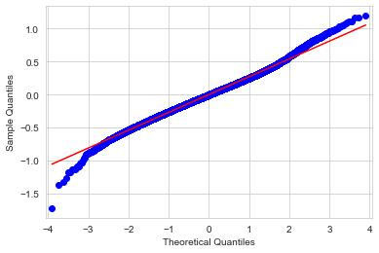
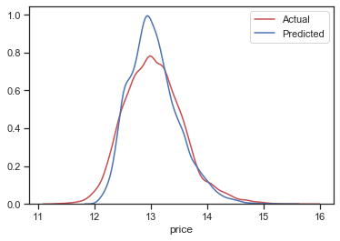
Regression Model
R squared = 0.732
P-values < 0.5
Breush-Pagan : f p-value > 0.5
Cross Validation 10 splits = 0.732
Residuals of Model
Actual Vs Predicted Target Values
Notes:
P values indicate chosen features used in model have effect on price

Slide 7
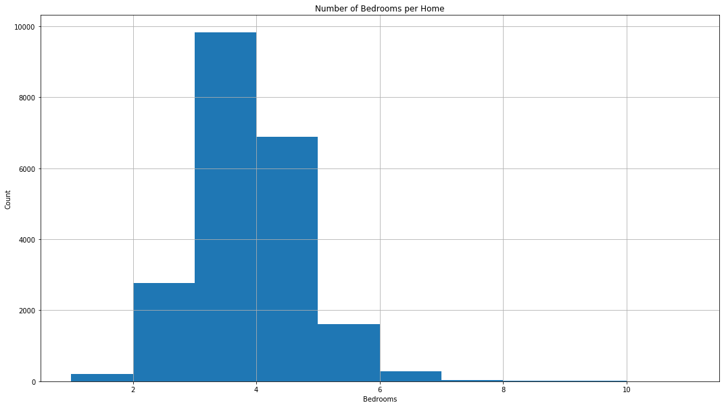
King County Housing Bedroom Analysis
Notes:
Overall Average Home Price: $540,297 Overall Average Number of Bedrooms: 3.4
3 bedrooms most common(mode), followed by 4 bedroom homes
1 BR House: $ 318,239
2 BR House: $ 401,387
3 BR House: $ 466,294
4 BR House: $ 635,565
5 BR House: $ 786,874
6 BR House: $ 825,854

Slide 8
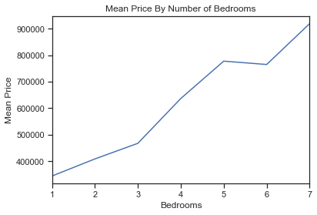
Spend & Save Value Per Bedroom
Notes:
Each bedroom in a home can increase the value of a home by an average of $127,573
Price per bedroom(average home price/number of bedrooms) :
1 br house: $329,414
2 br house: $201,122
3 br house: $155,516
4 br house: $158,925
5 br house: $157,375
6 br house: $137,642

Slide 9
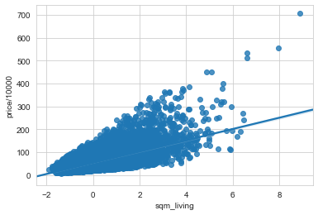
Square Meter Living Area Vs. Price ($10,000)
More Space = More Value
Notes:
Each individual square meter of living area
can increase value of the home by 0.4%

Slide 10
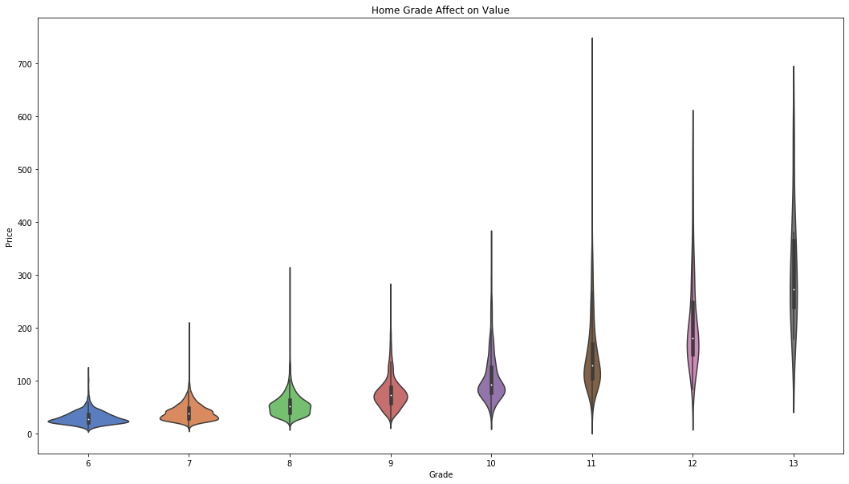
Good Inspection = Higher Value
Notes:
Every increase in grade unit can increase home value by 32%
According to King County government website: ‘Classification by construction quality which refers to the types of materials used and the quality of workmanship. Buildings of better quality (higher grade) cost more to build per unit of measure and command higher value.’
Represents the construction quality of improvements. Grades run from grade 1 to 13. Generally defined as: 1-3 Falls short of minimum building standards. Normally cabin or inferior structure. 4 Generally older, low quality construction. Does not meet code. 5 Low construction costs and workmanship. Small, simple design. 6 Lowest grade currently meeting building code. Low quality materials and simple designs. 7 Average grade of construction and design. Commonly seen in plats and older sub-divisions. 8 Just above average in construction and design. Usually better materials in both the exterior and interior finish work. 9 Better architectural design with extra interior and exterior design and quality. 10 Homes of this quality generally have high quality features. Finish work is better and more design quality is seen in the floor plans. Generally have a larger square footage. 11 Custom design and higher quality finish work with added amenities of solid woods, bathroom fixtures and more luxurious options. 12 Custom design and excellent builders. All materials are of the highest quality and all conveniences are present. 13 Generally custom designed and built. Mansion level. Large amount of highest quality cabinet work, wood trim, marble, entry ways etc

Slide 11
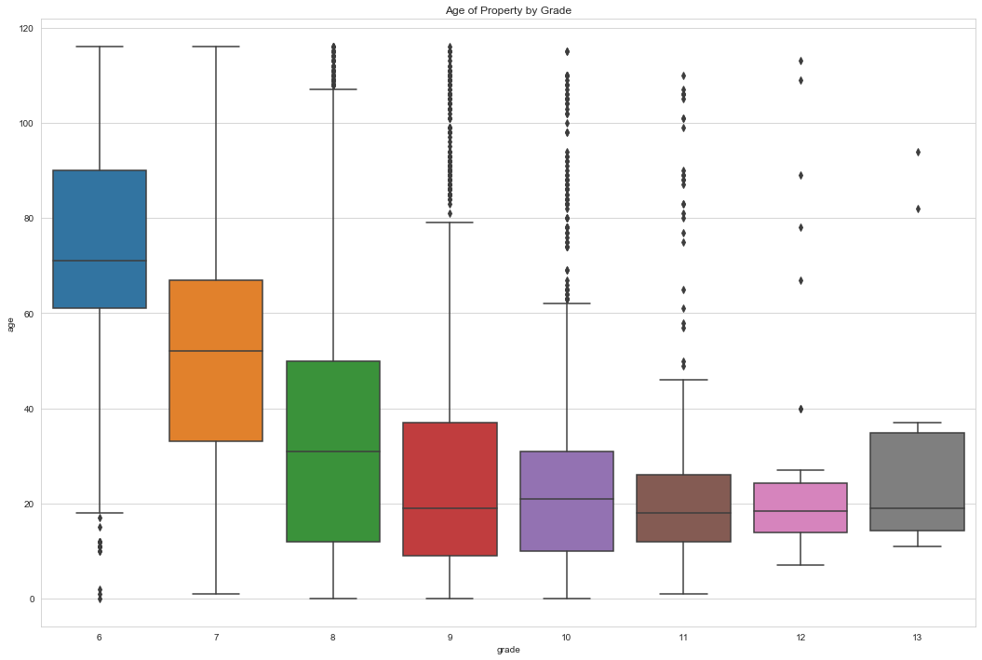
Relationship between Home Grade and Age
Notes:
Newer homes consistently earn higher grade during home inspections
Older homes trend lower average grades on home inspections
Recall that price average increases as grade increases

Slide 12
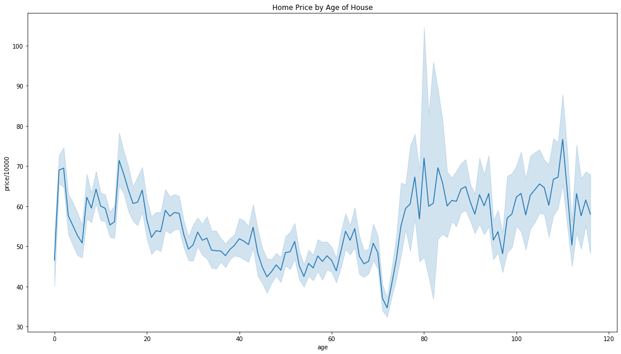
Home Age Affect on Value
Notes:
Strong deviation from mean of price occurs starting around home age of 75-80 years.
Example of how age can depreciate value as home ages
Renovating older homes can prevent the lower end of the price fluctuation
Condition and Grade have a stronger overall effect on price, especially on older properties, some of which present much higher values dependent on those criteria

Slide 13
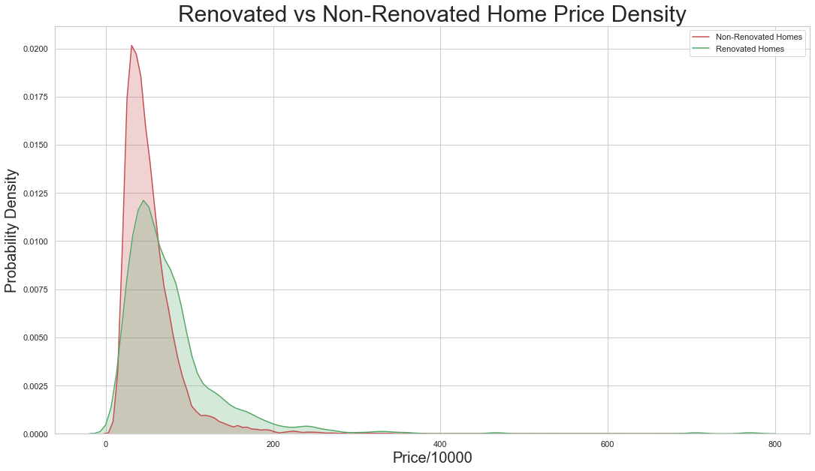
Renovation Effect on Homes Over 50 (Years Old)
Lower Value
Higher Value
Notes:
A historic house generally meets several criteria before being listed by an official body as "historic." Generally the building is at least a certain age, depending on the rules for the individual list. A second factor is that the building be in recognizably the same form as when it became historic. Third is a requirement that either an event of historical importance happened at the site, or that a person of historical significance was associated with the site, or that the building itself is important for its architecture or interior
Price on x axis
Density on y axis
Renovated homes: Average Price: $ 768,902/ Average Grade: 7.75 out of 13/ Only 3% of homes are renovated
Non-renovated homes: Average Price : $ 532,140/ Average Grade : 7.65 out of 13/ 97% of homes are not renovated
Average Price for Non-Renovated Homes with Grade over 7: $ 701,337
Renovating your home before selling can increase the value of your home by at least $60,000 to over $200,000 depending on other property features

Slide 14
Business Recommendations
Renovations result in significant increase home value for homes over 75 years old, consider renovating older buildings.
Consider home improvements prior to inspection to increase grade of inspection to increase house sale value.
When selling to families, consider number of bedrooms for the price per bedroom, average price per bedroom decreases as number of rooms increases, there is upsell potential.

Slide 15
Future Analysis
Polynomial regression analysis
Weighted features, what features are the most important features relating to price?
Assess possibility of different types of housing, examples: apartments, condos, townhomes, farmhouses, population demographics and likelihood of demographic preferences for home features
Minimize error potential in model

Slide 16
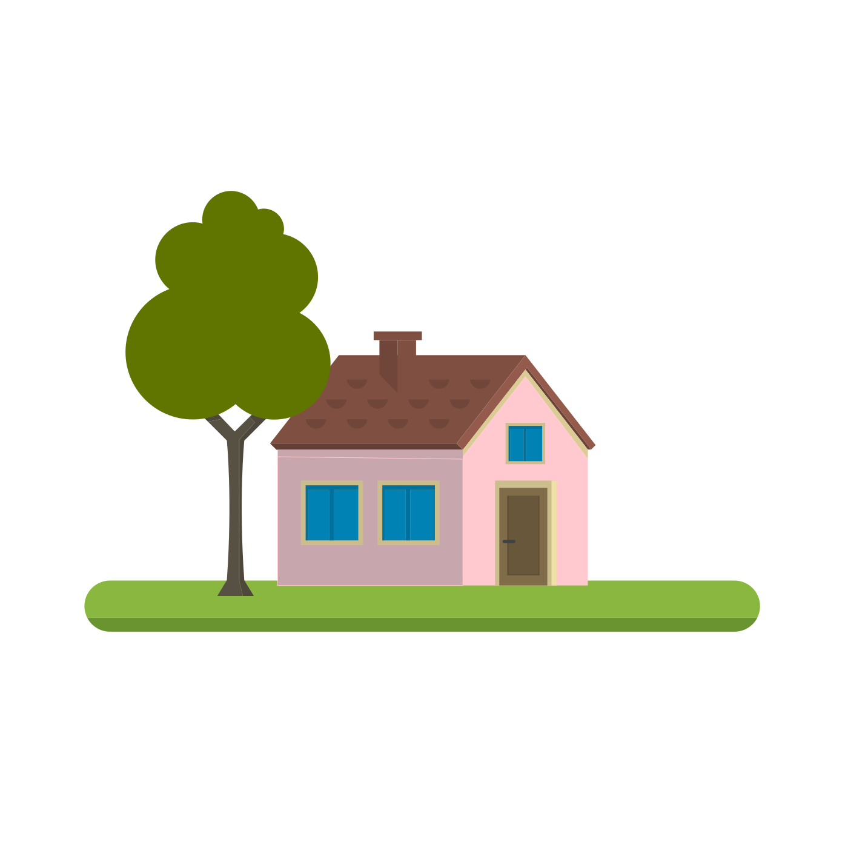
Thank you.

