Slide 1
Programming 1 Final
Ethan Sauvè
Treyvon Prophete
Andrew Neumann

Slide 2
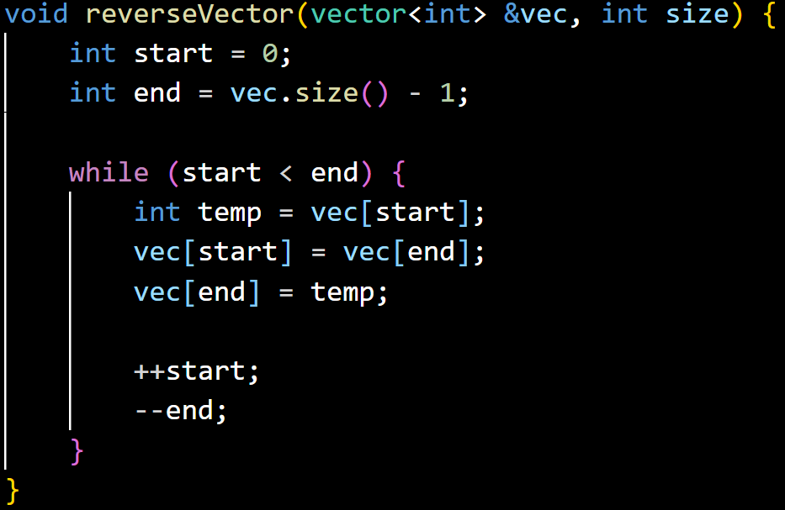
reverseArray function

Slide 3
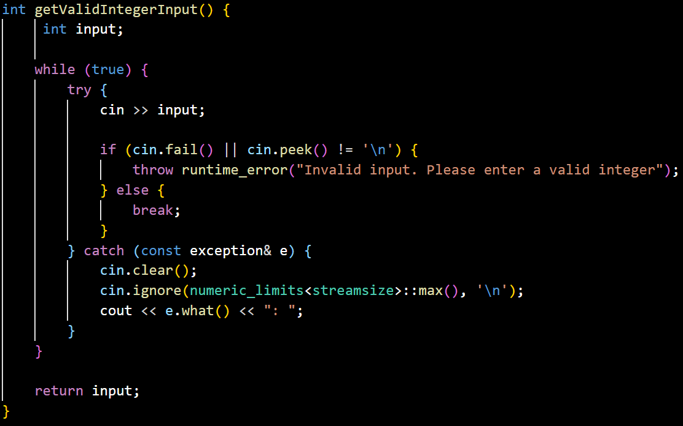
getValidIntegerInput function

Slide 4
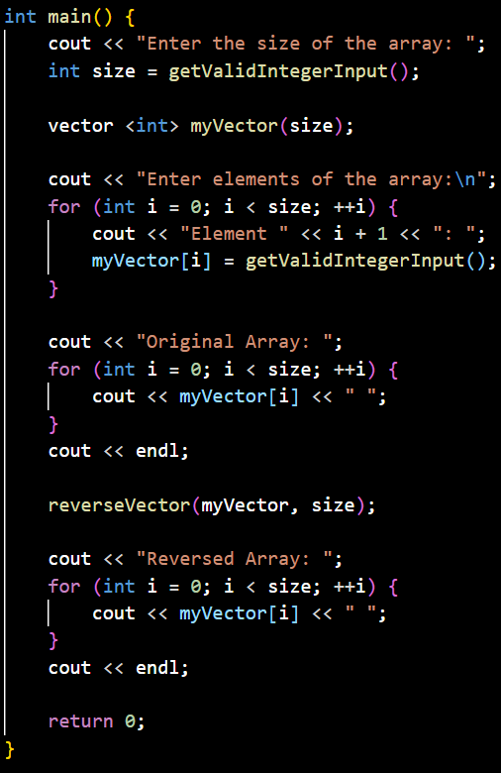
main function

