Slide 1
MVC
MODEL
VIEW
CONTROLLER

Slide 2
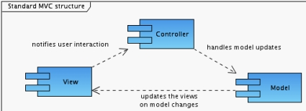

Slide 3
The basics: MVC, and annotations
As the name indicates, the Model-View-Controller pattern suggests the division of an application into the following elements:
Model: Contains the data model and all information that identifies the state of the application. It is generally self-consistent and independent of the other elements.
View: Stands on the other side in respect to the model and defines the representation of the data stored in the model. The view is commonly identified as your application's user interface (or GUI) or, in case of Web applications, the browser Webpage.
Controller: Represents the application logic. Here, it is defined how the user can interact with the application and how user actions are mapped to model changes.

Slide 4

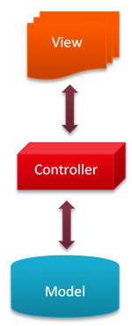


Is responsible for the presentation of data
Initializes, organizes and stores all surface elements
Is responsible for style and layout
Connects View and Model
Contains control logic
Delegated business logic, but does not contain it!
Stores data
Has only getter and setter functions
The goal of the Model-View-Controller-Pattern is a flexible program design , which facilitates a subsequent modification or expansion and allows reusability of the individual components.

Slide 5
Singleton Pattern
The singleton pattern is one of the best-known patterns in software engineering.
Essentially, a singleton is a class which only allows a single instance of itself to be created, and usually gives simple access to that instance.

Slide 6
public final class Singleton {
private static Singleton instance = null;
private Singleton() {}
public static Singleton getInstance() {
if (instance == null) {
synchronized(Singleton.class) {
if (instance == null) {
instance = new Singleton();
}
}
}
return instance;
}
}

Slide 7
Singleton in JAVAFX & MVC
Store a stage in a single accessible static class
Accessible by all elements
Ability to reset the scene as you wish
All elements can share the same stage
Data Persistence
Control all access to the model/data
1 database object to be used by all

Slide 8
Assignment flow
Dental GUI
Events
Results
Application Code
Event Handling
Error Handling
Save
State
Persistence – Serial Files
Storage
Persistence – MySQL Database

