Slide 1
Interface Fundamentals
Sahil 24117

Slide 2
Interface Fundamentals in Java
An interface in Java is a blueprint for classes. Unlike a class, an interface is a completely abstract construct that doesn’t hold any actual code for methods; it just lists methods with no implementations. An interface defines what methods a class should have, but not how these methods should behave.
Think of it as a contract: if a class claims to “implement” an interface, it is promising to provide specific functionalities listed in that interface.

Slide 3
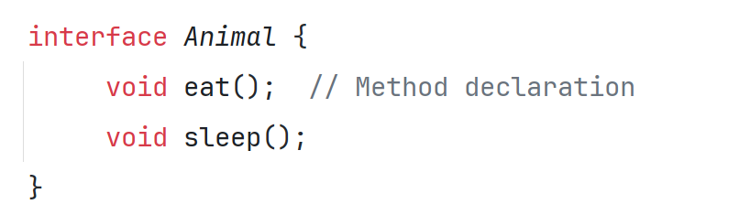
Creating an Interface
Syntax: To create an interface, use the interface keyword.
Structure: An interface typically contains method declarations, which are by default public and abstract. You can also add constants (variables that are final and static).

Slide 4
Implementing an Interface
When a class implements an interface, it’s required to provide the actual code for every method listed in that interface.
The keyword implements is used by a class to “sign the contract” that the interface represents.

Slide 5
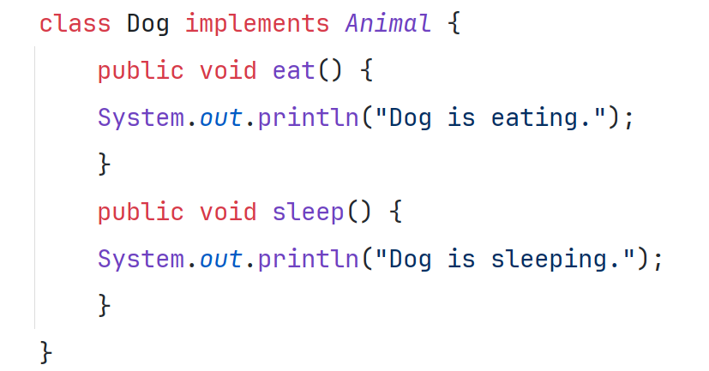
Here, Dog provides implementations for eat() and sleep(), fulfilling the requirements of the Animal interface.

Slide 6
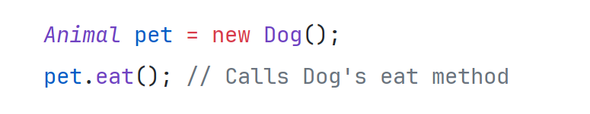
Using Interface References
Definition: You can create a variable of an interface type that references any object of a class that implements that interface.
This allows for a flexible way to handle objects, particularly when multiple classes implement the same interface.
In this example, Animal acts as a reference type, but the actual object is a Dog.

Slide 7
Implementing Multiple Interfaces
Why It’s Useful: A class in Java can implement more than one interface. This allows a class to provide multiple sets of functionality, almost like a multi-skilled object.
Syntax: To implement multiple interfaces, separate them with commas.

Slide 8
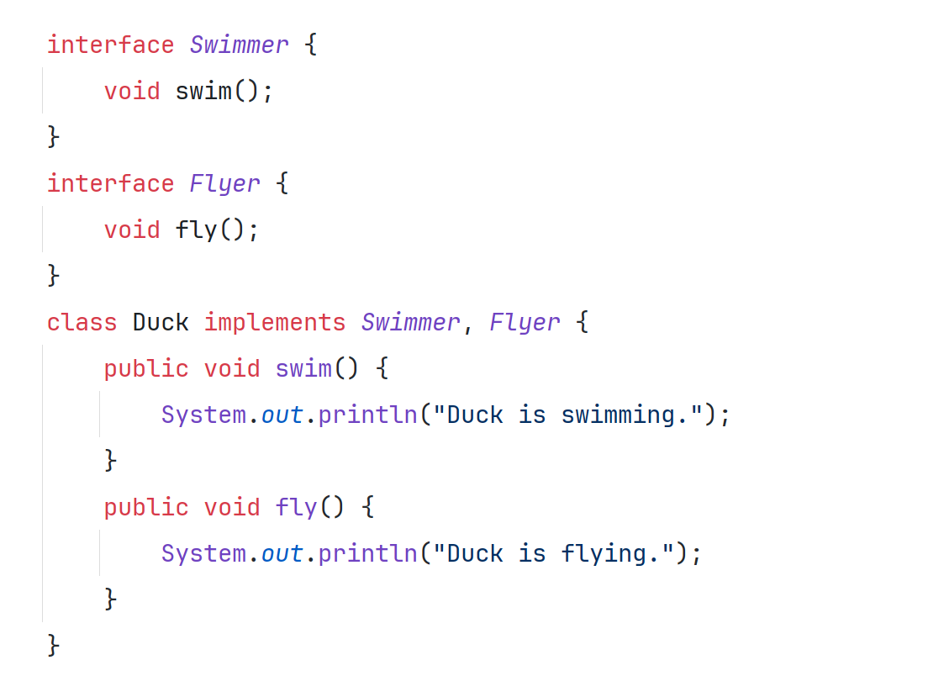
Here, Duck implements both Swimmer and Flyer, so it needs to provide methods for both swim() and fly().

Slide 9
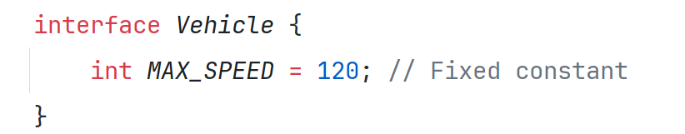
Constants in Interfaces
What They Are: Constants in interfaces are fields that are automatically public, static, and final. These fields represent fixed values that are common for all implementing classes.
The constant MAX_SPEED can now be accessed by any class that implements the Vehicle interface.

Slide 10
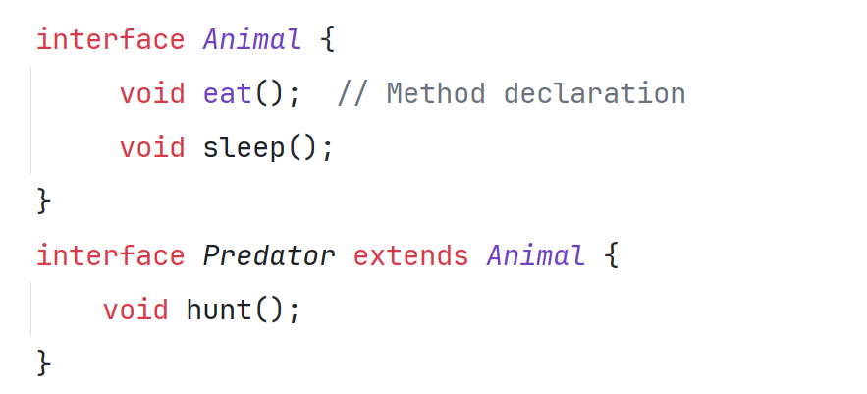
Interfaces Can Be Extended
How It Works: Similar to how classes can inherit from each other, an interface can extend (inherit) another interface. This allows an interface to add more methods on top of an existing interface.
Here, Predator inherits Animal and adds a hunt() method. Any class implementing Predator must implement all methods from both Animal and Predator.

Slide 11
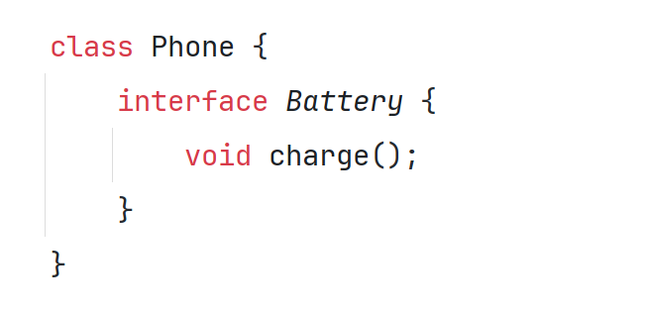
Nested Interfaces
Definition: A nested interface is an interface declared within another class or interface. This is typically used when the nested interface is only relevant to the enclosing class.
Here, the Battery interface is defined within the Phone class. Only classes related to Phone would likely use this Battery interface.

Slide 12
Final Thoughts on Interfaces
Why Interfaces Matter: Interfaces are a powerful way to ensure consistency across different classes while allowing flexibility in how each class implements its behaviour. They are widely used for scenarios where multiple classes should follow a common set of methods, even if their internal behaviours differ.
In summary, interfaces in Java provide a framework for consistency and flexibility, allowing various classes to follow the same blueprint without enforcing how they should behave. This makes Java code modular, easier to maintain, and highly adaptable to future changes.

