Slide 1



UE MLPC 2025:
DATA EXPLORATION TASK
Abdalaziz Adil Awad Ayoub Abdulkarim Al Jamal Beibarys Abissatov Jeronim Bašić

Slide 2

Annotation Quality
For audio recordings annotated by multiple people:
How precise are the temporal annotations?
61.5% for the 725 files with 2 annotators (446 files had min. 1 overlapping region within 100 ms threshold). File 560530.mp3 had 20 overlapping regions
How similar are the text annotations that correspond to the same region?
Mean cosine similarity of 42.7% (for two annotators) and 34.5% (for three annotators)
Notes:
We analysed annotation data to identify overlapping annotation durations among files.
1- We determined the annotation duration by subtracting the onset from the offset, then we detected the instances of unique overlapping between annotations using a precision threshold of 100 ms, to achieve the following results:
Total number of files with 2 annotators: 725; Number of files with at least 1 overlapping region with 2 annotators: 446; Maximum number of overlapping regions: 20 (for audio file: 560530.mp3)
The total number of files with 3 annotators was only 6 so its effect is quite negligible, but 4 out of those were overlapping in at least 1 region, with a maximum number of overlapping regions of 6.
In any case, this shows there is an agreement for 61.5% of the cases with two annotations within the given threshold, so the annotations are actually not very precise. Maybe this is explained by files containing complex or multiple sound events, which can be interpreted differently by the several annotators.
2- Here we calculated the mean cosine similarity score between the text embeddings of overlapping annotations to get the following results: “mean similarity with 2 annotators: 0.4271726608276367; mean similarity with 3 annotators: 0.3451352119445801”, which makes for some level of agreement, although lesser among triple-annotator files.

Slide 3
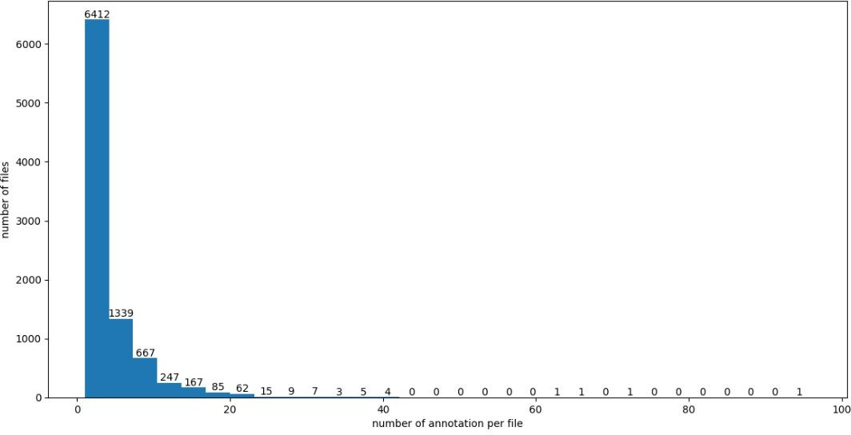
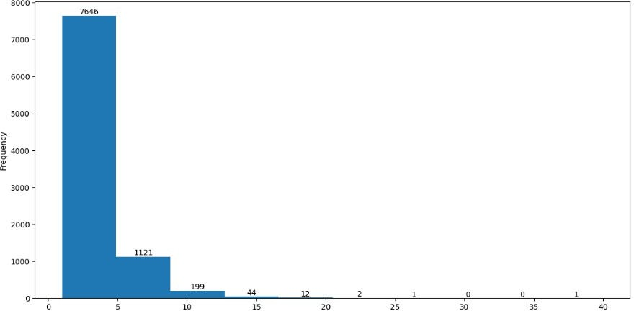
How many annotations did we collect per file?
How many distinct sound events per file?
Notes:
We visualized the number of annotations per file with a histogram (bins=30). We saw that a majority of the files (about 8000) contained <10 annotations, with about 6400 containing 3 annotations or less
Now in order to calculate the number of distinct sound events, we made the following assumption: instances of repeating sound events (e.g. a dog barks loudly) would have been annotated multiple times using the identical text. With this, we computed the number of unique textual annotations to get a ballpark figure of the number of distinct sound events. We found that over 7500 files contained 1-5 sound events, with only 3 with 20> sound events.

Slide 4
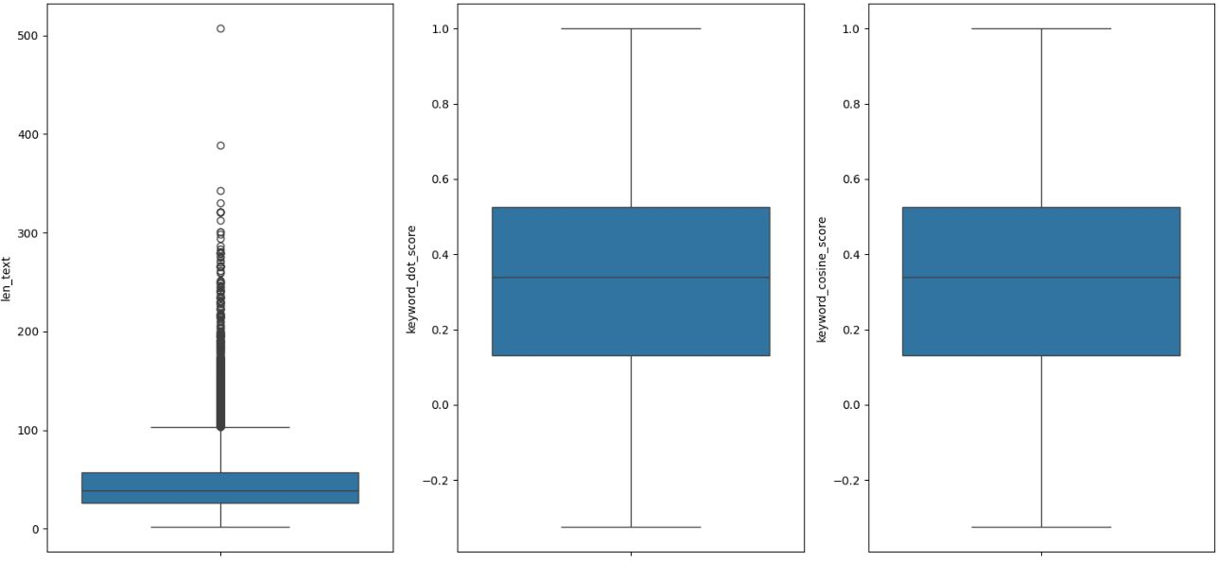
How detailed are the text annotations?
Notes:
To determine annotation quality, we calculated both the cosine similarity & dot product (which mathematically yielded identical results) between the embeddings of the audio annotations and the ones of the metadata for all annotators to obtain a similarity score.
We also calculated the length of characters in each annotation (not length of words),
Then we created box-plots to visualize some summary statistics for both these values, e.g. median annotation length of approx. 40 chars, we can also see a large number of outliers and some extreme outliers above 250 chars
Median similarity score of a little above 0.3 indicates low to moderate similarity between annotations. We had many examples of a zero similarity score (so orthogonal embedding vectors and no shared similarity). But also observed that a perfect annotation score of 1 was achieved, but more on that next slide. The worst score was about -0.4, so still not completely opposite vectors (which would be at -1)

Slide 5
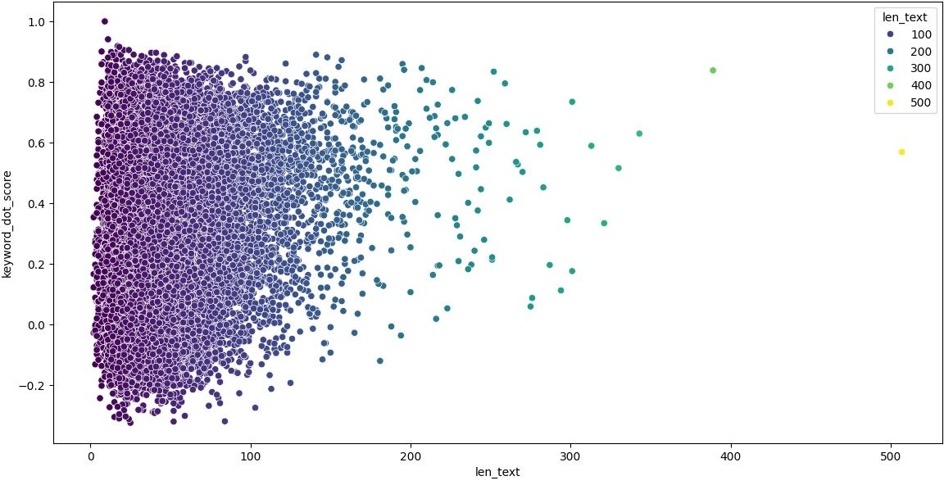
How detailed are the text annotations? (cont.)
Propose a simple method to filter or fix incorrect or poor-quality annotations.
Notes:
We then used a scatter plot to plot annotations length & similarity score against each other to try and find a correlation. We only did this visually, but even so, one can generally see that a longer annotation meant a better similarity score, so it might be the case that an annotator put more effort into typing annotations and thus achieved a better accuracy.
Or, as in the case with our #1 annotation, which consisted of a single word but achieved a perfect similarity score of 1, those annotations relied heavily on the metadata. The perfect annotation for instance just so happened to exactly contain the only word listed in the metadata, hence being a perfect match. Whether intentionally copied or not is unknown.
As mentioned, most of the lower quality annotations contained fewer chars. Therefore, a simple method at filtering such instances would be to exclude the quadrant of negative similarity scores containing <100 characters. We could also double-check whether highly-scoring ones were one-to-one copies of the meta data and use some threshold to filter those.

Slide 6
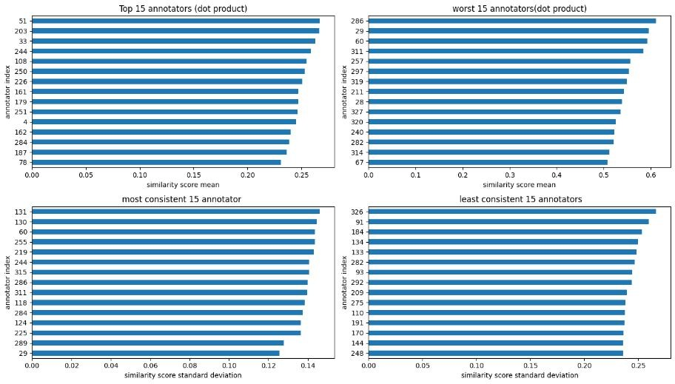
How much does the quality of annotations vary between different annotators?
Notes:
For annotation quality, we firstly mapped the long annotator ID’s to indices, which we mapped back at the end in order to identify them. Then, to determine the variation, we similarly used the mean cosine similarity scores for each annotator to calculate the standard deviation of the similarity scores across their respective set of audio files.
We visualized this in bar charts obtain the fifteen best/worst and most/least consistent annotators, although now realizing we somehow switched the titles of the best/worst scores graphs. The best performing annotator achieved a mean similarity score of around 0.6 and also was in the top 15 most consistent annotators, with only 0.14 SD.
While the worst averaged a little above 0.2, which is actually better than we expected. The least consistent annotators only had a standev of 0.25, so even they were quite consistent, although not necessarily consistently good, just little variation from their mean scores.

Slide 7
Thank you!
Any Questions?

