Slide 1



UE MLPC 2025: Challenge
Team Fumbling:
Abdalaziz Ayoub
Abdulkarim Al Jamal
Beibarys Abissatov
Jeronim Bašić

Slide 2
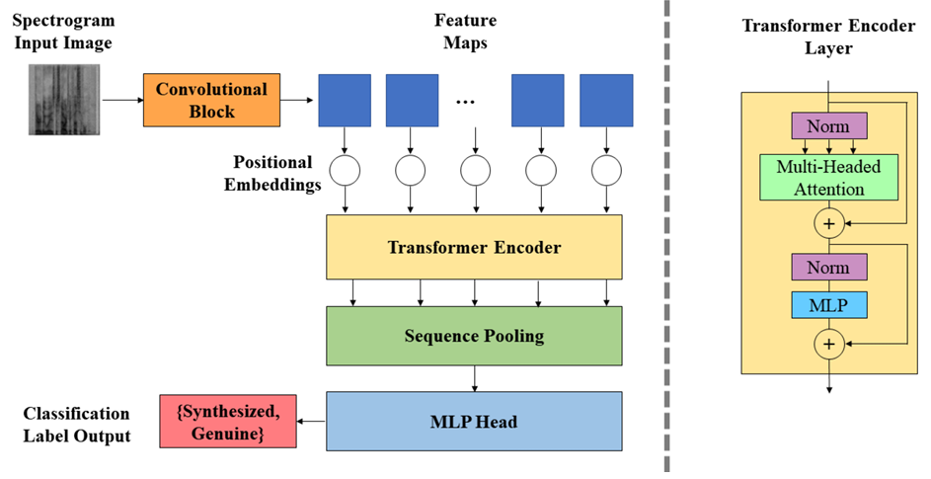

Architecture: Inspiration
Most Informative Feature: Mel-spectrograms
2D representations of audio ➨ Convolutional Transformer?
Convolutional layers: extract temporal feature maps
Transformer: models long-range dependencies
E.R. Bartusiak, E.J. Delp, Synthesized speech detection using convolutional transformer-based spectrogram analysis, IEEE, 2021
Notes:
In the previous project phase, we conducted a detailed feature analysis, which showed that mel-spectrograms carried the most informative signal among the available features—including MFCCs and the provided embeddings.
This insight motivated us to treat mel-spectrograms as a kind of visual input, since they are essentially 2D matrices representing time vs. frequency—very similar to grayscale images.
Drawing inspiration from the Convolutional Transformer architecture, we constructed our first model by stacking two convolutional layers to extract localized features from the spectrogram inputs, and then pass them through a Transformer encoder to capture longer-range dependencies
The output was used for frame-level classification, making the architecture suitable for sound event detection. This hybrid structure became the foundation for further refinements in our project

Slide 3
Chronology of the Challenge
Transfer Learning
Logarithmic Scaling
Cost-sensitive weights
CNN 512 Encoder w/ positive weights
CNN 512 Encoder
Melspectrogram
Using Embeddings
Conv-1D
1024 Encoder
Embeddings
(ineffective changes)
e.g. concatenating MFCC augmentation
Resnet-34
512 Encoder
(slightly useful)
Encoder
SED Conv-1D
1024 Encoder
Replacing Conv-1D
with linear projection
e.g. changing no. of attention heads, linear layers, weight decay
Embeddings with 2 linear layers

Slide 4
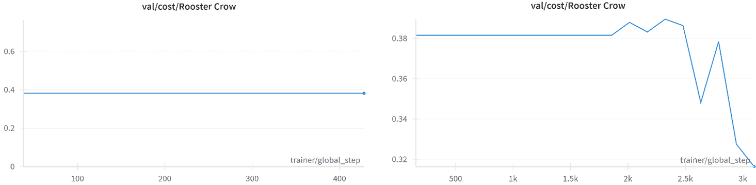
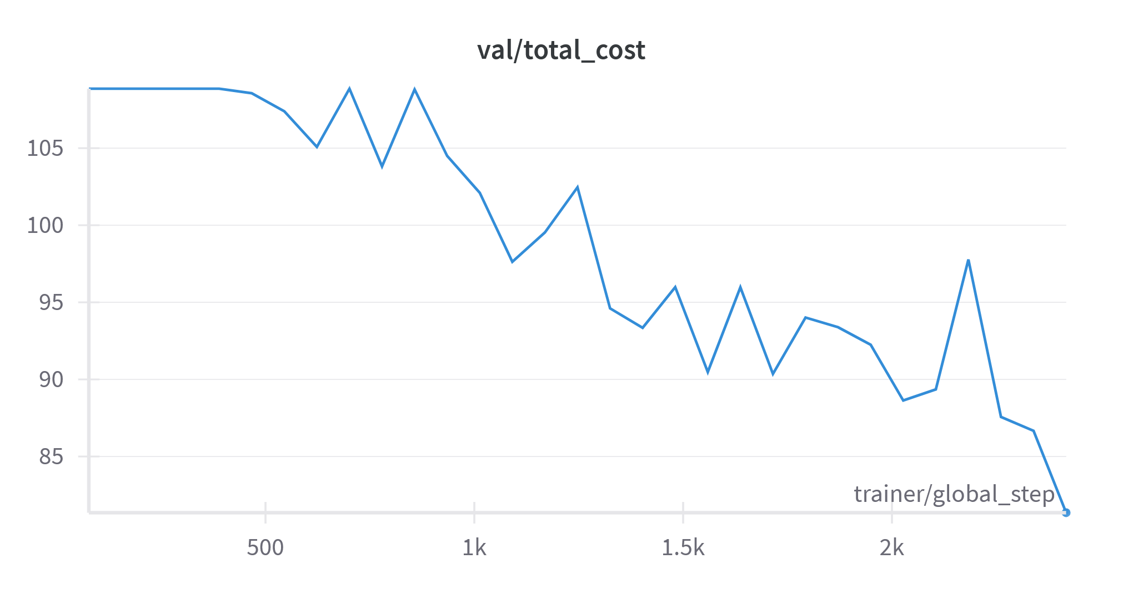
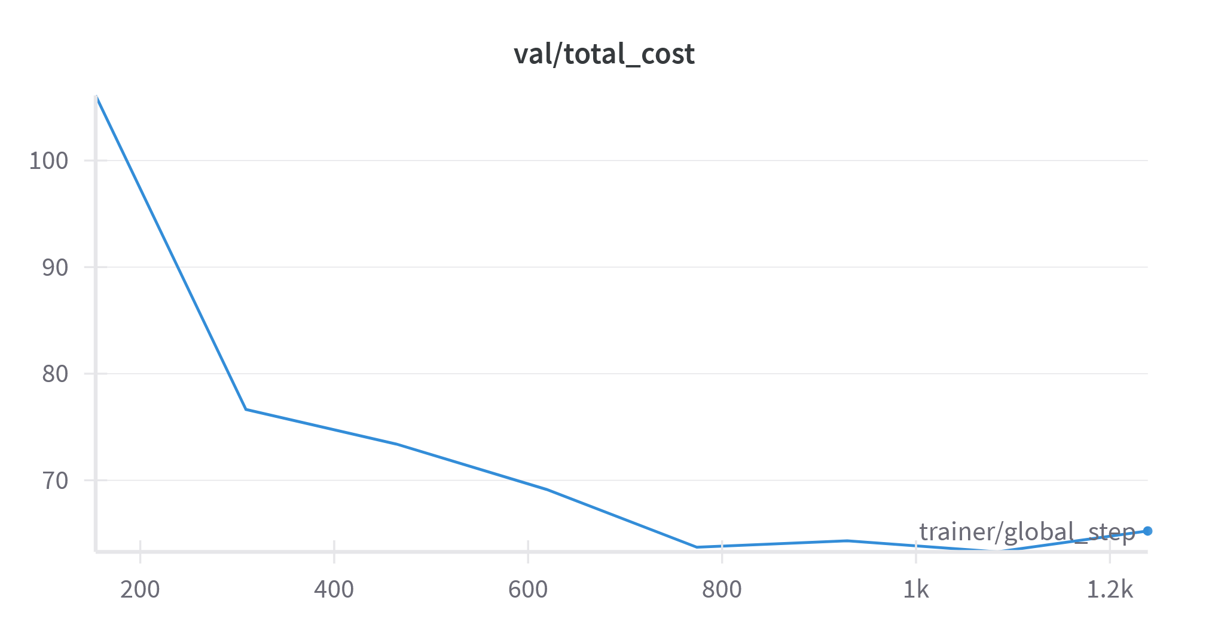
Impactful Changes
Cost-Sensitive Tuning of Positive Weights
Adjusted class-specific costs for rare class labels or non-improving ones.
Transfer Learning
Replaced our custom Conv2D stack with a ResNet-34 to extract richer representations.
Notes:
Changes resulting in cost improvements:
Cost-Sensitive Tuning of Positive Weights: We adjusted the class-specific loss weights in order help the model prioritize rare classes or ones with stagnant costs, e.g. Rooster crow which was only represented in 0.23% all data. This helped decreased the Avg. Cost per minute
Transfer Learning: We explored transfer learning by replacing our 2 stacked Conv layers stack with a ResNet-34, which is ofc pretrained on ImageNet but generalizes surprisingly well to log-mel-spectrograms since they have similar low-level patterns (edges, contours, textures), although we had to replicated the mel-spectrogram across three channels to match the ResNet’s expected input format, as well as remove max & adaptive pooling since these would result in the loss of the data’s temporal dimension in the data. Switching over to Resnet alone brought down our total cost per minute from 81 to 61 on the validation set, likely due to Resnet having alot more layers & can extract more abstract and rich representations for the transformer encoder to use. The constraint of having pre-trained layers may actually prevent overfitting as well, so an indirect form of regularization.
ResNet-34 has 34 layers. Specifically, it consists of an initial convolutional layer, followed by 16 residual blocks (which include 33 convolutional layers), plus the final fully connected layer.

Slide 5
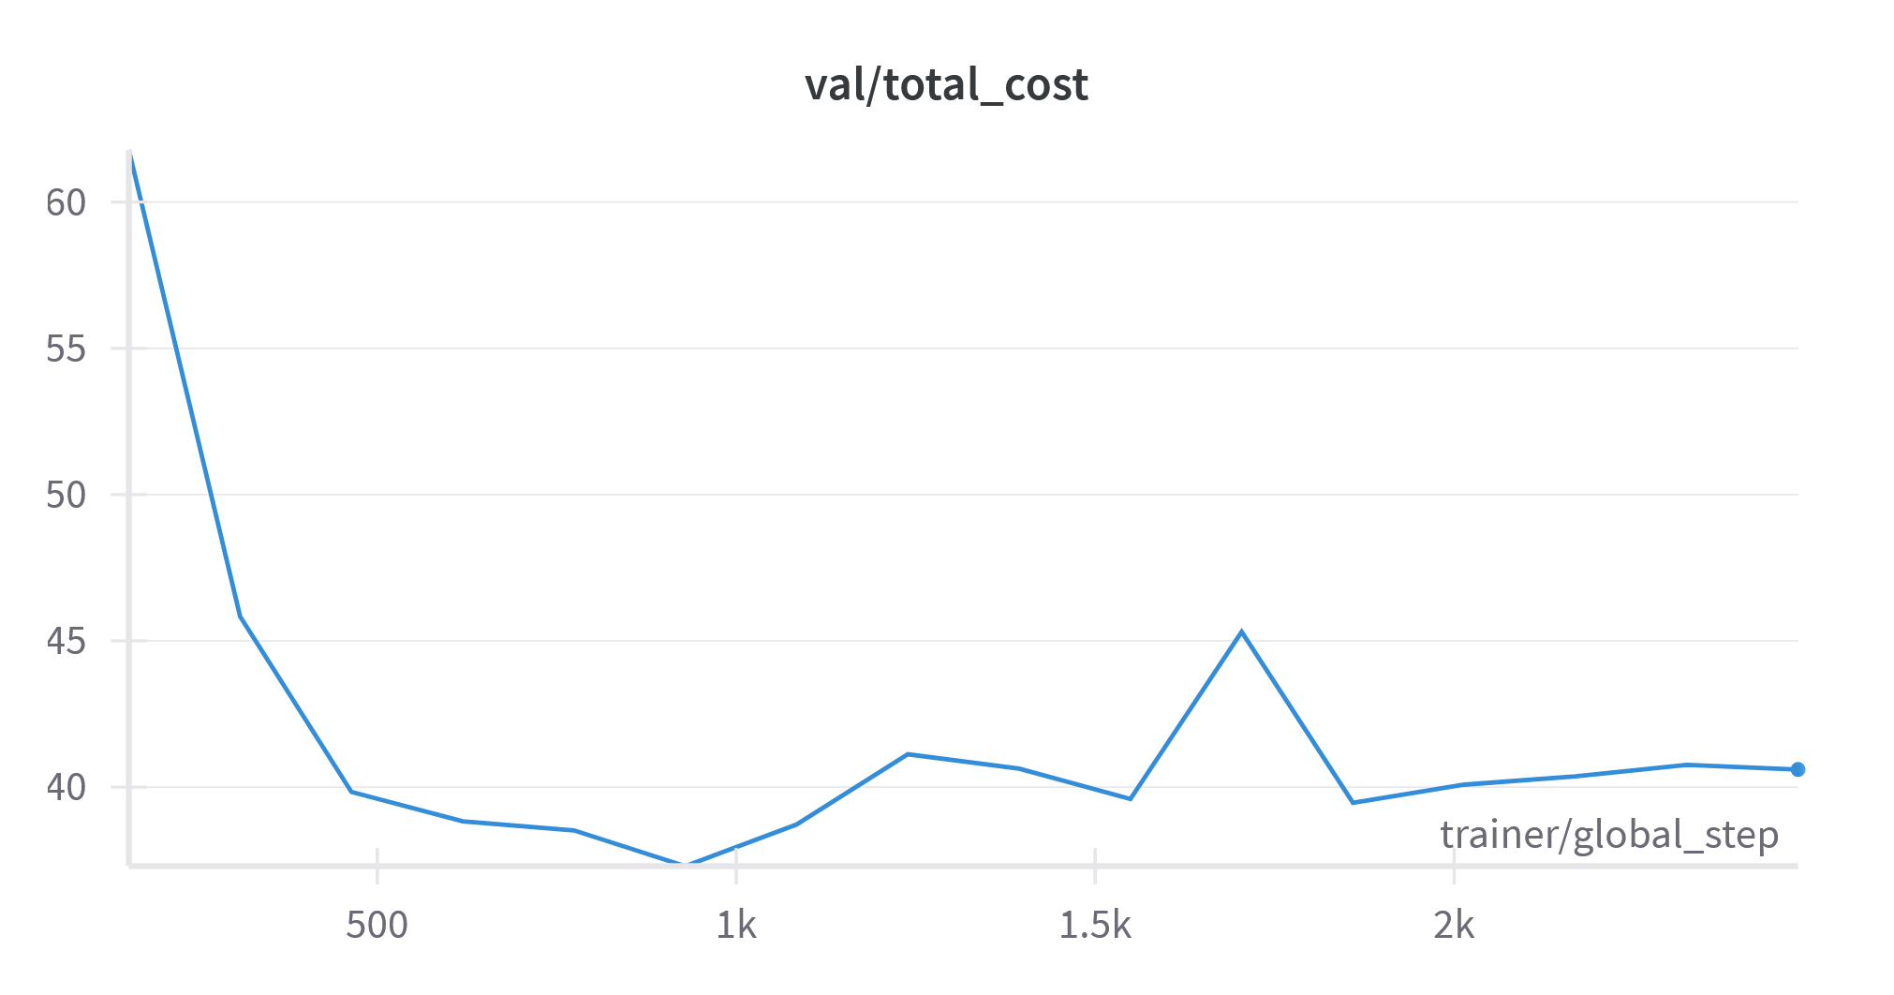
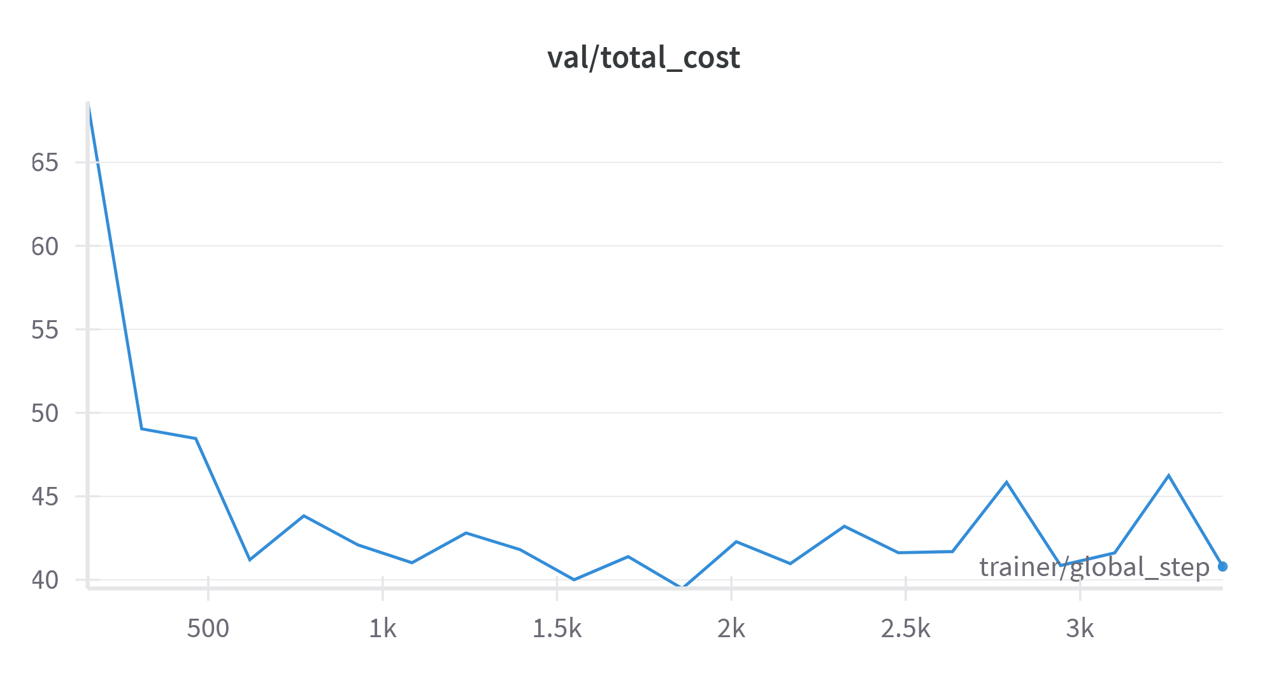
Impactful Changes
Embeddings
Replaced log-Mel spectrograms with provided audio embeddings (and thus also changed to Conv1D).
Linear projection layer
Used simple linear layer to project frozen precomputed embeddings in-place of Conv1D.
Notes:
Embeddings: In the next iteration of our model pipeline, we experimented with replacing the spectrogram-based input with precomputed audio embeddings that were provided to us. These embeddings themselves are designed to encode rich & high-level acoustic info in a compact form, and instead of using a ResNet to extract features from spectrograms, we projected the 768-dimensional embeddings using a 1D Conv layer, before passing them to our transformer.Surprisingly, this architecture significantly outperformed our spectrogram-based pipeline, achieving ~40 cost per minute, versus 61/min with ResNet. This improvement likely because embeddings already capture important audio context, so there is even less need for low-level feature extraction, which leads to better generalization and faster convergence. However, it does rely on a frozen external model, so likely not very applicable for real-world applications that should optimally operate directly on raw audio features. Nonetheless, we used them for our models.
Linear Projection: As a final step in our model development, we experimented with simplifying the pipeline, so instead of using the Conv layer to transform the 768-dimensional frozen embedding into a 1024-dimensional representation to feeding it into the Transformer, we thought a simpler linear projection might work just as well. Using this single linear projection layer, followed by a second linear transformation and GeLU activation, we achieved a new best performance of 37.3 cost/minute. We think that this this change reduced model complexity, led to more stable training, and improved generalization. Moreover, being fixed-size vectors, the embeddings don’t benefit as much from the local pattern detection of convolution.

Slide 6
Some Ineffective Changes
Spectrogram Augmentation
Applied time/frequency masking to spectrograms
Outcome: Performance slightly worsened (61 → 62.68)
Insight: Augmentation may disrupt critical acoustic features in this context
Concatenating MFCC Coefficients:
Useful MFCCs (e.g., coefficients 0, 1, 22 from previous report) summarize spectral content and can enrich the mel-spectrogram representation.
Outcome: No noticeable improvement in performance.
Insight: concatenating them along the frequency axis without channel separation may have led to suboptimal integration
Adding Additional Linear Layers:
a deeper classification head with two linear layers will improve the transformation of learned embeddings into the class probabilities.
Outcome: Minor performance gain.
Insight: The base model likely already had sufficient capacity.
Notes:
Not all ideas led to performance gains. For example, while spectrogram augmentation through frequency and time masking is common in large-scale audio tasks, in our case it slightly degraded performance (cost increased from 61 to 62.68).
This degradation may be due to the sparsity of our dataset; there were already a limited number of samples per class, so by masking time or frequency regions, we may have further reduced the amount of informative content, especially for rare events — ultimately hurting the model’s ability to separate similar classes. Perhaps a more careful augmentation method, possibly conditioned on event type or frequency range, could have yielded better results.
Another experiment involved concatenating the most informative MFCC coefficients (according to previous project phase: 0, 1, 22) to the mel-spectrogram to create a richer input feature. Although MFCCs theoretically add informative content, concatenating them along the frequency axis without channel separation may have led to suboptimal integration, especially when fed to the pretrained ResNet expecting consistent 2D patterns. A better approach might involve stacking them as an additional channel, although this was incompatible with the Resnet we used.
Lastly, we tried to improve classification by adding another linear layer at the output to better learn decision boundaries. But since our transformer already produced high-quality embeddings, this only added marginal improvement as the base model was likely already sufficient, so it was ultimately just a case of over-engineering the classifier head.

Slide 7

Thank you!
Any Questions?

