Slide 1
Bubs duds
Foxtrot group

Slide 2
The Problem
The owners of the website would like a secure online site that allows users to view the inventory from the shop and view ratings on the products.
They also want to be able to add descriptions and high quality photos to the items listed on their websites.
They get a steady amount of visitors monthly, but aren’t sure how much the business is going to grow.
Notes:
The powerpoint is info on the selected database, which kind of shows why you selected the one you did. So, use the SWOT info, then add pricing, maybe who is using it, etc. Then add info about your case study. What problem are you trying to solve? Any specifics on how that problem will be addressed would also be helpful. How you divide up the work for the presentation is up to you.

Slide 3

Database decision

Slide 4
Reasons
We chose the amazon aurora because we trust the name Amazon to deliver high quality service.
For a small business they offer many different pricing options for business. These solutions can be altered and scaled between different sizes to accommodate any size the business will grow to.
The on-demand pricing for t2.small is half that of t2.medium, which was previously announced.

Slide 5
What gets stored
The database is going to need to hold several fiends including:
- Product Name
- Brand Name
- Rating
- Price
- Description
- Item Photo

Slide 6
Users
For now the owner Brook McCallum will be operating the website on her own, so the site needs to be basic but also look professional. JSP pages will allow the site to be more dynamic. Forms allow the customers to add their own items to be listen for consignment.
The system is set up to also allow sorting by any description, like rating, brand name, or price.
If the site begins to grow, she will hire a web designer to take over the database and make necessary upgrades.

Slide 7
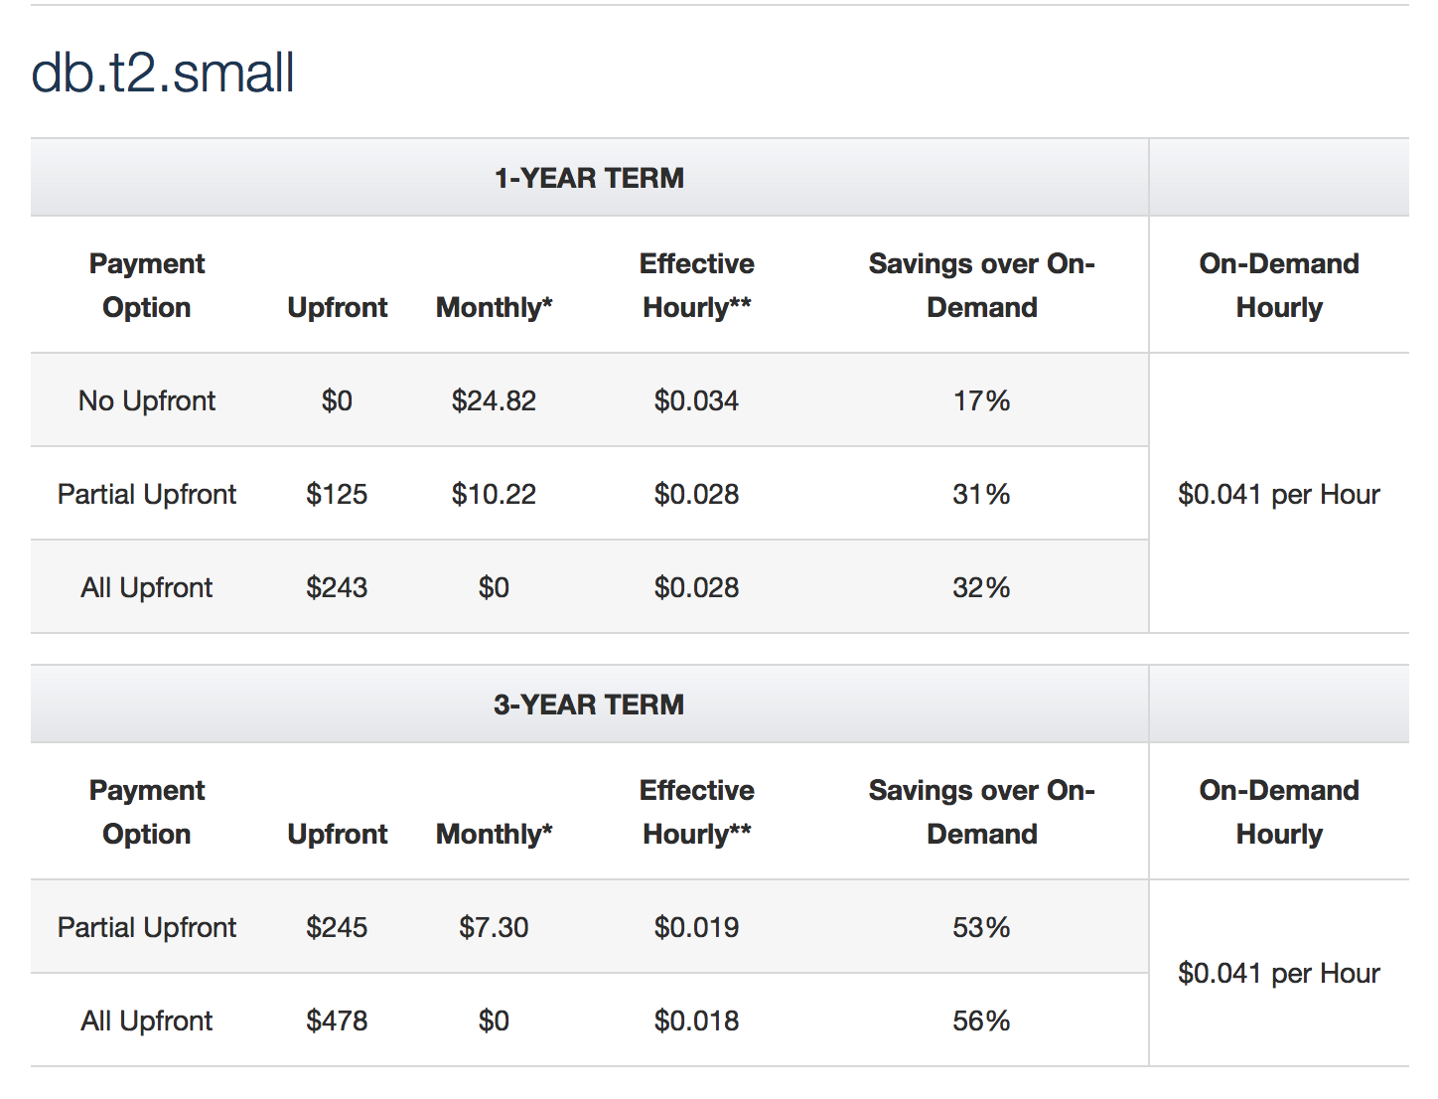
Contract Pricing
The database for a small connection for a 1 year term cost depends on how much money is placed upfront. The partial upfront option seems like it would be the best option.

Slide 8
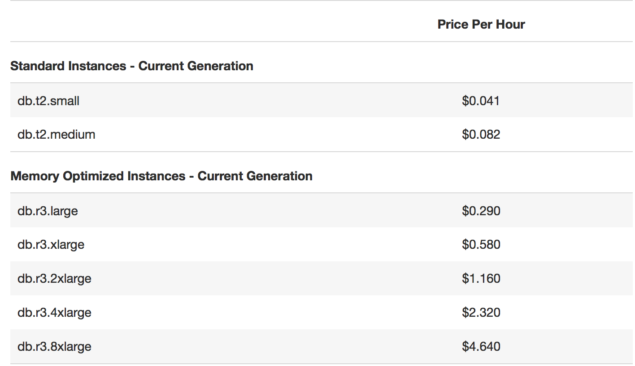
On Demand pricing
The database for an on demand small connection with a no contract term cost depends on how much bandwith is used.

Slide 9
Conclusion
Amazon Aurora combines the power of the amazon cloud and the pricing model make this database a win-win. The owners can focus on their business without stressing over contracts and bandwidth.
The support and reliability of AWS and their web host we believe that this is going to be the most efficient way to get their business up and running .

Slide 10
Foxtrot Group
William Terlop
Edward Jostad
Andrew Cox

