Slide 1

Warehouse Management Solution
PARADIGM
SNU
TEAM C.O.D.E

Slide 2

Prospects of FedNXT
01
Motive | Solution | Features
Why FedNXT?
Impacts
02
Technicalities
Working of FedNXT
Features
Machine Learning Model
03
Roles
Workflow Management
Roles and Responsibility

Slide 3
Problem Statement
To create a website or mobile application that becomes a one-stop solution for handling warehousing and supply chain management problems of the various parties involved in international shipping.
The proposed business model should predict the pricing strategy of the complete shipping model based on specific parameters such as category of goods, quantity of goods, distance travelled by freight, etc., that affect and relate to the shipment of the product.
It should fulfill needs of B2B sector.

Slide 4
FedNXT is one-stop solution to the supply chain and warehouse management needs of B2B sectors with additional features of giving on demand estimate of freight shipping charges using an API exposing the underlying machine learning model.
allows you to manage your inventory, sales, purchases, customers, invoices, take payments and much more.
Update your stock information, make purchases and view sales information from anywhere anytime.
For products, Add, edit, delete & view products, Print Barcodes, Import by CSV
Transfer products to warehouses, price estimation for freights using ML model

Slide 5
Why FedNXT?
CRUDE
ML Model
Evaluate
Transfer products to warehouses, price estimation for freights using ML model
API calls
Price Estimation
Scalable
Overview
Product quantity & expiry alerts
Daily, monthly custom sales, pay profit/loss purchase report
best-seller reports
FedNXT can perform crude operations of
Add
Delete
Update
Retrieve
Enlist
Inventory
Users
For products, you have Standard Product, Digital Product, Product Category with operation of
Add, edit, delete & view
Print Barcodes
Import by CSV
Customers can see status of their shipments
get updates on their status
create unique shipment ids
Track shipment°

Slide 6
Sales
Add, edit, delete & view sales
Payments (Multiple add, edit, delete)
Receive Payments online with Stripe, Paypal
Return Sales
Add, edit, delete & view delivery
Purchases
Add, edit, delete & view purchases
Payments (Multiple add, edit, delete)
Import by CSV
Dashboard
Overview & yearly Sales Chart
5 Latest Sales
Top 5 best selling products monthly & yearly
Products
Standard Product, Digital Product
Product Category
Add, edit, delete & view products
Print Barcodes
Import by CSV

Slide 7
Reports
Overview & warehouse stock charts
Product quantity & expiry alerts
Daily, monthly custom sales, payments, profit/loss purchase report
Customers, supplier, due, best-seller reports
UI/UX
User oriented design, touchscreen friendly
Suspend sales, print order & bill
Can show bill screen to customers
Add sale, payment & staff notes
Transfers
Transfer products to warehouses
Add, edit, delete & view transfers with status
Import by CSV
People
Add, edit, delete & view users, assign roles
Add, edit, delete & view customers, billers, suppliers
Import customers, billers, suppliers by CSV

Slide 8



Slide 9
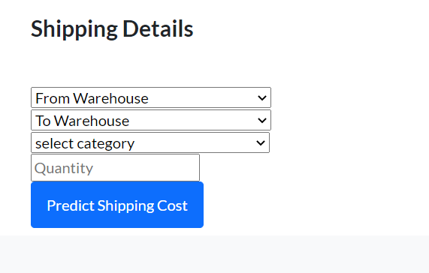
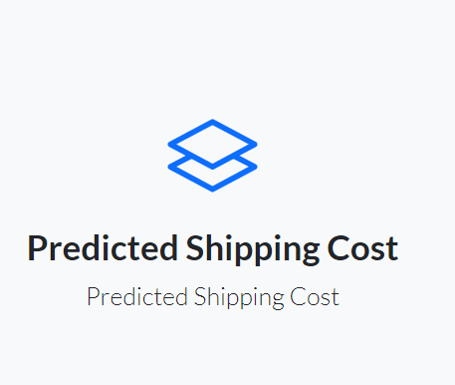

Slide 10
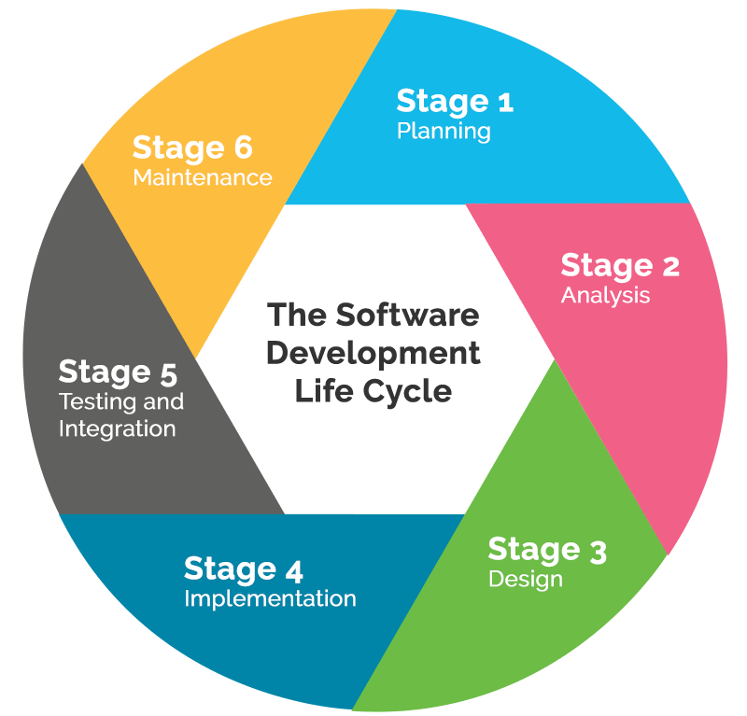
Stage 1
Planning
We started with doing a quick case study of Amazon Warehousing System
We outlined the features need in a warehousing software
Prepared the wireframe diagrams, workflow charts and website layout
Created a workspace

Slide 11
Stage 2
Analysis
Stage 3
design
We divided the workflow into two pipelines
First was to develop the Website
We analyzed the tech requirements and worked accordingly
Parallelly we work on training the machine learning model
We designed the basic database schemas
Defined the access routes
Worked on making navigational flow of the website
We continued with Regression Model

Slide 12
Stage 4
Implementation
Stage 6
design
We started with some boilerplate and finalized the schema
Started preparing the database
We completed the basic layout of website and worked on implementing various tools and measures
We started testing with dataset given to us.
We got issues in handling 80,000+ data entries
Still working on…..

Slide 13
Technology Stack Used
Team Roles
Aman Gupta
PHP/Backend
Shashank Kumar
Flask/ML
Shubhi Singh
Database/cpanel
Android-JAVA
PHP
One Signal for push notifications
Firebase login
MySQL
Cpanel- Dashboard
Domain Provider- freenom
Python
Flask
Postman
AWS Lambda
Machine Learning
Regards,
Team C.O.D.E

