Slide 1




ID ICH035
TEAM C.O.D.E
book
Problem
Statement

Slide 2
The global online on-demand home services market size was estimated at USD 3.71 billion in 2021 and is expected to expand at a compound annual growth rate (CAGR) of 16.7% from 2022 to 2030.
The worldwide requirement for these types of facilities is rising owing to the ease of accessibility and convenience provided by these facilities.
Our platform aims to link consumers with service providers and manage payment and billing transactions, which makes the payment process easier for customers. The rising number of advertising and marketing campaigns is a trend that will contribute to market growth.

Slide 3
Why Book-it-services?
CRUDE
Consumers
Eco-system
Consumers can register and request for desired service
Request service
View nearby providers
Give review
Create a supply chain ecosystem for on demand services
Create hyperlocal on demand services
The app can perform crude operations of
Add
Update
Retrieve
Enlist
User types
Service Providers
Categories
Service providers can register as per their category of service
Add, edit, delete & view
Get service request
Accept payments
Get reviews
Get various categories of services
Select from any category
Analyse booking pattern
Encourage locals

Slide 4
User App
User App, It comes with all the features your users will need to book your handyman service easily.
Bookit-service App
helps all on-field service providers to get the receive tasks and get service done.
Service Categories
Rentals
Cleaners
Laundry
Electricians
Plumbers and many more.
Laravel Admin Dashboard
Laravel Admin Dashboard allows administrators to manage all roles, permissions, services, and more.
Provider App
This is the primary interface for service providers who can assign, track and monitor handyman on field.
Admin App
Admin App gives the platform owners a bird-eye view of the entire business.

Slide 5
Development
Cycle

Slide 6
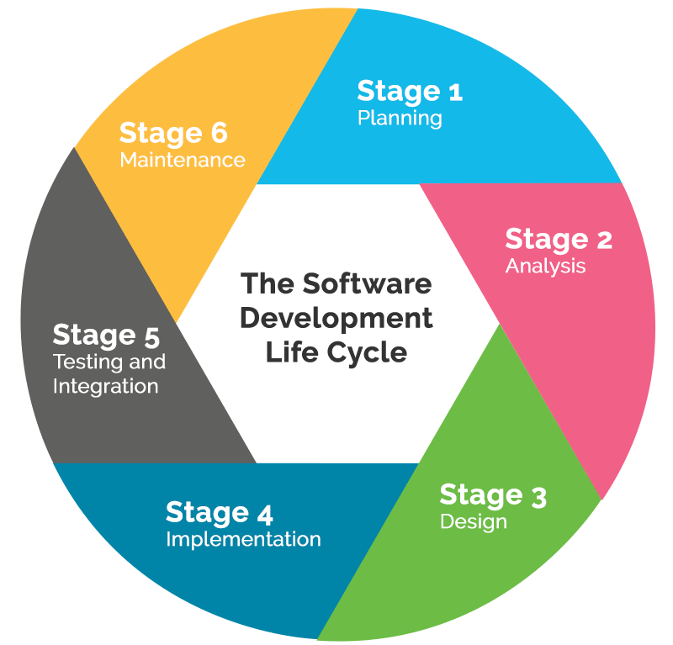
Stage 1
Planning
We started with doing a case study of Grofers/BlinkIt
We outlined the features need in on demand service app
Prepared the wireframe diagrams, workflow charts and website layout
Created a workspace

Slide 7
Stage 2
Analysis
Stage 3
design
We divided the workflow into two pipelines
First was to develop the app
We analyzed the tech requirements and worked accordingly
Parallelly we work on training the database
We designed the basic database schemas
Defined the access routes
Worked on making navigational flow of the website

Slide 8
Technology Stack Used
Team Roles
Aman Gupta
PHP/Backend/Flutter
Shashank Kumar
Database/Flask/ML
Android
Flutter
PHP sync
One Signal for push notifications
Firebase login
MySQL
Cpanel- Dashboard
Domain Provider- freenom
Regards,
Team C.O.D.E
Python
Flask
Postman
AWS Lambda
Machine Learning

