Slide 1

Project ‘Hive’
Contemporary Peer-to-Peer Social Engagement

Slide 2
Architecture Highlights
Unstructured Peer-to-Peer architecture.
Seamless fail-over / hand-off.
Double encryption (protocol+content).
Stream tunneling (VPN-like properties).
Distributed filesystem (e.g. IPFS).
Comprehensive Service Plugin API.

Slide 3
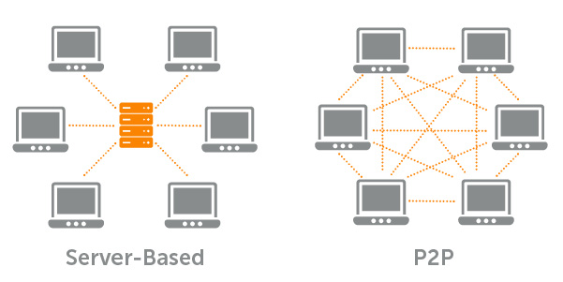
Central Server vs Peer-to-Peer

Slide 4
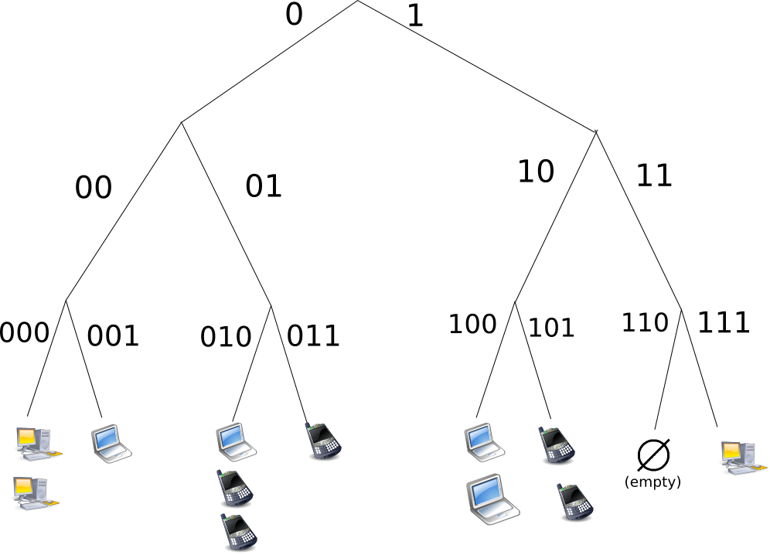
Structured P2P Network

Slide 5

Unstructured P2P Network

Slide 6
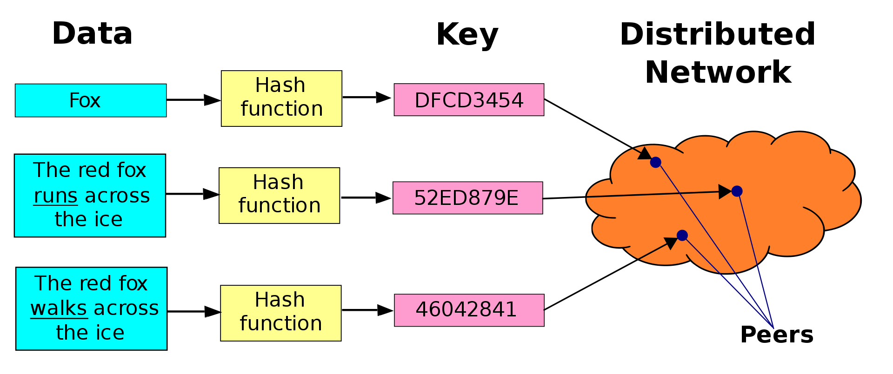
Distributed Hash Table (DHT)

Slide 7

‘Plugin Services’

Slide 8
Plugin Services
File / Stream Encryption & Keygen services.
P2P / Streams / Tunneling services.
Double-blind transaction services.
Distributed Filesystem abstractions.
Web-server-like services.
Multimedia streaming services.

Slide 9
Application Plugins (Examples)
Social Timelines / Message Boards / Conferencing.
File Sharing.
Currency Transfer / Buy / Sell / Auction.
Web-like content publishing.
Private Messaging.
Video/Audio Conferencing.
Video/Audio Broadcast.

