Slide 1

Project ‘Hive’
** DRAFT **
Contemporary Peer-to-Peer Social Engagement

Slide 2
LICENSE
The MIT License (MIT)
Copyright © 2022 8bitgeek at github
Permission is hereby granted, free of charge, to any person obtaining a copy of this software and associated documentation files (the “Software”), to deal in the Software without restriction, including without limitation the rights to use, copy, modify, merge, publish, distribute, sublicense, and/or sell copies of the Software, and to permit persons to whom the Software is furnished to do so, subject to the following conditions:
The above copyright notice and this permission notice shall be included in all copies or substantial portions of the Software.
THE SOFTWARE IS PROVIDED “AS IS”, WITHOUT WARRANTY OF ANY KIND, EXPRESS OR IMPLIED, INCLUDING BUT NOT LIMITED TO THE WARRANTIES OF MERCHANTABILITY, FITNESS FOR A PARTICULAR PURPOSE AND NONINFRINGEMENT. IN NO EVENT SHALL THE AUTHORS OR COPYRIGHT HOLDERS BE LIABLE FOR ANY CLAIM, DAMAGES OR OTHER LIABILITY, WHETHER IN AN ACTION OF CONTRACT, TORT OR OTHERWISE, ARISING FROM, OUT OF OR IN CONNECTION WITH THE SOFTWARE OR THE USE OR OTHER DEALINGS IN THE SOFTWARE

Slide 3
Architecture Highlights
Unstructured Peer-to-Peer architecture.
Seamless fail-over / hand-off.
Double encryption (protocol+content).
Stream tunnelling (VPN-like properties).
Distributed file-system (e.g. IPFS).
Comprehensive Service Plugin API.

Slide 4
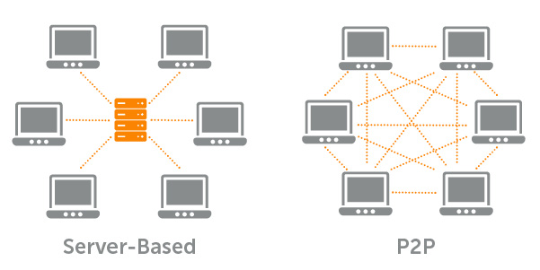
Central Server vs Peer-to-Peer

Slide 5
Peer-to-Peer Definitions
peer-to-peer: relating to, using, or being a network by which computers operated by individuals can share information and resources directly without relying on a dedicated central server.
For most of our purposes, we will use the term “peer” and “node” interchangeably.
Routing: guiding and directing network data between nodes from a source node to a destination node.

Slide 6
Peer-to-Peer Definitions (cont.)
Routing Table: A table of known possible destinations used to help guide network traffic between a source and a final destination.
routing algorithm: A collection of formula and methods used to optimally calculate a path between nodes over which to route traffic.
A* : (Pronounced “Ay Star”) is a path search algorithm, which is under consideration to use at the core of the ‘Hive’ routing algorithm.

Slide 7

A* Algorithm Demo

Slide 8
A* Algorithm Demo (cont.)
In the demo a search takes place from the lower left, to the upper right nodes.
Some nodes can’t reach other nodes directly, they are blocked.
A* is very good at finding a path around blockages.
A* uses a heuristic to approximate the most likely optimal path.

Slide 9
A* Algorithm Demo (cont.)
In the demo, the algorithm used for solving h(x) is ‘8-direction-Manhattan-distance’.
The ‘Hive’ routing algorithm requires a significantly more sophisticated routing algorithm.
The ‘Hive’ routing algorithm coupled with the routing table, and the totality of the methods that comprise a total routing solution, we will call “systemaschematizer” based on the word "schematisation".

Slide 10
Hive Routing Heuristic
Variable number of routes per node.
Hop distances are measured in time.
Inner transits maintain timing statistics to incorporate into the heuristic.
Congestion, and flow distribution fairness also to be factored into the heuristic.

Slide 11
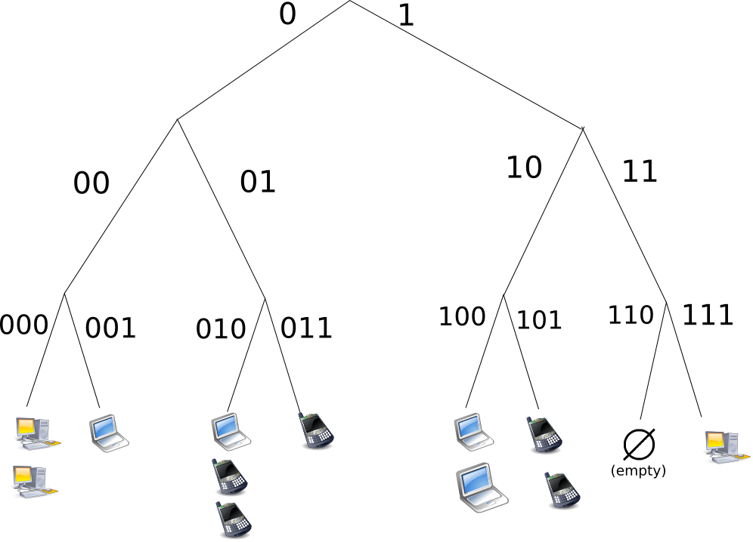
Structured P2P Network

Slide 12

Unstructured P2P Network

Slide 13
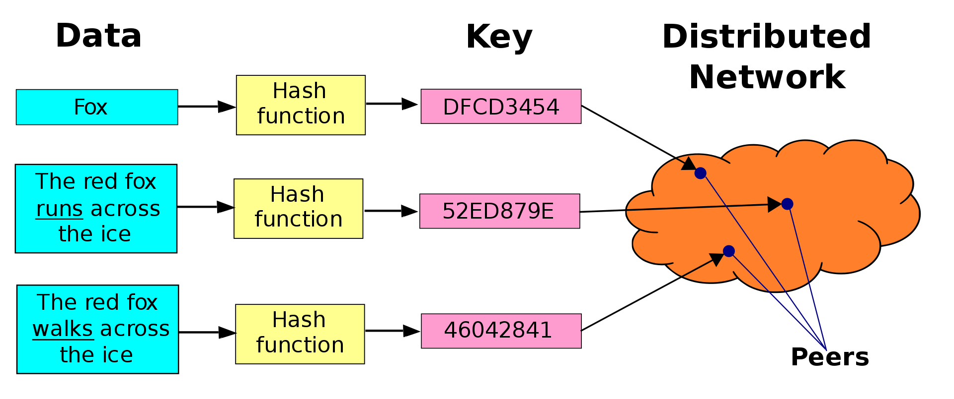
Distributed Hash Table (DHT)

Slide 14

‘Plugin Services’

Slide 15
Plugin Services
File / Stream Encryption & Key-gen services.
P2P / Streams / Tunnelling services.
Double-blind transaction services.
Distributed file-system abstractions.
Web-server-like services.
Multimedia streaming services.

Slide 16
Application Plugins (Examples)
Social Timelines / Message Boards / Conferencing.
File Sharing.
Currency Transfer / Buy / Sell / Auction.
Web-like content publishing.
Private Messaging.
Video/Audio Conferencing.
Video/Audio Broadcast.

Slide 17
Open Source Technology
Python-p2p-network
  GNU General Public License v3.0
Python Ipfs-api
  MIT License
Python blowfish
  GNU General Public License v3.0
...

Slide 18
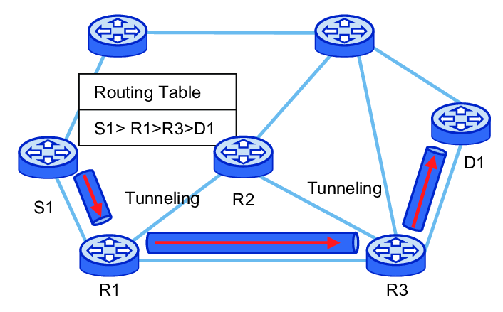
Inner P2P Routing Tunnels

Slide 19
Stream Tunneling
Outer P2P
  TCP Encrypted Stream Socket Connect P2P.
  Exposed Connectivity.
  Externally Routed.
Inner P2P
  VPN-Style Encrypted Tunneling Streams P2P.
  Concealed Connectivity.
  Internally Routed.

Slide 20
Inner P2P Malicious Node
Denial Of Service (e.g. chokes/blocks stream).
  Potential Mitigation
    Router statistics notice DoS and route around.
    Global removal from routing table.
Re-routing Of Stream parcels.
  Potential Mitigation
    Routing detects persistent missed arrivals, and initiates a failed-node isolation protocol.
    Global removal from routing table.

Slide 21
Inner P2P Failed Node Isolation
A method of doing a search between all P2P nodes to isolate a problem node.
Requires all node participation?
Define the procedure.

Slide 22
Global Inner Routing Table
Define the method of distribution.
Define the method of verification.
Define the inner stream connection and operating primitives.
Define the routing and heuristic algorithms....

Slide 23
Global Inner Routing Table (cont.)
Transshipment
  Determining the most cost-effective way to ship parcels from supplier to consumer while potentially using intermediate nodes.
  What is cost-of-transshipment heuristic composed of?
Maximum Flow Heuristic
  Given a network path that shows potential capacity over which parcels may be shipped, compute the maximum flow.
Define the the equation and method for obtaining the cost-of-transshipment heuristic.

Slide 24
Global Inner Routing Table (cont.)
Under consideration for routing core; A* (‘A ‘ Star) search algorithm using a derived cost-of-transshipment heuristic to solve h(x).
The space complexity characteristic of A* needs to be analyzed more thoroughly as node-id record storage requirement become defined.

Slide 25

Outer P2P Routing

Slide 26
Global Outer Routing Table
Define the method of distribution.
Define the method of verification.
Define the outer stream connection and operating primitives.

