Slide 1
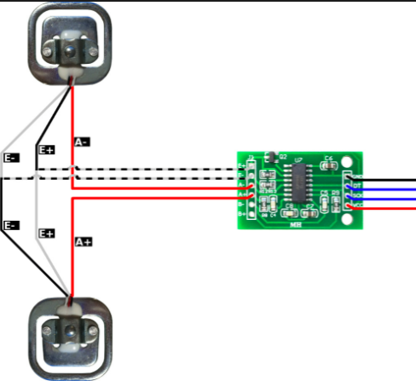
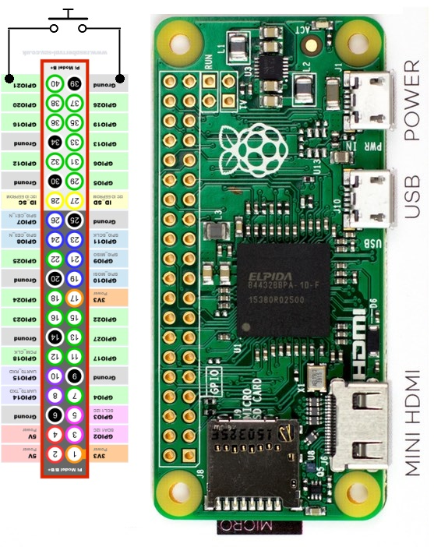







HX711 PIN – Load Cell 2 | Raspi GPIO
GND | Ground
DT | GPIO5
SCK | GPIO6
VCC | 3V3
HX711 PIN – Load Cell 1 | Raspi GPIO
GND | Ground
DT | GPIO17
SCK | GPIO27
VCC | 3V3

