Slide 1


Growing the Client-Advisor Relationship…
For Life.

Slide 2

ClientCast® will help you:
Market yourself to clients and prospects
Cross-sell to clients and prospects
Get referrals without even asking
Learn best practices, strategies & sales ideas to make you a more proficient professional and better business person
  “NAIFA ClientCast® is one of the greatest member engagement tools that we have; it creates real sales results. Use this marketing tool for recruitment and retention for our association. Be sure to take advantage of this NAIFA benefit!”
  -John F. Nichols, NAIFA President 2013 – 2014

Slide 3

Part One:
An online radio program designed to touch clients and prospects with audio content that motivates them to take action with you, their professional.
“NAIFA ClientCast® is the perfect tool for developing contact with our prospects as well as keeping us connected with our existing clients. By keeping them up to date with relevant information and educating them on important financial topics, we can provide them with a service like no other.”
-Marc Minor, Past #1 Rep with BD

Slide 4






Podcast Episodes
Shop the Economic Mega Sale
  with Robert Kiyosaki
Are You Overpaying on Taxes?
  with Sandy Botkin, CPA
How a 23-Year-Old Survives Cancer
  with Camille Snyder
Do Your Kids Overspend?
  with Dr. John Whitcomb
Estate Planning Mistakes of the Rich & Famous
  with Attorneys Danielle & Andy Mayoras
Maximizing Social Security
  with Robin Mueller

Slide 5
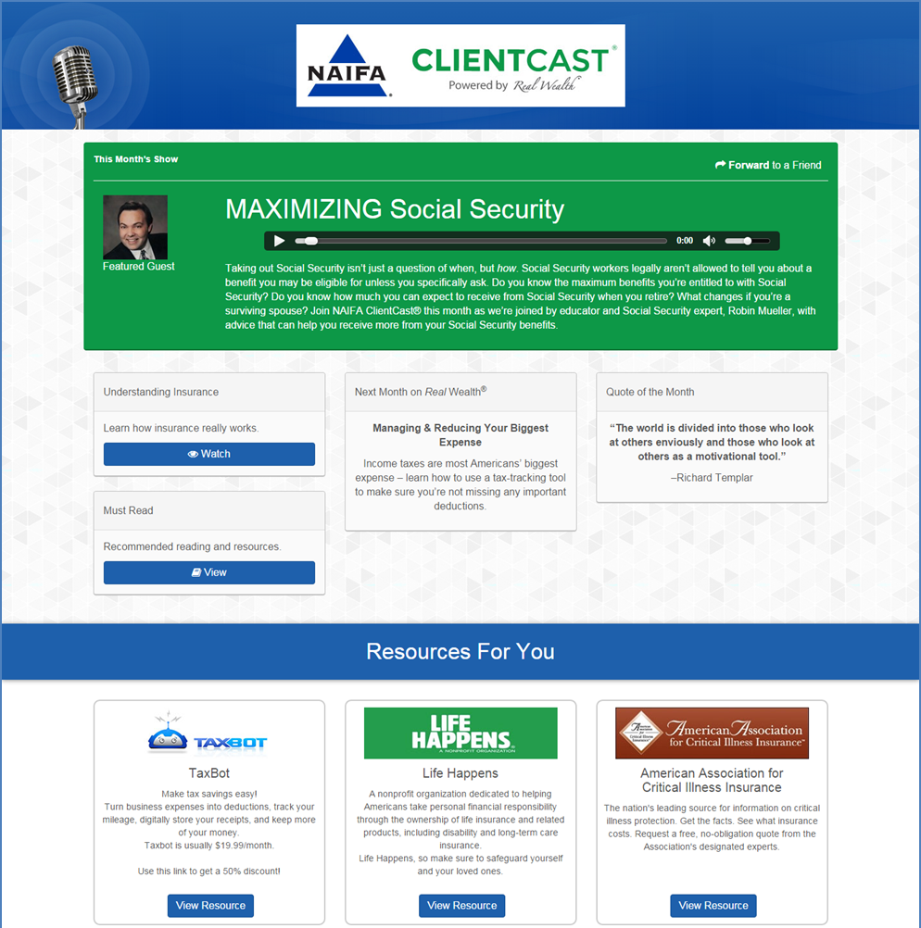
Basic Service
Notes:
Basic Service – Free as NAIFA member. http://RealWealthMedia.com/NAIFA

Slide 6
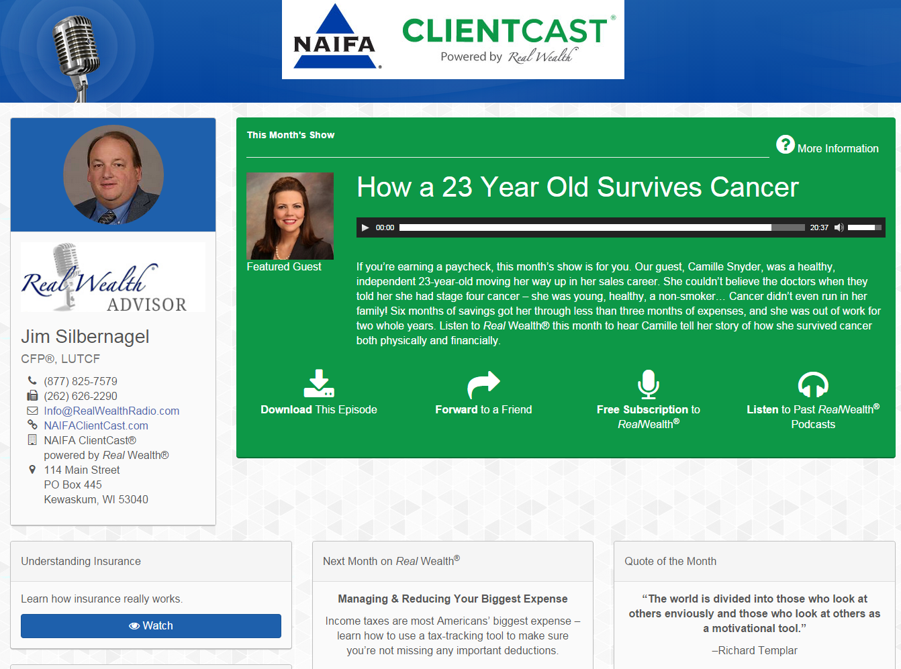
Premier Service – Brand It!
Notes:
Personalize your page with photo, logo, contact info. Also gives you “Listen to past podcasts” button. URL: http://RealWealthMedia.com/YourName
NAIFA Discount for the upgrade: $99 setup, $15.95/month.
Retail price: $250 setup, $250/month.

Slide 7


Part Two:
Real Wealth® conducts Power Session LIVE webinars each month to give you tools, best practice ideas & sales strategies.
We host the best of the best presenters that will educate, train and propel your business to new levels of success.
“I do a lot of interviews and presentations and today’s webinar was possibly the best I have ever done. Jim has a unique understanding of the subject matter, allowing me to focus on the most important points of my presentation.”
-Curtis Cloke, Keynote Speaker 2014 NAIFA-National Conference

Slide 8






Social Security: BIG Changes & BIG Opportunities
  with Robin Mueller & Tim Kiesling
How to THRIVE During the Economic Downturn
  with Van Mueller, LUTCF
Preparing for Life Insurance Awareness Month
  with Marv Feldman
Maximize Your Practice
  with Gina Pellegrini
Life Insurance as an Asset Class
  with John Wheeler
Instant IRA Success
  with Ed Slott
Notes:
Basic Service: Access to LIVE Webinar, same time every month. Second Friday at 10:30 a.m. Central. Email invitations go out for each session with registration information.

Slide 9
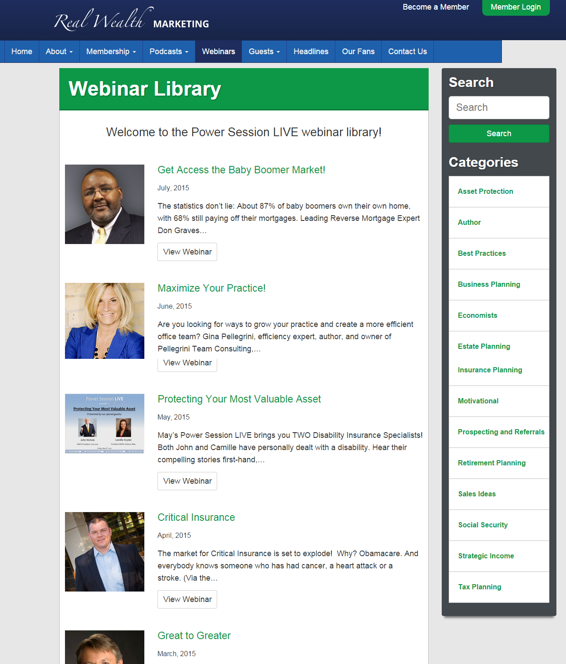
Webinar Library: Premier Service
Notes:
Premier Service: Also receive password to access full library of Power Session LIVE recordings.
Included in Upgrade price. ($99 setup, $15.95/month).

Slide 10
Service Options
Basic Service
  Share current month’s episode & marketing content with clients, prospects & networks
  Connect NAIFA ClientCast® to existing website
  Attend Power Session LIVE webinars in real time
  Access online marketing tips and materials
  Live sales support
Premier Service
  Everything on the left, plus:
  Customize marketing content
    Personalized NAIFA ClientCast® webpage
    Downloading options to add specific episodes strategically to existing website
  Access full Power Session LIVE webinar library
Free to NAIFA members!
Register at NAIFAClientCast.com
Discounted for NAIFA members!
$99 setup fee + $29.95/month
Retail price: $250 setup fee + $250/month
Notes:
Register, upgrade, watch a marketing tutorial, learn more and more at http://NAIFAClientCast.com.

Slide 11

Sign up & learn more at
www.NAIFAClientCast.com
Info@NAIFAClientCast.com
(877) 825-7579

