Slide 1

Cross-Frequency Statistical Arbitrage Engine
Latency Optimization and the Cross-Frequency Performance Lab
Understanding the model, its parameters, and optimization logic.
Vishnupriya Subramanian

Slide 2









The Problem & System Flow
Cross-frequency streams create
latency at each step of the pipeline.
Different arrival intervals require
synchronization waits
Incoming financial observations
Frequency alignment
Rolling statistics
Output / diagnostics
Rolling statistics add computation time (moving average, variance, covariance)
Multi-frequency data arrives asynchronously
Streams are synchronized onto a common timeline
Moving average
Variance Covariance
Results and diagnostics produced for analysis
Queuing builds when processing
can’t keep up
Latency is elapsed processing time. Throughput is the rate of completed outputs.
LATENCY IS ELAPSED PROCESSING TIME FROM INPUT TO OUTPUT. THROUGHPUT IS THE RATE OF COMPLETED OUTPUTS OVER TIME.

Slide 3


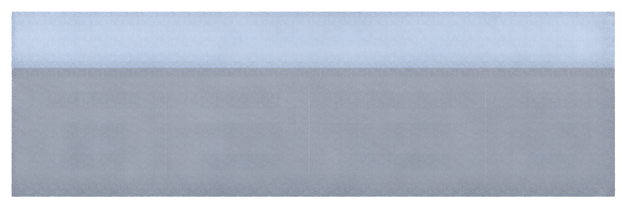

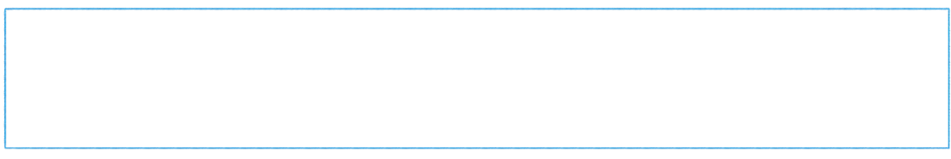



Benchmark Inputs & Latency Metrics
Benchmark inputs
Latency metrics
Incoming observations
Calculation complexity
Burst intensity
P50 median
P95 & P99
Latency reduction
Speedup
Number of data points
per interval
Scale from 1 (simple)
to 5 (complex)
How severe the sudden traffic surge is
Typical
latency
Tail latency
under load
Improvement
over baseline
How much
faster
How we calculate
Latency reduction (%) =
Speedup (x) =
before – after
before
× 100%
before
after
Illustrative example (hypothetical)
100 μs
39.8 μs
60.2%
2.51×
baseline
with optimization
latency reduction
speedup

Slide 4

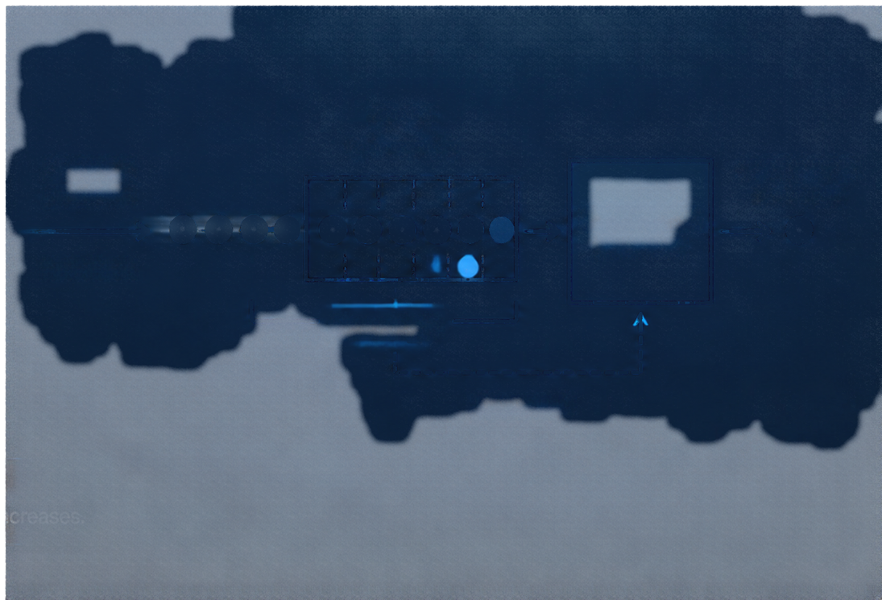

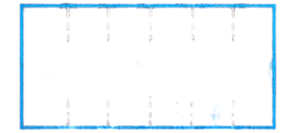















Traffic & Queue Behaviour
Arrival rate is observations per second
Processing capacity is processed observations per second
QUEUE
Queue capacity is the maximum
buffered observations
up to capacity
ARRIVALS
DEPARTURES
per second
per second
Utilization equals arrival rate divided by processing capacity times 100 percent
PROCESSING
per second
Arrival rate
Queue depth is the current number of observations waiting to be processed
Queue depth
Queue wait is the time observations spend waiting in the queue
Queue wait
When arrivals temporarily exceed processing capacity, queues build and waiting latency increases.

Slide 5

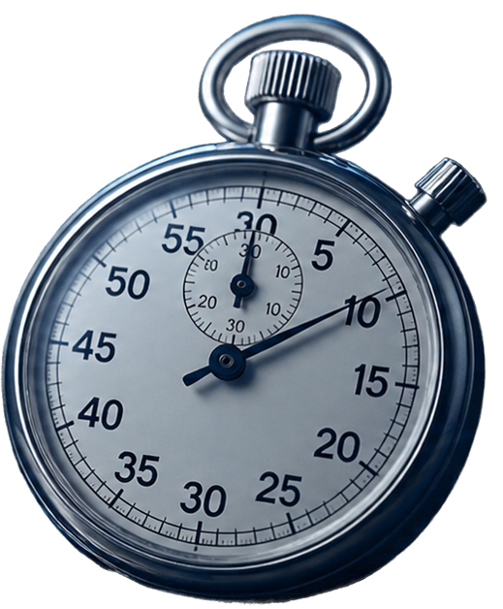


Frequency Alignment & Rolling Statistics
ALIGNMENT
ROLLING STATISTICS
Set stream intervals
and jitter tolerance
Define rolling window and
incoming observations
Choose strict wait-for-all
or bounded-lag
Select statistic (moving average, variance, covariance)
Incremental updates deliver O(1) work vs O(N) full recalculation
Bounded lag reduces wait while maintaining freshness
Operation reduction does not equal latency reduction

Slide 6
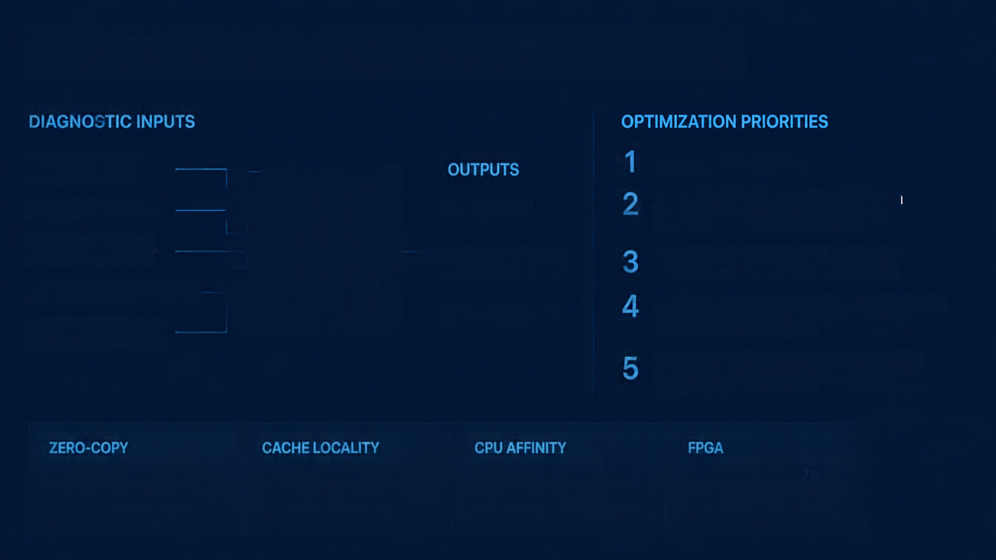







Diagnostics & Optimization Priorities
DIAGNOSTIC INPUTS
CPU utilization %
1
Incremental rolling stats
OUTPUTS
2
Reduce unnecessary synchronization with bounded lag where valid
Memory pressure %
BOTTLE NECK
Bottlenecks
Network delay (ms)
Improved profile
3
Balance queue arrival and capacity
the stage limiting overall performance
Synchronization delay (ms)
Reduce data-copy and network overhead; improve cache locality
Recommendations
4
Queue pressure (%)
5
Consider CPU affinity/FPGA only after profiling and feasibility
ZERO-COPY
CACHE LOCALITY
CPU AFFINITY
Move data without copying betweenuserspace and kernel or across processes.
Access data that is close in memory to reduce latency and misses.
Pin work to specific cores to reduce context switches and cache disruption.
Programmable hardware accelerator for specific, high-throughput tasks.

Slide 7




Key Takeaways & Model Boundaries
Profile end-to-end to find the real bottlenecks
Optimize computation and synchronization before hardware
Track P95 and P99, not just the median
Throughput and latency measure different things
Validate model predictions with measured real-system data
Model boundaries
Quick glossary
This website provides an educational, deterministic model.
It is not live exchange data and not a hardware benchmark.
Latency
elapsed time from input to output
μs / ns
microseconds / nanoseCONDS
P50 / P95 / P99
50th, 95th, 99th percentile latencies
The 60.2% example is hypothetical.
Replace with measured baseline from your report.
Incremental computation
update only what changes
Throughput
rate of completed outputs over time
FPGA
field-programmable gate array
Thank you

