Slide 1
Drug repositioning
Joshua Ellis

Slide 2
Introduction
A common rejection module (CRM) for acute rejection across multiple organs identifies novel therapeutics for organ transplantation
Khatri, Roedder, Kimura, Vusser, Morgan, Gong, Fischbein, Robbins, Naesens, Butte, Sarwal
2013
Apply previously developed drug treatments along with publicly available data to develop new treatment options

Slide 3
Problem
Billions are spent on new drug development
Many drugs do not work for their intended purpose
Lower priority diseases are left behind
Long term immune suppressions regimens has not improved

Slide 4
Motivation
Repurpose previously developed drugs to help lower priority diseases
Improve 5-yr graft survival rates with better drug treatment
Develop a method to reliably integrate tests from GEO
Test repurposed drugs to see if method works

Slide 5
Biology
Rejection
Immune system protects against foreign objects
Cannot perfectly match organ donors
Reduce
Immune cell infiltration
Graft injury
Increase
Graft survival

Slide 6
Methods
P-values
Microanalysis exercise
GEO2R
FDR
Microanalysis exercise
Effect size
Hedges’ adjusted g
Fisher’s Method
Pathway Analysis

Slide 7
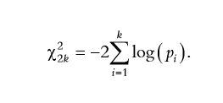

Fisher’s Method and Effect size
Fisher’s Method
Effect size
Meta-analysis by combining p-values
Sum of logs of p-values across multiple studies
P-Value<0.2
Sumlogs in R
Corrects for small sample bias
Allows comparison of two groups
Meta-effect size>0
Effsize package in R

Slide 8
Pathway Analysis
SPIA
Different analysis from the paper

Slide 9
Data description
GSE50058,GSE1563,GSE2137,GSE36059,GSE25092
Organism: Homo sapiens
Tissue: Renal transplant
Sample size: ~600
Split between Rejection and Stable
Platform: Affymetrix
File type: .CEL

Slide 10
Flowchart
Retrieve Probe data
CEL Files
Statistical analysis on each data set
Differentially Expressed Genes for each data set
Combine p-values and effect size
Differentially Expressed Genes overall

Slide 11
Results from Renal study
Significant Genes Paper
Significant Genes Project
BASP1
CD6
CXCL10
CXCL9
INPP5D
ISG20
LCK
NKG7
PSMB9
RUNX3
TAP1
ISG20
CD8
CXCL10
CXCL9
NKG7
PSMB9
TAP2

Slide 12
Discussion
CRM of 9 genes
Findings match up with the paper
Similar immune responses
Find drugs to interact with the differentially expressed genes
Chosen through literature search
Pooling different data sources is possible

Slide 13
Repurposed Drugs
Dasatinib (Sprycel)
Cancer drug
Atorvastatin (Lipitor)
Cholesterol drug
CXCL10
CXCL9
LCX

Slide 14
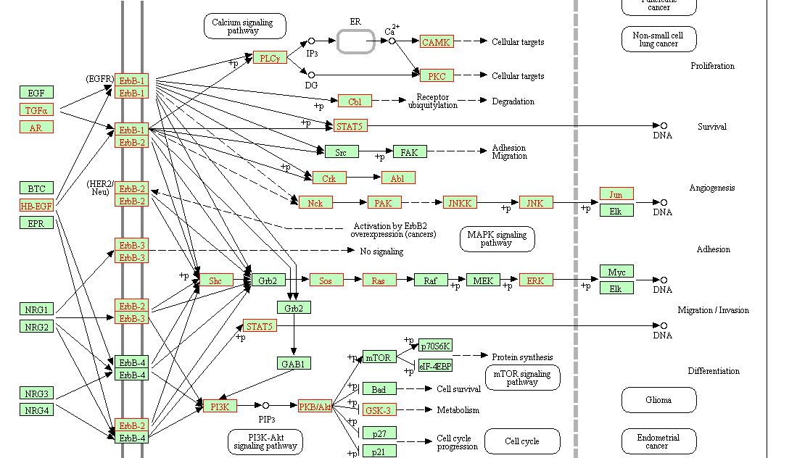

Slide 15
http://udel.edu/~mcdonald/statfishers.html
https://www.leeds.ac.uk/educol/documents/00002182.htm
https://medlineplus.gov/ency/article/000815.htm

