Slide 1

MINISTRY OF EDUCATION OF THE REPUBLIC OF BELARUS BELARUSIAN STATE UNIVERSITY Faculty of Applied Mathematics and Informatics Department of Computer Technologies and Systems BUSKO EGOR ANDREEVICH DETECTION AND RECOGNITION OF BUILDINGS ON SATELLITE RADAR IMAGES
 | Project Manager: Associate Professor of the Department of CTS FPMI, Doctor of Technical Sciences Nedzved Alexander Mikhailovich
Busko E. A. Course work Minsk, 2021

Slide 2
Objectives and purpose of the project
The purpose of this course work is to study the pre-processing of SAR images, as well as the implementation of building recognition on satellite radar images using the YOLO neural network.
Work tasks:
Processing of SAR images and extraction of informative fragments
From a large number of different structures in the image, determine which building classes will be detected
Solve a problem with small enough data to train the network
Generate a dataset suitable for our chosen network model
Train and test a neural network model to identify buildings in SAR images

Slide 3
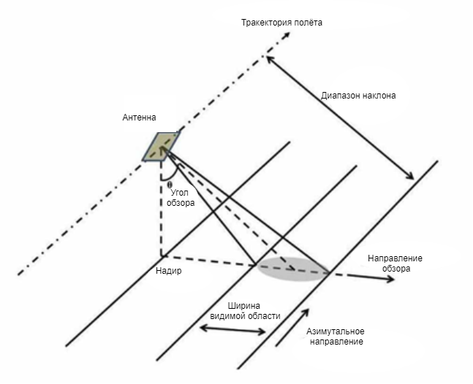
Schematic representation of satellite operation
SAR is a form of radar that is used to create 2D images or 3D reconstructions of objects such as landscapes.
SAR uses the movement of a radar antenna over a target area.

Slide 4
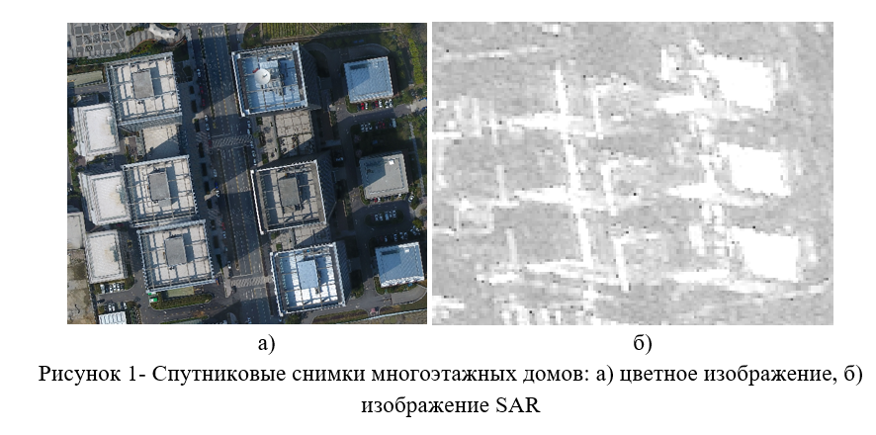
Satellite images
b)
Image 1 - Satellite images of multi-storey buildings: a) color image, b) SAR image

Slide 5
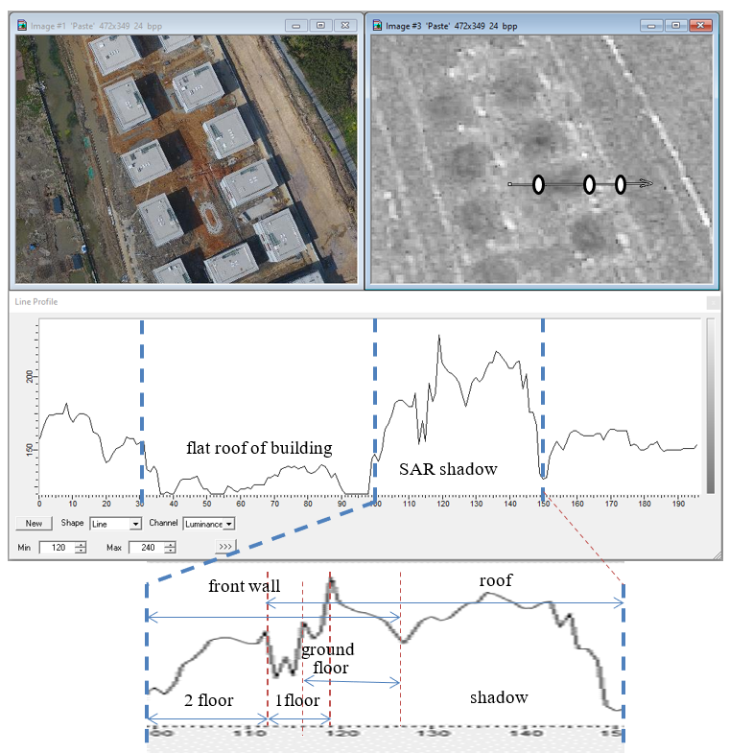
Solving the problem of selecting buildings
Based on the profile of the building on the SAR image with a description of the shadow, key classes were determined to be determined using the Yolo network.

Slide 6

Quantifying Buildings for Learning
Большую часть изображений мы отнесли к набору для обучения (в процентном исполнении 85%) и 10% к набору для тестирования.

Slide 7
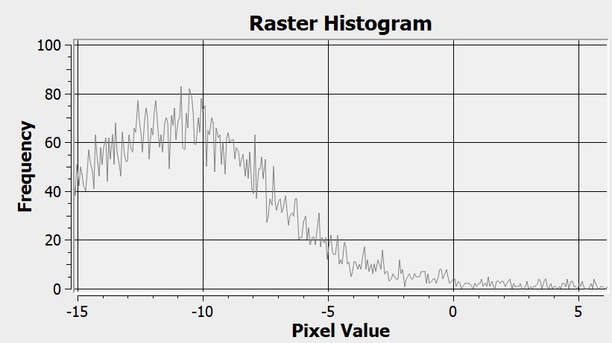
SAR Image Histogram

Slide 8
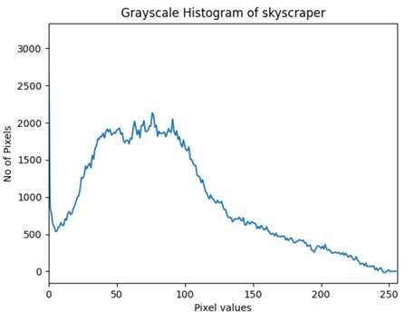
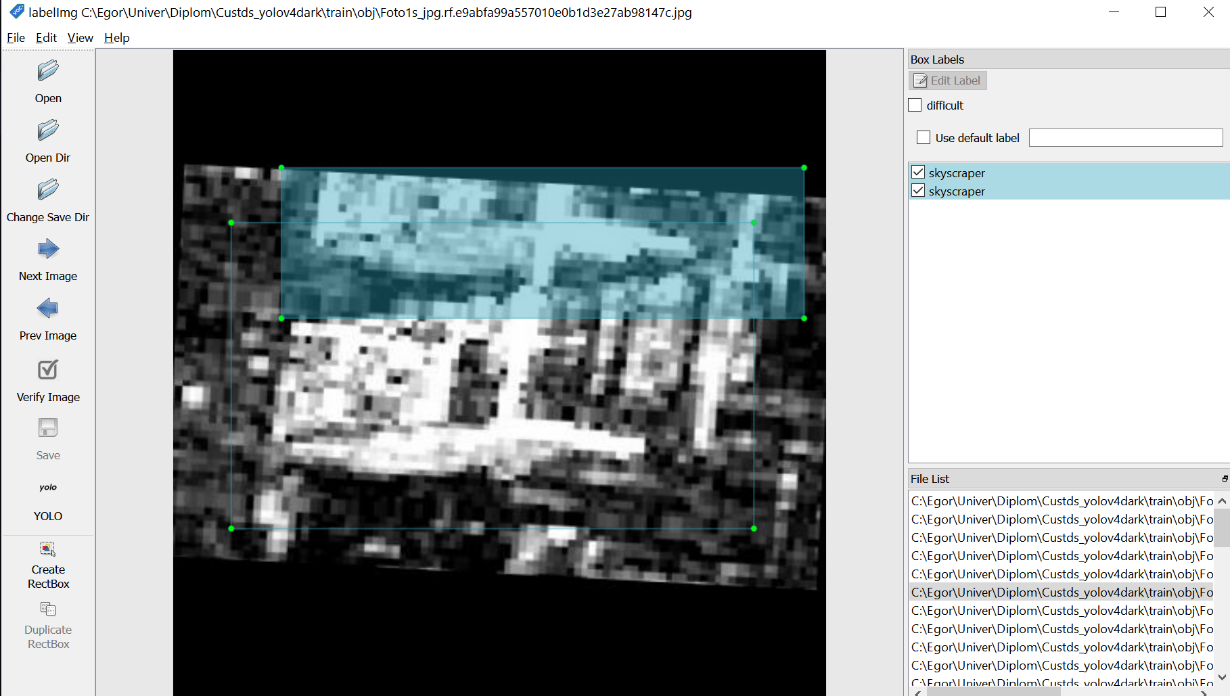
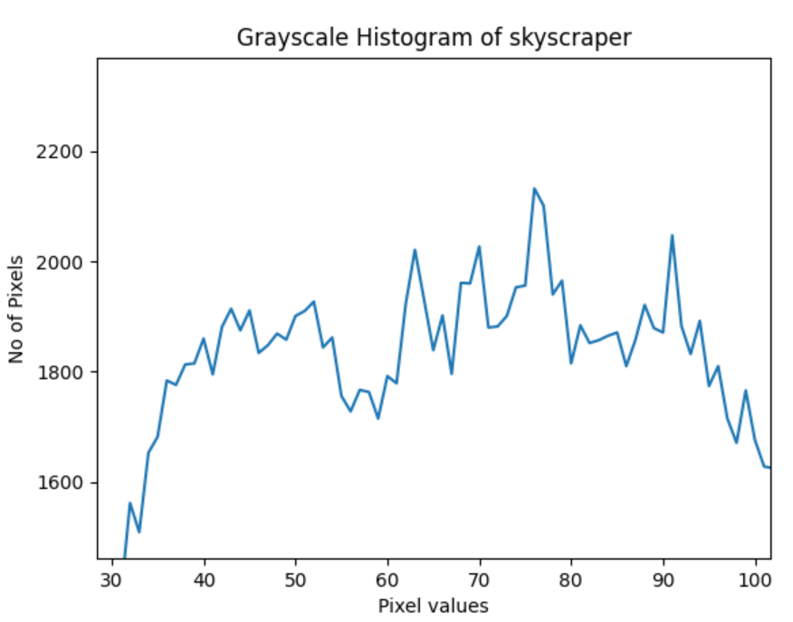
Image labeling program

Slide 9
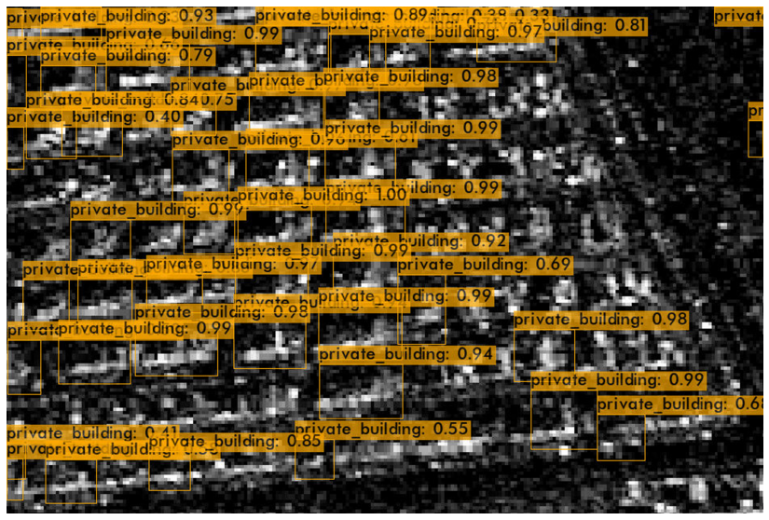
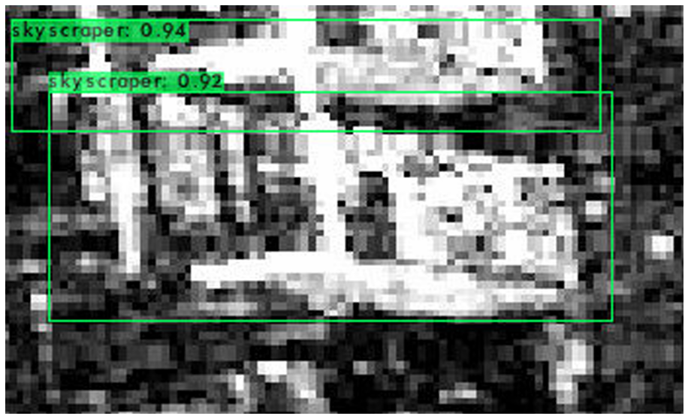
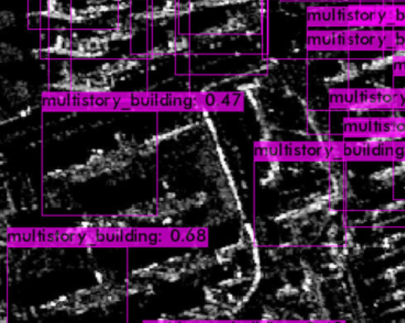
Test results

Slide 10
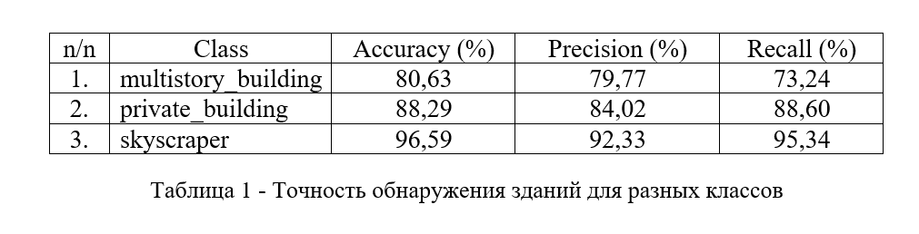
Results of detection of buildings of three classes
Table 1 - Building detection accuracy for different classes

Slide 11
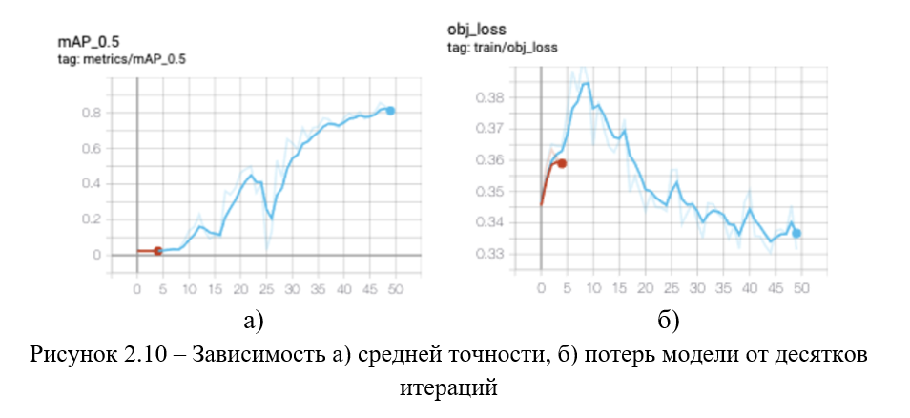
Estimation of losses and average accuracy of the model
Figure 2.10 - Dependence of a) average accuracy, b) model losses on tens of iterations

Slide 12
Conclusion
To prepare the training set, an application was developed that allows you to select and classify the corresponding fragments. On their basis, the YOLOv4 neural network model was trained. The trained YOLOv4 model showed quite good results in detecting three classes of buildings on satellite radar images, especially skyscraper class buildings. The trained model is intended to solve cadastral problems - the search for illegal buildings.

