Slide 1
LLMConvFinQA: Conversational Financial Question Answering
LLM-powered system for multi-turn financial document analysis
Ammar Mohemmed

Slide 2
Objective
The objective of this work is to design and implement an LLM-based solution for the given problem of conversational question answering over financial documents, using the provided ConvFinQA dataset (dev_turn.json).

Slide 3
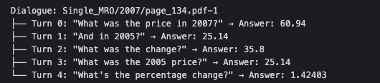
Data
Total Entries: ~1,490 individual question-answer pairs
Unique Dialogues: ~421 conversational sequences
Average Length: 3.5 turns per dialogue
Format: JSON array with structured annotations

Slide 4
Proposed Solution
ConvFinQA Dataset
Data Preparation
(Dialogue grouping & turn ordering)
Document Context Builder
(Text + HTML Table)
Conversation Memory
(Explicit message history)
LLM Invocation (GPT-4o)
(Chat Completions API)
Result Parsing
Numerical Validation
Results Logging

Slide 5
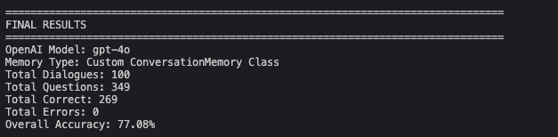
Results

Slide 6
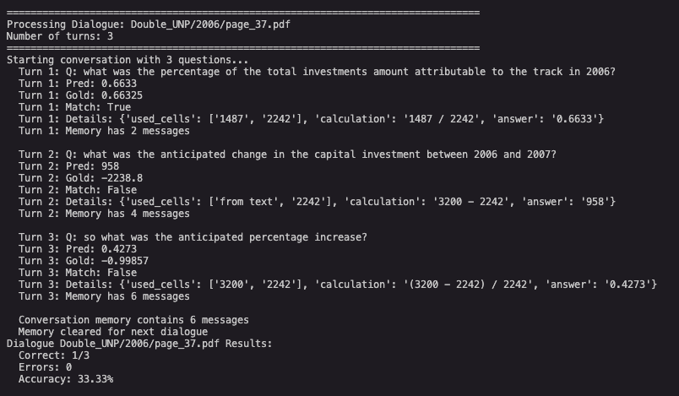
Mismatched Case

Slide 7
Mismatched Case
🎯 The Issue:
Unit mismatch!
2006 value: $2242 million
2007 value: $3.2 billion = $3200 million
Dataset calculation: 3.2 - 2242 = -2238.8 ❌ (Wrong! Mixed units)
LLM calculation: 3200 - 2242 = 958 ✅ (Correct! Same units)
💡 What's Wrong:
The dataset annotation is incorrect! It's doing:
3.2 billion - 2242 million
But treating 3.2 billion as just "3.2" instead of converting to 3200 million
The LLM is actually correct:
2006: $2242 million
2007: $3.2 billion = $3200 million
Change: $3200M - $2242M = $958M increase ✅

Slide 8
Improvements
Going through mismatched items and identifying issues
Improve the prompts
Compare with different LLM
Convert HTML tables into structured representations
Combine LLM reasoning with lightweight symbolic computation

