Slide 1
Neural Tuning and Representational Geometry
Kriegeskorte & Wei (2021), Nature Reviews Neuroscience
Presented by Audrey and Kevin
Notes:
This paper is a review. It does not run a new experiment. It explains how two common ways of studying the brain fit together.

Slide 2
The Big Question
When you see something, many brain cells fire. How does that activity stand for what you saw?
Scientists usually answer this in one of two ways:
View 1: look at one cell at a time and ask what it likes.
View 2: look at the whole group of cells together and ask how the overall patterns compare.
This paper explains how the two views are connected.
Notes:
Keep this slide simple. The rest of the talk is about View 1, View 2, and how they relate.

Slide 3
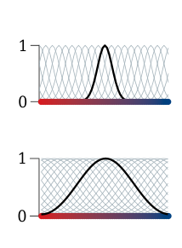
View 1: Each Cell Has a Favorite
Many brain cells fire most for one "favorite" thing, such as a line tilted at one angle.
Like a radio tuned to one station, the cell responds less as the line tilts away from its favorite.
A plot of this is called a tuning curve (right).
Top: a picky cell that only likes a narrow range of angles. Bottom: a less picky cell.
Notes:
Point to the black curve in each plot. The grey curves are other cells with different favorite angles.

Slide 4
View 2: A Map of Patterns
Each picture you see produces a pattern of activity across all the cells.
Compare every pair of patterns: similar patterns sit close together, different ones sit far apart.
This gives a "map" of how the brain groups things. The paper calls it the representational geometry.
The map tells us which things are easy for the brain to tell apart (far apart) and which are easy to mix up (close together).
Notes:
An everyday analogy: a map of cities. You can know all the distances between cities without knowing which roads connect them.

Slide 5
Main Point 1: The Cells Build the Map, but Not the Other Way Around
If you know what every cell likes, you can work out the map.
But the same map can be built by very different sets of cells.
Analogy: rotating a map changes which way is "up", but every distance stays the same.
So the map tells you what information is there, but not which cells carry it.
Notes:
This is why the two views are both useful. The map is simpler, but it hides the details of individual cells.

Slide 6
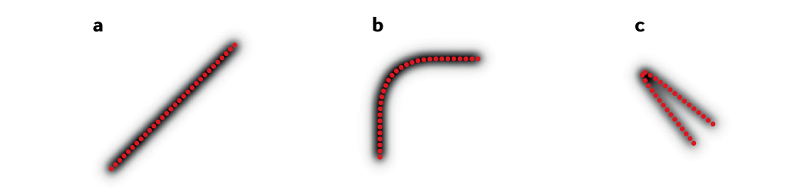
Main Point 2: Telling Things Apart
Older work mostly measures how well the brain separates very similar things (e.g., two almost identical angles).
Below: three maps (straight, bent, folded). Neighbouring points are equally far apart in all three.
But when folded, opposite ends come close together, so very different things become easy to confuse.
Lesson: you need the whole map, not just nearby comparisons.
Notes:
This is Fig. 2 in the paper. Each red dot is one stimulus. The older measure (Fisher information) is the same for all three, but the folded one loses information.

Slide 7
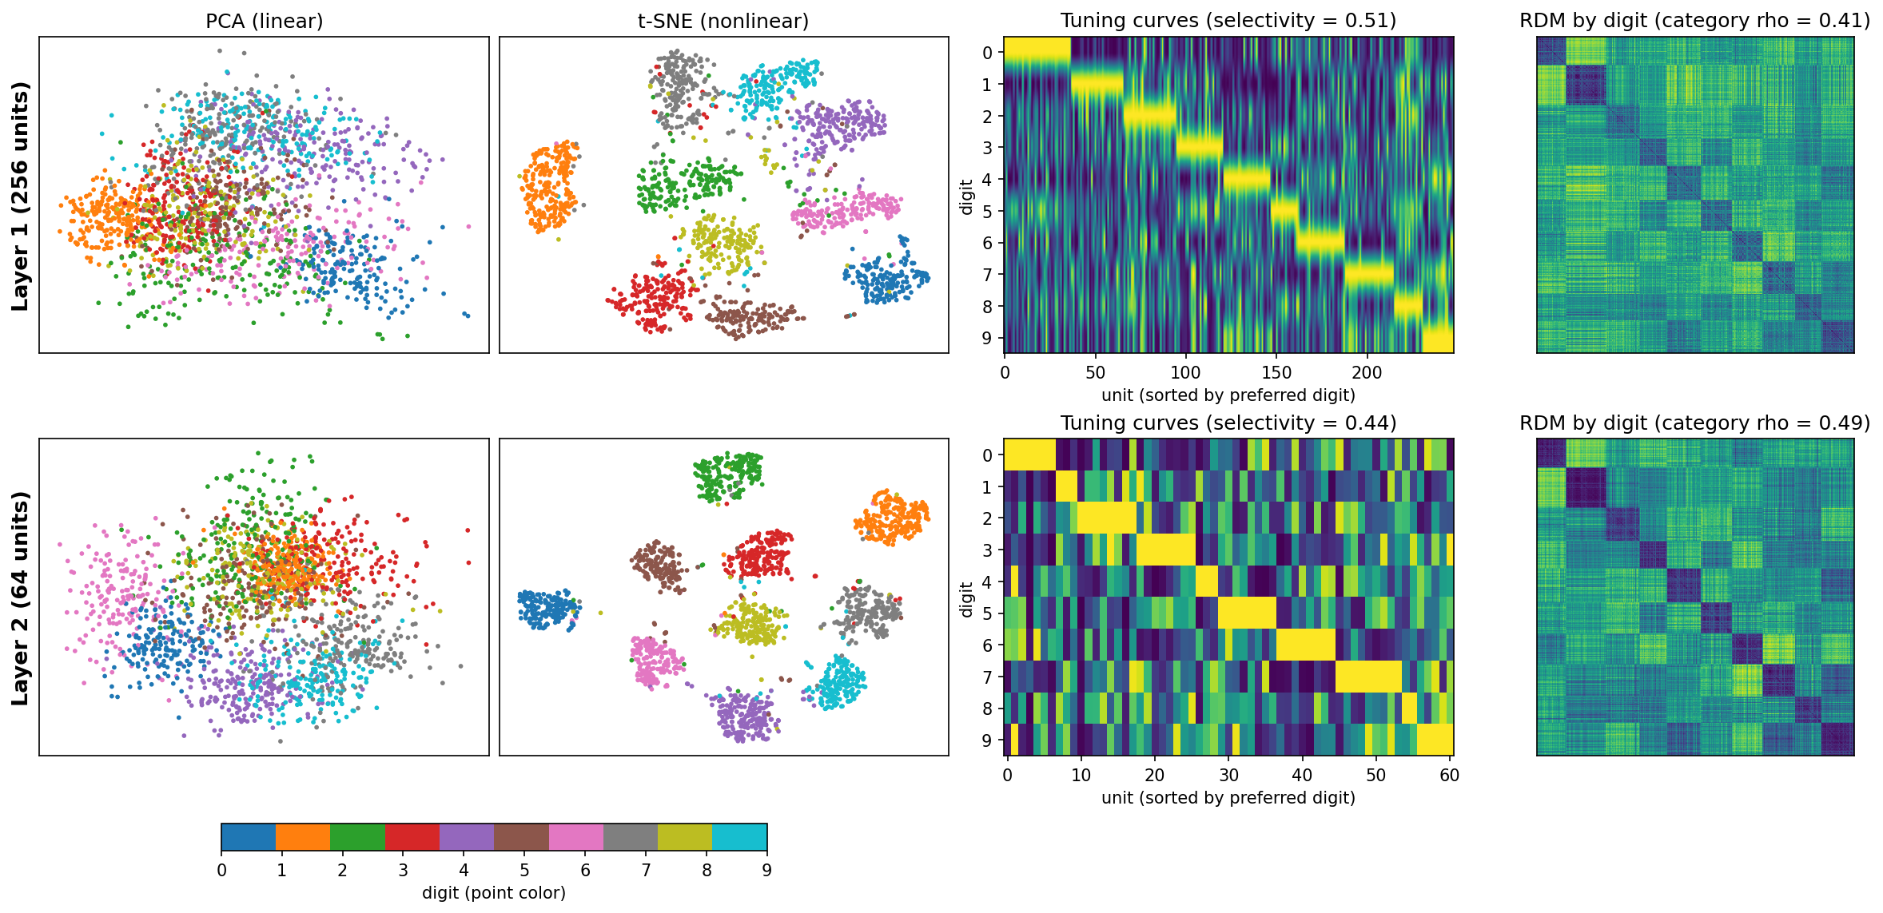
Our Mini-Experiment: Inside a Digit-Recognizing Network
We trained a small computer network to read handwritten digits (96% correct) and compared two of its layers.
The deeper layer is simpler: it packs the information into far fewer directions (8 instead of 27).
The deeper layer groups the same digits closer together on its map (match to "same digit" grouping rose from 0.41 to 0.49).
But single units in the deeper layer are less picky about one digit, so the digit information is shared across the group.
Notes:
Same lesson as the paper: looking at single units and looking at the map can tell different stories. Columns in the figure: two ways of drawing the map, each unit's favorite digits, and the distance table.

Slide 8
Takeaways and Discussion
Looking at single cells and looking at the whole group are two sides of the same coin.
The group map tells you what the brain can tell apart; single cells tell you how it is built.
Limitation: the paper is mostly theory with simple examples, not new experiments.
Question for the group: when is it better to study one cell at a time, and when is the big picture enough?
Notes:
Open the floor for discussion.

