Slide 1
Neural Tuning and Representational Geometry
Kriegeskorte & Wei (2021), Nature Reviews Neuroscience 22: 703-718
Presented by Audrey and Kevin
Notes:
This is a Perspective (a review with toy simulations). It does not report new experiments. It explains how two common ways of describing neural codes are related.

Slide 2
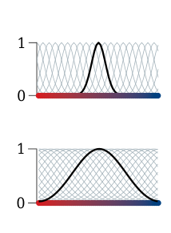
Two Ways to Describe a Neural Code
Tuning curve: one neuron's average firing rate as a function of a stimulus property (e.g., V1 neurons tuned to edge orientation). Right: one narrowly and one widely tuned neuron (black) among many others (grey).
Representational geometry: treat the whole population's response to each stimulus as a point, and measure the distances between all pairs of points.
These distances are stored in a representational dissimilarity matrix (RDM): rows and columns are stimuli, each cell is how different two responses are.
Goal of the paper: show mathematically how these two views relate.
Notes:
Tuning is the classic single-neuron view used in electrophysiology. Geometry is the population view, common in fMRI and large-scale recordings. It describes what a downstream reader of the whole population could decode.

Slide 3
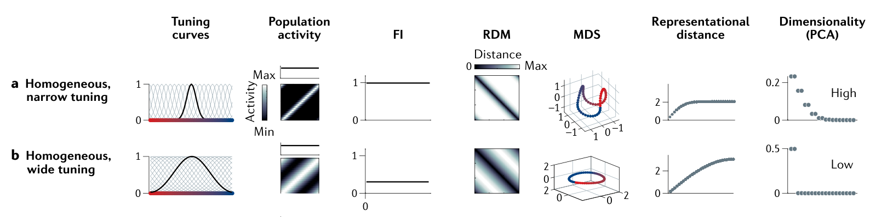
Tuning Determines Geometry (Fig. 1a-b)
Same population of orientation-tuned neurons, only the tuning width differs.
Narrow tuning: nearby orientations already look very different, then distance levels off quickly. The patterns spread across many dimensions.
Wide tuning: distance grows gradually with orientation difference. The patterns form a simple circle in 2 dimensions.
So changing the tuning changes the geometry, even though both codes cover all orientations.
Notes:
Walk across the columns: tuning curves, population activity, FI, RDM, MDS (a 3D picture of the geometry), distance vs. orientation difference, and dimensionality.

Slide 4
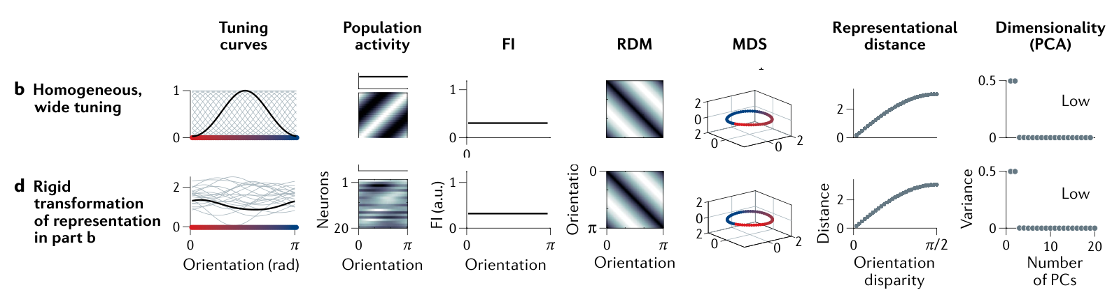
Geometry Does Not Determine Tuning (Fig. 1b vs. 1d)
Row d is row b rotated and shifted in the space of neural responses.
The tuning curves look completely different (messy, non-bell-shaped), but the RDM, the MDS picture and the distances are identical.
So many different sets of neurons can produce the same geometry.
What the geometry leaves out: whether the information is held by a few selective neurons or spread across many.
Notes:
Compare the first two columns (very different) with the RDM and MDS columns (the same). Each neuron's tuning curve is just one viewing angle on the same geometry.

Slide 5
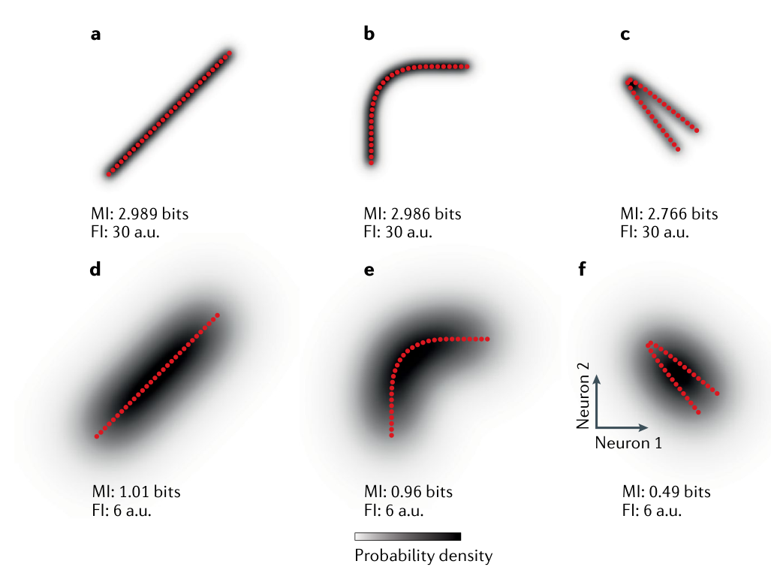
Local Sensitivity Is Not the Whole Story (Fig. 2)
Fisher information (FI) measures how well the code distinguishes very similar stimuli. Mutual information (MI) measures how much the response tells you about the stimulus overall.
Each panel: 30 stimuli (red dots) encoded by two neurons. Top row low noise, bottom row high noise.
Bending or folding the line keeps FI the same (the dots stay equally spaced), but folding lowers MI because opposite ends become confusable.
Lesson: FI only sees the local geometry; the full geometry is needed to predict what can be told apart.
Notes:
Point to panels c and f. MI drops from 1.01 to 0.49 bits at high noise, while FI stays at 6.

Slide 6
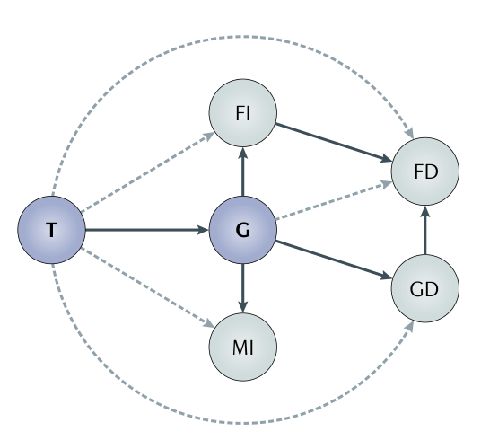
Summary of the Relationships (Fig. 3)
An arrow means "is enough to determine", assuming we know the noise.
Tuning (T) determines geometry (G).
Geometry determines FI, MI, fine discrimination (FD) and general discrimination (GD).
No arrow goes backward: knowing the geometry does not give you the tuning, and knowing FI does not give you the geometry.
Also covered in the paper: efficient coding and noise correlations (Fig. 4), which become easier to understand through geometry.
Notes:
If the audience remembers one figure, it should be this one.

Slide 7
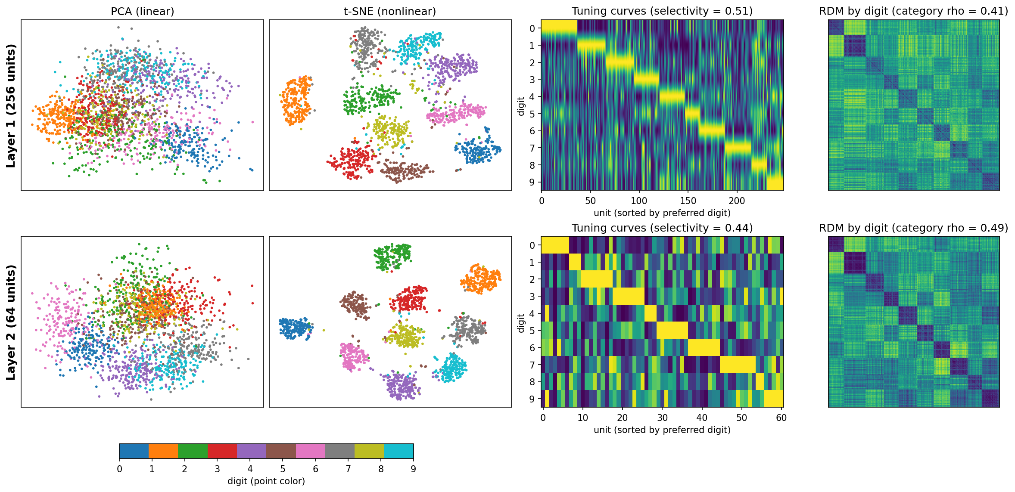
Our Analysis: Two Layers of an MNIST Network
We trained a small network (784-256-64-10, 96% test accuracy) and compared hidden layer 1 with hidden layer 2.
Compression: layer 2 needs 8 principal components to explain 90% of the variance, versus 27 in layer 1.
More digit-like geometry: the RDM matches a "same digit vs. different digit" model better (0.41 to 0.49), and t-SNE clusters are cleaner.
Less selective tuning: layer 2 units respond to several digits (selectivity 0.51 to 0.44), so digit information is spread across the population.
Notes:
Columns: PCA (linear), t-SNE (nonlinear), tuning curves per unit, and RDMs. The tuning and geometry change in different directions across layers, which is exactly the paper's point.

Slide 8
Takeaways and Discussion
Tuning describes how individual neurons encode information; geometry describes what the whole population makes available to a reader.
Tuning determines geometry, and geometry determines FI, MI and discrimination performance, but not the reverse.
Strength: one clear framework that connects single-neuron studies with population and RSA studies.
Limitation: theory and toy models only, and it assumes the noise can be made uniform, which may not hold for real neurons.
Discussion: if geometry is what matters for behaviour, why would the brain prefer one set of tuning curves over another?
Notes:
The authors suggest firing-rate limits, energy cost, ease of learning, and readout by only part of the population as possible reasons.

