Slide 1


Slide 2

introduction
our project is based on finding the cuss words within a chat data and then transfer it by encrypting it & later by reading the same through decryption.
Notes:
© Copyright PresentationGo.com – The free PowerPoint template library

Slide 3
Acknowledgement
We cannot express enough thanks to our faculty for their continued support and encouragement: Mr. Gaurav Raj, our respected faculty at JUA. We offer our sincere appreciation for the learning opportunities provided by him.

Slide 4
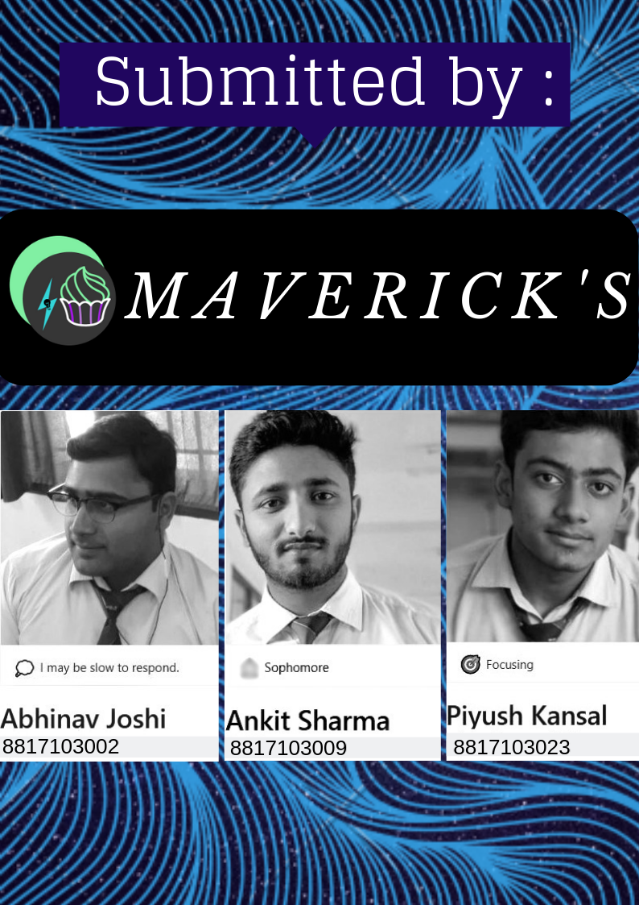

Slide 5


Slide 6
Tools and techniques used
1. Language - JAVA
2. IDE - Eclipse
3. JAR files

Slide 7
Used Algorithms
1. Searching (from JAVA Collections & KMP Algorithm)
2. Sorting (from JAVA Collections)
3. Dijkstra’s Algorithm
4. Min heap build up( for min. sum of two number formed from elements of array)
5. JAVA AES (Advanced Encryption Std.)
6. Most occurred longest substring (DP)
7. Reversal of String (Divide & Conquer)
8. Generation of random alpha-numeric string

Slide 8
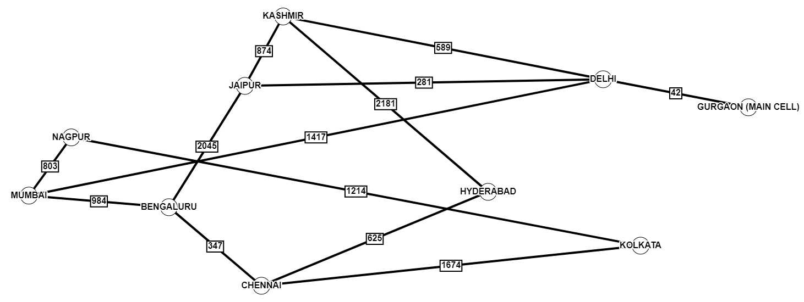
Undirected Graph for Dijkstra's Algorithm

Slide 9

Working of the OPTION 1
Sort HashMap (value)
***Descending order
Load
Chat
File
Searching
Sorting
Fetching
Start
Search for the phone no’s
Get the top no.
After that make up HashMap take no’s as key
* Element stored at first position in the HashMap(key)
Tracking System
Get path & distance
Using Dijkstra’s algo
As GURGAON is assumed to be source location and location obtained from tracker is destination
Generate a file containing shortest path and distances between all cities
Fetching
Generate map
Get Location
Storing
the output
Using the dummy tracker
**Generating random location, MIN-HEAP, random()
Using modification of AES
Save the encrypted data
Encrypt the stored output by using modification of AES by adding reversal
Phone number as well as the shortest distance and path encrypted then saved to a txt file
Save it to text file
E-mail
E-MAIL
SENT
Encryption
End
Maverick’s
Using JAVA SMTP
Attach the text file to the mail and send it with subject MAVERICK’S

Slide 10
Working of OPTION 2
Save it to a string variable
Using AES decryption
First line is encrypted with AES only and it is ended with ‘::’
Save it to a string variable
Start
Load The File
Get 1st line
Decrypt it
Get 2nd line
Using AES decryption
Store it in the same string
Decrypt it
Reverse the encrypted part
Get the encrypted part
Print the strings
Using recursive approach
Using DP approach
Save it to same string variable
Search for the longest subsequence
End
Maverick’s

Slide 11
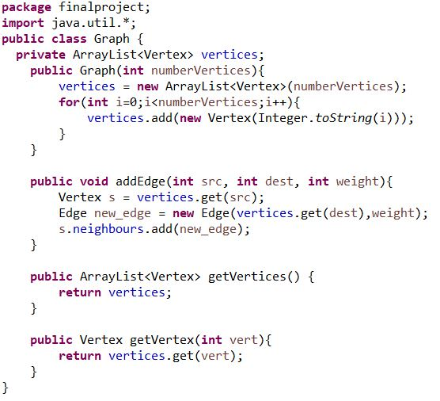
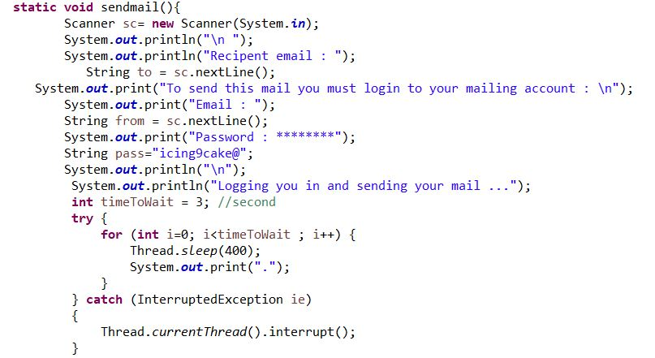
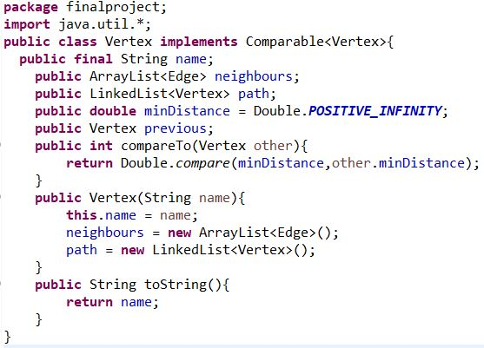
Code snippets

Slide 12
Applications and future expectations
Easier way to observe the wrong transfer of messages
Further this project might be connected to a chat messenger.
Modification of AES (Advanced Encryption Standard) boosts up the encryption level
Sending the information from one node to another node via a email can be further done on any messengers.
Surveillance of rumours or fake news.

Slide 13
Credits
These awesome resources helped us a lot while this project was in making :
Introduction to Algorithms (By : Cormen)
StackOverflow (Some high rated and working answers)

Slide 14

Gain from GitHub
Version control system i.e. Git helped us a lot while making this project. Our group used web-based hosting such as GitHub for checking the old mistakes and later correction for fixing up in the code there by one of the member. It played a vital role as we need to do undo-redo or transfer of code to one another PC.
Our group members GitHub profile links are given below:
Abhinav Joshi - www.github.com/AJAbhinav
Ankit Sharma - www.github.com/8nkit
Piyush Kansal - www.github.com/PiyushKansal279

Slide 15
Thanks!
Maverick’s

