Slide 1
Part 1: Optical Imaging
  Generation of light
  Plane wave propagation: geometrical optics
  Optical Imaging modalities
    Low scattering (microscopy, OPT, SPIM)
    High scattering (DOT,FMT)
Part 2: Innovation
  6 teams
  Work on Canvas
  Work on SWOT matrix (Strengths, Weaknesses, Opportunities, Threats)
  Elevator Pitch
Part 3: Neuroimaging
  Functional MRI
  Functional Diffuse Optical Tomography
Part 4: Biomedical analysis technologies
  Elisa
  FACS
Part 5: Biomedical Optics
Part 6: Imaging Trivial
Part 7: Presentation of Innovation Teams
Jorge.ripoll@uc3m.es

Slide 2
Neuroimaging
Functional MRI, DTI, MEG, EEG

Slide 3
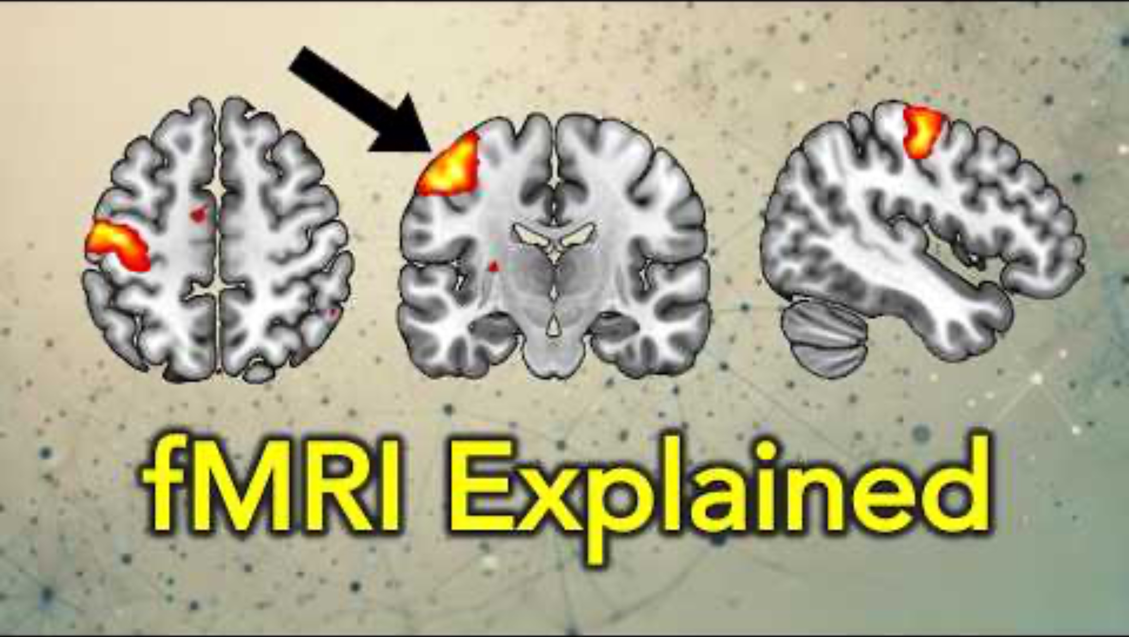

Slide 4
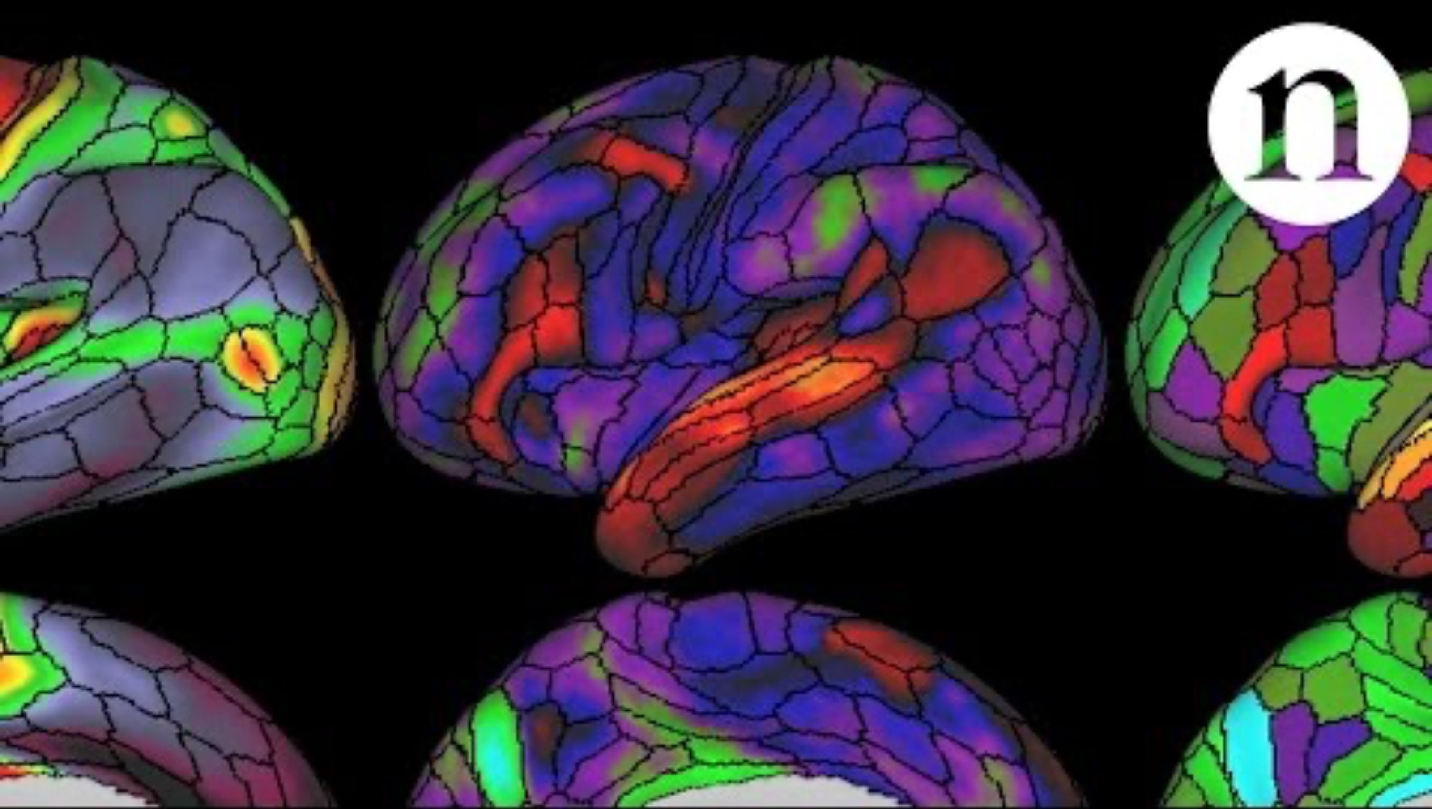

Slide 5
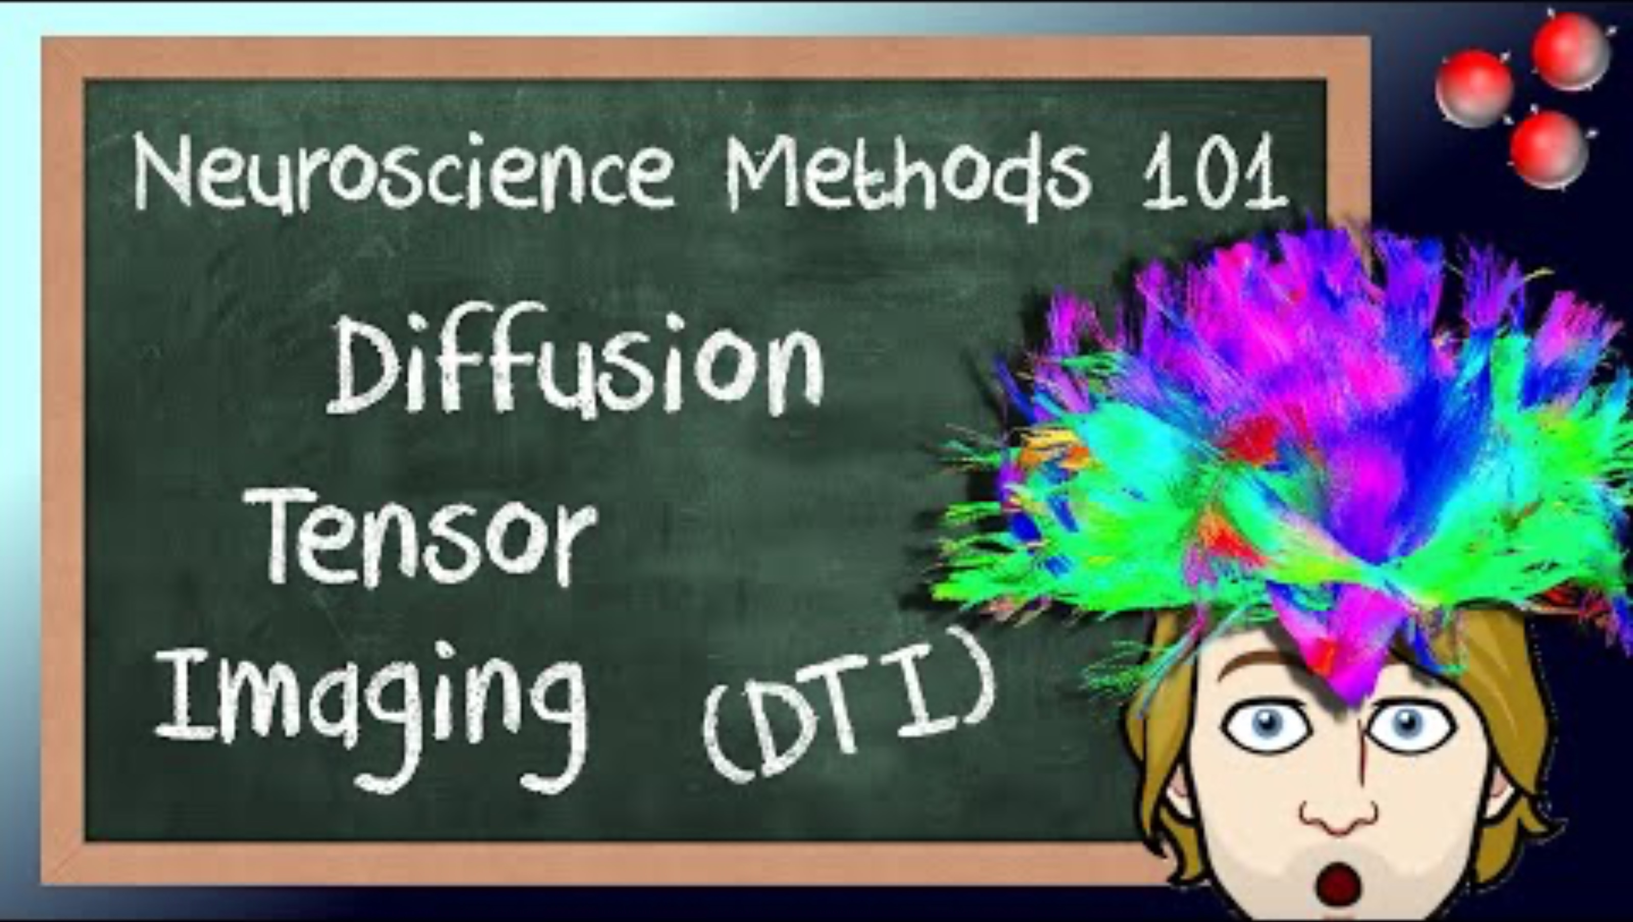

Slide 6
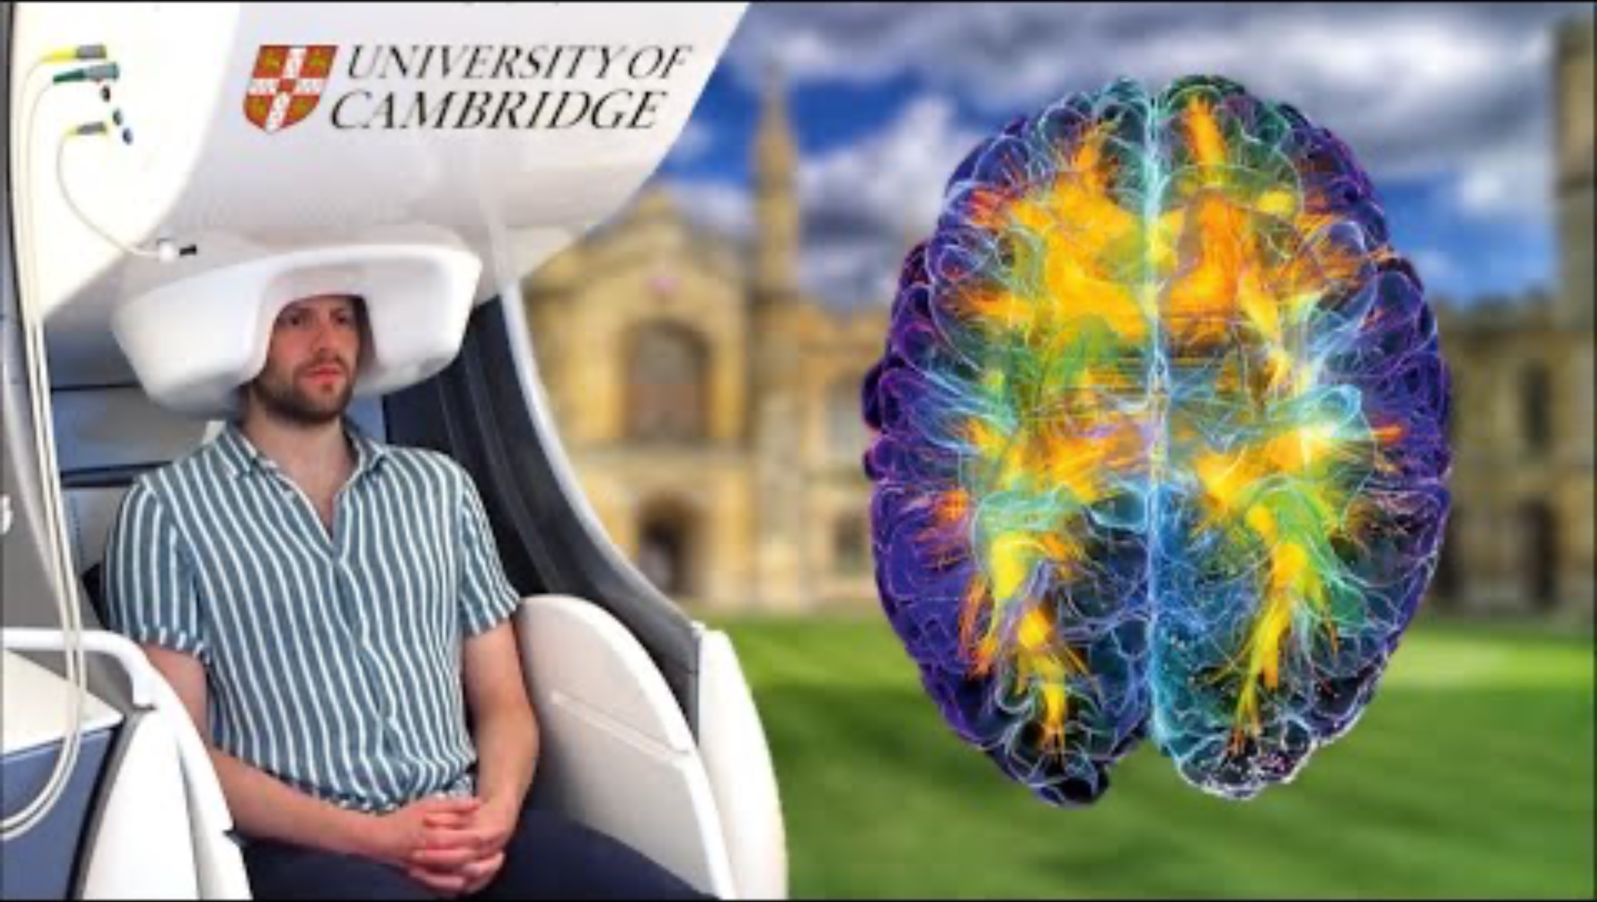

Slide 7
Optical Methods
Functional Diffuse Optical Tomography (fDOT)

Slide 8
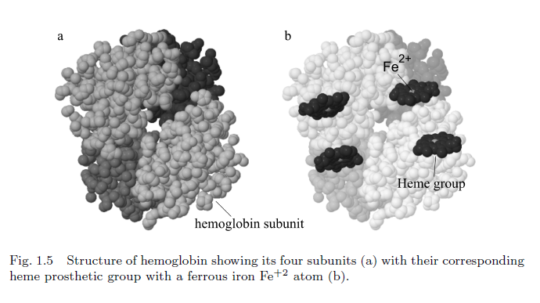
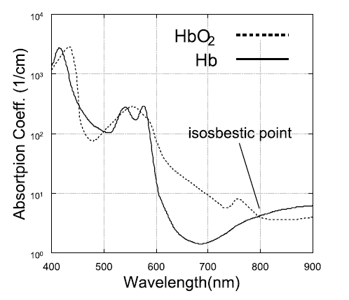

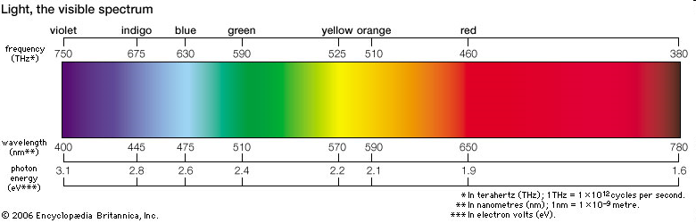
Blood Absorption

Slide 9
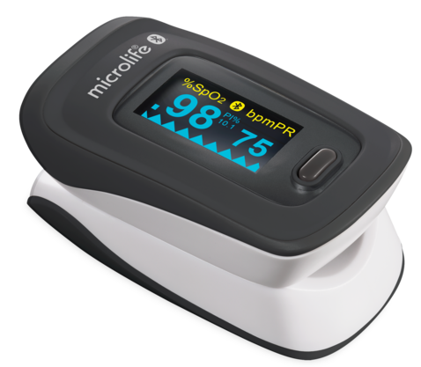
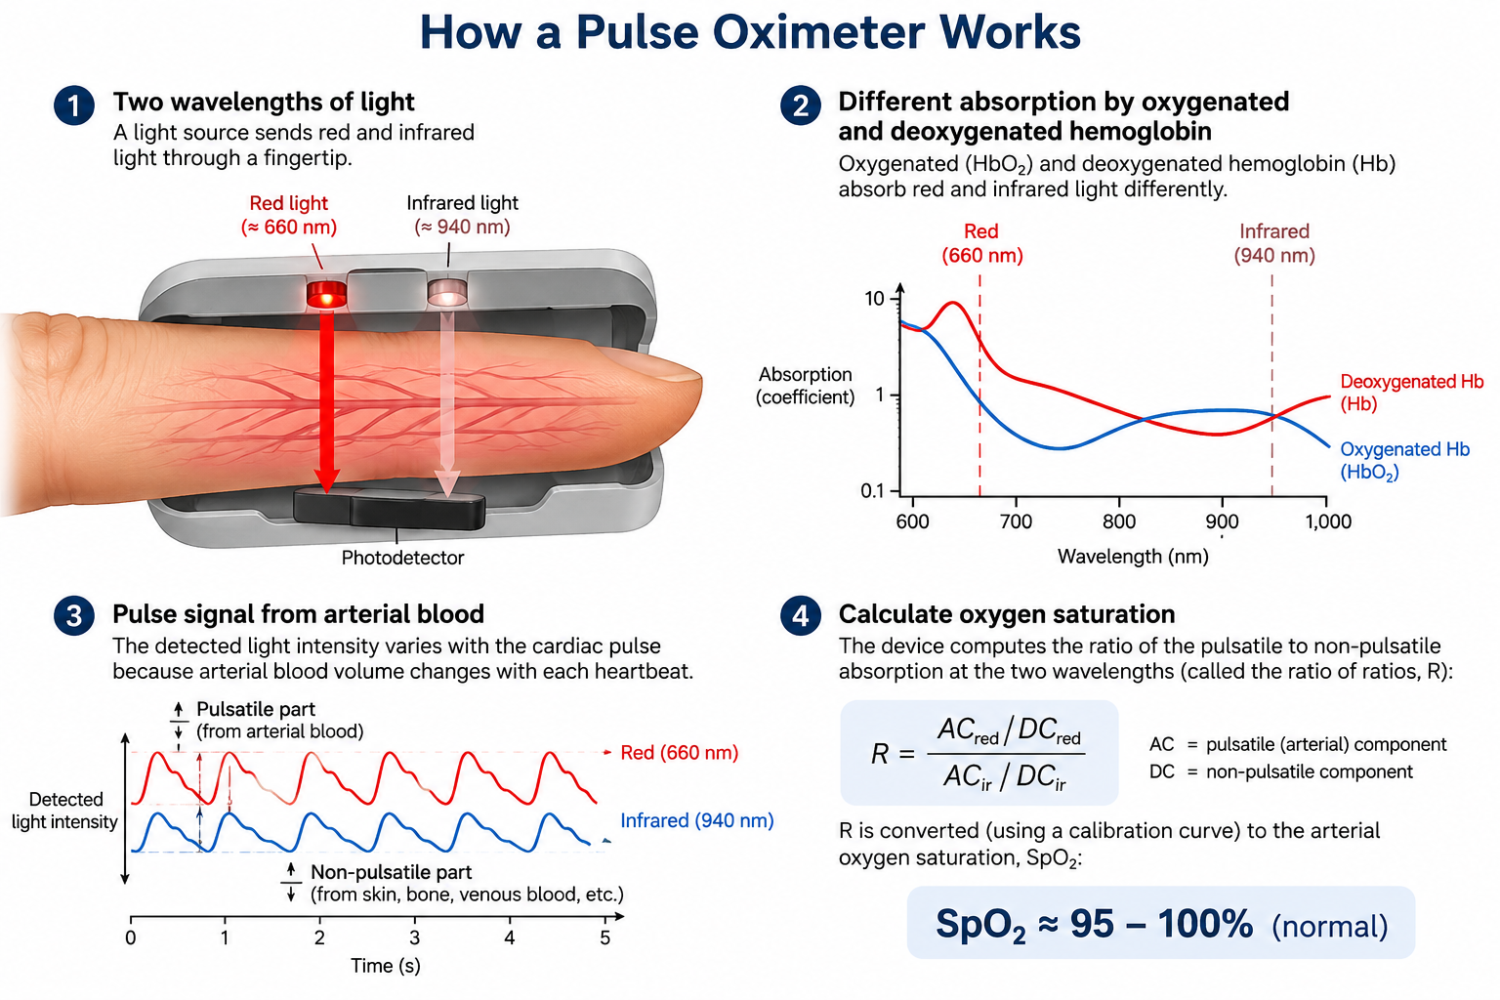

Slide 10
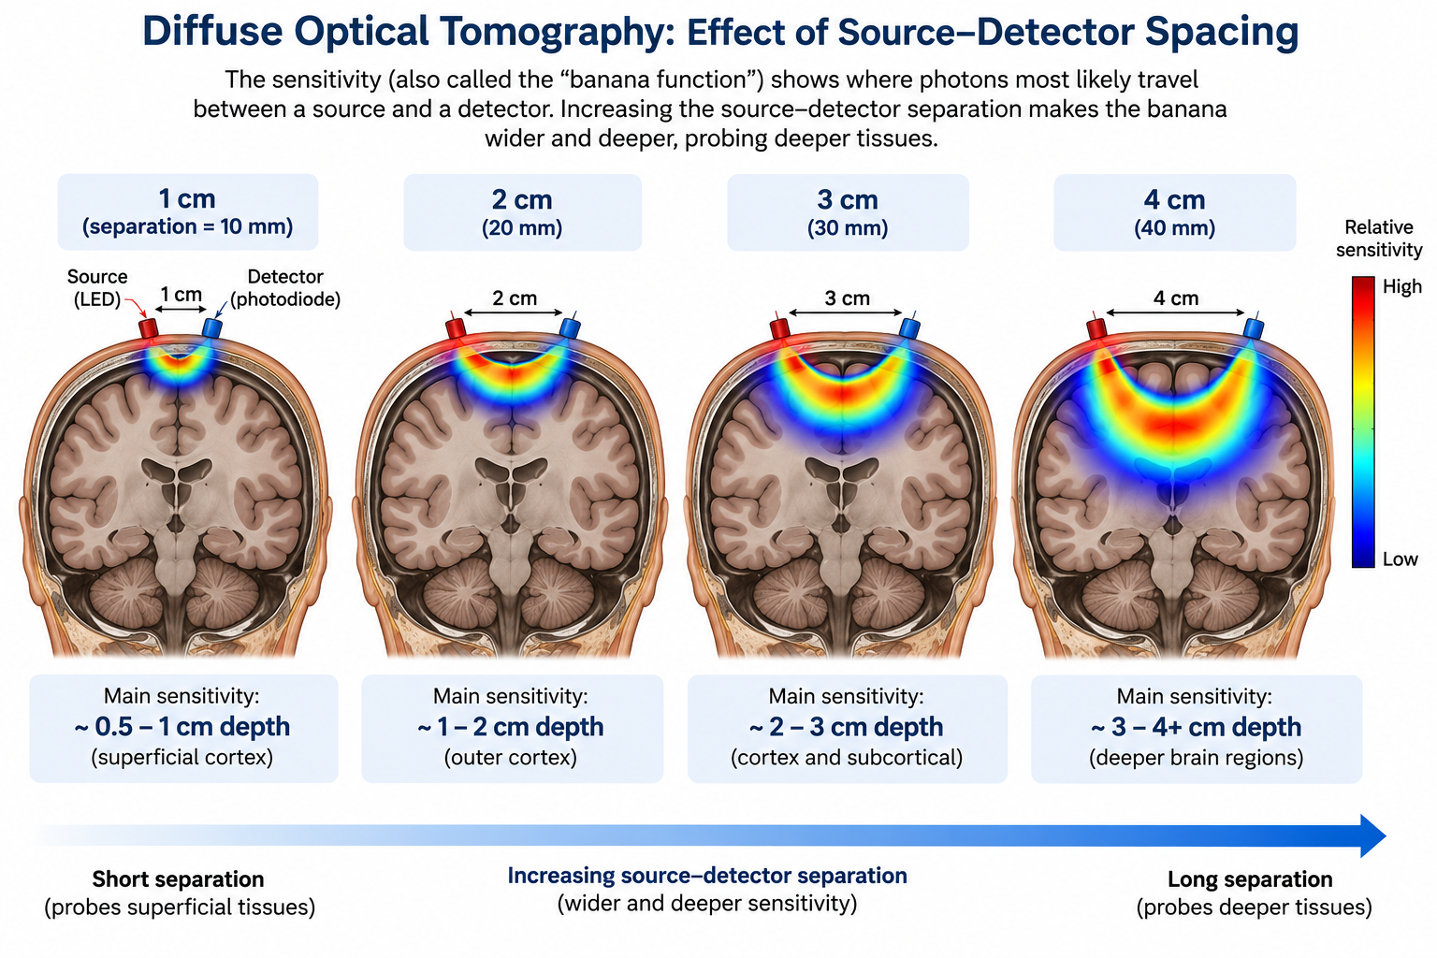

Slide 11
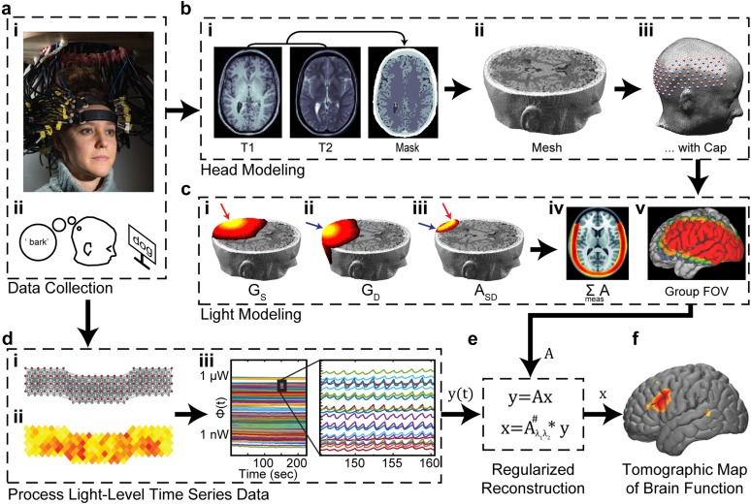
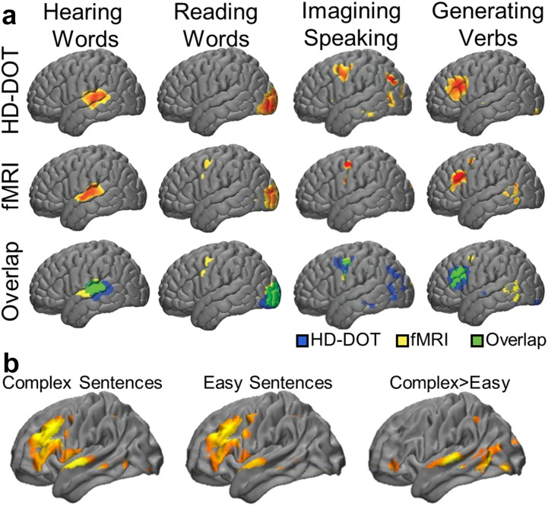
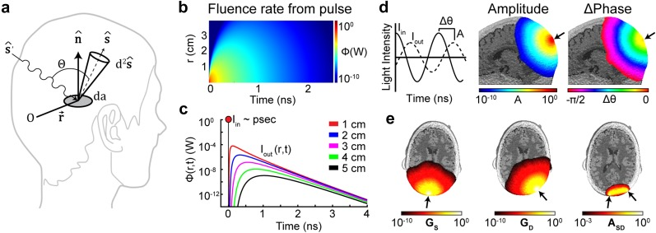
Functional Diffuse Optical Tomography

Slide 12
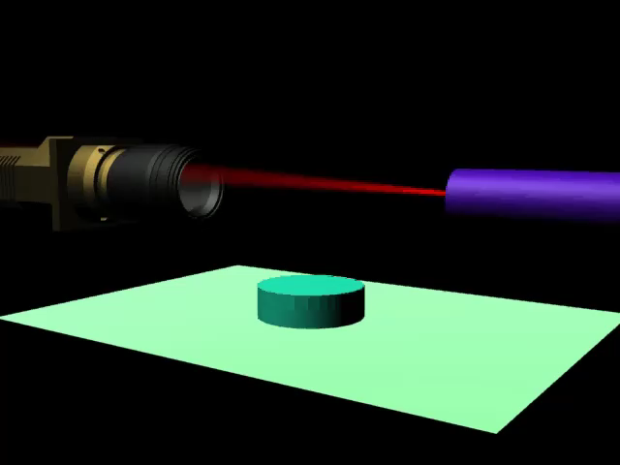
Non-Contact FMT

Slide 13
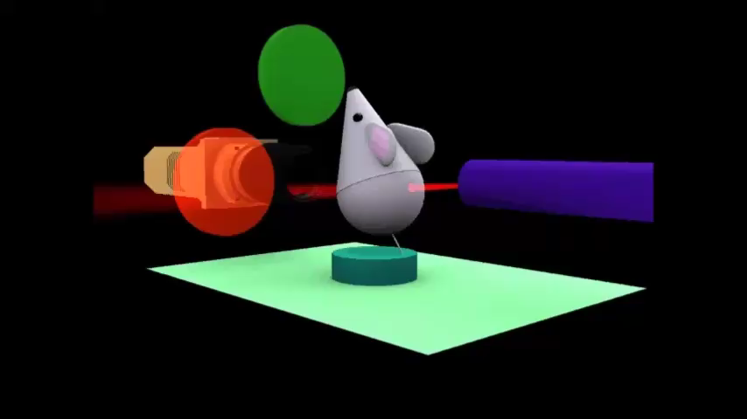
Wavelength Selection

Slide 14
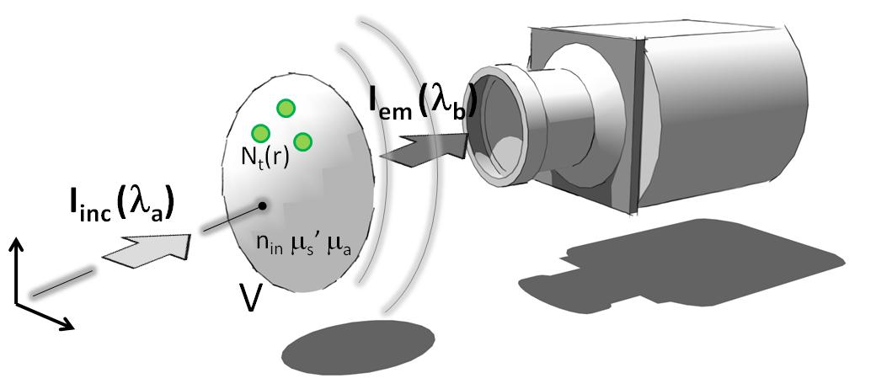
DOT Principles
DOT recovers Hb and HbO Concentration
Inverse Problem: Using the measurements as a starting point, what distribution of absorbers (mainly blood) caused them?

Slide 15
DOT vs Single Image
Single Image
Absorber (vessel)
Tissue

Slide 16
Principles of Tomography
Diffuse Optical Tomography
Absorber (vessel)
Tissue
source

Slide 17
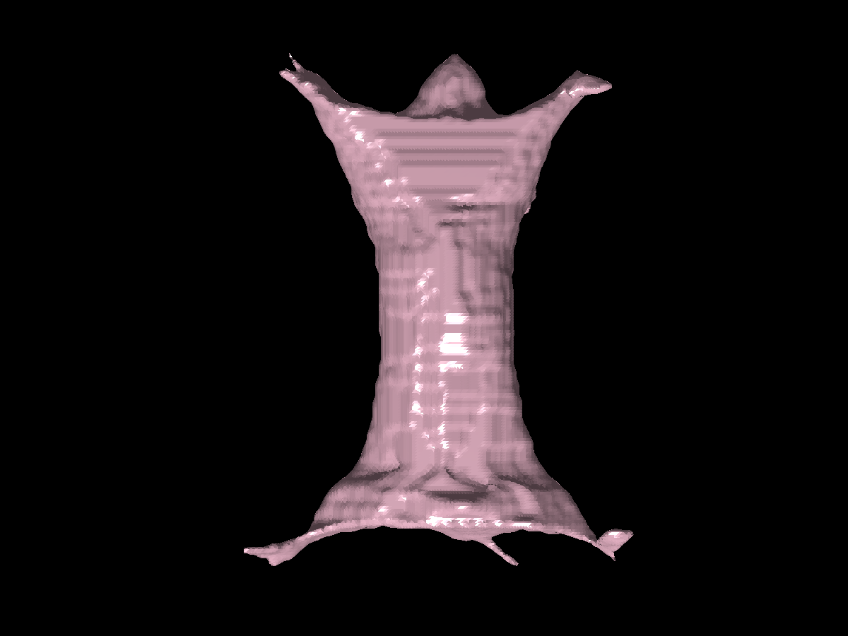
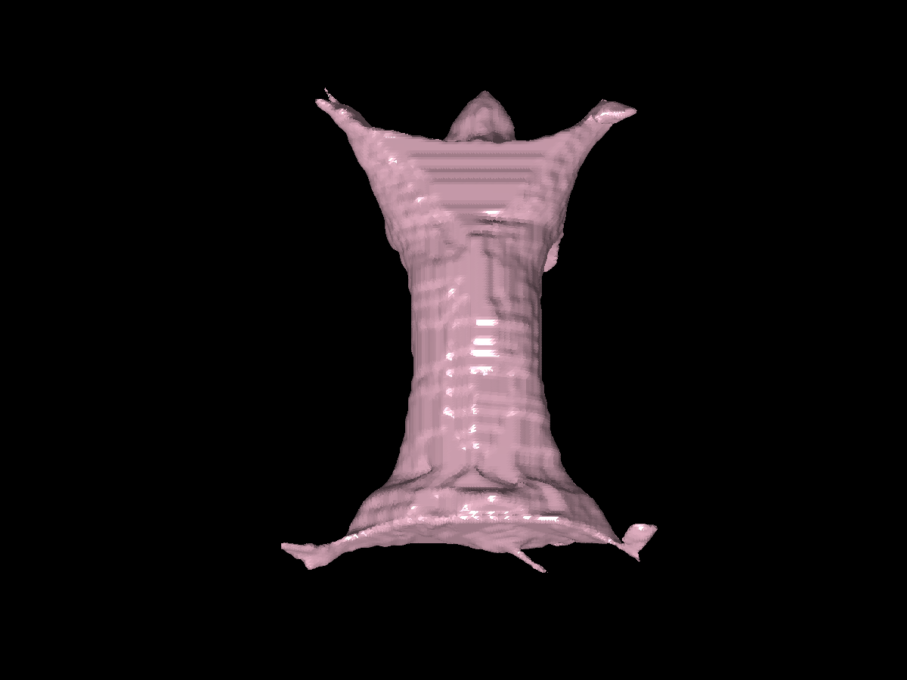
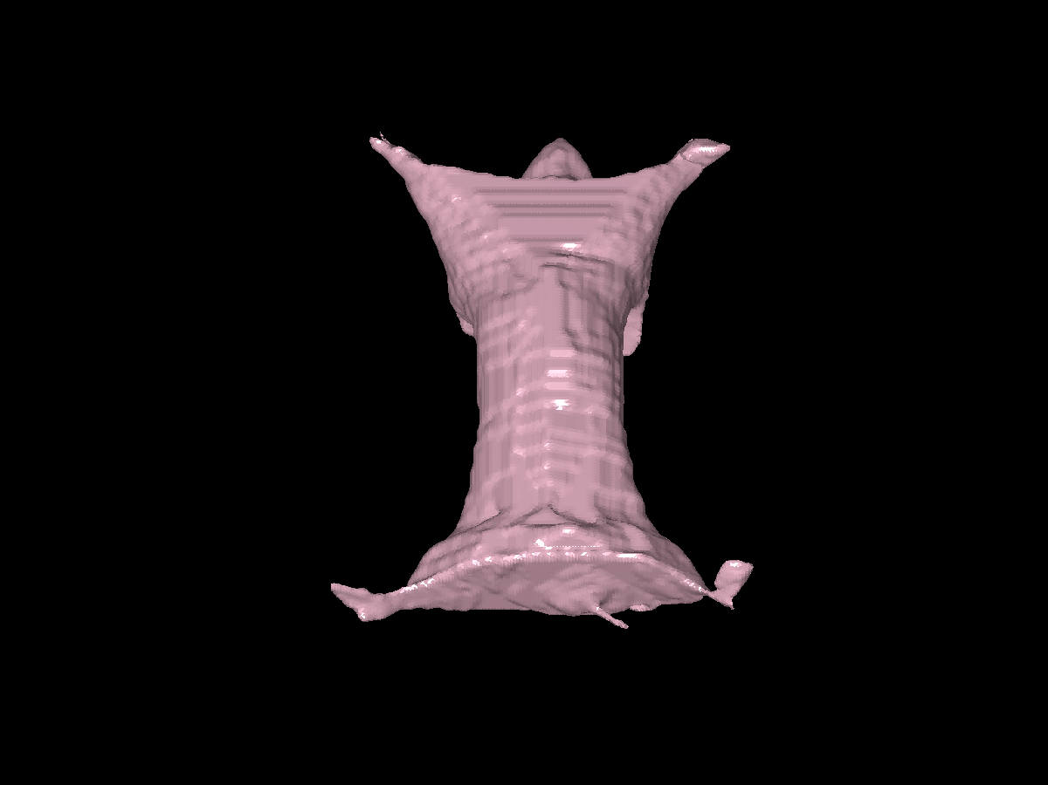
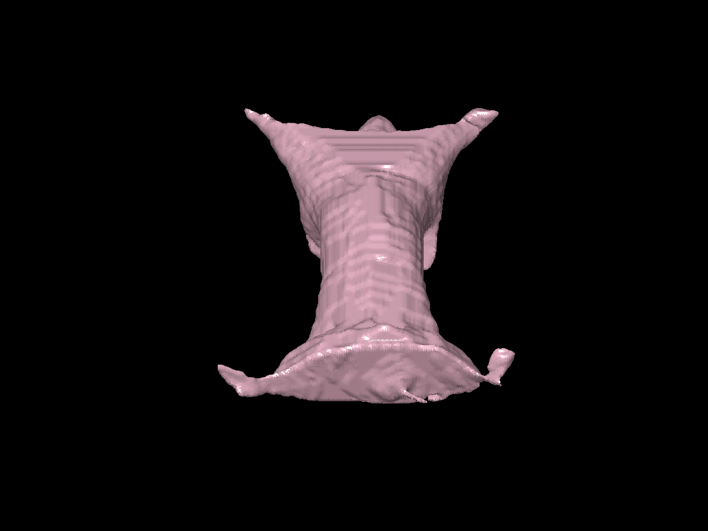
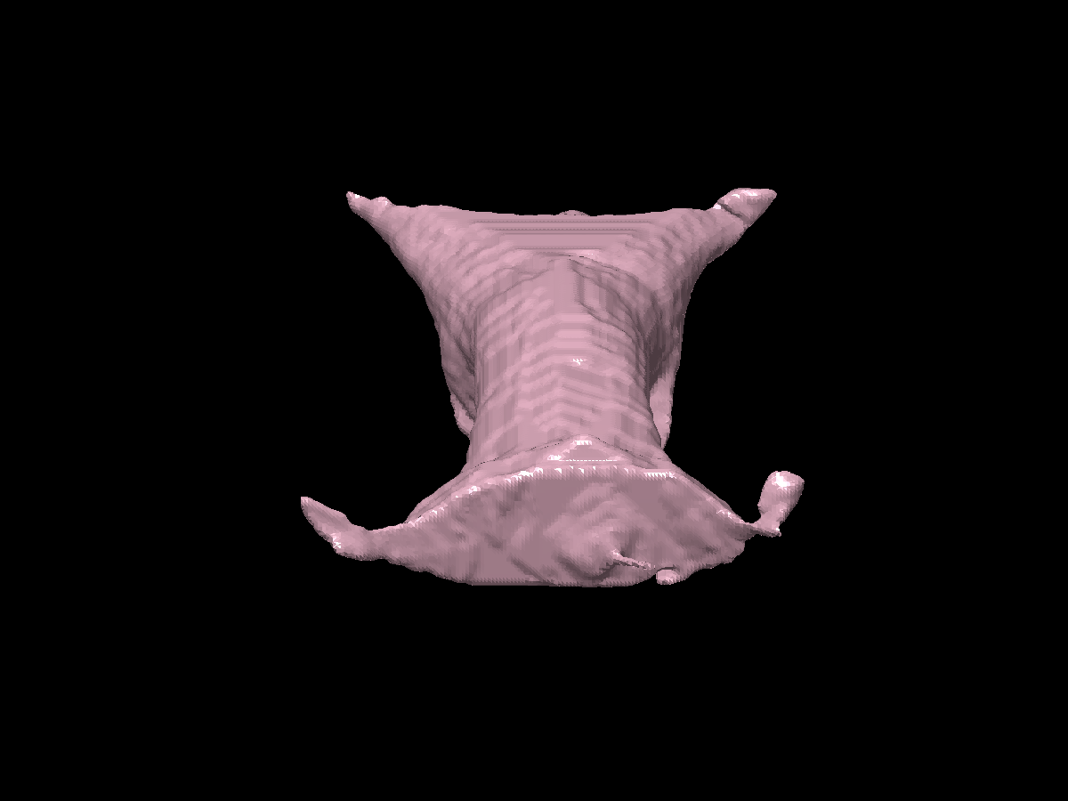
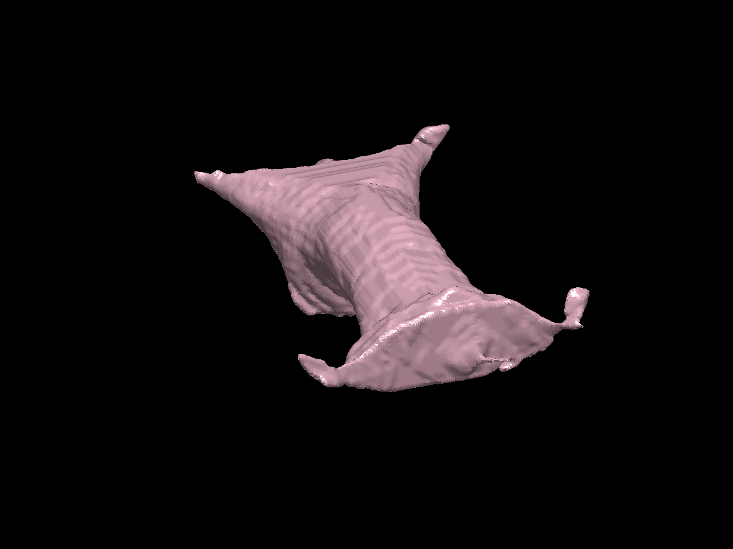
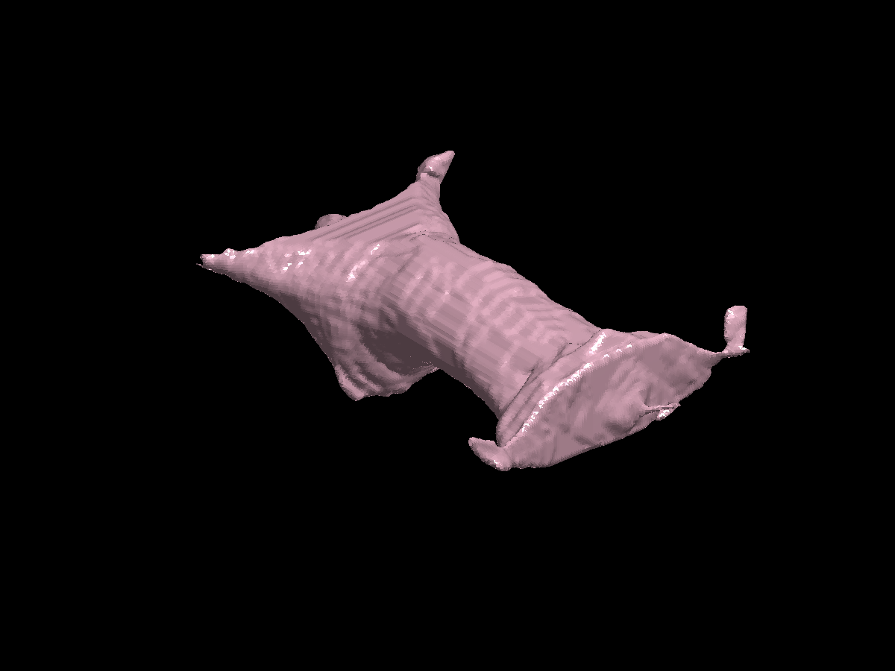
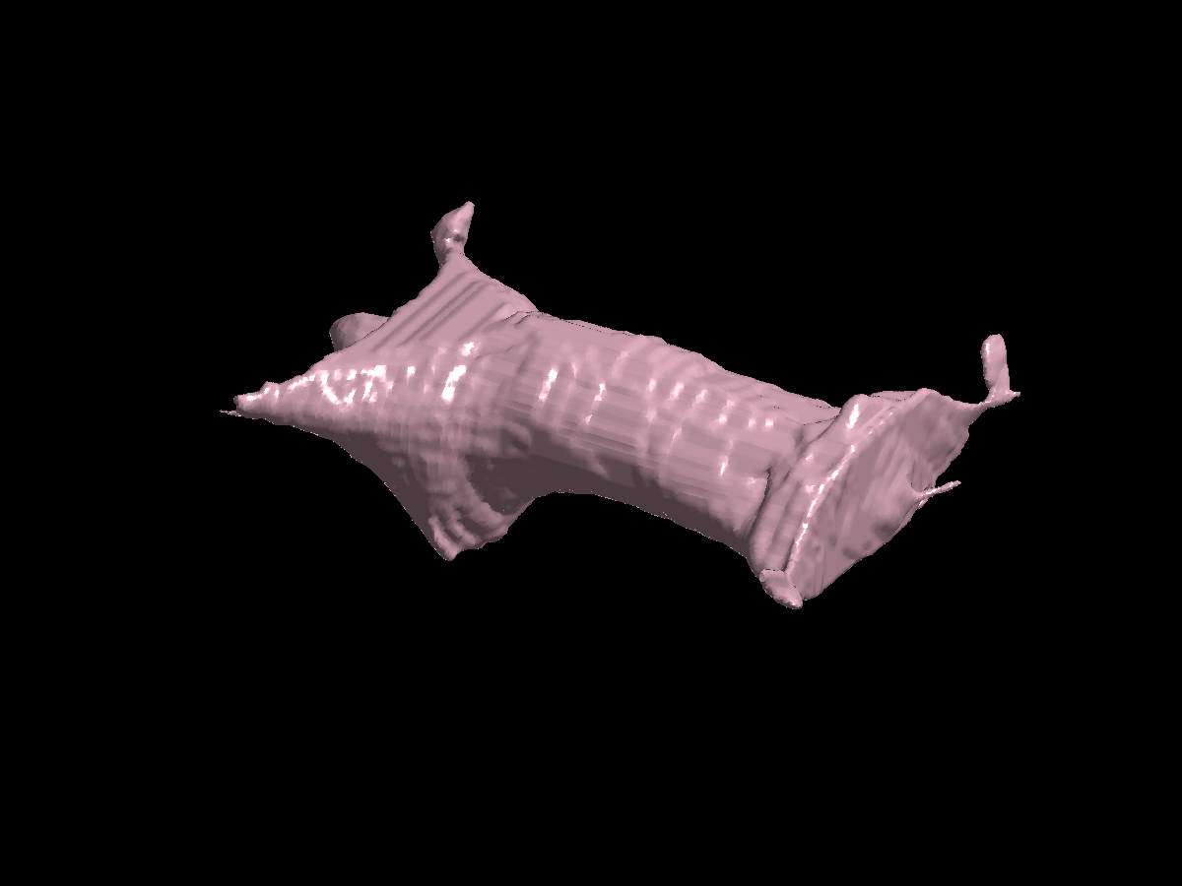
Forward Problem

Slide 18
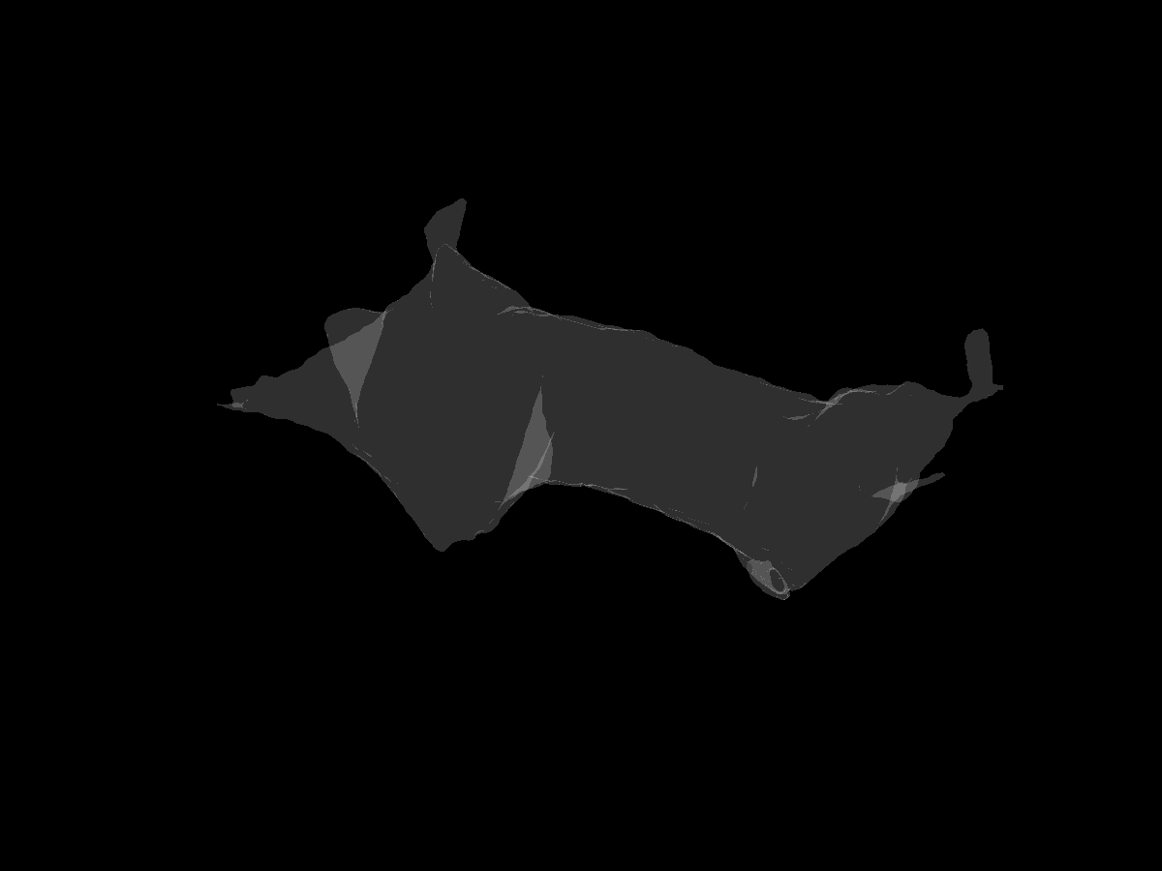
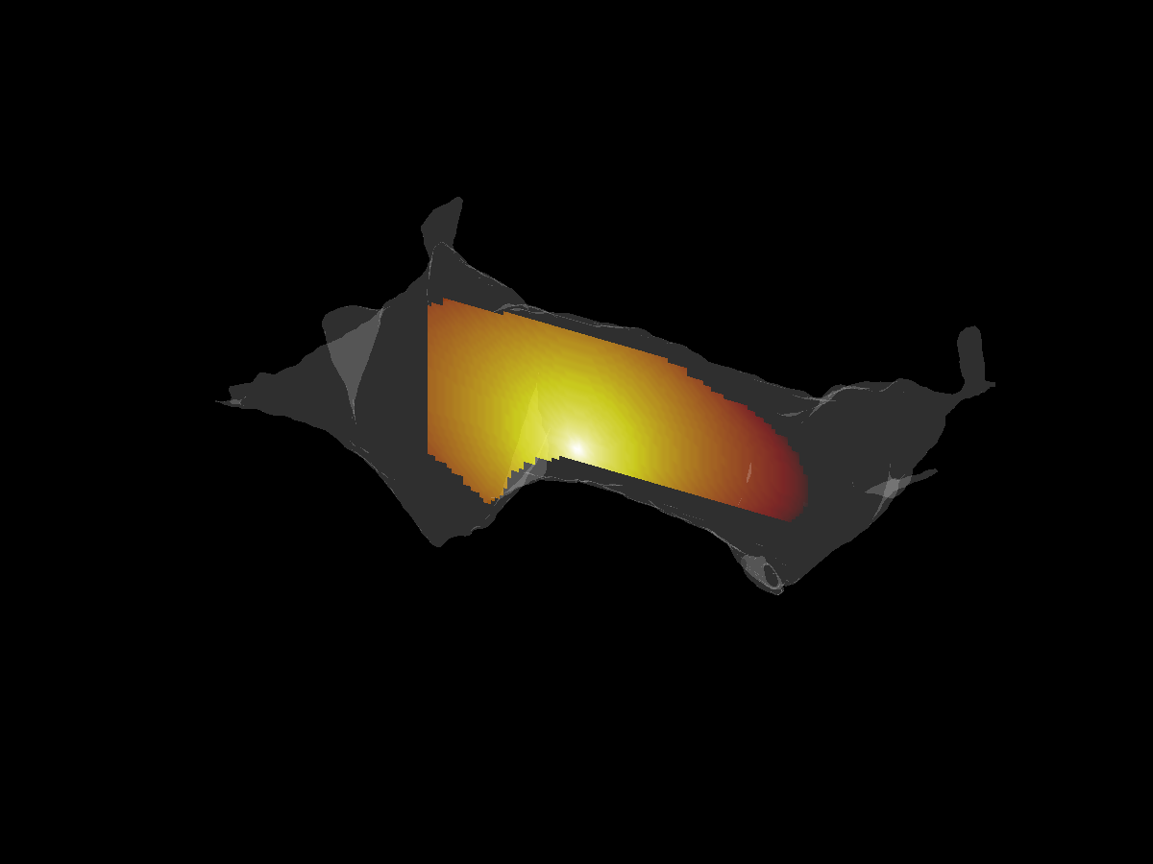
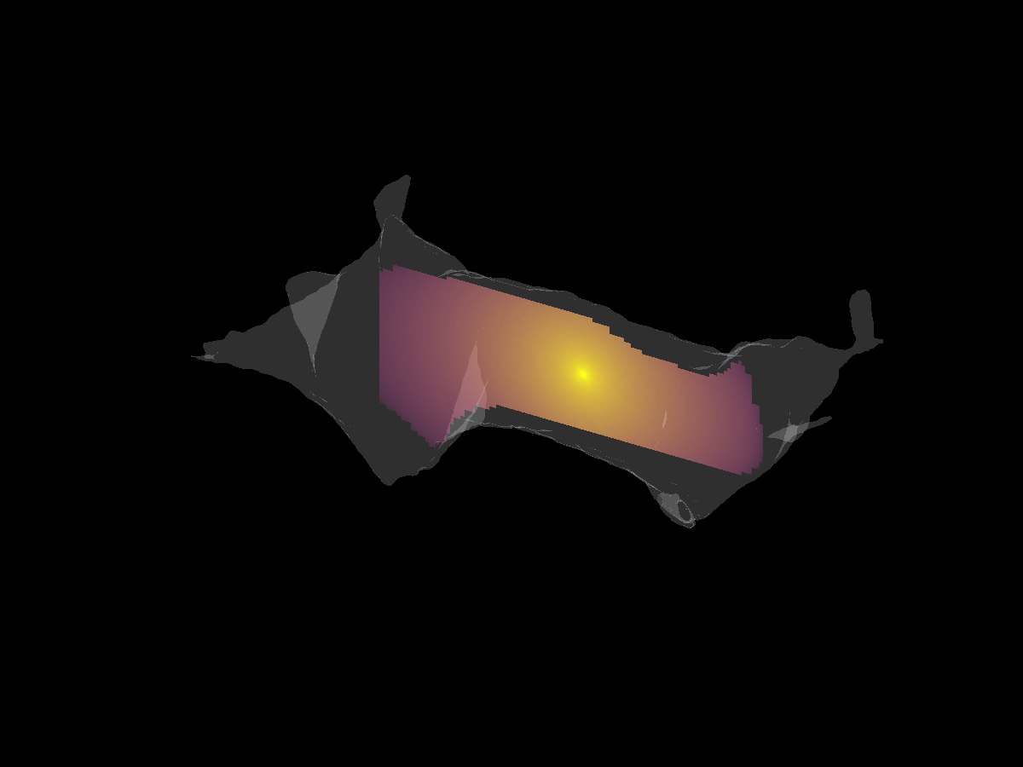
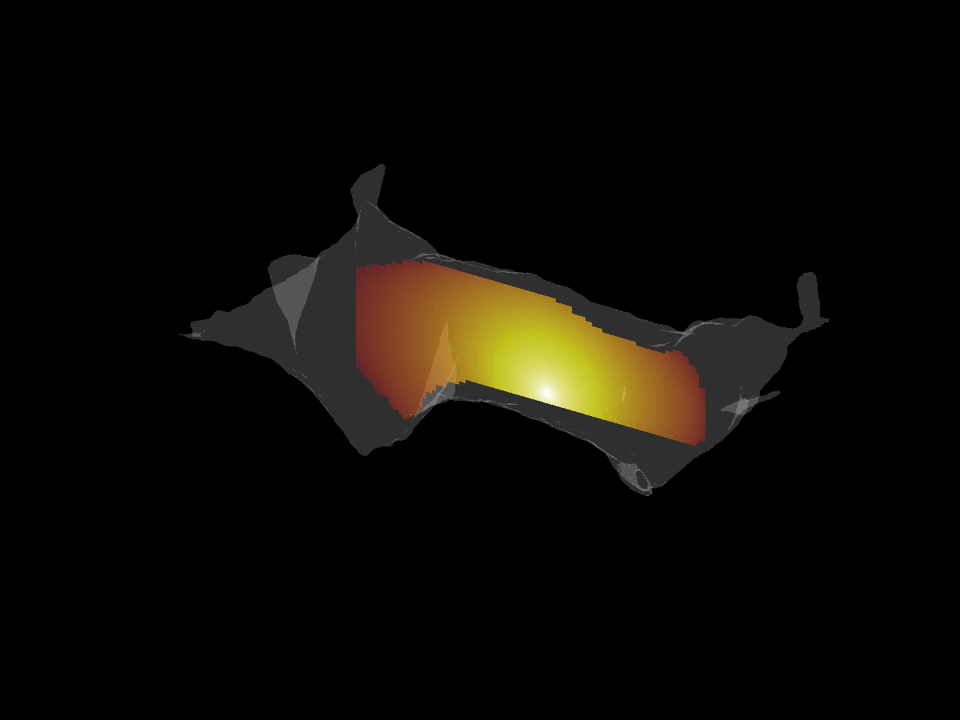
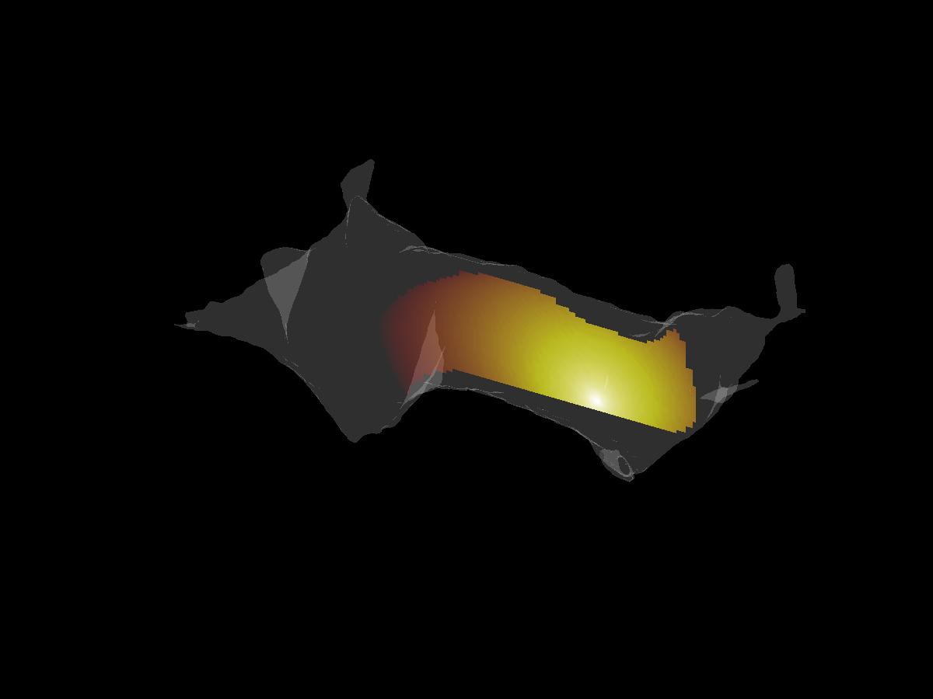
Forward Problem

Slide 19
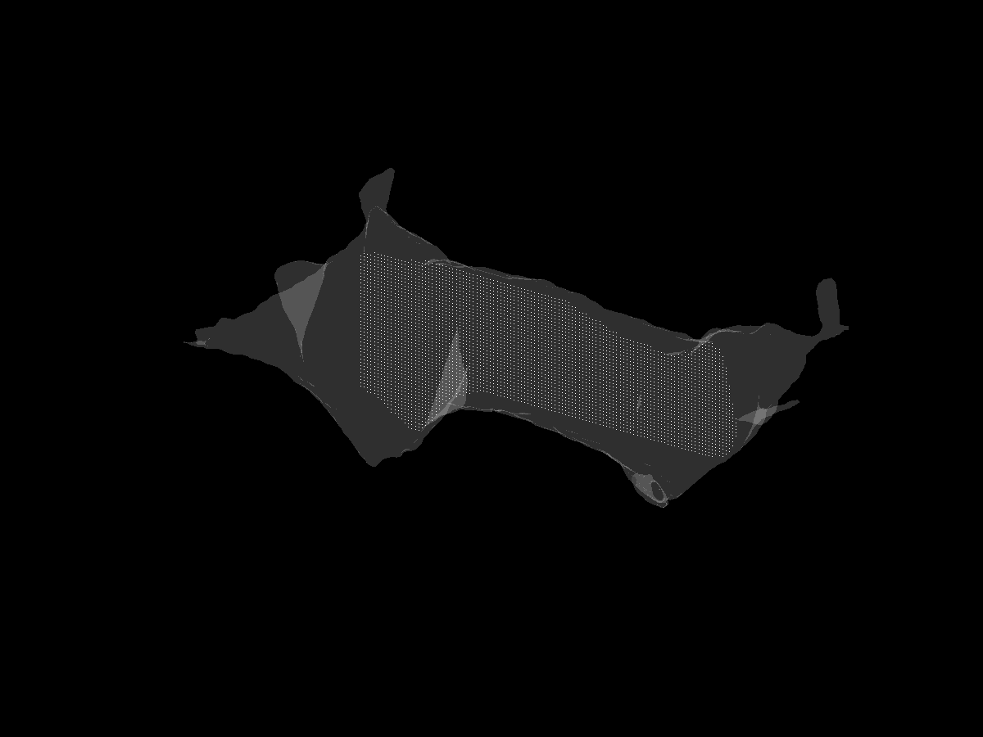
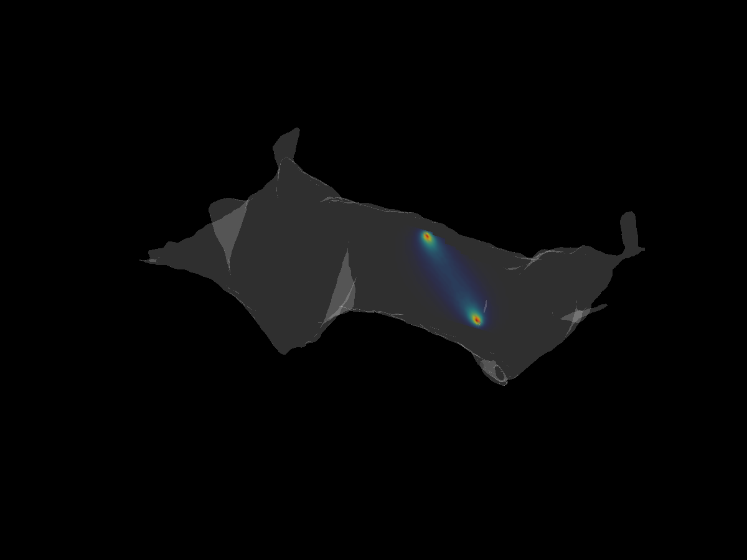
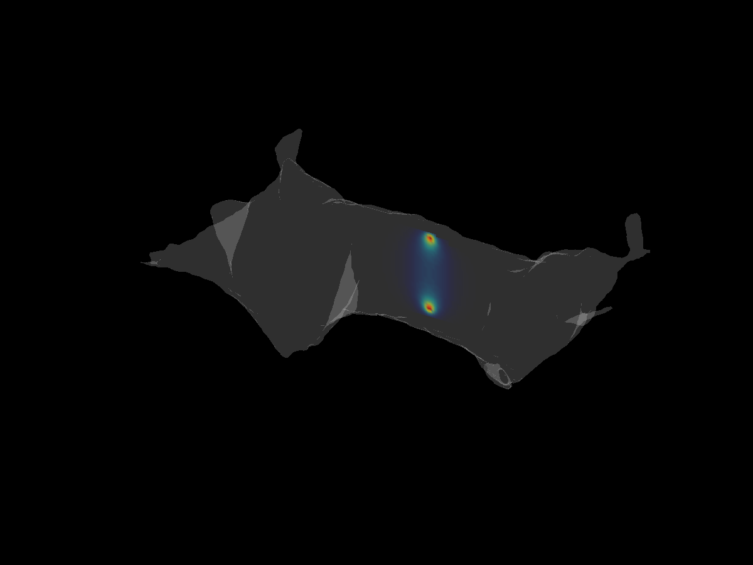

Inverse Problem
Detector
Weight Matrix
Mesh
The Weight Matrix Represents the contribution
of a certain voxel to the measured signal

Slide 20
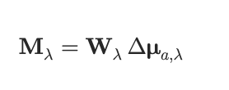
Forward Problem
3D Absorption Map
Weight Matrix
Wavelength-dep
Measurements

Slide 21

Inverse Problem
Wavelength-dep
Measurements
Inverted Weight Matrix
3D Absorption Map
Ill-Posed Problem
Iterative Methods, SVD

Slide 22
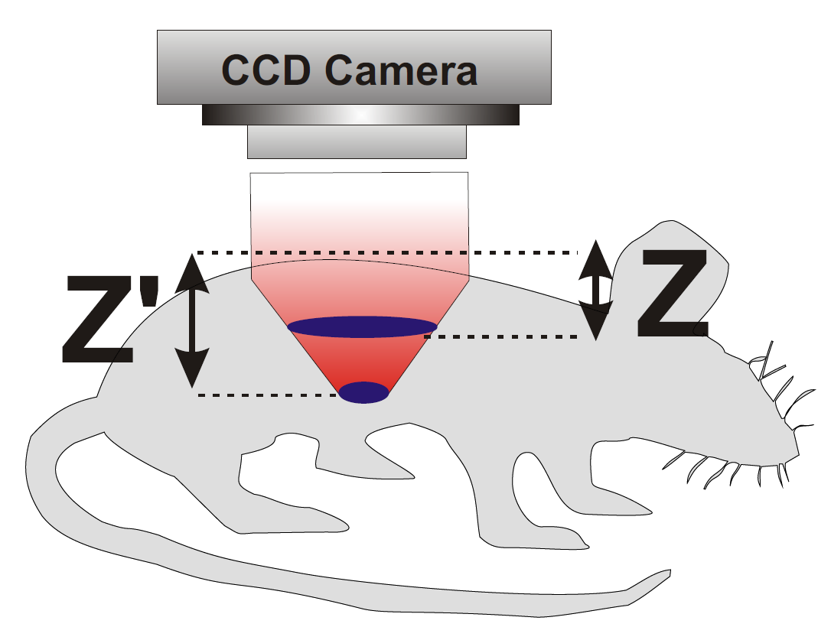
Relationship with Measurements

Slide 23
