Slide 1


Fake Job Posting Detection Model
Group # 2
Team: Michael Uzoma, Nafis Ahmed, Sammar Abbas, Yajing Zhou

Slide 2
Introduction :M | Page: 01
The internet has made job search easier and more convenient than ever before, but it has also created new opportunities for scammers and fraudsters to exploit unsuspecting job seekers.
Detecting fake job postings can be challenging due to the large volume of job listings online and the sophisticated tactics used by scammers.
This project aims to develop a machine learning model for fake job posting detection using a publicly available dataset and a variety of data preprocessing and modeling techniques.
By detecting fake job postings, this project can contribute to the prevention of online fraud and the protection of job seekers' personal and financial information.

Slide 3
Methodology :M | Page: 02
The methodology for this project consists of several key steps:
Problem identification,
Data collection,
Data preprocessing,
Feature engineering,
Model selection,
Model training and evaluation,

Slide 4
Data Collection & Business Problem :M | Page: 03
The dataset used for this project is a publicly available, from Kaggle called "Real or Fake Job Posting Prediction", which contains information about job postings.
Link: https://www.kaggle.com/datasets/shivamb/real-or-fake-fake-jobposting-prediction
Total Features: 18, and Rows: 17,880.
Business Problem to solve: "The problem is to develop a machine learning model that can accurately predict whether a job posting is real or fake, in order to help prevent job seekers from being targeted by fraudulent job postings."

Slide 5

Data Insight :S | Page: 04
Ref: https://www.convert.com/wp-content/uploads/2021/02/How-to-Turn-Mounds-of-Data-into-Usable-Meaningful-Insights-2021-Guide-.jpg
Notes:
Ref: https://www.convert.com/wp-content/uploads/2021/02/How-to-Turn-Mounds-of-Data-into-Usable-Meaningful-Insights-2021-Guide-.jpg

Slide 6
Data Description :S | Page: 05
Column Name | Description
job_id | unique job ID
title | the title of the job ad entry
location | geographical location of the job ad
department | corporate department
salary_range | indicative salary range
company_profile | a brief company description
description: | the details description of the ad
requirements | enlisted requirements for the job opening
benefits | enlisted offered benefits by the employer
telecommuting | true for telecommuting positions
has_company_logo | true if company logo is present
has_questions | true if screening questions are present
employment_type | full-type, part-time,contract,etc
required_experience | executive,entry level,intern,etc
required_education | doctorate, master’s degree, bachelor,etc
industry | automotive, IT, health care, real estate, etc
function | consulting, engineering, research, sales, etc
fraudulent | 0 - real 1 - fake
Target variable: fraudulent
Real Postings = 0
Fake Postings = 1
Total entries: 17880

Slide 7
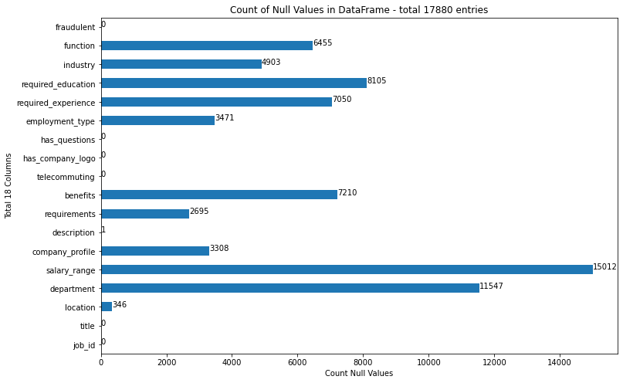
Missing Values :S | Page: 06

Slide 8
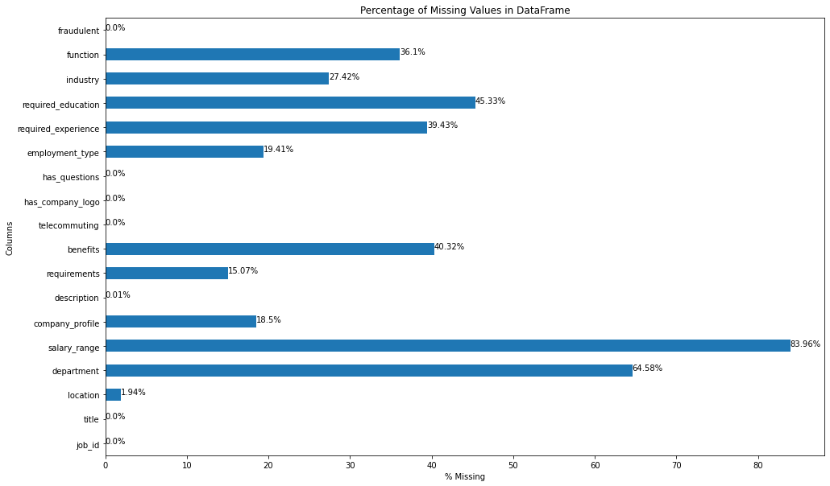
Missing Values :S | Page: 07

Slide 9

Missing/ Add New Values Strategy :S | Page: 08
Create three new features: Country, State, City from location.
Extract values for function from title.
Add new column has_company_profile from company_profile.
Extract Salary range from description.
Drop unnecessary columns:
Job_id
Company_profile
Department
location
https://www.sas.com/en_ca/insights/articles/data-management/8-ways-an-enterprise-data-strategy-enables-big-data-analytics/_jcr_content/par02/image_2db7.img.jpg/1457718602393.jpg

Slide 10
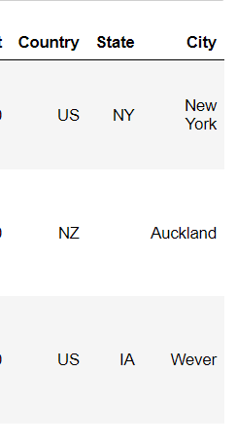
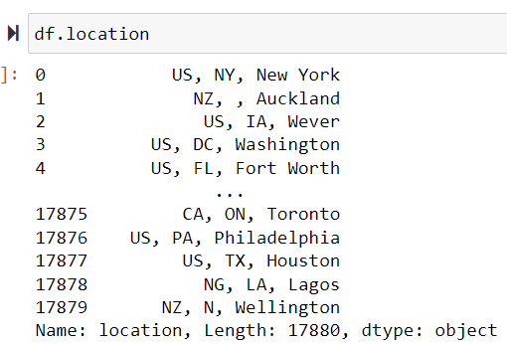
Column: location :S | Page: 09
Field ‘location’ Three new fields

Slide 11
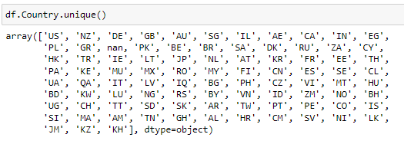
Column: Country :S | Page: 10

Slide 12
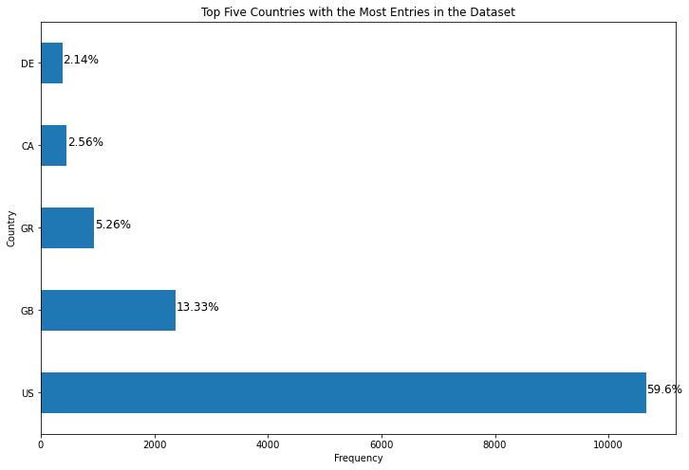
Column: Country :S | Page: 11

Slide 13
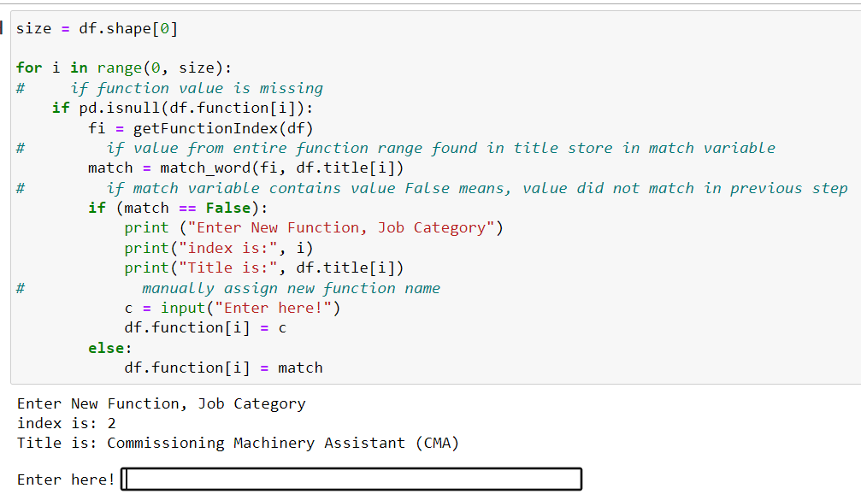

Column: function :S | Page: 12
Extract functions from job title
Define functions manually

Slide 14
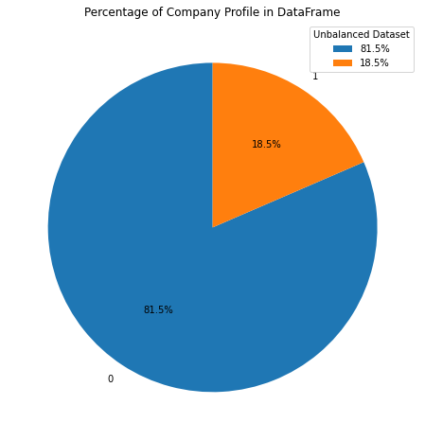
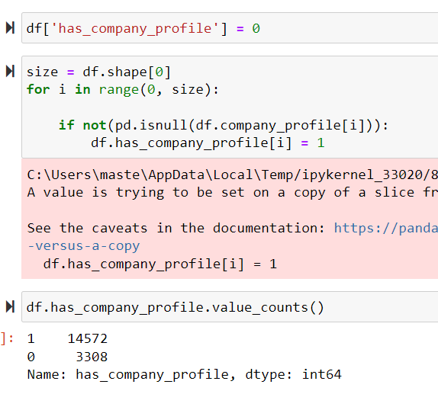
Column: company_profile :S | Page: 13
Created New field if has/has not profile

Slide 15
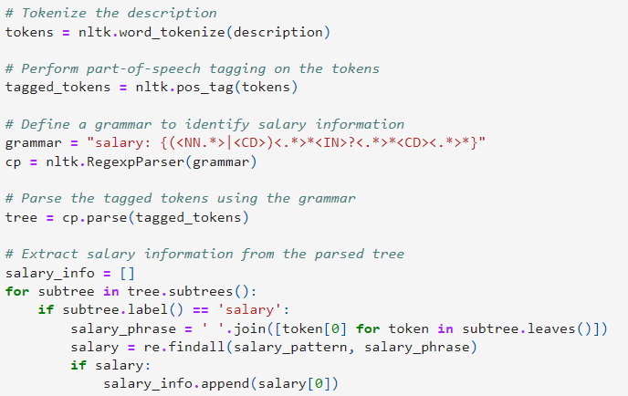
Extract Salary Range from Description :S | Page: 14
Ref: https://github.com/8sagh8/Capstone-Project/blob/main/Capstone_Project_v08.ipynb

Slide 16
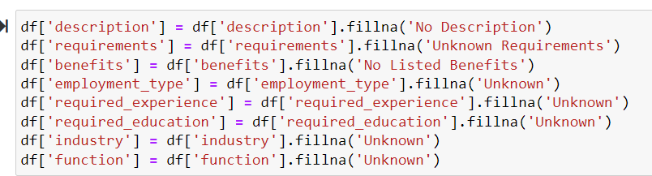
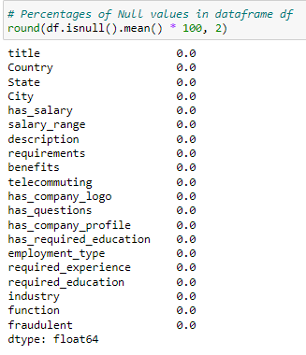
Fill Missing Values to other fields :S | Page: 15
"To proceed to the next step, we replaced missing values with 'unknown'."

Slide 17

Stopwords and Vectorization :M | Page: 16
Ref: https://miro.medium.com/max/820/1*kMf7dZW4jTyaq1hxjA0pgg.png

Slide 18
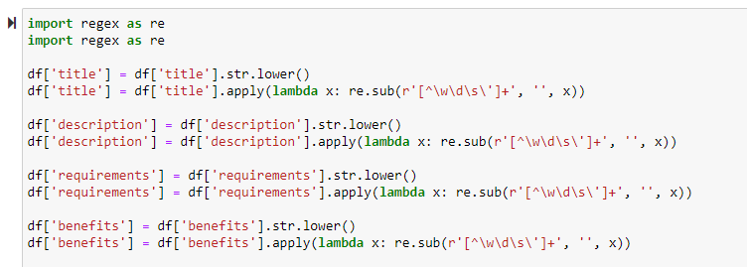
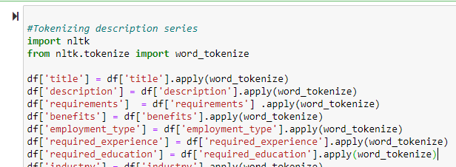
Stopwords and Vectorization :M | Page: 17
Removing extra whitespaces & tokenization

Slide 19
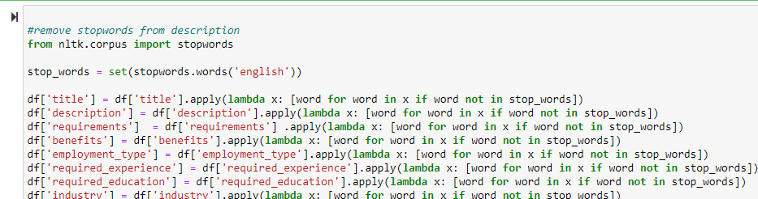
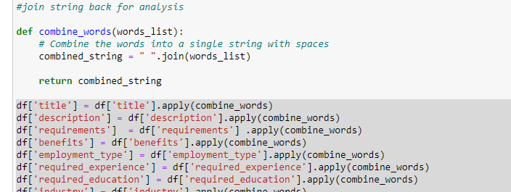
Stopwords and Vectorization :M | Page: 18
Removing Stopwords
Rejoin tokens

Slide 20
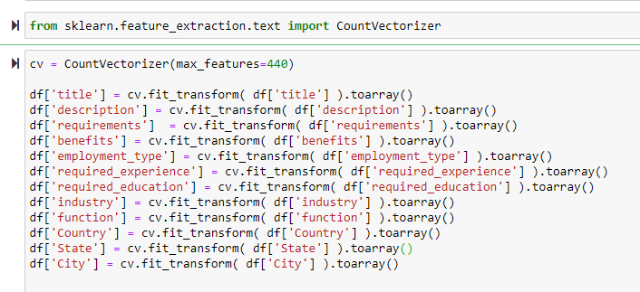
Stopwords and Vectorization :M | Page: 19

Slide 21

Unbalanced Dataset – SMOTE :Y | Page: 20
Ref: https://res.cloudinary.com/practicaldev/image/fetch/s--z3hTx2Mg--/c_imagga_scale,f_auto,fl_progressive,h_420,q_auto,w_1000/https://thepracticaldev.s3.amazonaws.com/i/styj0x94uatv5wvefvjy.png

Slide 22
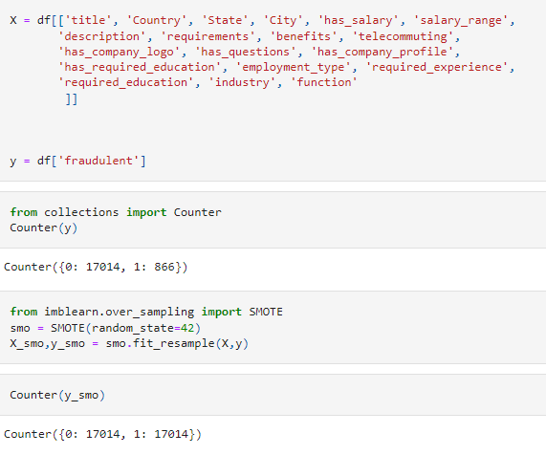
Unbalanced Dataset – SMOTE :Y | Page: 21
SMOTE stands for
Synthetic Minority Over-sampling Technique

Slide 23
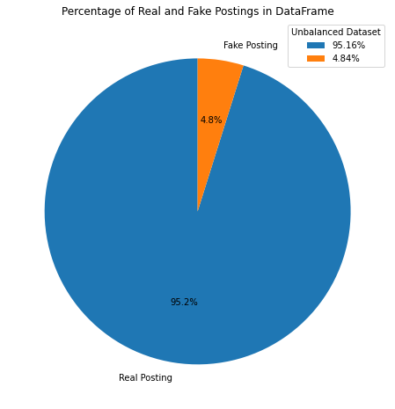
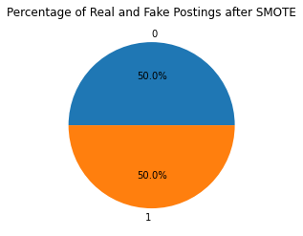
Unbalanced Dataset – SMOTE :Y | Page: 22
SMOTE stands for Synthetic Minority Over-sampling Technique
After
Before

Slide 24

Model Selection :Y | Page: 23
Ref: https://rightclick.ai/wp-content/uploads/2019/03/Model-Building.jpg

Slide 25
Data Split and Model Selection :Y | Page: 24
Split dataset in training set 80% and testing set 20% of dataset
Model Building:
Neural Network
Logistic Regression
Decision Trees
Random Forests
Support Vector Machines

Slide 26
Models’ Performance at Training Set :Y | Page: 25
Models | Training Dataset
 | Accuracy | Precision | Recall | F1 Score
Logistic Regression | 76.64 | 80.79 | 69.88 | 74.94
Decision Trees | 80.91 | 79.18 | 83.86 | 81.45
Random Forests | 80.91 | 79.06 | 84.07 | 81.49
Support Vector Machines | 80.64 | 79.14 | 83.2 | 81.12
Neural Network Model | 80.9 | 79.13 | 83.9 | 81.45
Notes:
Based on the table, we can see that all five models have similar accuracy scores, ranging from 76.64% to 80.91%. The decision tree, random forests, and neural network models have higher recall and F1 scores, indicating that they are better at identifying positive instances in the dataset. The logistic regression and support vector machine models have higher precision scores, indicating that they make fewer false positive predictions.
It's important to note that these performance metrics are based on the training dataset only, and the true performance of the models may differ on unseen data. It's also important to evaluate the performance of the models on a separate validation or test dataset to ensure that they generalize well to new data.

Slide 27
Models’ Performance comparison :Y | Page: 26
Models | Training Dataset |  |  |  | Testing Dataset
 | Accuracy | Precision | Recall | F1 Score | Accuracy | Precision | Recall | F1 Score
Logistic Regression | 76.64 | 80.79 | 69.88 | 74.94 | 76.77 | 81.09 | 69.94 | 75.11
Decision Trees | 80.91 | 79.18 | 83.86 | 81.45 | 80.87 | 78.8 | 84.57 | 81.58
Random Forests | 80.91 | 79.06 | 84.07 | 81.49 | 80.91 | 78.64 | 84.99 | 81.69
Support Vector Machines | 80.64 | 79.14 | 83.2 | 81.12 | 81.05 | 79.25 | 84.22 | 81.66
Neural Network Model | 80.9 | 79.13 | 83.9 | 81.45 | 81.13 | 79.04 | 84.84 | 81.84
Notes:
Based on the table, we can see that:
The logistic regression model performs similarly on the training and testing datasets, with only slight changes in accuracy, precision, recall, and F1 score.
The decision tree, random forest, and neural network models have slightly higher performance on the training dataset than on the testing dataset, indicating a potential issue with overfitting.
The support vector machine model has slightly higher performance on the testing dataset than on the training dataset, indicating better generalization to new data.
Overall, the performance of the models is similar on both datasets, suggesting that they are able to generalize reasonably well to new data.

Slide 28
Pipeline – On going process :S | Page: 27
More Data to train Model
Collaboration to improve Code
improve Model Predictions
Build Application

Slide 29
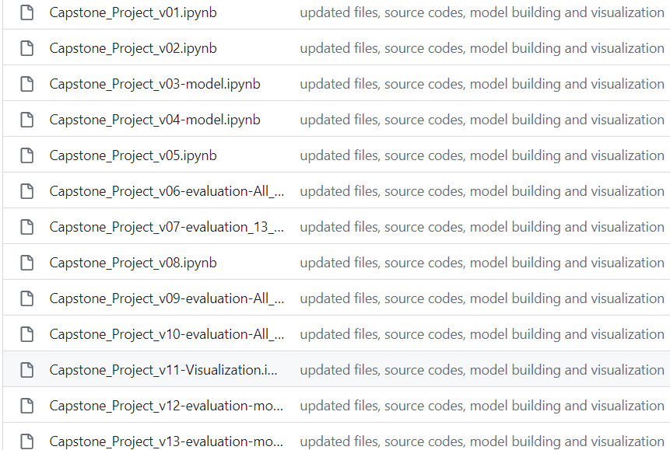
Collaboration :S | Page: 29
Github Repo: https://github.com/8sagh8/Capstone-Project
Status: Public
Version controlled
Different files for
Data cleaning,
Model Building,
Visualization.

Slide 30
Thank You

