Slide 1
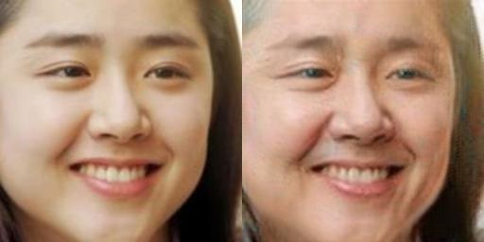
Cycle-GAN 기반의 Face Aging
Image-to-Image Translation
팀원 남성현
심현보
양민규
양성규

Slide 2
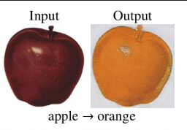
데이터 수집
Why CycleGAN?
Face Dataset
Face Aging
Cycle GAN
Data Collection
Google Colab
unpaired data
Modeling
Train & Test
Evaluation

Slide 3
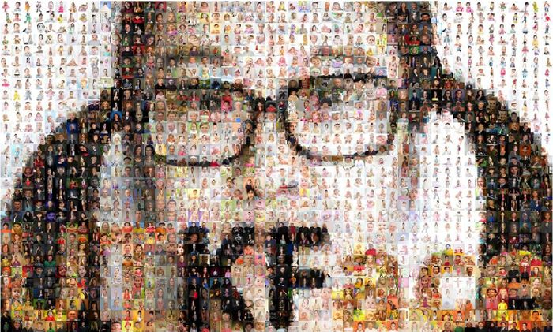
데이터 수집
UTKFace
Face Dataset
Cropped Faces Dataset
18yo~25yo Faces (1056s)
50yo~60yo Faces (1066s)
256×256 Format
Gender/Race는 구분하지 않음
Face Aging
Cycle GAN
Data Collection
Google Colab
Modeling
Train & Test
Evaluation
https://susanqq.github.io/UTKFace/

Slide 4
모델 설명
A
Real B
G(B to A)
fake A
Model
fake A
D(discriminate A)
Real or Fake
Face Aging
Cycle GAN
Real A
Data Collection
Google Colab
B
Real A
G(A to B)
fake B
Modeling
fake B
D(discriminate B)
Real or Fake
Train & Test
Evaluation
Real B

Slide 5
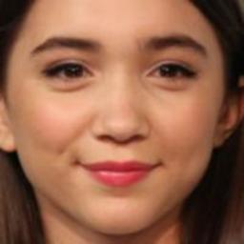
모델 설명
Discriminator
input
output
Face Aging
Cycle GAN
Data Collection
0.7 0.8… 0.7 1.0…
…
Google Colab
32×32
Modeling
Train & Test
224 x 224
Evaluation

Slide 6
encoder
decoder
모델 설명
Resnet
Generator
Face Aging
Conv layer
Cycle GAN
Conv layer
Data Collection
Google Colab
Conv layer
Modeling
Conv layer
Train & Test
Evaluation

Slide 7
모델 설명
Generator
convolution
resnet
deconvolution
Face Aging
Cycle GAN
Data Collection
Google Colab
INPUT
OUTPUT
Modeling
Train & Test
Image size
Evaluation
256 X 256
32 X 32
32 X 32
256 X 256

Slide 8
모델 설명
Real B
G(B to A)
fake A
Model
fake A
D(discriminate A)
Real or Fake
Face Aging
Cycle GAN
Real A
Data Collection
Google Colab
Real A
G(A to B)
fake B
Modeling
fake B
D(discriminate B)
Real or Fake
Train & Test
Evaluation
Real B

Slide 9
Discrim-inator
B
0.8 0.8… 0.6 1.0…
…
0.0 0.0… 0.0 0.0…
…
모델 설명
D loss
B`₁
Discriminator loss
32×32
Ideal Fake
Generator A2B
Face Aging
0.7 0.8… 0.7 1.0…
…
D loss
1.0 1.0… 1.0 1.0…
…
A₁
Cycle GAN
32×32
Ideal Real
Data Collection
Discrim-inator
A
Google Colab
0.9 0.8… 0.7 0.6…
…
1.0 1.0…
1.0 1.0…
…
B₁
D loss
Modeling
32×32
Ideal Real
Generator B2A
Train & Test
Evaluation
0.7 0.6… 0.7 0.9…
…
D loss
0.0 0.0… 0.0 0.0…
…
A`₁
32×32
Ideal Fake

Slide 10
Discrim-inator
B
0.5 0.3… 0.2 1.0…
…
1.0 1.0… 1.0 1.0…
…
모델 설명
G loss
B`₁
Generator B2A
Generator loss
32×32
Ideal Real
Generator A2B
Face Aging
A``₁
L1 loss
A₁
Cycle GAN
Data Collection
Discrim-inator
A
Google Colab
B``₁
L1 loss
B₁
Modeling
Generator B2A
Train & Test
Generator A2B
0.7 0.3… 0.4 0.6…
…
G loss
1.0 1.0… 1.0 1.0…
…
Evaluation
A`₁
32×32
Ideal Real

Slide 11
모델 설명
Training and Testing
Face Aging
Hyper Parameter
Batch size = 1
Initial learning rate = 0.0002
Epoch cycle = 120
Number of convolution layer = 58
Number of parameter = about 5200
The largest number of fitter = 12
Learning time = 12 hours ( + 48 hours)
Cycle GAN
Data Collection
Google Colab
Modeling
Train & Test
Evaluation

Slide 12
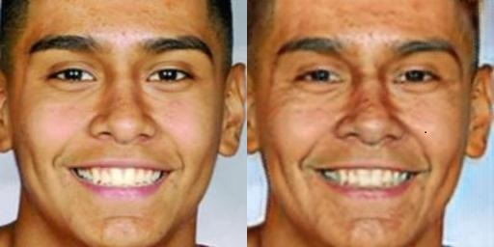
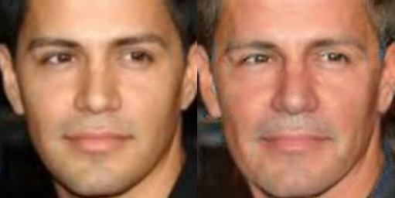
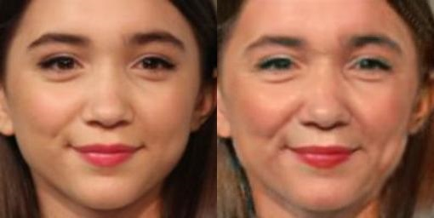
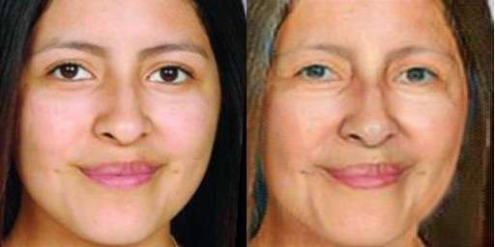
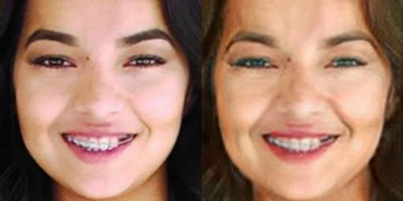
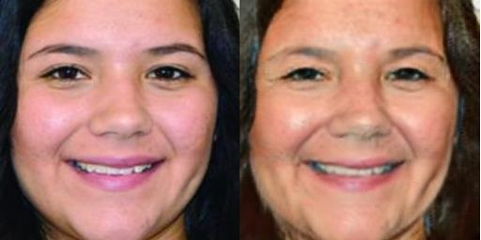
모델 테스트
테스트 결과 – 20s to 50s
Face Aging
Cycle GAN
Input
Output
Data Collection
Google Colab
Modeling
Train & Test
Evaluation

Slide 13
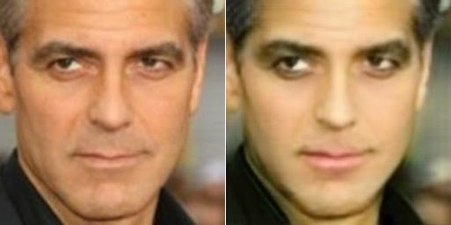
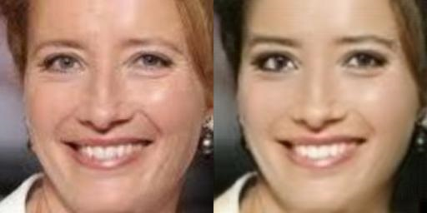
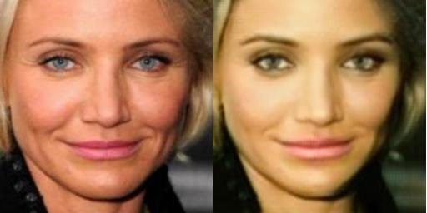
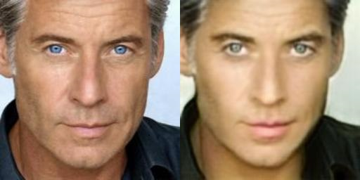
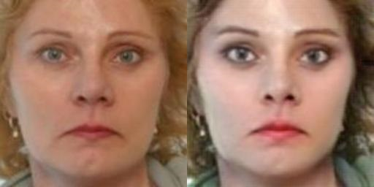
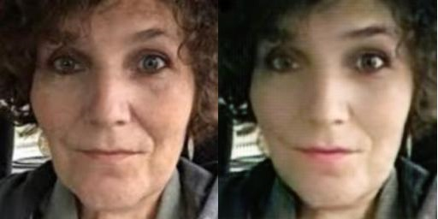
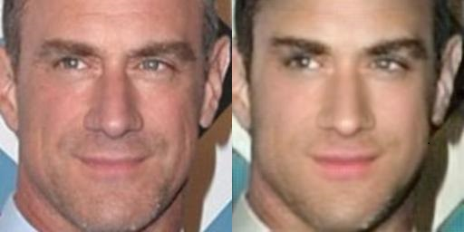
모델 테스트
테스트 결과 – 50s to 20s
Face Aging
Cycle GAN
Input
Output
Data Collection
Google Colab
Modeling
Train & Test
Evaluation

Slide 14
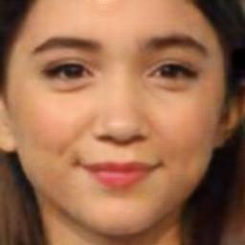
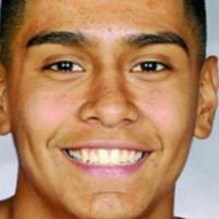

모델 설명
시행 착오
Face Aging
Cycle GAN
A
Generator B2A
A
Data Collection
ll F(A), A ll1
Google Colab
Modeling
B
Generator A2B
B
Train & Test
ll G(B), B ll1
Evaluation

Slide 15
Q & A

